Slide 1
Accessible Design 101
An introduction to core design concepts
February 4th, 2022
Notes:
Monica

Slide 2
Good to Know
Link to the slidedeck
URL: https://bit.ly/3AuffZ5
Two scheduled breaks: after Shaun’s demo and before the breakout sessions
Live transcription is provided
Link to presentation materials: https://bit.ly/3qUgayy

Slide 3
Who Are We?
Monica Olsson - SBCTC, Accessibility Policy Associate
Susanne Weatherly - Everett Community College, Interim Director in the Center for Disability Services
Alissa Sells - SBCTC, Program Administrator Student Success Center
Shaun Hegney - Spokane Falls Community College, Program Specialist Disability Support Services
Notes:
Monica

Slide 4
What Will We Talk About?
Why Accessibility Matters
Law and Policy
Universal Design and Assistive Technology
Screen Reader Demo!
Core Concepts
Breakout Sessions
Notes:
Susanne - ADKAR framework

Slide 5
Why Accessibility Matters
Accessibility creates equity
Barriers create inequity
Legal Requirements:
Federal Laws
State Law
Notes:
Susanne - ADKAR

Slide 6
What does accessible mean?
"Accessible” means that individuals with disabilities are able to independently acquire the same information, engage in the same interactions, and enjoy the same services within the same timeframe as individuals without disabilities, with substantially equivalent ease of use. (University of Montana 2014 OCR Resolution Agreement 10122118)
Notes:
Monica

Slide 7
Legal Landscape
Federal Laws: Americans with Disabilities Act, 1990 and Section 504
People/Students with disabilities (PWD & SWD) cannot be denied services or program access due to their disability.
Entitled to use appropriate accommodations.
PWD should have access to material of the same quality and within the same time frame as people without disabilities.
SWD should be able to access the course material as easily as a student without a disability.
Notes:
Susanne

Slide 8
Legal Landscape (cont.)
State Law: OCIO Washington Policy 188
All state agencies must meet minimum IT technical accessibility standards.
All covered tech must meet established and testable WCAG 2.1 AA standards.
The procurement, development, and implementation of instructional, administrative, or communications technologies and content.
College websites, learning management tools, student information systems, training materials, instructional materials, and assessment tools.
Notes:
Monica

Slide 9
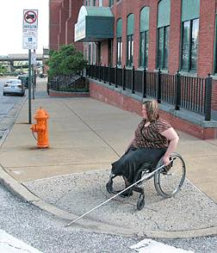
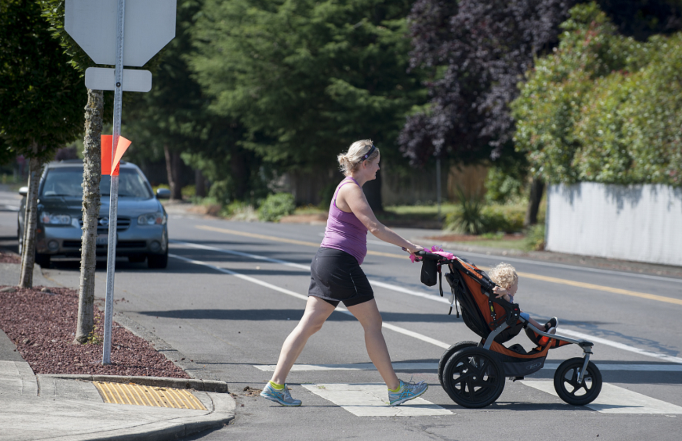
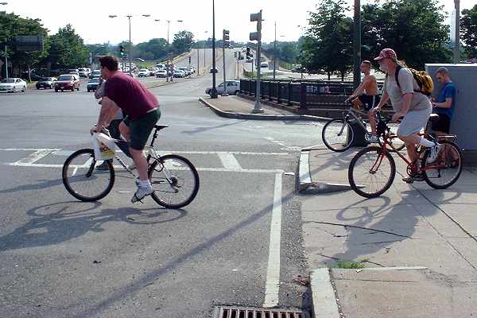
Universal Design = Access for All
Example: Curb cuts
Notes:
Monica

Slide 10
Universal Design for Learning
Universal Design for Learning creates learning environments in the virtual and f2f classroom that can be used to the greatest extent possible by anyone, regardless of their condition, without the need for additional modification or accommodations.
Notes:
Susanne
Belongingness Example: When your Word documents and other materials are designed with accessibility in mind, then students and others don’t have to ask for alternate versions from the DS office or HR. PDFs!

Slide 11
UDL
Multiple means of engagement
Learner’s motivation and relevancy
Multiple means of representation
Content delivery
Multiple means of action/expression
Assessment - how can people show you what they know?
3 core principles developed by CAST
Notes:
Monica

Slide 12
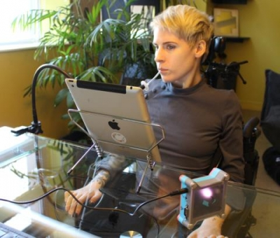
What is Assistive Technology?
Hardware and software (low tech and high tech) that helps people with disabilities complete a task.
Screen readers
Voice Command
Mouthstick
Adaptive keyboards/mice
1-touch can opener
Low vision cutting board
Notes:
Monica
Image source: https://www2.ocadu.ca/keyword/inclusive-research-design-centre

Slide 13
Screen reader demo with Shaun

Slide 14
Screen Readers the Basics
A Screen Reader is a piece of software that reads text, navigational elements, and other relevant information to a user who may be low vision or fully blind.
A screen reader is designed to allow independent navigation of a computer or mobile device even if a user has no vision.
Screen readers may be first party software built into an operating system, Voice Over (Apple iOS and macOS), Windows Narrator (MS Windows) or offered separately by third party developers such as NVDA or JAWS (MS Windows only.)
Notes:
Shaun

Slide 15
5 Minute Break

Slide 16
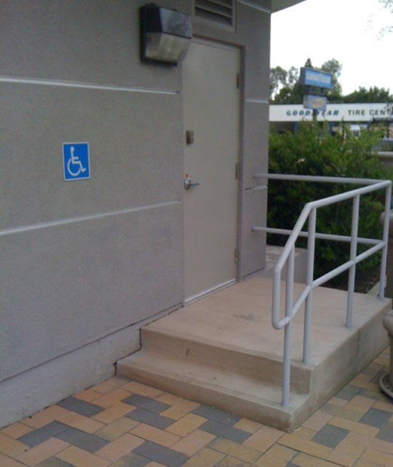
Inaccessible Experiences
We will demonstrate what it's like to engage with inaccessible materials so you can experience why creating accessible content is essential to equitable access for all.
Uncaptioned video
Inaccessible document
Frozen 2 Trailer without audio description
Frozen 2 Trailer with audio description
Notes:
Susanne

Slide 17
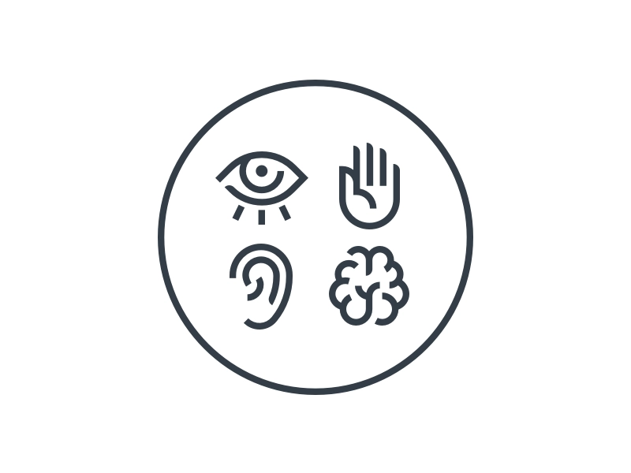
Creating
Accessible Content
Core Concepts
Notes:
Monica
Graphic design by Matt Kistler for Dribble

Slide 18
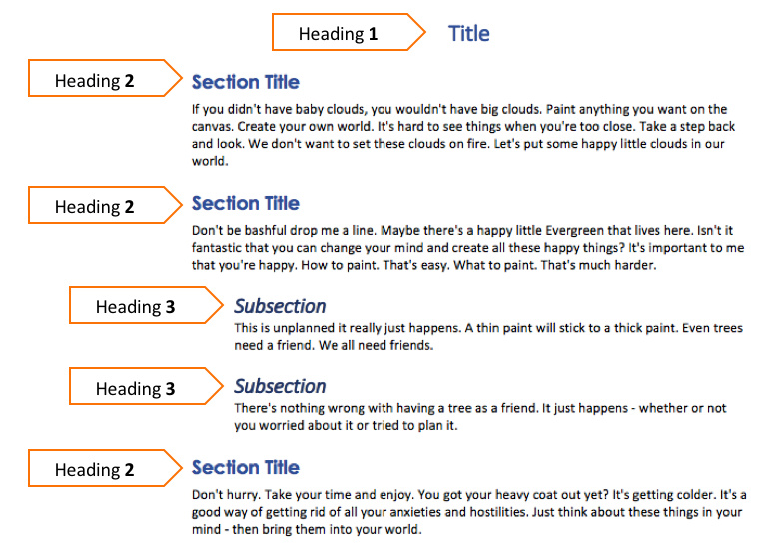
Core Concept 1
Meaningful Heading Structure
H1- H4
Notes:
Using logical and sequential headings in your document or web page provides the basis for good structure and navigation.
Did you know that screen reader users can use keyboard commands to bring up a list of all detected headings? This is one important way people using assistive technologies may choose to navigate content. Sighted people do the same thing by skimming a document and visually detecting section titles and subsections.
To create a heading you select the text you want as your heading, then you select the desired heading level using the built-in Styles/Formatting pane. You can modify the font type, size, and color of your headings to achieve the look you want.
Avoid using more than 3-4 heading levels. Simple structure is best.
The title of the document should be H1 and you do not want to repeat Heading level 1. After that, using Headings in sequential order, and don’t skip heading levels.

Slide 19
Core Concept 2
Write meaningful alternative text descriptions for images and pictures.
Mark decorative images as such, so a screen reader skips them.
Alt Text for Images
Notes:
Susanne

Slide 20
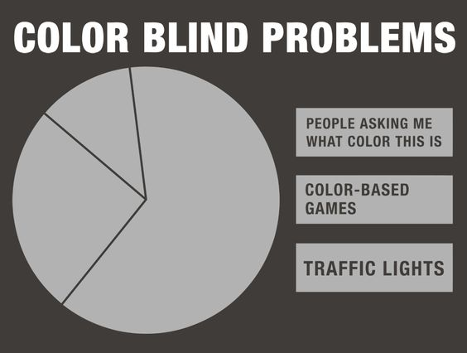
How To Make Images Accessible - Alt Text
AVOID:
Including images or diagrams without descriptions.
Just ignore an image that is decorative.
DO use:
Add “Alt Text” for images.
Write meaningful alt text descriptions. (Pie chart titled Color Blind Problems. Chart has three different sized sections that are all the same color. The available labels are: people asking me what color this is, color based games, and traffic lights)
Decorative images should be marked as such. (Add null alt text for decorative images)
Pro Tip: Using patterns in charts can make them more accessible as well
Notes:
Susanne

Slide 21
Core Concept 3
Embed URLs into text that clearly describes the link destination in a meaningful and contextualized way.
Descriptive Hyperlinks
Notes:
Alissa
Full length URLs are difficult to read and rarely contain any useful information, so be sure to embed/link your URLs into descriptive text that tells the reader where they will be taken if they click on the link.

Slide 22
Tips for Descriptive Hyperlinks
AVOID using:
Unlinked, text only URLs
https://sbctc.instructure.com/courses/1578604
Hyperlinked, full text URLs
Visit SBCTC’s Library of Accessibility Resources https://sbctc.instructure.com/courses/1578604
Non-descriptive link text
“Click Here” to visit SBCTC’s Library of Accessibility Resources
DO use:
Hyperlinks embedded directly into meaningful text describing where the link takes you
Visit SBCTC’s Library of Accessibility Resources to learn more about descriptive hyperlinks.
Notes:
Alissa
Now I’d like to share some tips for using descriptive hyperlinks.
Let’s say we want to direct readers to a specific online resource, for example the SBCTC Library of Accessibility Resources. There are a few things we should avoid when doing this.
The first is using a full-length URL that is not hyperlinked, meaning if you try to click on it, it doesn’t take you anywhere.
Why? Because a screen reader is going to read out the full text of the URL letter by letter:
h t t p s : / / s b c t c .i n s t r u c t u r e . c o m
and also because not formatting the URL as a true hyperlink prevents screen reading software from being able to navigate or skip through the content by URL.
It also prevents everyone from being able to click on the link.
We also wouldn’t want to create a hyperlink using the full-length URL as the hyperlinked text.
Why? Because it is cumbersome for readers. Again, screen reading software will read out the entire link letter by letter after identifying it as a link
[link] h t t p s : / / s b c t c .i n s t r u c t u r e . c o m
and for sighted readers, lengthy URLs create visual clutter and are not very nice to look at.
When might you include a hyperlinked URL using it’s full text? The most appropriate use for a full URL would be in a hard copy handout where someone might need to be able to retype the actual URL in order to access the resource. In this case, it is a good practice to use a URL shortening tool like Bit.ly to make your URLs easier to read and remember.
The last thing to avoid is hyperlinking generic phrases like “Click here” that lack context or meaning.
Why? Screen reading software will say [link] “Click here” but give no information about where the URL goes, when skimming through content and repeatedly hearing [link] “Click here”, [link] “Click here”, [link] “Click here” isn’t very helpful.
A quick way to check if your hyperlinks are descriptive enough is to read through them to ensure that they make sense and provide sufficient detail when read out of context.
So, what is the most helpful way to direct your readers to a specific online resource?
Answer: Hyperlinks that are embedded directly into meaningful and contextualized text describing where the link takes you will provide non-sighted and sighted readers with the most information.
In this example, a good way to direct readers to the SBCTC Library of Accessibility Resources, would be to hyperlink that text within the sentence. Doing it this way tells readers exactly what the resource is, where the link will go, and makes it easier to find.
Visit SBCTC’s Library of Accessibility Resources to learn more about descriptive hyperlinks.
Bonus Tip: Link text is typically auto-formatted in a different color. I like to bold my links so they have more contrast against the color of my page.Avoid hyperlinking generic phrases like “Click here” that lack context or meaning.Avoid hyperlinking generic phrases like “Click here” that lack context or meaning.
Avoid hyperlinking generic phrases like “Click here” that lack context or meaning.

Slide 23
Core Concept 4
Use numeric or bulleted lists.
Don’t manually type numbers, dashes, or other symbols to “look” like a list.
Accessible Lists
Notes:
Monica
There are two main types of lists. The first is an ordered list, which is a numeric list, and the second type is an unordered list, which uses bullets or another symbol from the built-in list designs.
Use bulleted or numbered lists by using the built in formatting tools (not by typing the numbers or dashes yourself). Using the list formatting tool allows a screen reader to determine the length of the list and the reader can understand how the content is organized and how many items are on the list. When you click on what appears to be a list, the list icon in the design tab should be selected. If it’s not, then the “list” has not been formatted as a list.

Slide 24
Core Concept 5
Use a simple Sans Serif font in a 12 pt. or larger font size.
Check that your text color and background color have a contrast ratio of 4.5:1 or higher.
Do not use color alone to indicate meaning.
Use real text, rather than scanned images of text.
Readability of Text:
Font Size, Style & Color
Real Text
Notes:
Alissa
Font Size, Style & Color: Choosing which font size, font style, and font color to use is an important decision when creating content.
Generally speaking, the smaller the text size, the more complex the text style, and the lower the contrast the text has against the background, the more difficult your content will be to read.
Real Text: All text contained in your content should be real/readable text, meaning that it is not a scanned image of text.

Slide 25
Selecting Font Size, Style & Color
The best advice to follow here is “just because you can, doesn’t mean you should.”
You could use a 10 pt. font to fit everything on a page, but should you?
You could use a fancy styled font with a lot of decoration because it’s pretty, but should you?
You could use yellow for your text color because it’s your favorite color, but should you?
Notes:
Alissa
Font Size: refers to how large the characters display on a screen or printed page and is measured in points
For example: 12 pt., 14 pt., 16 pt.
12 pt. is a good starting font size, but 14 pt. is even better.
Font Style: refers to the design of the font and is referred to by name
For example: Ariel, Calibri, Helvetica
There is no agreed upon single “best” font style for every situation, but using a simple sans serif style font is typically a good choice.
I think of san serif as meaning “without feet”.
Fancy font styles that have a lot of decoration or that deviate from standard character styles are difficult to read at length, especially for those who may have dyslexia, who may be new language learners, or who may have difficulty processing patterns. Whenever possible it is a good idea to avoid using overly decorative and cursive fonts, combining multiple font styles, and typing long phrases in all caps. Fonts that have too much space between characters and words or that are squished together can also be challenging to read.
Font Color: refers to the hue, lightness, and saturation of the text and is typically represented by a color name, hex code, or an RGB number combination
For example: black, #000000, R0 B0 G0
When choosing a font color, something to consider is the contrast ratio between the color of the font and background color of the page or screen. To pass a contrast check, color combinations should have a contrast ratio of 4.5:1 or higher between the foreground and the background. Try to avoid color combinations with extremely low contrast ratios like yellow on white or very light blue on white which will be will be difficult to read, even if the text size is extra large. Excessively high contrast combinations should be avoided as well because they can cause a halo effect and fatigue the eye.
Anyone want to guess what the contrast ratio is for the yellow text on a white background? It’s only 1.17:1 which is well below the 4.5:1 threshold.
And, color alone should not be used to indicate meaning.
For example, let’s say you decide to use a green font for all of the vocabulary words in your course and then tell students “Be sure to explore the definitions of the words in green throughout the course.”
The usefulness of the green text would be lost for a student using a screen reader. Screen readers do not use color to navigate content so this student would not be able to skim through a page to identify or review words.
The meaning of the green text would also be lost for a student with a red/green color deficiency. This is the most common type of “color blindness” and this student would not be able to accurately identify the words marked in green.
You should also avoid using a rainbow of font colors and text highlighting in your content as this can be distracting and cause visual confusion.
Font size, font style, and font color impact one another, so you’ll need to consider all three before making a final selection. For example, sometimes you can compensate for a lower contrast between colors by increasing the font size, but if you’ve also chosen a complexly styled font, adjusting the size or color may not be enough to ensure it’s easily readable by your audience.

Slide 26
Contrast Examples
Poor Contrast | Good Contrast
Dark red on black does not pass at 3.56:1 | Yellow on black passes at 17.93:1
Blue on orange does not pass at 2.54:1 | Black on orange passes at 8.42:1
Red on green does not pass.at 1.05:1 | White on green passes at 7.51:1
Black on purple does not pass.at 2.62:1 | Aqua on purple passes at 6.38:1
Notes:
Alissa
This graphic shows examples of different font colors on varying background colors. The examples on the left have poor contrast and the examples on the right have adequate contrast.
Remember that a ratio of 4.5:1 or higher is what you’re aiming for.

Slide 27
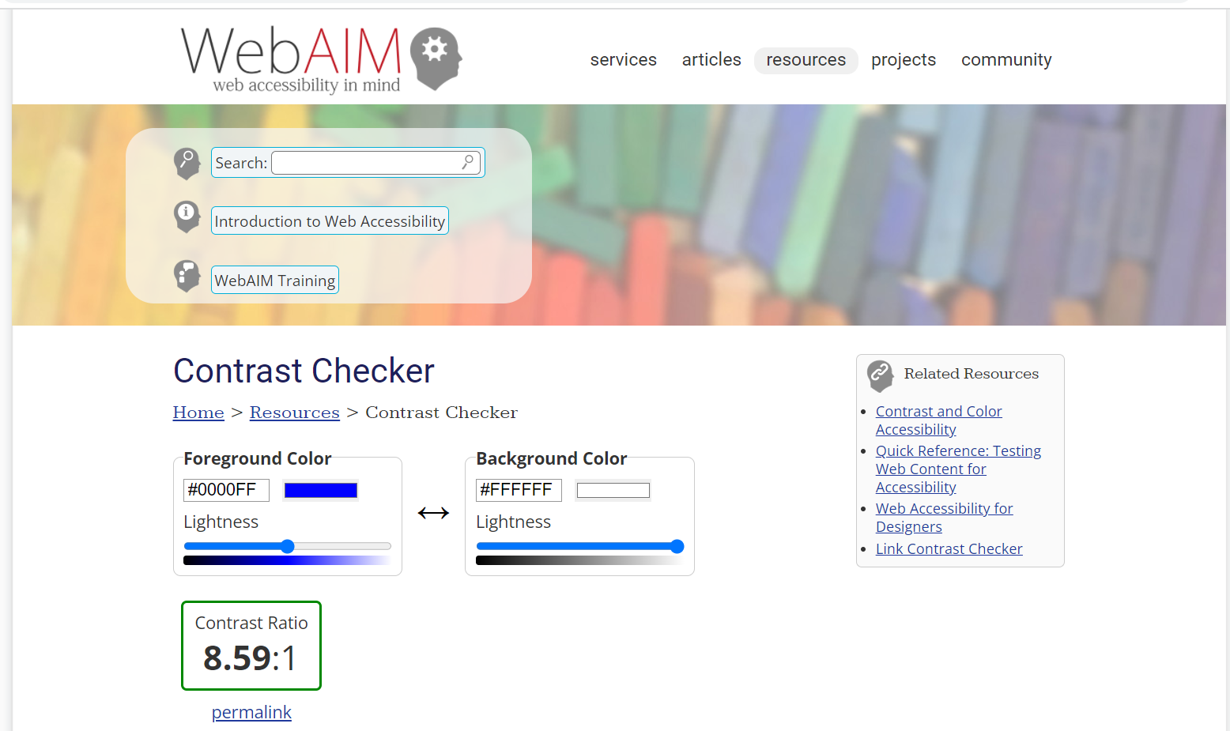
Checking Contrast Ratios
An easy way to check the contrast ratio, or brightness between colors, is to use a checker such as WebAIM's Contrast Checker.
Notes:
Alissa
An easy way to ensure your text and page color combos will be easy to read is to check them using a contrast checker.
I like using WebAIM’s contrast checker.
You can enter the hex codes for any fore and background color combination and the checker will let you know if it passes the minimum 4.5:1 contrast threshold.
Foreground: #0000FF (dark blue)
Background: #FFFFFF (white)

Slide 28
Real Text
Real text is searchable.
Real text can be read by a screen reader.
Real text can be modified by assistive technology.
Notes:
Alissa
What is real text? Real text consists of the true text characters on a page. These characters can be recognized/read by assistive technologies, making them adaptable, customizable, and searchable.
The easiest way to understand what real text is is to understand what it is not.
Text embedded in images, graphics, screenshots, or scanned documents, is not real text because is only an image of text.
For example, if you scan a copy of an article for students to read, the resulting file is only an image of the words rather than real text. It cannot be read by assistive technology, in most cases cannot be resized with adequate resolution, cannot be keyword searched, etc. which creates readability and usability issues for many students. This loss of adaptability means that it is not accessible for all students. As Susanne mentioned earlier, scanned documents can be run through an OCR process to convert them to real text. If you do include text contained within an image, for example in a page banner, be sure to add an alt text description or mark the image as decorative if it is not important to the page content.
A quick test to determine if text is real or if it is an image, is to try selecting it with your cursor. If you can’t highlight or select it, it is not real text.

Slide 29
Core Concept 6
Tables are used to display data.
Don’t use tables to control the layout of your page.
Always apply a Header Row and/or Header Column.
Use the TAB key to check the logical flow.
Table Structure and Layout
Notes:
Monica
Logical flow is left to right and top to bottom.

Slide 30
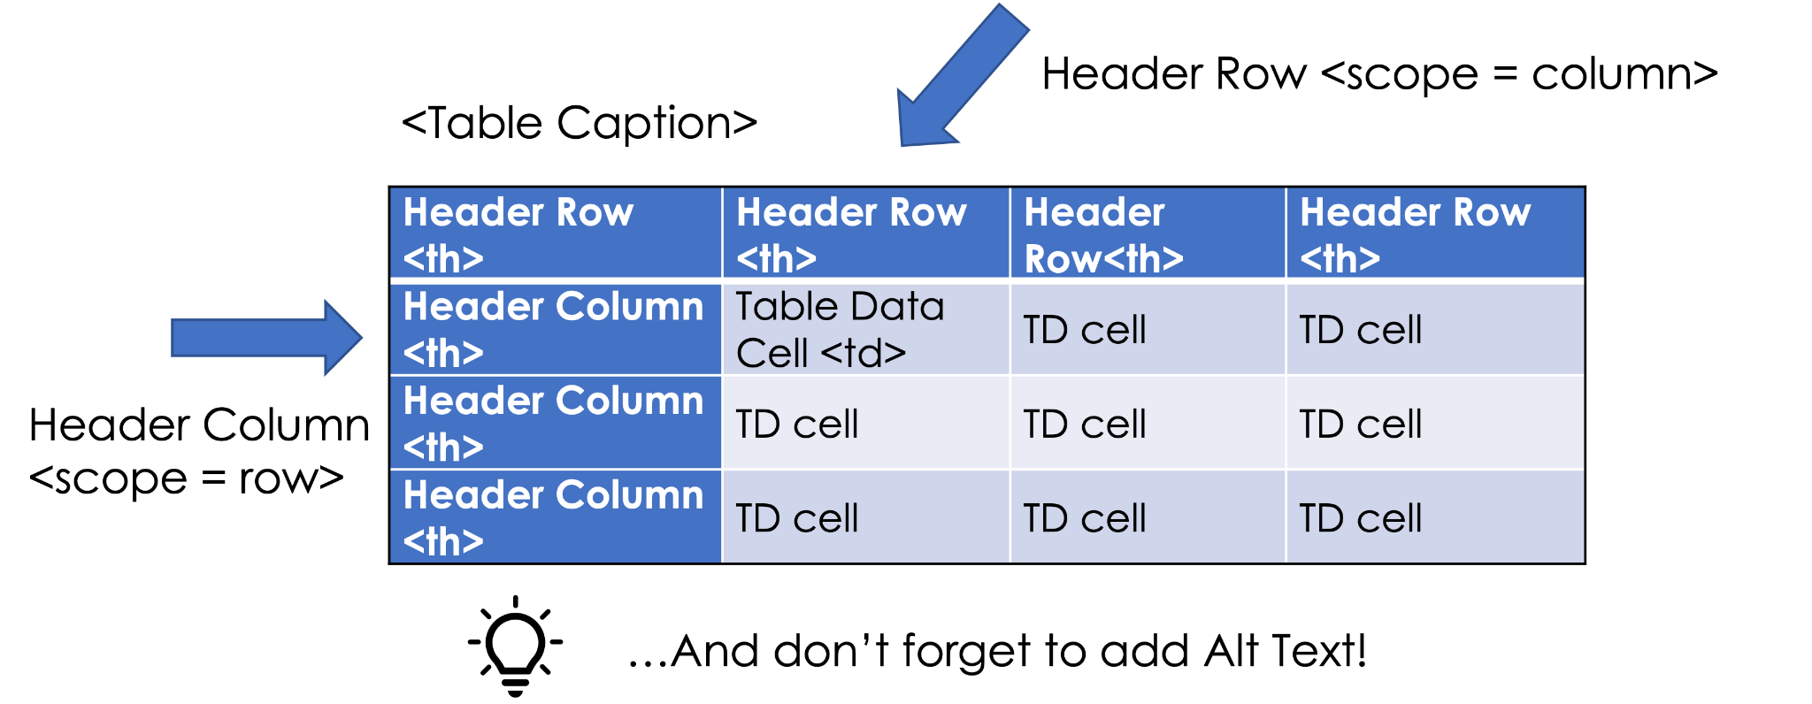
Anatomy of an Accessible Table
Notes:
Monica
WebAIM accessible table article: https://webaim.org/techniques/tables/data

Slide 31
Core Concept 7
Record accessible videos by verbally describing visual information.
Accurately caption the videos afterwards in Panopto, YouTube, send to 3Play, etc.
Turn on automated captions in Zoom Meetings.
Accessible Videos and Zoom Meetings
Notes:
Susanne - ASR is still better than nothing.

Slide 32
Accessible Videos & Captions
AVOID:
Making references to items on a presentation or board without explaining what they are. (e.g. “the graph shows where plant life grows”)
Create, select, or post videos without captions available.
Automated Speech Recognition [ASR] captions are not accurate enough to comply with the law, but something is better than nothing.
DO THIS:
Create Accessible Videos.
Make your presentation accessible by verbally explaining visual materials using clear and concise language. (e.g. “the pie graph shows 85% of plant life is found in the ocean, and 15% is on land)
Correct the automatic caption file to make closed captions 99% accurate. (e.g. add punctuation and correct errors using the video editor in Panopto or YouTube.)
Notes:
Susanne - MANY people use captions, not just those who may be Deaf.
Identify the speaker in the captions if needed. - 3Play ASR not the most accurate - but some captions are better than nothing

Slide 33
Core Concept 8
Some content editing applications have a built-in Accessibility Checker.
Checkers help find and fix problems.
Manual checking is still required.
Accessibility Checkers
Notes:
Alissa
What is an accessibility checker?
An accessibility checker is a tool that can help you find and fix many accessibility issues in your content, but they are not perfect.
For example, an accessibility checker can’t determine if the alt text you wrote is appropriate for the image. It will simply tell you whether alt text exists or not.
The best way to create accessible content is integrate as many of the core concepts we’ve discussed today as you can into your everyday workflow.
Which programs have accessibility checkers?
Microsoft Word and Canvas both have built-in accessibility checkers.
Google docs does not have a built-in checker, but you can easily install an accessibility checker app for Google docs called Grackle docs.
In your breakout session, you’ll have an opportunity to practice using the accessibility checker that corresponds to the Breakout topic you’ve chosen.

Slide 34
Another 5 Minute Break
Remember to come back for your breakout session!
Notes:
Alissa?
It’s time for a break. See you back in 5 minutes and then we’ll move into our breakout sessions.

Slide 35
Breakout Sessions
It’s time to practice!
Please join the breakout room you signed up for.
If you are unable to join a room, just let us know which one you’d like to join in the chat and we’ll get you where you want to be.
Please return to the main room when the breakouts end.
Room A: Word docs
Room B: Google docs
Room C: Canvas pages
Notes:
Monica?
Remember to come back after your breakout session ends!

Slide 36
Resources
SBCTC’s Accessibility Micro Courses - a collection of micro-courses focused on how-to’s for creating accessible content
SBCTC's Library of Accessibility Resources - a public Canvas site containing learning resources for creating accessible content
SBCTC Best Practices for Accessible Course Design - a web page listing accessible content practices
20 Tips for Teaching an Accessible Online Course - an online article by Sheryl Burgstahler, PhD - University of Washington
Notes:
Susanne

Slide 37
Resources (cont.)
The Design of Online and Remote Learning for Everyone - a recorded session from NW eLearn with presenter Sheryl Burgstahler PhD, University of Washington
Designing Accessible Cyberlearning: Current State and Pathway Forward - a web article edited by Sheryl Burgstahler & Terrill Thompson, University of Washington
“The Checklist” - an accessibility checklist created by Everett Community College
Standard 4.4 - WA Course Design Checklist, - course design resources created by SBCTC, Standard 4.4 focuses on creating accessible content
Notes:
Alissa briefly explains Standard 4.4 on the WA Course Design Checklist

Slide 38
We leave you to consider….
What types of design and decision making power do you have? Do you have input on...
What course materials are used?
Which documents are posted to the web?
How can you bring accessibility into your work?
Notes:
Shaun?

