Slide 1
Accessibility in Procurement:
How to Read a VPAT
Terrill Thompson
Manager, IT Accessibility Team
UW-IT Accessible Technology Services
https://uw.edu/accessibility

Slide 2
Acronyms used in this presentation
W3C = World Wide Web Consortium
WCAG = Web Content Accessibility Guidelines
ARIA = Accessible Rich Internet Applications
VPAT = Voluntary Product Accessibility Template

Slide 3
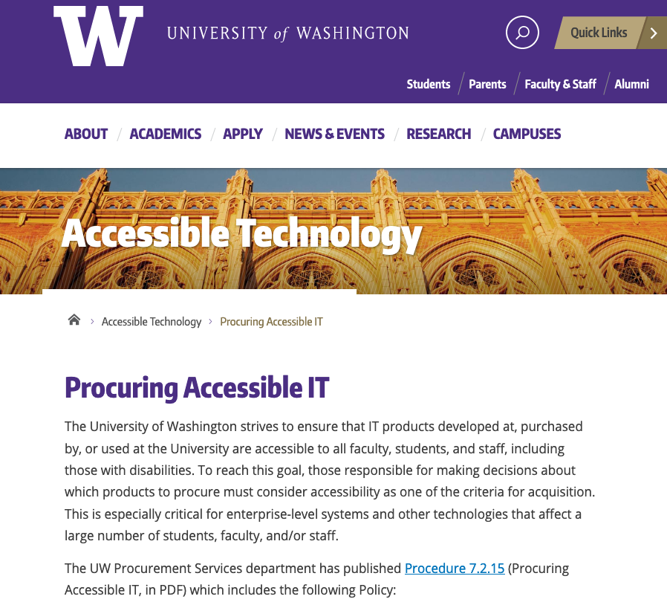
IT Accessibility in Procurement
Solicit accessibility information.
Validate accessibility information received.
Include accessibility assurances in contracts.
https://uw.edu/accessibility/procurement

Slide 4
Soliciting accessibility information
  University of Washington bidders and vendors shall be required to demonstrate that information technology provided to the University of Washington conforms to or addresses each of the World Wide Web Consortium’s Web Content Accessibility Guidelines (WCAG) 2.1, Level AA success criteria wherever demonstrating such performance is practicable. Vendors may do so by providing a Voluntary Product Accessibility Template (VPAT) using VPAT 2.3 or higher. The VPAT templates are available from the Information Technology Industry Council. There are four different editions of the VPAT, based on different accessibility standards. Since IT procured by the University of Washington must meet WCAG 2.1 Level AA, the most appropriate edition for our needs is the WCAG edition (the INT edition is also acceptable since it includes WCAG 2.1 guidelines). NOTE: It is not sufficient for a bidder or vendor to simply provide a VPAT; they must take care to do so accurately. If they have insufficient expertise in-house, they should receive help from an independent third party accessibility consultant. The VPAT 2.x templates includes detailed instructions. Bidders and vendors should be expected to follow these instructions, and complete all required parts.
Source: UW Procurement Policy 7.2.15

Slide 5
Laws & Policies
Section 504 of the Rehabilitation Act of 1973
Americans with Disabilities Act of 1990 & Amendments
  Both are civil rights laws that prohibit discrimination against persons with disabilities.
  Over 500 legal complaints have been filed against higher education institutions for having inaccessible IT.
Washington State Policy 188
  "Establishes the expectation for state agencies [including higher education institutions] that people with disabilities have access to and use of information and data and be provided access to the same services and content that is available to persons without disabilities…"

Slide 6
IT Accessibility Standards
Web Content Accessibility Guidelines (WCAG)
  an international web accessibility standard,
  published by the World Wide Web Consortium (W3C)
  version 1.0 was published in 1998
  version 2.0 was published in 2008
  version 2.1 was published in 2018
Success Criteria (78)
  Level A — 30 success criteria
  Level AA — 20 success criteria
  Level AAA — 28 success criteria

Slide 7
WCAG 2.1 Example 1 of 3
1.3.1 Info and Relationships (Level A)
  Headings
  Labels on Form Fields
  Accessible Table Markup

Slide 8

WCAG 2.1 Example 2 of 3
2.1.1 Keyboard (Level A)
  All functionality of the content is operable through a keyboard interface.
  Take the #nomouse challenge!

Slide 9
WCAG 2.1 Example 3 of 3
4.1.2 Name, Role, and Value (Level A)
  Proper use of ARIA

Slide 10
What is ARIA?
Stands for "Accessible Rich Internet Applications"
A W3C specification for markup that can be added to HTML to improve accessibility for assistive technology users
Communicates an element's role, state, and properties

Slide 11
Example:
Accordion Widget Before ARIA
<button>
More info
</button>
<div id="info1">
This section contains more info.
</div>

Slide 12
Example:
Accordion Widget After ARIA
<button
aria-controls="info1"
aria-expanded="false">
More info
</button>
<div id="info1">
This section contains more info.
</div>

Slide 13
What is a VPAT?
Stands for "Voluntary Product Accessibility Template"
Is a standard means by which IT vendors can provide documentation on whether and how they meet accessibility standards
  VPAT 2.4 (February 2020) is the latest version
  VPAT 2.3 or higher is required for reporting on conformance to WCAG 2.1
Four editions:
  WCAG 2.1
  Section 508
  EN 301 549 (European Union)
  INT (incorporates all of the above standards)

Slide 14
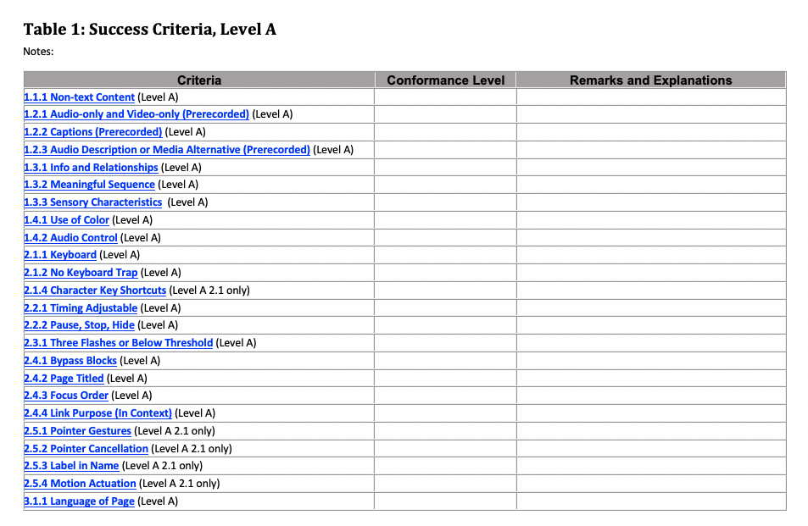
VPAT 2.3, WCAG Edition

Slide 15
Three Columns in a VPAT
Criteria: One row for each WCAG success criterion
Conformance Level:
  Supports
  Partially Supports: Some functionality of the product does not meet the criterion.
  Does Not Support: The majority of product functionality does not meet the criterion.
  Not Applicable
  Not Evaluated
Remarks & Explanations:
  Detailed remarks to justify the answer in the Conformance Level column

Slide 16
Required Metadata at top of VPAT
There are 11 required fields in the instructions. These are arguably the most critical:
  Name of product/version
  Report date
  Contact information for follow-up questions
  Evaluation methods used
  Applicable standards/guidelines

Slide 17
Quick Guide to Reading a VPAT
Did they include all required metadata?
Did they fill the form out properly?
  Conformance Level is one of the available choices
  Remarks/explanations is sufficiently detailed so you can make an informed decision about their product's accessibility.
Look a little closer at a few specific success criteria:
  1.3.1 Info and Relationships
  2.1.1 Keyboard
  4.1.2 Name, Role, and Value

Slide 18
Questions to ask yourself
Who completed the VPAT? (an independent accessibility consultant is preferred)
Did they follow instructions? (if not, a VPAT is either new to them or is not something they take seriously)
Do they seem to be knowledgeable of accessibility?
After reading their VPAT, do you know more about the accessibility of their product?
After reading their VPAT, what follow-up questions do you have for the vendor?

Slide 19
Example Questions for Vendors
Is your product accessible?
In your VPAT, you said X related to 1.3.1 Info and Relationships. Could you please elaborate on that? What are some specific examples of how your product meets this success criterion?
Please describe how your company addresses the need for accessibility throughout the product lifecycle.
What is your methodology for testing your products for accessibility? Who does the testing? Which tools and assistive technologies do you use?
What sort of training do your designers, engineers, and quality assurance personnel receive on accessibility?

Slide 20
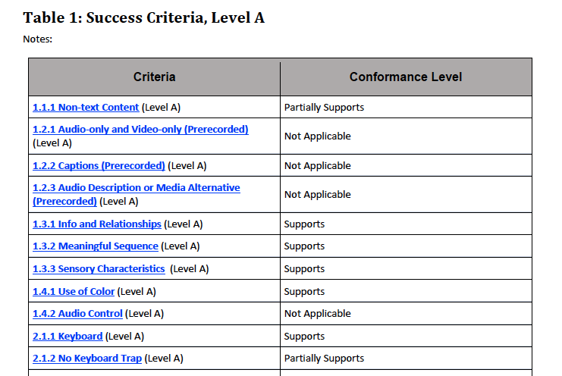
Example VPAT #1

Slide 21
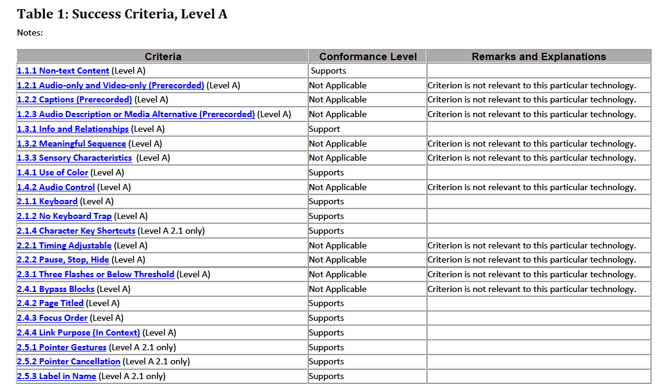
Example VPAT #2

Slide 22
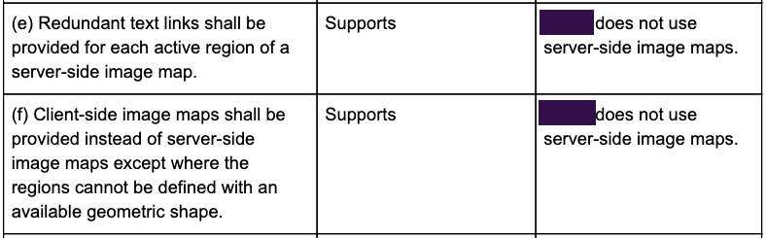
Example VPAT #3

Slide 23
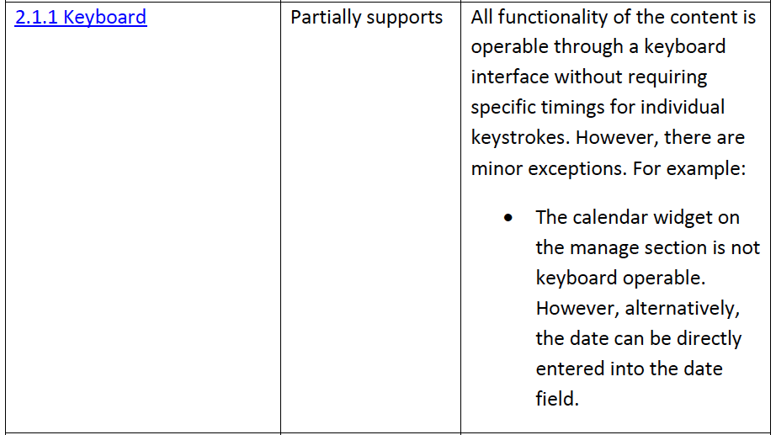
Example VPAT #4

Slide 24
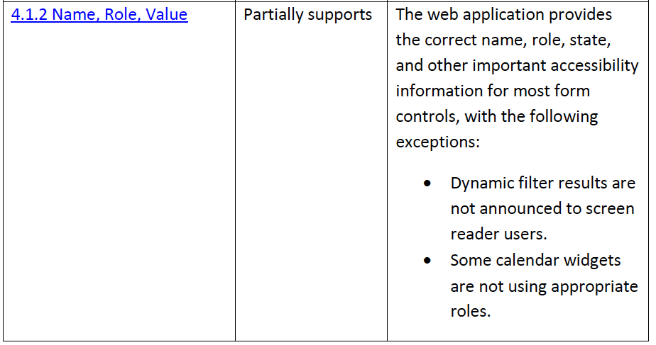
Example VPAT #5

Slide 25
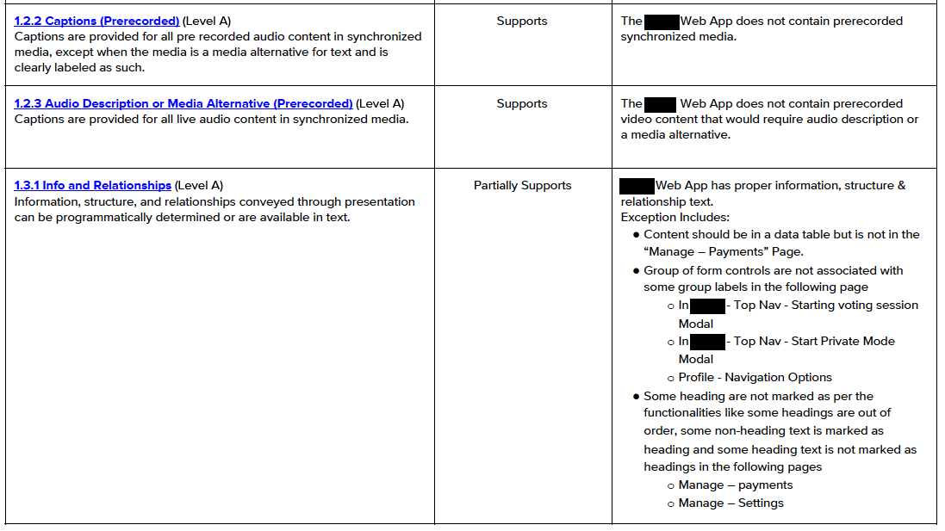
Example VPAT #6

Slide 26
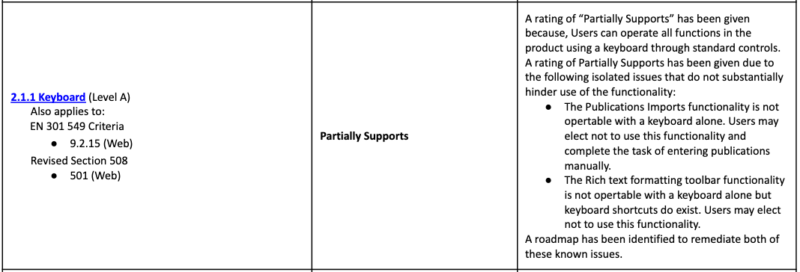
Example VPAT #7

Slide 27
Higher Education Community Vendor Assessment Tool (HECVAT)
Already used by 100+ colleges & universities
Focus has been on security
A new version is expected to be released in conjunction with the EDUCAUSE annual conference (October 29?) that includes several accessibility-related questions.

Slide 28
Open Product Accessibility Template (OPAT)
GSA project to digitize Accessibility Compliance Reports (ACRs, e.g., VPATs)
A few of the benefits:
  Self-validation of data
  Makes comparisons across products easier
  Version control; able to track changes over time
https://github.com/GSA/open-product-accessibility-template

Slide 29
Questions?

