Slide 1
Fall 2023
Adult Education Advisory Council
10.9.2023
Clark College

Slide 2



Personal Capacity Inventory
Gifts I can give to my community
Gifts of the Head (Things I know something about and would enjoy talking about with others, e.g., art, history, movies, birds.
Gifts of the Hands (Things or skills I know how to do and would like to shar with others, e.g., carpentry, sports, gardening, cooking).
Gifts of the Heart (Things I care deeply about, e.g., protections of the environment, civic life, children).
Notes:
Think-pair-share – ​
think: about the prompts that most resonate with you; ​
pair: with one other person; ​
share: what you're comfortable sharing

Slide 3
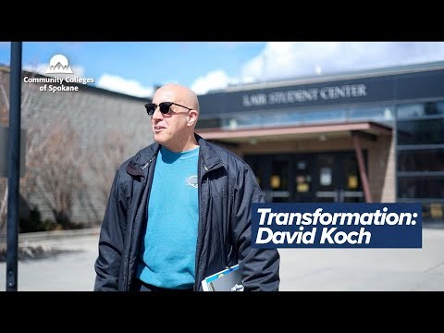
BEdA Student Spotlight

Slide 4
Clark College New Arrival Panel

Slide 5
Basic Education for adults update
Fall 2023 Adult Education Advisory Council
Will Durden
Director, Basic Education for Adults

Slide 6
Basic education for adults update
Fall enrollment
Testing alternatives
Planning Grant Proposal with Community College Research Center
New Data System

Slide 7
Basic education for adults update
Ability to Benefit
Digital Equity
Professional Development
Corrections Education Associate Director

Slide 8
Questions
Will Durden
Director, Basic Education for Adults
State Board for Community and Technical Colleges
360.704.4323 (work)| 503.961.3306 (cell) wdurden@sbctc.edu

Slide 9
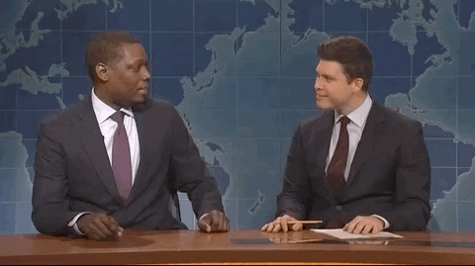
CBS/ AEAC Membership
Industry update

Slide 10
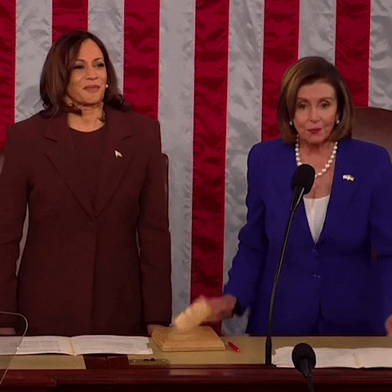
Legislative Update

Slide 11
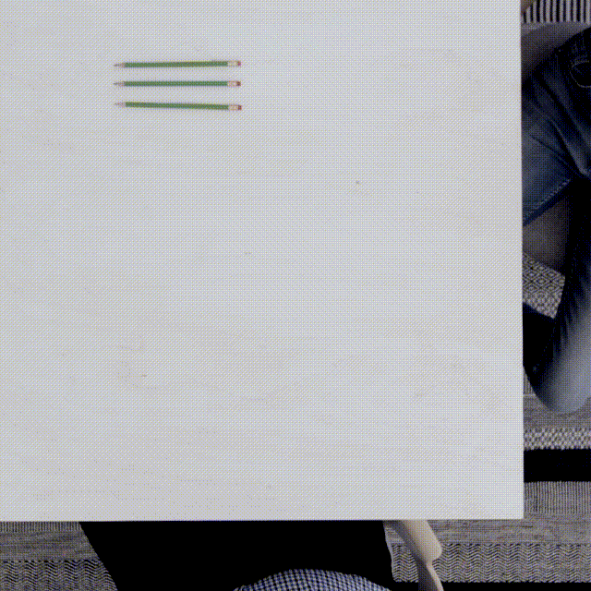
Business Meeting

Slide 12
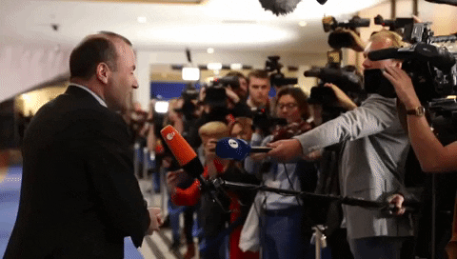
Committee Breakouts/Report Out

