Slide 1
WACTC PROMISING PRACTICES WEBINAR:
Innovative Practices in Dual Credit
South Puget Sound Community College, Shoreline Community College, Bellevue College & Columbia Basin College
March 1, 2023

Slide 2
Land Acknowledgement
As a step toward honoring truth and achieving healing and reconciliation, we open today by acknowledging the traditional territories of the Squaxin Island Tribe of the South Puget Sound. Today, we honor the land on which Washington State Board of Community and Technical Colleges office resides. While we are distributed across many first people’s nations, we remain dedicated to opening our time together by honoring those that came before us.
We know that such statements only become truly meaningful when coupled with authentic relationships and sustained commitment, and as such, we commit to continued efforts to build our collective understanding and action to foster authentic Tribal community connections.

Slide 3
Labor Acknowledgement
We acknowledge that our nation (and our institutions) have benefited from the free enslaved labor of Black people. We recognize the interconnected histories of Indigenous peoples who were forcibly removed from their land and the history of those who were forcibly brought to it. We acknowledge the enduring impacts of the African diaspora, honor the contributions, talents, and dreams of our Black communities.
We acknowledge the immigrant labor that has contributed to the this country as a critical labor force, including voluntary, involuntary, trafficked, forced, and undocumented peoples. We recognize and honor their important contributions. In these acknowledgements, we commit to the essential work of moving beyond awareness to action through meaningful changes at our institutions and in our communities.

Slide 4
House Keeping & Ground Rules
Please leave your video off
Please stay muted at all times unless speaking
Chat will be monitored for questions, so please feel free to use it.
Ask for clarification:
If there is something that you don't understand, please ask for clarification. If you don't understand the issue or solution, then there are probably others that also don't understand.
Please be open and courteous to hearing other people's perspectives. Honest and constructive discussions are needed to obtain the best results.
*This meeting is being recorded

Slide 5
WACTC PROMISING PRACTICES WEBINAR: Innovative Practices in Dual Credit
South Puget Sound Community College – Practices related to college navigators on the high school campus
Shoreline Community College – Innovative biotechnology and biomanufacturing programs and partnerships
Bellevue College – Pacific NW College Credit consortium for CTE credit
Columbia Basin College – Broad-based CTE opportunities and marketing with equity in mind

Slide 6
College and High School Partnership
College Navigators on the High School Campus
South Puget Sound Community College

Slide 7
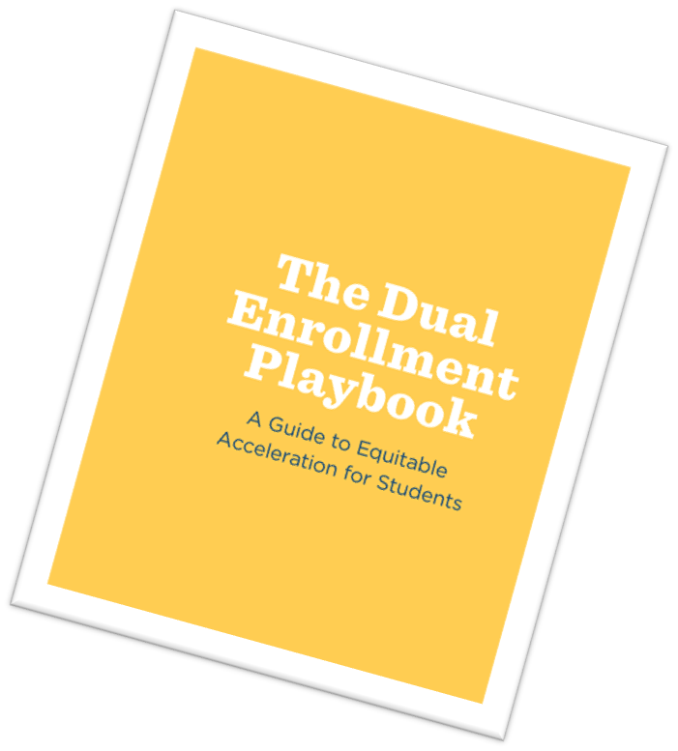
Dual Enrollment Playbook
P1: Set a shared vision & goals that prioritize equity
P2: Expand equitable access
P3: Connect students to advising & supports that ensure equitable outcomes
P4: Provide high-quality instruction that builds student’s competence & confidence
P5: Organize teams & develop relationships to maximize potential

Slide 8
Expand Equitable Access

Slide 9
Partner Spotlight: The Navigator Program
Yelm High School
Rural school located about 20 miles away from South Puget Sound Community College
Navigator is a South Puget Sound Community College employee in the Outreach Department
Works collaboratively with the Career Center Specialist
On site at the high school two days a week throughout the school year

Slide 10
Target Student Audience
These are students who will qualify for the SPSCC IGNITE & Black Scholars programs.

Slide 11
Outcomes & Goals

Slide 12
Navigators in Action
For the schools we are working with, the top five requests for assistance by students are:
FAFSA/WASFA application help
Scholarship Research
College admissions application help
Dual Credit information
Help researching colleges

Slide 13
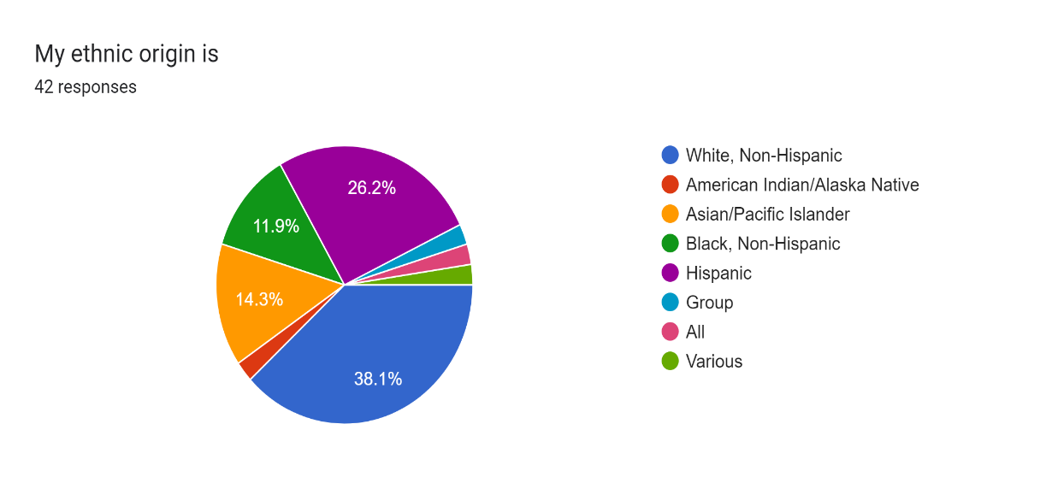
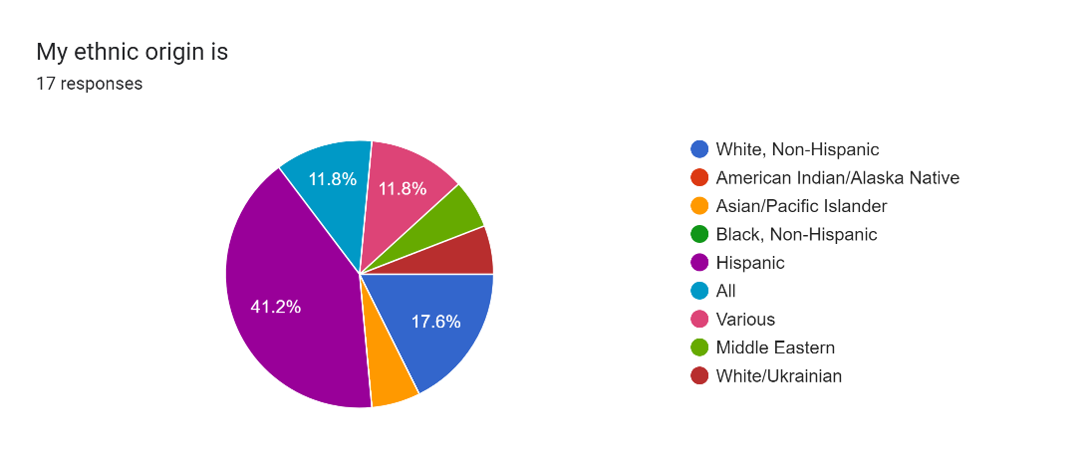
Who the Navigators are Working With
Student self-reported ethnic identity:

Slide 14
Connecting the Pieces
Navigators can be a resource to information & inclusive support
Marginalized student populations need the resources brought to them in order to enroll in Concurrent Enrollment programs
Supportive advising helps students avoid the pitfalls of “collecting” dual credit by offering clear integration of Concurrent Enrollment offerings connected to pathways
It’s not about the “right” program…
it’s about
the right fit for the student!

Slide 15
Program Spotlight: Assessment in the High School
Phased out use of Accuplacer at the start of COVID and replaced with Guided Self Placement and Web Based Mathematics Assessment and Course Management Platform (WAMAP) assessments.
Assessment Center coordinates with high schools to offer Web Based Mathematics Assessment and Course Management Platform (WAMAP) placement on site.
Removes cost and transportation barriers for students.

Slide 16
Web Based Mathematics Assessment and Course Management Platform (WAMAP)

Slide 17
Onsite Assessment Advantages

Slide 18
Innovation, Partnerships, and Future Planning at Shoreline Community College

Slide 19
Innovative Biotechnology and Biomanufacturing Partnerships
Multiple regional employers expanding in the Biomanufacturing sector have identified this as a critical workforce need
Specific educational programs developed for adult learners and High School school students

Slide 20
Essentials of Biomanufacturing Training program
Entry level Biomanufacturing associates Training program
Course outcomes and assessment methods developed in partnership with Bristol Meyers Squibb, Seagen and AGC
Low math and science requirements to begin the program
Work with High School partners to develop courses accessible to running start students
Create multiple on-ramps for the training program

Slide 21
Essentials of Biomanufacturing Training program – High School track
Developed in partnership with AGC Biologics and Edmonds School District – formerly “BioPath” program
High school juniors recruited using extensive High School teacher network develop through Biotech outreach program
Looking for students not necessarily interested in a 4-year STEM degree
Students enroll via running start in one 3 credit Biomanufacturing Lab course per quarter – NO need to rearrange a full senior year schedule of classes

Slide 22
Essentials of Biomanufacturing Training program – High School track continued
Courses held at the AGC Biologics Biomanufacturing training site.
Industry Partners - Parse Bioscience, NovoNordisk, Fred Hutch, Nanostring, AGC Biologics provide:
Students matched with industry mentors for the length of the program
Students earn Basics of Biomanufacturing Certificate and credits towards the Biotech Lab Technician AAAS degree

Slide 23
10 Week Essentials of Biomanufacturing Training program
Entry level Biomanufacturing associates Training program for adult learners
Accelerated version of the the year-long high school program

Slide 24
Biotech Technician Training Program– High School track (launch 2023)
Developed in partnership with Fred Hutch and Shoreline School District
Students will Complete a 1-year Biotech Technician certificate program at Shoreline
Graduates would receive required training to work in any of the Fred Hutch Basic Sciences divisions as an entry level Lab Technician

Slide 25
Biotech Technician Training Program– High School track (launch 2023) Continued
High School students complete 2 paid internships at Fred Hutch
1st internship between Junior and Senior year
2nd internship between Senior year and 1st year at Shoreline
Senior year, students enroll in running start courses to prepare for 1 year Biotech credential at Shoreline
1-year credential will articulate to the AAAS Biotech Lab Technician Degree

Slide 26
Building High School Pathways to Industry
Develop relationships with aligned high school programs
Design lower credit courses college course that function as an onramp to a credential or degree
Engage with industry to design course outcomes and assessments
Involve industry HR, College Foundation, Marketing and Outreach in process

Slide 27
Who We Are
Colleges
School Districts
Bellevue
Edmonds
Granite Falls
Issaquah
Lake Stevens
Lake Washington
Marysville
Mercer Island
Mukilteo
Northshore
Renton
Riverview
Snohomish
Sno-Isle Tech Skill Center
Snoqualmie Valley
Sumner
WANIC Skill Center
Pacific NW College Credit is a consortium made up of 5 colleges, 16 school districts and 2 Skills Centers in the Pacific Northwest. We act as the bridge between the college and the high school to offer college credit!

Slide 28
What is CTE Dual Credit?
A program allowing high school students to earn college credit
Dual credit for your high school CTE classes, earned right at your high school!
CTE: Career and Technical Education
Dual Credit: earning high school credit and college credit at the same time!
All high school students - grades 9 – 12 – are eligible
Students must earn a B or above to get college credit
Credit earned through CTE Dual Credit is posted to a college transcript
Notes:
CTE Dual Credit is college credit that you can earn from your eligible high school classes at your high school!
CTE stands for Career and Technical Education
Dual Credit means that you are earning high school credit and college credit at the same time!

Slide 29
CTE Dual Credit Background
Background
The articulation process is framed, defined and validated by the following:
RCW 28B.50.530 – Agreements between district boards of trustees and school boards
WAC 131-15-095 (2) – Teacher credentials
State Board for Community and Technical Colleges Policy Manual
Carl D. Perkins Career and Technical Education Improvement Act of 2006
SSB 6377 – Legislative support for articulation between high schools and community and technical colleges
Notes:
CTE Dual Credit is college credit that you can earn from your eligible high school classes at your high school!
CTE stands for Career and Technical Education
Dual Credit means that you are earning high school credit and college credit at the same time!

Slide 30
Standardized Documents
The following are standardized documents and generally used statewide:
Consortium Memorandum of Agreement (Master articulation agreement) reviewed and resigned every three years by lead administrators of the Consortium’s secondary and postsecondary education partners (college presidents and school district superintendents).
Program Articulation Agreements reviewed/updated regularly, on a three year rotation, or as deemed necessary, due to changes in class/course content, structure, etc.
Teacher Verification Forms, certifying high school teacher responsible for teaching 100% of college course competencies, signed annually.
College Competency Checklist
Notes:
CTE Dual Credit is college credit that you can earn from your eligible high school classes at your high school!
CTE stands for Career and Technical Education
Dual Credit means that you are earning high school credit and college credit at the same time!

Slide 31
Partnerships
College Program information being made available to registered students
Cross participation in General Advisory Committee’s
High school and College faculty relationships
Notes:
CTE Dual Credit is college credit that you can earn from your eligible high school classes at your high school!
CTE stands for Career and Technical Education
Dual Credit means that you are earning high school credit and college credit at the same time!

Slide 32
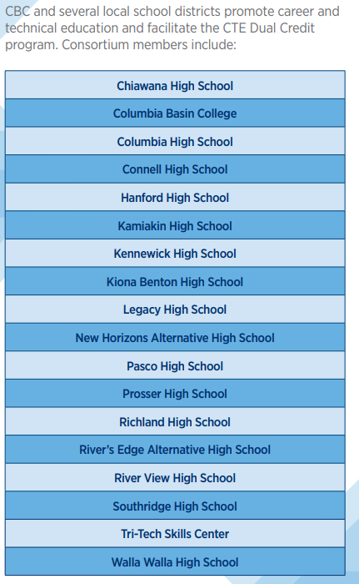
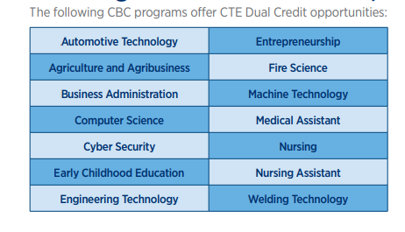
Who we are.

Slide 33
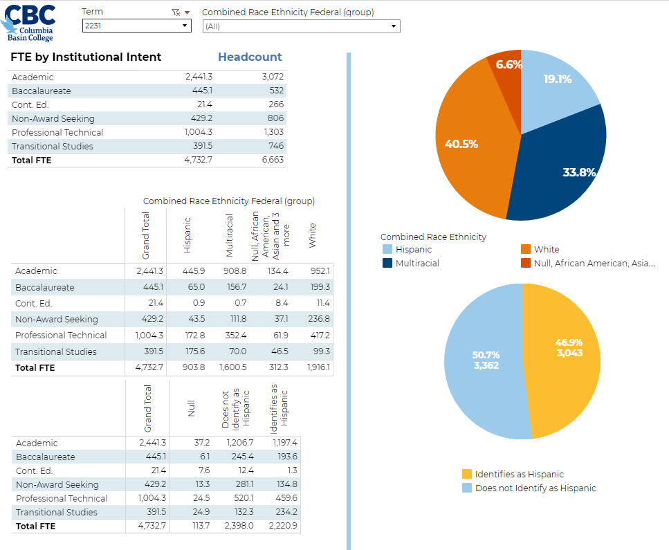
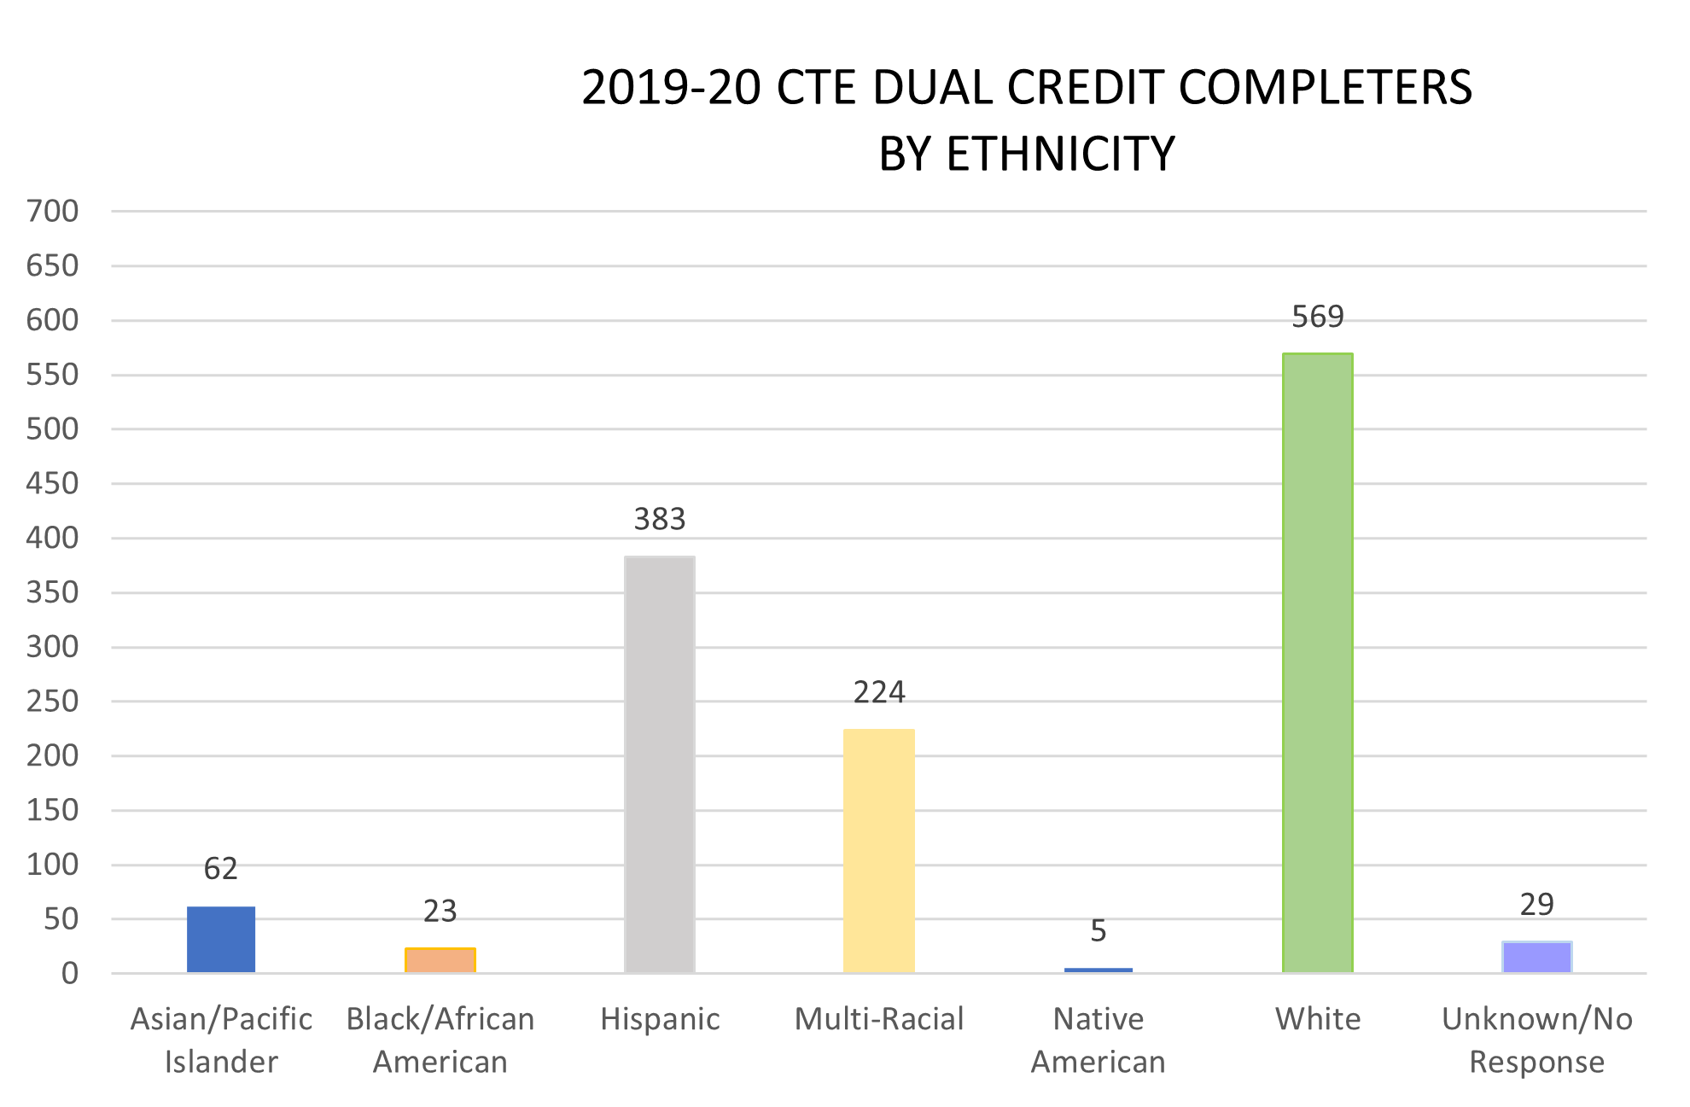
Hispanic Serving Institution
Credit completers (earners) by Race/Ethnicity for 2020-21:
2020-21 CTE DUAL CREDIT COMPLETERS BY ETHNICITY AND HEADCOUNT

Slide 34
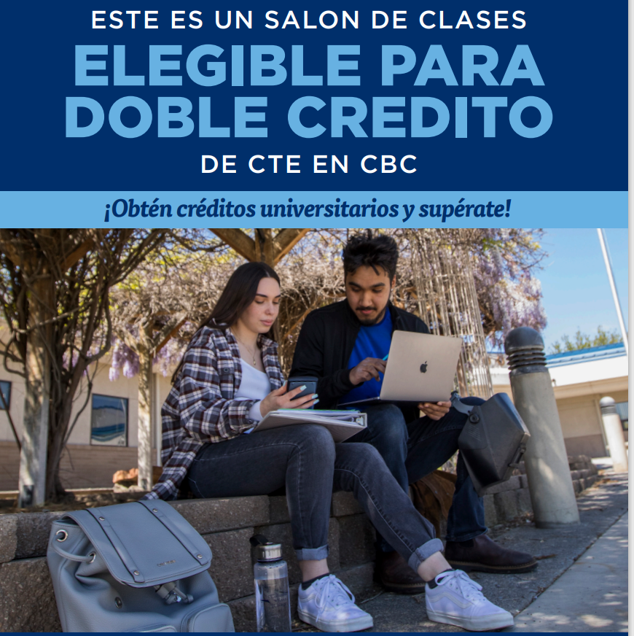
Marketing with DEI in mind

Slide 35
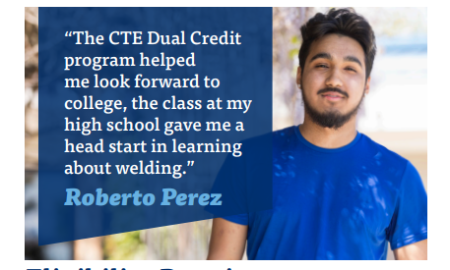
CTE Dual Credit works!

Slide 36
Questions? Please raise hand or drop question in the chat.

Slide 37
WACTC/SBCTC Promising practices exchange
Do you have a promising practice at your college that is—
--Advancing racial equity, closing equity gaps?
--Increasing enrollment, student success, graduation?
--Re-engaging adult students?
Please share it! Go to:
https://www.sbctc.edu/about/task-forces-work-groups/strategic-enrollment/promising-practices.aspx

Slide 38
Presenter Contact Information
Anne Molenda Director of K-12 Partnerships & Recruitment amolenda@spscc.edu
Guy Hamilton Executive Academic Dean, STEM ghamilton@shoreline.edu
Tanya Rettinger Director, PNWCC Consortium tanya.rettinger@bellevuecollege.edu
Cinthia Alvarez Director for K-12 Partnerships cdalvarez@columbiabasin.edu
SBCTC Contact Jamie Traugott Director of Dual Credit & K-12 Alignment jtraugott@sbctc.edu

