Slide 1
Landmark department of Justice Ruling
ADA Title II and Web Accessibility
Monica Olsson, Policy Associate and Michael Hanscom, CATO Co-Chair
October 3, 2024
Notes:
Monica

Slide 2
disability
12,579 (4%) disabled students reported in 23-24 Academic Year
2-10% of a college's student headcount
28.7% US adults have a disability (cdc.gov)
$2,223,605 spent on disability accommodations in 2023-24 (DAP Report, 24 colleges)
Blind or low vision
Color Blind
Deaf or Hard of Hearing
Learning disabilities
Developmental disabilities
Physical disabilities
Mental Health
Notes:
Monica

Slide 3
ADA Title II AND HIGHER Education
Title II – Applies to public entities such as state and local governments, libraries, school districts, state colleges, and community colleges. (That's us!)
Ensures that disabled people have equal access and can participate fully in the programs and services offered by colleges.
Includes web content, electronic documents, and web/mobile applications.
Notes:
Michael

Slide 4
ADA TITLE ii regulatory rule
Accessibility of college websites and content, electronic documents, and third-party web/mobile applications, digital textbooks, digital course content
Word, PowerPoint, PDF, Excel
Establishes technical standard (WCAG 2.1 AA)
Includes digital instructional content (Canvas) and materials (textbooks)
Limited exceptions (e.g., Archived Web Content)
Aligns with Washington State's existing Policy 188
ADA Fact Sheet to learn more
Notes:
Monica

Slide 5
Example third-party applications
ctcLink
Okta (Multi-Factor Authentication tool)
Highpoint HCX (CS pillar only)
Canvas
Student Success Software (Request for Proposal in process)
Library Databases
Notes:
Monica

Slide 6
Timelines
Two years from rule publication: April 24, 2026
The distinction between 2 or 3 years is based on census numbers of 50,000 or greater (2 years) or less than that for 3 years. This refers to the greater population and the communities that our colleges draw from, not our campus populations.
Notes:
Michael

Slide 7
Colleges Do this right now
Publish a statement acknowledging the new ruling and the college's plans for compliance. (Here is an example Title II page from Highline College.)
Provide a notice to the public on how an individual can request alternate means of communication or reasonable modification. (Here is an example assistance request from Highline College.)
Provide a statement to the public on how an individual can report a web or digital accessibility barrier to the college. (Here is an example accessibility statement from Highline College.)
Notes:
Michael

Slide 8
WACTC CALL TO ACTION
Commitment from our highest leaders
Set the expectation that this is an institutional-wide responsibility with common messaging
Identify funding sources for system-wide auditing and remediation tools and centralized work effort across the colleges
Tools used by the CA Community Colleges include Equidox, SensusAccess, and Pope Tech scanning tool
Accessibility training for all faculty and staff
Consider minimum requirements such as the Word, Email, and PDF Micro Courses relevant to employee's role
Track completion rates using a central tool (e.g., ctcLink training)
Notes:
Monica

Slide 9
Alignment with Work Plan
WACTC-Tech Work Plan includes Accessibility
Ensure all technologies and processes are accessible to everyone.
CATO partnership via STAC and WACTC-Tech
WACTC Constitution
To increase the effectiveness of community and technical college education in the state of Washington through appropriate joint action and coordination of member institutions
Notes:
Michael

Slide 10
Thank you!
Questions?
(P.S. The following slides provide extra information and context.)
Notes:
Both

Slide 11
COST Considerations
Likely costs will include, but are not limited to:
Captioning for pre-recorded (e.g., classroom) and live (e.g., events) video
Document remediation
Any actively used electronic documents, in classes or on websites
Can be contracted or done in-house with tools like Equidox or SensusAccess
Software review and testing
Voluntary Product Accessibility Template (VPAT) reviews don't catch everything
Hands-on experience and testing will be necessary
Website reviews and updates
Scanning tools like pope.tech can help with identifying issues
Negotiations with vendors regarding accessibility of their offerings
Notes:
Both

Slide 12
existing resources
Focus on new content moving forward including third-party applications.
SBCTC Accessibility Micro Courses
Ally tool inside Canvas
ctcLink Accessibility open forums
Notes:
Monica

Slide 13
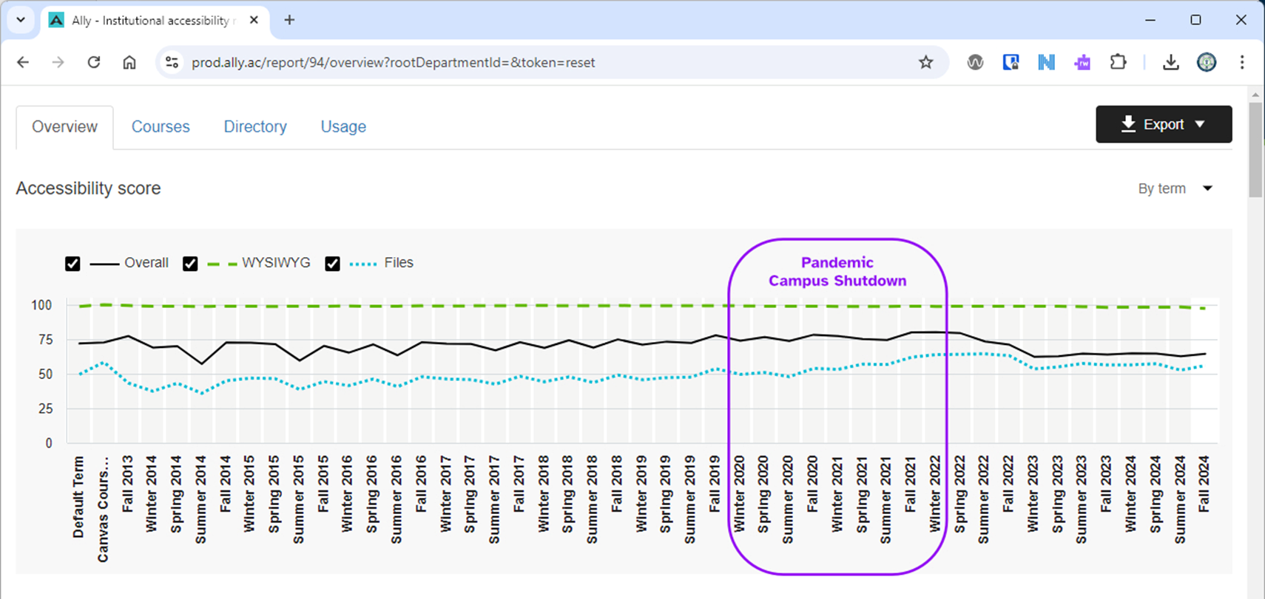
CANVAS ALLY SCORE EXAMPLE
Notes:
Michael

