Slide 1
Travel & Expense Process Alignment Task Force Final Recommendations
ctcLink College Collaboration Group Meeting – May 14, 2025

Slide 2
Introductions
Lia Homeister
T&E Task Force Lead,
ctcLink College Leader,
Renton Technical College
Miranda Brown
Travel & Account Payable Specialist,
Skagit Valley​ College

Slide 3
Background

Slide 4
Task Force Members
Subject Matter Experts​
Jessica Briggs, Renton Technical​
Miranda Brown, Skagit Valley​
Becky Cox, Bellingham Technical
Heather Emlund, Seattle​
Angela Garza, Yakima Valley​
Christopher Pitman, Olympic​
Teri Sexton, SBCTC​
Arega Tesfaye, Everett​
Jennifer Warden, Green River​
Lead ​
Lia Homeister, Renton Technical​
Functional Analysts ​
Jennifer Smith​, SBCTC
Michele Rockwell​, SBCTC
Data Services Staff
Carmen McKenzie, SBCTC​
Ivy Brent​, SBCTC
cCCG/PAW Liaisons
Pat Daniels, Highline​
Pauline Marvin-Smith, Peninsula​
Jo Munroe, SBCTC​

Slide 5
Task Force Responsibility
Conduct an initial review of the ctcLink Travel & Expense process and provide recommendations on best practices and available variances. ​
Connect with related subject matter experts and end-users across the system for a variety of activities, including gathering ideas about pain points, utilization of the system, and review of training and tools.

Slide 6
Scope
Travel Employee Profile​
Travel Authorizations​
Cash Advance​
Expense Reports

Slide 7
The Recommendations

Slide 8
Recommendations Summary
26 items total
Mix of global, best practice, and optional recommendations
Covers processes, configuration, and enhancements recommendations

Slide 9
Setting Expectations
The recommendations are:
A complete overhaul of the system
Brand new app/system
In conflict of state regulations
Realistic changes that can be done now at the local level
Enhancement ideas to improve the system globally
Compliant with state regulations as they are understood today
The recommendations are not:

Slide 10
Finding 1
Defaults can be utilized more frequently to avoid tedious steps and errors for travelers and travel admins to clean up.
Global and local configurations can also be reviewed and modified to avoid extra steps and processes outside the system.

Slide 11
Finding 2
Labels are recommended to be modified to make the travel documents more intuitive for travelers to fill out.
Error messages and tool tip messages are also recommended to be reviewed and modified to provide clearer directions for travelers.

Slide 12
Finding 3
The CTC system can leverage communities of practice to share ideas and resources to continue to improve processes.
Training classes on state travel guidelines are also recommended.

Slide 13
Overall Themes
Prerequisite Steps to Clear the Road for the Traveler
Better Signage to Direct the Traveler
Training & Communities of Practice to Sustain Improvements

Slide 14
Organization
Item # | Description | College Variance | Implementation Notes
Number to identify recommendation | Description of the recommendation. | Global Adoption Requirement with College Options Recommendation Best Practice Optional College Choice | No delay Contingent on…

Slide 15
1. Travel Employee Profile

Slide 16
1.1 Display Name
Item # | Description | College Variance | Implementation Notes
1.1 | Employee Data > Display Name: This is a required field, but it does not populate from HCM data, due to an Oracle sync issue​. Update per directions on the Editing Employee Name Data QRG. | Global Adoption | No delay (users can do this now)

Slide 17
1.2 Default Profile
Item # | Description | College Variance | Implementation Notes
1.2 | Organizational Data > Expenses Processing Data: When setting up the Employee Travel Profile, Travel Admins should check travel profile defaults to ensure that they are set to the correct profile/institution. When updating the default profile, it should be checked if the traveler is active (or has active travel) at other institutions. Issues with payment can arise if the default travel profile Empl Rec does not match the Empl Rec on other travel documents. Queries have been updated so that travel admins can easily check a mismatch. | Global Adoption | No delay (users can do this now)

Slide 18
1.3 Default Profile Query Check
Item # | Description | College Variance | Implementation Notes
1.3 | Organizational Data > Expenses Processing Data: Travel Admins can do a regular check of default profiles using this query: QFS_EX_EMPL_TRAV_DEFAULTS_CF | Recommended Best Practice | No delay (users can do this now)

Slide 19
1.4 Default Chartstring
Item # | Description | College Variance | Implementation Notes
1.4 | Organizational Data > Default ChartField Values: Based on the below options, colleges should decide how they best apply the Default ChartField Values for their travelers. There is only one default chartstring available in the Travel Employee Profile. That default chartstring carries over to all travel documents the traveler creates. However, it can be overwritten within the travel documents by the traveler. | Requirement with College Options | No delay (users can do this now)

Slide 20
1.4 Default Chartstring Options
Option 1
Enter the Oper Unit only. This option allows the traveler to enter whichever chartstring they need in all of their travel documents. No chartstring will auto-populate in this scenario, so it will force the traveler to choose. Note: the system will automatically populate the HCM department number into the Dept field if left blank. Travelers will need to know to overwrite that field when entering their chartstrings.
Option 2
Enter the default department budget. This will auto-populate the traveler’s department chartstring in all travel documents. However, they would need to overwrite it for Cash Advance, as a global chartstring is required for cash advances. This method is recommended if the traveler has a department budget that is regularly used and does not use Cash Advance.
Option 3
Enter the global cash advance chartstring. This will auto-populate the global cash advance chartstring in all travel documents. Travelers would need to overwrite it for their other travel documents (e.g., Travel Authorizations and Expense Reports). This option makes sense if travelers do not have a set department budget for travel and would be changing their chartstring for each travel.

Slide 21
1.5 Cash Advance Level
Item # | Description | College Variance | Implementation Notes
1.5 | Organizational Data > Cash Advance Level: The Travel Admin should check the Cash Advance limits based on their college’s policy. This can be set by Business Unit, which would save time, if they have consistent limits for employees. Colleges can submit a ticket to be updated by SBCTC. It can also be set individually if needed for specific cases. | Recommended Best Practice | No delay for individual updates (mass update by Business Unit should be requested to SBCTC via ticket)

Slide 22
1.6 Expense Defaults
Item # | Description | College Variance | Implementation Notes
1.6 | User Defaults > Expense Defaults: Set the Billing Type field as “Billable” and Transportation ID field as “POV/Auto” as the default. This can reduce steps later on for travelers. Travelers can also edit their own. | Recommended Best Practice | No delay for manual entry; mass update contingent on request from college and SQL update by SBCTC technical team

Slide 23
1.7 Expense Types Defaults
Item # | Description | College Variance | Implementation Notes
1.7 | User Defaults > Expense Type Defaults: It is recommended to update for each employee their default Expense Type and their corresponding Payment Type and Billing Type data. This will allow these fields to auto-populate in the Travel Authorization, saving tedious steps and time for the traveler. A mass update by Business Unit is possible. Travelers can also edit their own. | Recommended Best Practice | No delay for manual entry; mass update contingent on request from college and SQL update by SBCTC technical team

Slide 24
1.8 ACH
Item # | Description | College Variance | Implementation Notes
1.8 | Bank Accounts > Organizational Data & Bank Account Info: It is recommended to set the default Payment Method to Automated Clearing House (ACH). This can help reduce time/effort into tracking uncashed checks. It can be set up as System Check for specific cases as needed. Travel Admins should notify the traveler how they can check their bank account information in FIN Employee Self-Service, as the default may differ from their bank account in HCM. Travel Admins can use this query to check the bank account used: QFS_EX_NO_PROFILE_BANK_ACCT. | Recommended Best Practice | No delay for manual entry; implementation timelines will vary by college – careful consideration of impacts needed at the local level

Slide 25
2. Travel Authorizations

Slide 26
2.1 Over Per Diem Functionality
Item # | Description | College Variance | Implementation Notes
2.1 | Over Per Diem Functionality: The allowing over per diem functionality should be turned off and instead new over per diem expense types should be utilized for lodging. This would allow over per diem for some expense types without risking overages for per diem meals. | Global Adoption | Contingent on local configuration completion

Slide 27
2.2 Accounting Default
Item # | Description | College Variance | Implementation Notes
2.2 | Details > Accounting Default: Travelers should check their accounting default. If their Travel Employee Profile default has their correct chartstring, this should be set. If not, the traveler needs to enter the correct chartstring. Entering it here will avoid having to enter for each expense line which will save time and effort. Travelers may be unfamiliar with chartstrings and may not know the correct chartstring to enter. They should check with their supervisor or budget manager for the correct chartstring for the specific travel. | Recommended Best Practice | No delay (users can do this now)

Slide 28
2.3 Quick-Fill
Item # | Description | College Variance | Implementation Notes
2.3 | Details > Quick-Fill: Travelers should use the Quick-Fill option to save time and effort. This allows travelers to enter multiple expense lines at one time. They should enter the corresponding dates and select the appropriate Expense Types. | Recommended Best Practice | No delay (users can do this now)

Slide 29
2.4 Quick-Fill Enhancement Request
Item # | Description | College Variance | Implementation Notes
2.4 | ER Idea: Add the Description field on the Quick-Fill page to reduce manual entry of the description field for each line. | Global Adoption | Contingent on ER completion (page customization)

Slide 30
2.5 Updated Expense Types
Item # | Description | College Variance | Implementation Notes
2.5 | Details > Expense Type: Add/Update Expense Type options for seamless approval workflow and accounting compliance. ​Updating the Expense Types can result in reduced pre-travel paperwork by triggering a refinement template in the approval workflow, allowing higher-level executives to be added for specific travel types. In-state and out-of-state Expense Type codes must be linked to different GL accounts, requiring separate codes for each. Revising descriptions of codes will also make them easier to find for users. | Global Adoption | Contingent on ER completion (global configuration)

Slide 31
2.6 Expense Details Check
Item # | Description | College Variance | Implementation Notes
2.6 | Details: The Expense Types Defaults should be updated in Travel Employee Profile so that users do not need to enter separately for each line. (Addressed in Travel Profile section.) This could also reduce error. It is also recommended for travelers to check their work by clicking the “View Printable Version” link, which will show a summary of each line. | Recommended Best Practice | No delay (users can do this now)

Slide 32
2.7 Expense Lines Enhancement Request
Item # | Description | College Variance | Implementation Notes
2.7 | ER Idea: Add the Date and Payment Type fields to the expense line so that the traveler doesn’t need to click and open that in the Details page. If space is needed, it is recommended to remove the Currency field. | Global Adoption | Contingent on ER completion (page customization)

Slide 33
3. Cash Advance

Slide 34
3.1 Cash Advance Chartstring
Item # | Description | College Variance | Implementation Notes
3.1 | Global Chartstring: All colleges should utilize this global chartstring for cash advances specifically. This chartstring uses a clearing account. This will help reduce manual fixes and compliance issues. Global Chartstring: Fund 790 Class 285 Dept 98389 State Purpose N | Global Adoption | No delay (users can do this now)

Slide 35
3.2 Reference Field
Item # | Description | College Variance | Implementation Notes
3.2 | Reference: The traveler should enter the TA# in the Reference field. There is no linking on the back end between a Travel Authorization and Cash Advance. Adding the TA# to the Cash Advance would allow travel admins to properly reference and connect all documents related to the same travel. | Recommended Best Practice | No delay (users can do this now)

Slide 36
3.3 Reference Label Enhancement Request
Item # | Description | College Variance | Implementation Notes
3.3 | ER Idea: Update the Reference field label "Reference" to “Travel Authorization #” or something similar, to direct travelers to enter their TA# in that field. | Global Adoption | Contingent on ER completion (page customization)

Slide 37
3.4 System Check Label Enhancement Request
Item # | Description | College Variance | Implementation Notes
3.4 | ER Idea: In the Source field, change the option label of “System Check” to “System Payment” or something similar, to avoid confusion about the payment method being a check. The payment method will be whatever is in the traveler’s profile. | Global Adoption | Contingent on ER completion (global configuration)

Slide 38
4. Expense Reports

Slide 39
4.1 Requiring Receipts Functionality
Item # | Description | College Variance | Implementation Notes
4.1 | Requiring Receipts Functionality: Configuration around receipt attachments and exceptions is customizable based on school need. Colleges should adjust their configuration as needed per college policy. In general, it is recommended to make the configurations as streamlined as possible for travelers to avoid redundancy (e.g., having to attach the same thing on multiple lines). | Requirement with College Options | Contingent on local configuration completion

Slide 40
4.2 Personal Expense Label Enhancement Request
Item # | Description | College Variance | Implementation Notes
4.2 | ER Idea: Update the Personal Expense toggle label from “Personal Expense” to “Reimbursable” (yes/no toggle) as it is more intuitive and clearer for travelers. | Global Adoption | Contingent on ER completion (page customization)

Slide 41
4.3 EXC4500 Report
Item # | Description | College Variance | Implementation Notes
4.3 | EXC4500 Report: Request to be updated to reflect more detailed information needed for auditors and/or to print for reference. An alternative is to expand the details and print the screen to PDF. | Optional College Choice | Contingent on if the report can be updated with more detail

Slide 42
5. Other

Slide 43
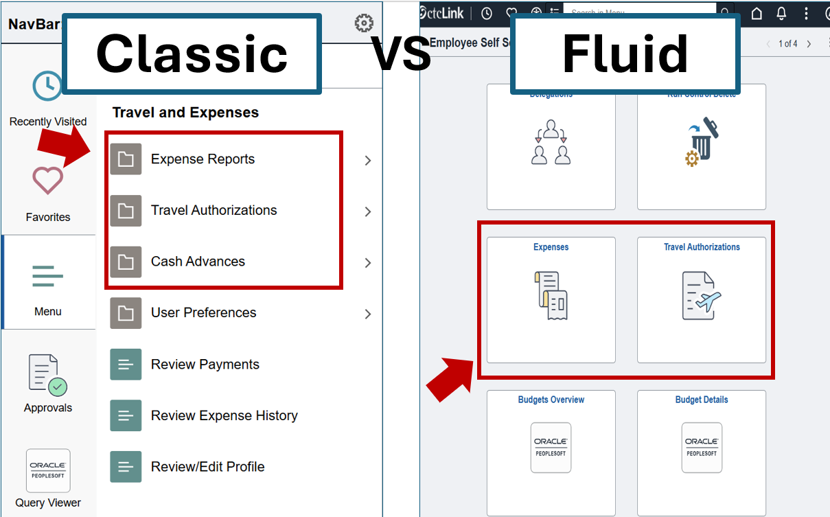
5.1 Classic vs. Fluid
Item # | Description | College Variance | Implementation Notes
5.1 | Classic (navigation) vs. Fluid (tile): It is recommended to use the Fluid interface when available (e.g., Travel Authorizations and Expense Reports): Fluid is a responsive and adaptive interface​ Accessibility best practice for inclusivity ​ More user-friendly on different devices​ Fluid is more sustainable long-term; some T&E Classic pages are being de-supported​ FSCM Image 50 PUM Update (Oct. 26, 2024) has fixed a lot of issues related to Fluid in T&E | Recommended Best Practice | No delay (users can do this now)

Slide 44
5.2 Auditor Roles
Item # | Description | College Variance | Implementation Notes
5.2 | Auditors: There are auditor security roles that can be given to auditors so that they can pull information during an audit. They would have access to everything needed except PCards. This will help save time for colleges, as they will not need to pull and print information for auditors. | Recommended Best Practice | No delay (access should be requested to SBCTC via ticket)

Slide 45
5.3 Error Messages Enhancement Request
Item # | Description | College Variance | Implementation Notes
5.3 | ER Idea: Review and update any error messages and tool tip messages and adjust for clarity as needed. Updated language TBD. | Global Adoption | Contingent on ER completion (global configuration)

Slide 46
5.4 Training
Item # | Description | College Variance | Implementation Notes
5.4 | Training: It is recommended that a community of practice be created for travel admins and travelers, coordinated by SBCTC, to share resources and foster peer training/support. It also recommended that state-wide trainings on state travel should be provided for travel admins and travelers. | Recommended Best Practice | No delay with informal community of practice; formal coordination will take time to set up

Slide 47
Summary of Global Adoption Recommendations
Item # | Title | Implementation Notes
1.1 | Display Name | No delay (users can do this now)
1.2 | Default Profile | No delay (users can do this now)
1.4 | Default Chartstring | No delay (users can do this now)
2.1 | Over Per Diem Functionality | Contingent on local configuration completion
2.4 | Quick-Fill ER | Contingent on ER completion (page customization)
2.5 | Updated Expense Types | Contingent on ER completion (global configuration)
2.7 | Expense Lines ER | Contingent on ER completion (page customization)
3.1 | Cash Advance Chartstring | No delay (users can do this now)
3.3 | Reference Label ER | Contingent on ER completion (page customization)
3.4 | System Check Label ER | Contingent on ER completion (global configuration)
4.1 | Requiring Receipts Functionality | Contingent on local configuration completion
4.2 | Personal Expense Label ER | Contingent on ER completion (page customization)
5.3 | Error Messages ER | Contingent on ER completion (global configuration)

Slide 48
Grouping of Items for Implementation
No Delay Items | Mass Updates Available & Auditors | Global & Local Configurations | Page Customizations | Training | Policy
1.1 Display Name | 1.5 Cash Advance Level | 2.1 Over Per Diem Functionality | 2.4 Quick-Fill ER | 5.4 Training | Transportation Policy
1.2 Default Profile | 1.6 Expense Defaults | 2.5 Updated Expense Types | 2.7 Expense Lines ER
1.3 Default Profile Query Check | 1.7 Expense Types Defaults | 4.1 Requiring Receipts Functionality | 3.3 Reference Label ER
1.4 Default Chartstring | 1.8 ACH | 3.4 System Check Label ER | 4.2 Personal Expense Label ER
2.2 Accounting Default | 5.2 Auditor Roles | 5.3 Error Messages ER
2.3 Quick-Fill | 4.3 EXC4500 Report
2.6 Expense Details Check
3.1 Cash Advance Chartstring
3.2 Reference Field
5.1 Classic vs. Fluid

Slide 49
New Expense Type Descriptions
In State Airline
In State Hotel Per Diem
In State Hotel Misc
In State Hotel OverPerDiem
In State Hotel Stu Group
In State Hotel Tax
In State Meal Breakfast
In State Meal Dinner
In State Meal Lunch
In State Meals Stu Group
Int'l + HI Airline
Int'l + HI Hotel
Int'l + HI Hotel Tax
Int'l + HI Meals
Miscellaneous Communication
Miscellaneous Travel
Out of State Airline
Out of State Hotel Per Diem
Out of State Hotel Misc
Out of State Hotel OverPerDiem
Out of State Hotel Stu Group
Out of State Hotel Tax
Out of State Meal Breakfast
Out of State Meal Dinner
Out of State Meal Lunch
Out of State Meals Stu Group
Registration
Supplies
Transportation Auto Rental
Transportation Mileage
Transportation Other
Transportation Parking
Transportation Toll

Slide 50
Questions?

