Slide 1
State Board for community and technical college
Fall 2024 Updates
Val Sundby, Director of Transfer Education

Slide 2
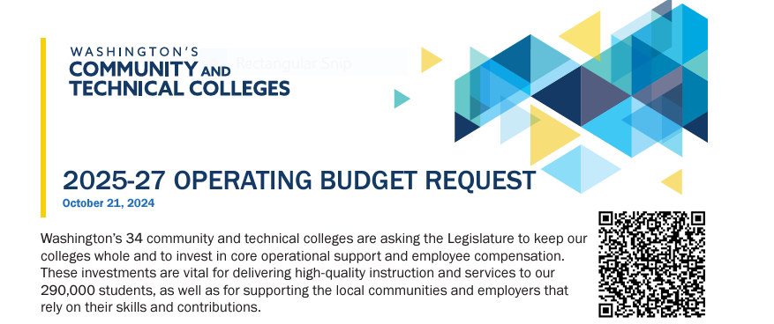
2025-27 operating budget request
Maintain previously approved state allocation ($28.6 million in fiscal year 2025, carried forward in 2025-27)
Provide Fully Funded, Competitive Compensation ($183 million)
Support College Operations ($90 million)
Operating Budget One-Pager

Slide 3
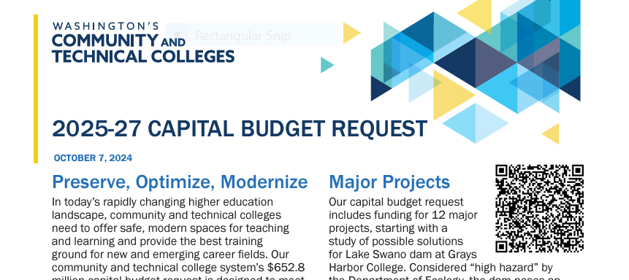
2025-27 Capital budget request
$652.8M for major projects, minor works, and clean buildings act compliance
Capital Budget One-Pager

Slide 4
Course sharing
Final RFP for course sharing software was released in early September
Responsive bids are under review with the goal of selecting a winning bidder by the end of November
Goal: implementation in time for pilot programs to begin in time for Summer/Fall registration

Slide 5
ADA Title II Department of justice ruling
All colleges must comply with regulations by April of 2026
SBCTC staff have presented to the State Board, WACTC, IC, and WSSSC to emphasize the impact of these regulations and the need for campus-wide engagement in meeting them
The requirements have broad accessibility requirements of all public facing materials (including instructional content) that must be met in advance of an individual request for accommodation
SBCTC staff are working on updated training and resources

Slide 6
Gainful employment
Gainful Employment/Financial Value Transparency (GE/FVT) Reporting has been pushed back to January 15, 2025.
SBCTC Policy Research is liaising with the National Student Clearing House for provision of baseline reports and preparing reports for those unable to access the NSC service.
ctcLink financial aid and query development experts are preparing queries colleges can use to extract and upload data not provided by NSC.
Policy Research and the Workforce staff are working with colleges to identify programs that may be impacted by the metrics, and by changes to the 150% rule if it is re-enacted.

Slide 7
System level Institutional review board
Available this fall, the system IRB will:
  Provide individual colleges and college consortia with an IRB service for grant applications and research proposals
  Provide an educational function, including ‘mock IRB’ opportunities as schedule permits, training and development for faculty that wish to learn more about the IRB process or serve on an IRB, and opportunities to support inclusion of IRB experience in undergraduate research projects.
  Develop a resource center for faculty, staff and students to learn more about the IRB process.

Slide 8
College in the high school
The first College in the High School Legislative Report in response to 2SSB 5048 is available now
SBCTC staff is submitting the 2023-2024 CiHS report on course enrollment to the Office of Financial Management this fall. Colleges should expect to receive their reimbursement in the January 2025 allocation.

Slide 9
Student Success Middle Leadership Academy
Applications open Winter 2025 for a Summer 2025 start
Curriculum topics
  The Essential Roles of Leadership in Student Success
  Keeping Student End Goals in Mind
  Student Experience
  Leadership Traits to Drive Change
  Managing and Advancing Institutional Change
  Effective External Partnerships and the Leadership Journey

Slide 10
Student success tool rfp
RPF is complete; vendor responses under review
Final vendor selection expected by end of November
A plan is being developed to support colleges with implementation

Slide 11
Computer science expansion funding
Funds were distributed to 18 colleges in Allocation #4
These funds have flexible spending guidelines to allow colleges to invest in the areas most critical to their development and/or expansion of Bachelor of Science in Computer Science programs
Funds are expected to be ongoing, however specific allocation amounts will vary across years based on total funding and number of participating colleges

Slide 12
Statewide degrees under review
Computer Science
  New CS DTA/MRP approved
  Elimination of the CS pathway in the AS-T Track 2 degree up for a final vote this fall
PreNursing
  Workgroup has formed; work is morphing to a pre allied health degree
Biology DTA/MRP and AS-T Track 1
  Working is being formed and will begin in January
  Will build on the work done via the STEM Transfer Partnerships grant

Slide 13
Questions?
Val Sundby
Director of Transfer Education
vsundby@sbctc.edu

