Slide 1
SBCtc updates
Articulation and Transfer Council
Val Sundby, Director of Transfer
October 2022

Slide 2
SBCTC 2023 Legislative priorities
Fully funded competitive compensation for faculty and staff
Advance equity, diversity and inclusion efforts already underway
Support workforce development programs
Expand learning technology for classes, equipment and IT infrastructure
Funding for the system's capital project list to maintain and modernize campuses

Slide 3
Statewide transfer work – lots happening!
University of Washing CCRI Stem Transfer Partnerships
  10 pair of CTC and public BI partners working on STEM transfer issues
  https://www.uw.edu/ccri/stpdatanote1/
Independent Colleges of WA – Transfer Pathways to the Liberal Arts
  Transfer conversations between CTC and private BI partners
  Additional workgroups focusing on psychology and biology pathways
  https://www.teaglefoundation.org/Call-for-Proposals/Initiatives/Transfer-Pathways-to-the-Liberal-Arts
JTC Degree Reviews
  Computer Science DTA/MRP, Biology DTA/MRP, AS-T Track 1, Pre-Nursing DTA/MRP, Nursing DTA/MRP

Slide 4
Bachelor of science – computer science
Funding available to implement and scale Bachelor of Science in Computer Science programs
A minimum of $20,000 is available to each college to support program development or expansion. These funds are flexible and there may be more available so ask for what you need!
There is also funding for 2 different faculty workgroups focused on equity in Computer Science
https://www.surveymonkey.com/r/bachelorofscienceincomputerscience
  Funding Survey is Due 10/28

Slide 5
Climate solutions
Funding available for a variety of programs focused on integrating climate solutions and climate justice across the curriculum
Lots of opportunity for faculty engagement:
  Climate Justice Faculty Leads (transfer discipline focused)
  Workforce Faculty Retreats
  Curriculum Development Workshop
Additional opportunities for facilities directors
https://www.surveymonkey.com/r/Climatechange_1022
Funding Survey is Due 10/28

Slide 6
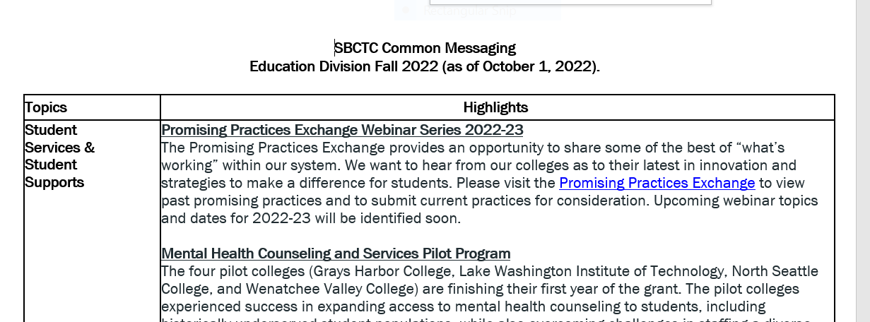
Education division updates
There are lots of exciting programs happening in Student Services, the Student Success Center, Basic Education for Adults, and Tribal Government Relations
Check out the Fall Common Messaging Document in the chat for all the details

Slide 7
Questions?
Val Sundby
Director of Transfer
vsundby@sbctc.edu
360.972.0872 (c)

