Slide 1
COP – Debt Payments and ST/LT Liabilities
Sabra Sand – Clark College, Director of Business Services
Lori Carambot – Walla Walla Community College, Director of Special Fiscal Services

Slide 2
What is a COP?
COP stands for Certificates of Participation
Debt financing thought the State Treasurer for:
  Equipment purchases
  Real estate purchase or construction (approved by the Legislature in the Capital Budget)
  Software purchase or construction

Slide 3
General COP info
State Treasurer typically sells bonds twice a year
  Late February
  Mid/late August
All COP requests are pooled together in a sale
Details are at:
https://www.tre.wa.gov/partners/for-state-agencies/state-leasepurchase-program

Slide 4
Requesting a COP
If it is a real estate purchase or building construction, needs to go through the capital budget process through SBCTC
  Financial Contract
  Feasibility Study
Submit a “Notice of Intent” form to the State Treasurer
  This establishes the earliest date you may request reimbursement
Submit a “Project Overview Form” to the State Treasurer
State Treasurer reviews project

Slide 5

Requesting a COP
For construction, a contractor must be selected before moving forward with a COP sale. (State Treasurer typically needs this about 30 days before bond sale)
For equipment, a listing of equipment to be purchased is generally required (COP term cannot exceed equipment life span)
Submit financing documents to State Treasurer
Bond sale happens….

Slide 6
After Bond Sale
Receive bond sale documents
  Intro letter
  Expenditure requirements (IRS)
  Repayment schedule
  Sources and uses

Slide 7
Booking initial entries
Sources and uses page

Slide 8
Booking initial entries
Amount of debt ST/LT to be booked
Amount of premium/discount
Total amount including issuance cost for the college
COP request, amount that can be drawn
Issuance cost to be booked as expense
Issuance cost to be booked as expense
Additional proceeds, held by State Treasurer, applied to first interest payment

Slide 9
Booking A/R and expenditure initial entries-Government type funds
FMS Entries-Government Type Funds
T/C GLs
156 1354/3221 (src 0807) $7,350,000.00
(agency 010 – Bond retirement and interest)
Premium $1,168,214.55
Less:
Underwriter cost (4,885.96)
Cost of Issuance (9,051.03)
$1,154,277.56
156 1354/3221 (0869)(OIP-UD-COI) $1,154,277.56
Then, book underwriter cost and cost of issuance revenue and expenditure…
438 1110/3221 (src 0869) $13,936.99
437 6514/1110 (sobj PC) $13,936.99

Slide 10
Booking A/R and expenditure initial entries-Government type funds
Illustrative Entries
  T/C GLs Account Description Due from Amount
  156 1354/3221 147.xxx.xxxx.0807 PAR on COP 010 $7,350,000.00
  156 1354/3221 147.xxx.xxxx.0869 Record prem-UD-COI 010 $1,154,277.56
  438 1110/3221 147.xxx.xxxx.0869 UD and COI revenue $13,936.99
  437 6514/1110 147.xxx.xxxx.PC UD and COI expense $13,936.99

Slide 11
Booking debt entries
FMS Entries
For FMS, only record PAR value
Need to determine short term vs long term
*Premium or Discounts can be booked and amortized on financial statements only if material.

Slide 12
Booking Debt Entries
Let’s assume we received this COP in March 2017.
Book $480,000 as short term
Remaining COP debt as long term
  $7,350,000-480,000=$6,870,000

Slide 13
Booking Debt Entries-Government Type Funds
Let’s assume we received this COP in March 2017.
For governmental funds, book in fund 999
Book $480,000 as short term
Remaining COP debt as long term
  $7,350,000-480,000=$6,870,000
T/C GLs Description Amount
344 1820/5273 Book entire liability $7,350,000
345 5273/5173 Re-class short term liability $480,000

Slide 14
Initial entries are booked, now what…
You can begin to draw funds if expenditures have already happened
Otherwise, your funds sit in an Local Government Investment Pool (LGIP) account and earn interest!!

Slide 15
Booking Interest Accrued as A/R
Let’s assume we received this COP in March 2017.
We earn interest each month on funds held by State Treasurer
Monthly statement-State Treasurer
Book as additional receivables and revenue
Interest is drawn on the same basis as COP funds

Slide 17
Booking Interest Accrued as A/R-Governmnt Type Funds
Interest earned each month until year end
T/C GLs Description Amount
150 1354/3205 March interest $4,915.63
087 3205/3210 Reclass revenue $4,915.63
150 1354/3205 April interest $5,206.12
087 3205/3210 Reclass revenue $5,206.12
150 1354/3205 May interest $5,256.92
087 3205/3210 Reclass revenue $5,256.92
150 1354/3205 June interest $5,534.01
087 3205/3210 Reclass revenue $5,534.01

Slide 18

At the same time we are earning interest, we are also drawing on the funds…

Slide 19
Drawing COP Funds
Request for Release of Proceeds form
Copies of all Invoices
Proof of payment (Copies of checks/bank wires)
  If vendor by credit card
    Copy of payment to vendor
    Copy of credit card statement showing payment to vendor
    Copy of payment/wire to credit card company
Try to avoid requesting reimbursement of labor costs
Try to avoid requesting reimbursement for use tax

Slide 20
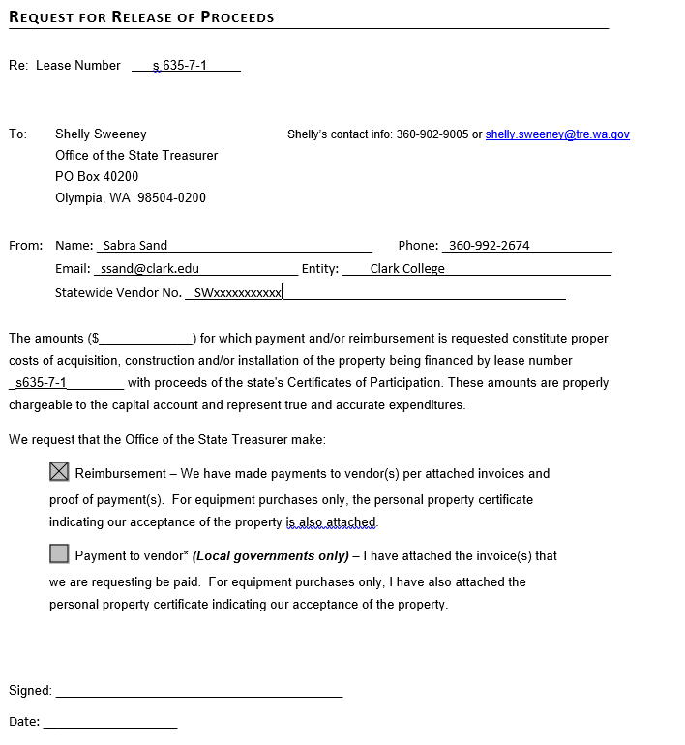
Drawing COP Funds
Request for Release of Proceeds form
Fax or mail form, invoice copies and proof of payment to State Treasurer

Slide 21
Drawing COP Funds-entries
T/C GLs Description Amount
154 1110/1354 COP Draw #1 $914,459.07
040 1150/1151 Cash received $914,459.07
437 6514/1110 (sobj JF) Re-class expense $914,459.07
002R 1110/6510 (sobj JF) Re-class expense $914,459.07

Slide 22
Year End Balancing…

Slide 23
Year End – Balance debt with State Treasurer
Based on our previous entries, we have:
5173 Short term liability $480,000
5273 Long term liability $6,870,000
Treasurer sends a document that must match our entries

Slide 24
Year End A/R Balance
6/30/17 balance

Slide 25
Year End – Balance A/R with State Treasurer
Based on our entries, we have:
1354 Receivable from State Treasurer
State Treasurer posts a 5154, we must match in SMART and the 6/30 statement

Slide 27
It’s a new year! Now we have to start making payments!

Slide 28
Making debt payments
First payment is interest only, due 12/01/2017
Need to use additional proceeds held by S/T first
No adjustment to short term or long term debt because it is interest only
T/C GLs Description Amount
158 6510/1354 (sobj PE) Interest pmt, addtnl proceeds $4,277.56
002 6510/1110 (sobj PE) Interest pmt $300,951.61
019R 1110/1206 If State Treasurer pulls from LGIP $300,951.61

Slide 29
Making debt payments
Second payment is interest and principal, due 06/01/2018
T/C GLs Description Amount
002 6510/1110 (sobj PE) Interest payment $183,750
002 6510/1110 (sobj PD) Principal payment $480,000
348 5173/1820 Clear short term portion $480,000
019R 1110/1206 If State Treasurer pulls from LGIP $663,750

Slide 30
Reclass debt entries
At year end, re-class short term debt for due w/in a year
Do not net change in short term liability when you make 6/1 payment!
Re-class $625,000 from long term to short term
Leave remaining COP debt as long term
  $6,870,000-625,000=$6,245,000

Slide 31
Rec-class debt entries
At year end, re-class short term debt for due w/in a year
Re-class $625,000 as short term
Leave remaining COP debt as long term
  $6,870,000-625,000=$6,245,000
T/C GLs Description Amount
345 5273/5173 Book short term liability $625,000

Slide 32
Spreadsheet to track funds
This plus additional proceeds held for interest payment equal 6/30 A/R balance

Slide 33
IRS Spend down requirements
15% of funds must be spent within 6 months of issuance
60% of funds must be spent within 12 months of issuance
All funds must be spent within 18 months of issuance
*If spenddown requirements are not met, the agency will be responsible for the cost of any required arbitrage calculations and/or payments to the IRS.

Slide 34
Other issues to think about…
Interest incurred during construction - to capitalize or not?
  GASB currently looking at revising this guidance
Amortizing premium or discount for financial statement purposes
  Only if material
  Complicated
  Off books manual entry that follows the life of the COP
  If you capitalize interest during construction, needs to be reduced by current year amortization expense

Slide 35
Final thoughts
Entries in this presentation are only for governmental type funds
Proprietary funded COPs use different trans-codes
Always notify State Board when you get a COP-OFM needs to coordinate
All COPs are different, the State Board can help
  Contact Denise Nguyen or John Ginther for assistance

Slide 36
Questions?

