Slide 1
Fixed Assets
Tracking and recording
Sabra Sand – Clark College, Director of Business Services
Lori Carambot – Walla Walla Community College, Director of Special Fiscal Services

Slide 2
Guides and Policies
Fiscal Affairs Manual 40.20
OFM SAAM Manual Chapter 30
OFM SAAM Manual Chapter 85.60 Capital Assets Accounting Procedures and Illustrative Entries

Slide 3
Guideline Highlights
These are the minimum standards for fixed assets (SAAM)
Capital assets are valued at acquisition cost including delivery, taxes and any costs for setup/installation less any trade discount amounts
If self-constructed assets and debt is acquired to finance, add in any interest paid during the construction
All ancillary costs are included – such as surveys, appraisals, site prep, sales tax, delivery/shipping (not feasibility studies or preliminary work)
Donated assets – valued at the estimated acquisition value
General Assets are recorded in Fund 997
Fixed Assets belonging to Internal Service Funds and Enterprise funds are recorded in their respective funds
Never record fixed assets in agency funds
Don’t “delete” assets
All assets purchased through COPs must be capitalized

Slide 4
General Ledger Accounts
2110 Land
2140 Intangible Assets (non-land) with Indefinite Useful Lives
2210 Buildings
2220 Allowance for Depreciation – Building
2310 Improvements Other than Buildings (Infrastructure)
2320 Allow for Depr. – IOTB
2410 Furnishings and Equipment
2420 Allow for Depr. – Furn. & Equip.

Slide 5
(General Ledger Accounts cont.)
2430 Library Resources
2440 Allow for Depr. – Library Resources
2470 Intangible Assets with Definite Useful Lives
2480 Allowance for Amortization = Intangible Assets
2510 Construction in Progress

Slide 6
Capital Assets (FAM 40.20)
Definition: Long-lived assets of a relatively fixed or permanent nature, tangible, and not held for resale. Capable of repeated use and expected to last more than a year.
Acquired through donation, purchase, capital lease or construction

Slide 7
Capital Lease (40.20.10a)
Definition: Leases that transfer all the benefits and risks inherent in ownership of an asset where the title will eventually be owned by the college. One or more of the following must be met:
  By the end of the lease, ownership is transferred to the college
  The lease contains a bargain purchase option
  Lease is equal to 75% of the estimated useful life of the leased asset. Would require prior approval by GA and OFM
  If at the inception of the lease, the present value of the minimum lease payments excluding executory costs is 90% or more of the FV of the asset.
    Executory costs are usually insurance, maintenance, and taxes
If these conditions are not met, it is considered an operational lease (record as ED or EH sub-object)

Slide 8
Useful Life
Use the SAAM Commodity Code table found at SAAM 30.50
This is a 4-digit code that defines the type and useful life of a capitalized fixed asset
Do not use 0500 for buildings – use the o5xx where xx indicates useful life

Slide 9
Fixed Asset Valuation
& Recording

Slide 10
Land
Never depreciated
If purchased with a building – must separate land component from building component

Slide 11
Buildings
Will only depreciate if cost is greater than $100,000
Included in Cost
Not Included
  Loading docks
  Heating and air conditioning equipment
  Refrigeration equipment
  All other permanently attached that are integral parts of the structure
  Cost of preparing the site, such as demolition
  Additions to a building are included if they exceed $100,000
  Additions, replacements or extraordinary repairs ONLY if they extend the life of the building, increase capacity, or substantial improvement in quality of output or reduction in operating costs. (30.20.20.c)
  Replacements if greater than $100,000 and at least 10% of replacement value of the asset
  Furniture and fixtures
  Movable equipment
  Roof Repair/Replacements
  Floor covering replacements
  HVAC system repair/replacement

Slide 12
Improvements Other than Buildings (IOTB)
Permanent improvements to the land
Commodity code 06xx (xx is the number of years to depreciate)
Examples – roads, sidewalks, parking lots, outside lighting, solar projects, wind projects, storm or sewer water systems
Capitalize only if value is $100,000 or greater
Replacements if greater than $100,000 and at least 10% of replacement value of the asset (examples in SAAM)

Slide 13
Equipment
Value greater than $5,000
Value includes sales tax, transportation/shipping, site prep, and installation
Trade-ins – the NBV of the asset traded in is added to the cost of the replacement item to determine the total amount to capitalize for the new asset (SAAM 85.60.50)
Donated equipment if estimated fair market value is $5,000 or greater – this will be a reconciling item between FMS and DirectLine
Small and Attractive
  Need policy to define
  Need a system to inventory
May be attached to a building but capitalized separately unless it is integral to the building

Slide 14
Library Resources
Not restricted by dollar value
Entered at year end as an aggregate amount

Slide 15
Small and Attractive
Must be marked/tagged and identified
Must be recorded and inventoried
Subject to physical inventory counts
Perform a risk assessment to determine at risk items or classes of items
Should have a written policy for S&A
SAAM 30.40.30
  Guns, firearms and accessories must always be included
  If no written policy then:
    Laptops, notebooks, tablets and smartphones with cost over $300
    Optical devices, binoculars, telescopes, cameras, desktop computers, TVs, DVD/Blu-ray players and video cameras with cost over $1,000 must be inventoried

Slide 16
Recording Assets in FMS
Detailed Transaction Codes can be found in FAM 40.20.60
Process different in Government vs Proprietary Funds

Slide 17
Depreciation
Recorded in same fund as asset
See FAM 40.20.70 for transaction codes

Slide 18
Disposals
FAM 40.20.80
At year end, don’t net disposals and acquisitions

Slide 19
Physical Inventory

Slide 20
Inventory
Inventory officer issues tags when new items are received
  Sequential and destroyed tags should be documented
Physical inventory is to be conducted
  Can be revolving or specific point in time
During inventory watch for items that possibly should be tagged but are not
Written inventory instructions are required and are to include
  How and where items are to be counted and information to be recorded
  Who to ask if there is a question
  What procedures are to be followed
Count sheets are to be signed as attestation

Slide 21
Year end disclosure
Schedule E

Slide 22
Reports Capital Asset Activity to the State for CAFR disclosure
Use the CR2128 and Year end fixed asset entries
Important to keep acquisition and disposal entries separate
  Increases and decreases in both acquisition/disposal and depr for acquisitions and disposals need to be recorded and reported separately

Slide 23
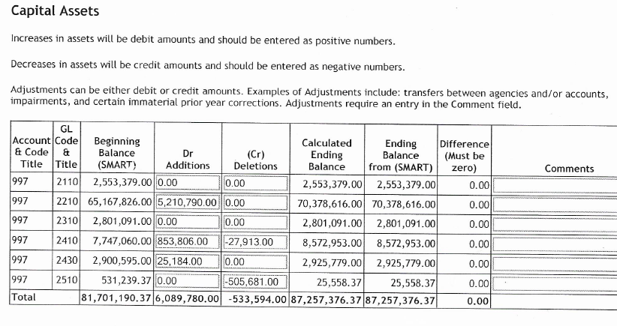

Slide 24
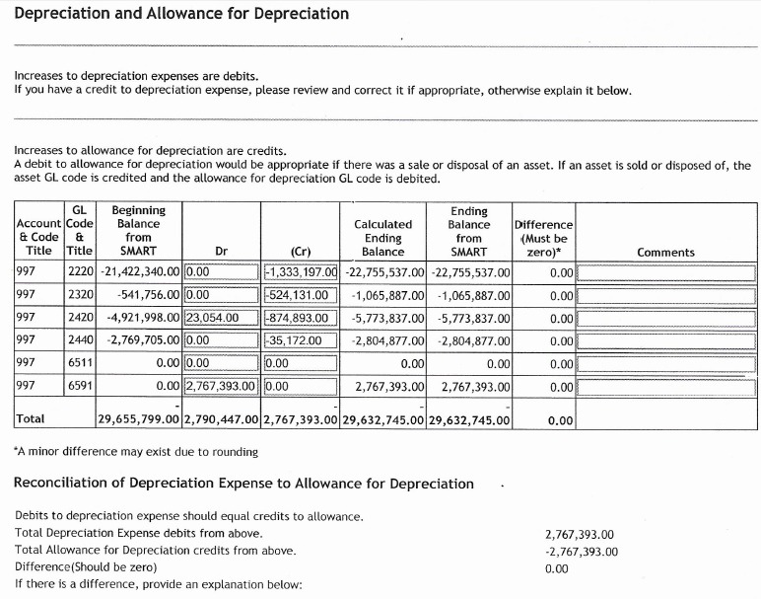

Slide 25
Questions????

