Slide 1
Vendor Payment Advance
& a couple other tidbits
Sabra Sand – Clark College, Director of Business Services
Lori Carambot – Walla Walla Community College, Director of Special Fiscal Services

Slide 2
What we are going to cover
VPA-what is it?
Initial Advance
End of the Biennium
Monthly VPA Process
Payroll
VPA errors/out of balance
VPA tracking
Operating transfers
Year end negative cash transfers
Resources

Slide 3
VPA-What is it??
The Vendor Payment Advance (VPA) is unique to the Community and Technical College system.
Since the Colleges are able to maintain their own bank accounts, we are not required to utilize the Treasurer to pay our vendors directly. VPA is used to:
  1) Provide funds up front to help with cash flow and
  2) A monthly reimbursement process when using Treasury Funds (001, 057, 060, 08A, 253 and a few others).
Setup as an initial advance, and then a monthly reimbursement process each month as the year progresses
“Advance” must be returned at the end of each biennium

Slide 4
Initial advance
For the Colleges utilizing the Advance, SBCTC provides the amount the College is authorized to draw at the beginning of each biennium.
The amount is roughly 17% of the preceding biennium’s monthly allocation
The Advance is deposited in the College’s bank account to help with its cash flow

Slide 5
Initial Advance - end of the biennium
If you are a College that requests a VPA at the beginning of each biennium you will need to request the funds from the State Treasurer and book the following entry:
New biennium Initial VPA:

Slide 6
Initial Advance – end of the biennium
If you are a College that has as advance, you must return it to the State Treasurer at the end of the biennium prior to close. Here are the entries:
Initial VPA Return from prior biennium:

Slide 7
Monthly VPA Process
As you pay bills in Accounts Payable, the trans-codes you use really are what generate your monthly VPA reimbursement request information.
In Accounts Payable, a T/C 503 is used for expenditures against state appropriated funds.
The daily job group FG001D generates the reimbursement entry needed for VPA.
It creates a matching T/C 502 entry for each 503 entry made in A/P.
The 503 entries populate the monthly GA3231 report listing out all expenditures, totaled by fund that you will need to seek reimbursement for from the State Treasurer.

Slide 8
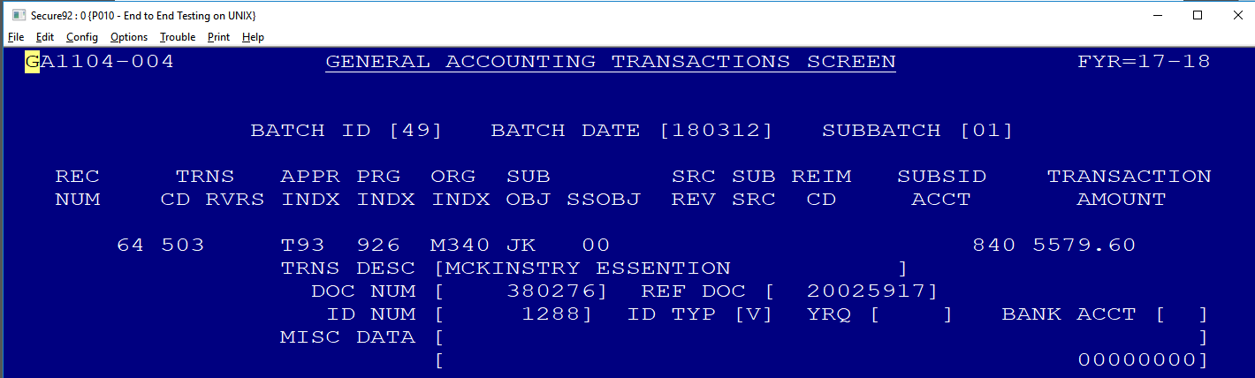
Checks written on A/P invoice screen in a state appropriated fund (BM3002) utilizing trans code 503 automatically posts as:
6505 Accrued Expenditure / 5150 Due to Fund 840 (refer to SUBSID ACCT)

Slide 9
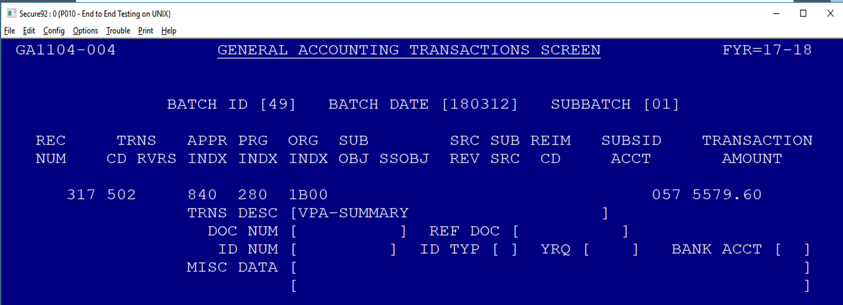
automatically post a transcode 502 for each fund used in current batch posting as:
1350 Due from xxx Fund / 1110 Local Cash
System will automatically post a transcode 502 for each fund used in current batch posting as:
1350 Due from xxx Fund / 1110 Local Cash

Slide 10
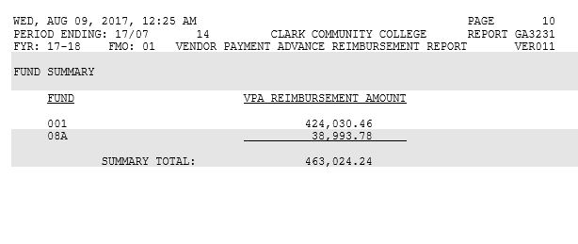
Monthly GA3231 Report-VPA

Slide 11
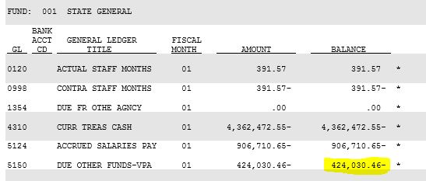
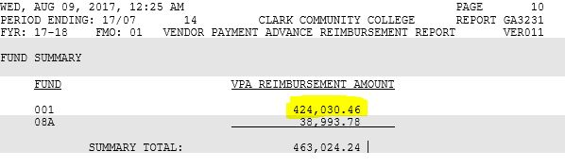
Monthly GA3231 Report-VPA – Balancing to GA1332

Slide 12
Request reimbursement from the State Treasurer
Request reimbursement for the summary total amount on the GA3231 report
Complete an A-7A form and fax to the State Treasurer’s office detailing:
  Each fund requested
  Amount requested by fund
  Debit or credit depending on whether you are requesting or sending funds back
  Signatures must be signed in full names
A-8A form if your total summary is a negative and you are returning funds

Slide 13
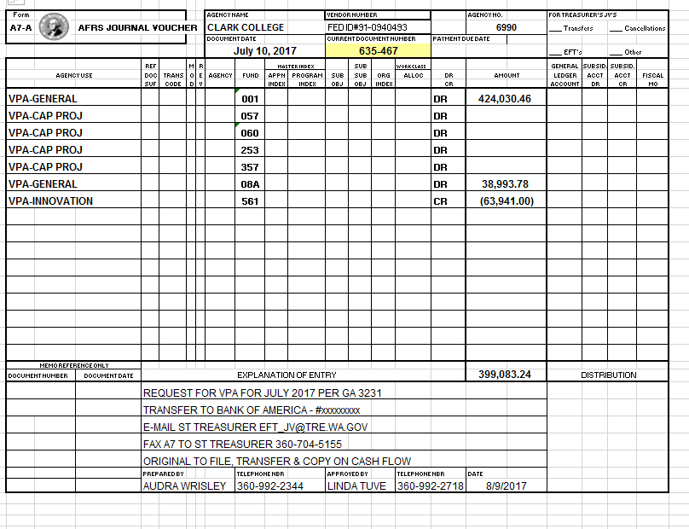
Request reimbursement from the State Treasurer

Slide 14
Monthly VPA Process
At month end, FG012M is run – monthly general ledger reporting
This job group contains a job, GA3200J
  Automatically creates the T/C 504 entries (6510/6505 and 5150/4310)
  Assumes you have requested all funds from the State Treasurer per your GA3231 report
This is one way that your GL can get out of balance if you do not request funds or send back funds as appropriate

Slide 15
A word about payroll
College’s payroll is paid out through a central payroll bank account at the State Board
When payroll is expended for state appropriated funds the State Board requests the funds from the State Treasurer on your behalf
You still need to track them, and they are automatically booked as though you received the funds
Essentially it is charged against your appropriations

Slide 16
VPA Errors / Out of Balance
If you don’t request or send back appropriate funds to the State Treasurer each month, it will create an in process out of balance
If your due to/due from’s aren’t entered correctly, you could be out of balance (1350/5150)
Try to complete all entries the day before month end
Upload your smart data the day of month end to assure you are in balance
Smart pages 404 and 405 can help identify out of balance issues
GA1409D – total funds in GL 1350 should match off the individual funds GL 5150

Slide 17
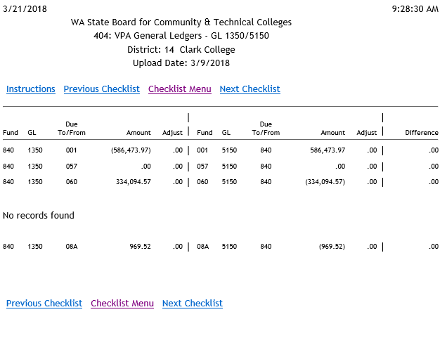

Slide 18
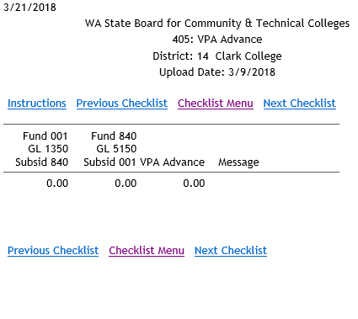

Slide 19
VPA Tracking
We worked with SAO to develop a tracking document that the auditors like to use to account for our VPA dollars on an annual basis
This helps identify any areas where it might be out of balance with the financial statements
VPA tracking and balancing can also be achieved through a cash flow document as well as various uses of downloaded information
Need to remember to account for the payroll
Need to remember to account for revolving funds, you don’t seek reimbursement for those

Slide 20
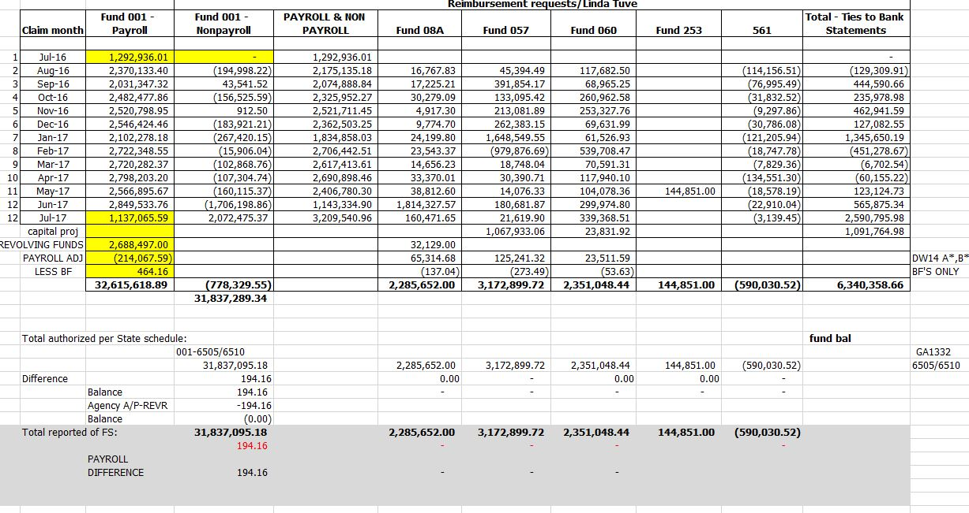
VPA Tracking

Slide 21
Things to watch for
Capital reimbursement requests can be requested when paid or as part of your month end process
Journal (GAT) adjustments – don’t forget to add the 502 entry and the correct fund source when posting to fund 840

Slide 22
Operating transfers
Operating transfers reflect one fund giving cash to another fund
Specific revenue source codes and transcodes must be used to accurately reflect these transfers
Remember to also use the due to/due from field
Smart page 401 checks for errors in operating transfers

Slide 23
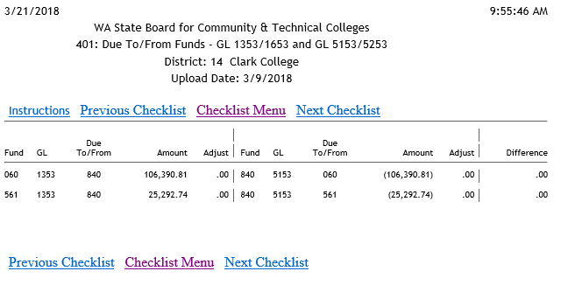

Slide 24
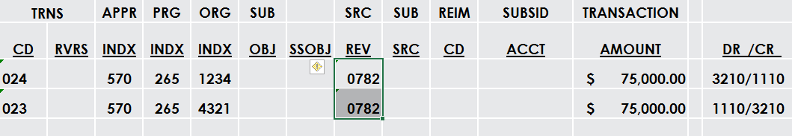
Operating transfers – within the same fund
Use revenue source code 0782 for both sides and transcodes 023 for receiver and 024 for giver
Never use 023R for operating transfers

Slide 25
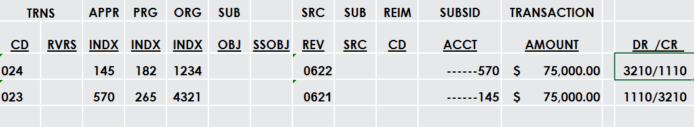
Operating transfers – different funds
For the giver use T/C 024 with source revenue code 0622
For the receiver use T/C 023 with source revenue code 0621
Don’t forget the subsidiary field for due to/due from
Never use 023R for operating transfers

Slide 26
Year end negative cash
RCW 43.88.260 states that no fund can have negative cash at the end of a biennium
The transfer of cash between funds must have the approval of the College Board or designee
Do not do negative transfers to state appropriated funds
Do temporary entries to clear up the negative cash
In the example below, Fund 850 has negative cash so we are borrowing from Fund 148
Remember to reverse the entry in the new year!

Slide 27
Vpa Resources
Fiscal Affairs Manual (FAM) 50.65 – Vendor Payment Advance https://fam.sbctc.edu/
State Administrative and Accounting Manual (SAAM) 85.74 https://www.ofm.wa.gov/sites/default/files/public/legacy/policy/85.74.htm
Vendor Payment Advance FY17 – simplified (Excel)
Vendor Payment Advance FY17 (Excel)
BAR Subject matter experts can help! https://www.sbctc.edu/colleges-staff/commissions-councils/bar/bar-subject-matter-experts-contacts.aspx

Slide 28
Questions??

