Slide 1
Accounts Payable Reports & Processes
Sylvia James
Director of Fiscal Services
Budget, Accounting & Reporting Council Conference March 2018

Slide 2
Today’s Topics
Reports: BM3100 (Invoice Extract Error Report), BM3103 (AP Check Error Report), BM3104A (Daily Check List by Check/Voucher Number), BM3104B (Daily Check List by Name), BM3105 (Pending Payment Report), BM3106 (AP Transaction Load Error Report), BM3109 (Cancellations), MM2200 (Pending Encumbrances List), BM3230A-C (Check Registers)
An Overview of the Daily Check Run Process and Additional Processes: Encumbrances, Processing a Payment with and without an Encumbrance, Manual Financial Aid Check Requests, Making Changes to Financial Aid Checks, Cancelling and Cancel/Re-issue of Checks

Slide 3
Reports: BM3100 Invoice Extract Error Report

Slide 4
Reports: BM3103 (AP Check Error Report)

Slide 5
Reports:BM3104A (Daily Check List by Check/Voucher Number), BM3104B (Daily Check List by Name)

Slide 6
Reports: BM3105 (Pending Payment Report)

Slide 7
Reports: BM3106 (AP Transaction Load Error Report), BM3109 (Cancellations)

Slide 8
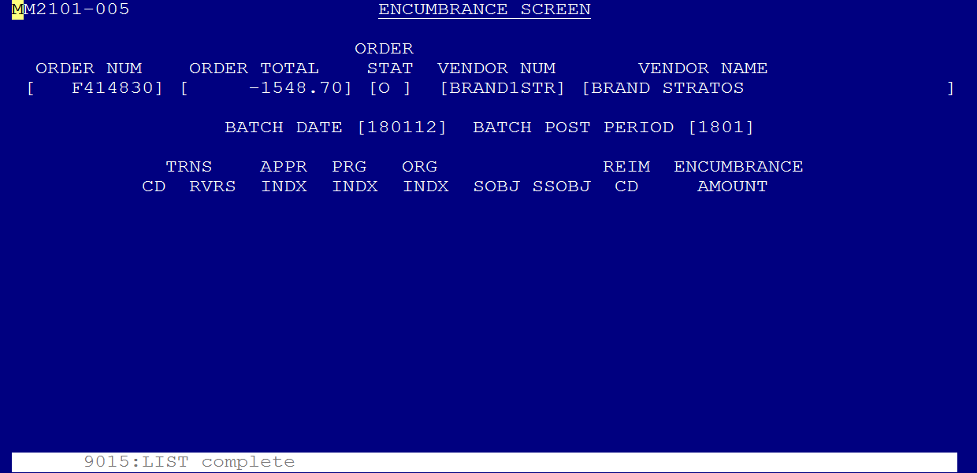
Reports: MM2200 (Pending Encumbrances List)

Slide 9
End of Month Reports: BM3230A-C (Check Registers)
All included in one file – May be utilized in balancing the Bank Statement.

Slide 10
Encumbrances (Screen MM2101)
Purchasing department will put new purchase order encumbrances in the encumbrance box. These new purchase orders will include all encumbrances, check enclosed orders, and contracts. Only encumbrance copies get encumbered into the MM2101 screen.
Before entering a new encumbrance verify that the proper budget authority has signed the purchase requisition, and that the budget code on the PO has correct coding.
TO ENCUMBER
From the System Menu enter MM2101 in the highlighted field and press the "ENTER" key.
When the Encumbrance Screen comes up enter the Purchase Order number, from the top right-hand corner of the Purchase Order, this generally begins with an F and then six numbers.
TO ADD
Press the "F2" (Add Order) key after entering the Purchase Order number.
Enter the TOTAL dollar amount of the Purchase Order in the order total box. Press the "TAB" key to move to the Vendor Number field.
Enter the Vendor ID in this field; press the "ENTER" key. The line just above the boxes on the bottom of the screen will also tell you which keys to use.
Enter the budget coding from the Field Order and the highlighted area will be in the RVS (reverse) field. To move to the next field press the "TAB" key. Enter the coding as indicated on the Field Order. The cursor will automatically move to the next field when one field is full. If you make a mistake and need to go back press the "SHIFT" and "TAB" keys at the same time, this will move the cursor back one field at a time. When you have entered all coding enter the dollar amount for that line of coding in the ENCUMBRANCE AMOUNT field. You need to put the decimal in place, but if there are no cents you don't need to put the final two zeroes. When you have entered the dollar amount press the "ENTER" key. If you have no more coding to enter press the "F6" (Order Complete) key. The line just above the boxes will say Add Complete and the screen will come up blank, ready for you to enter another Field Order. If you have more lines of coding to enter continue entering them as you did before, when you enter the last line of coding press the "ENTER" key and then the "F6" key. “F2” will copy data entered.
Date stamp with date entered on the bottom of the PO.
Continue this process until all Purchase Orders are encumbered.
To leave the Encumbrance Screen press the "F8"(Menu) key.
When you have entered all encumbrances for the day run a tape and total them to balance with reports the next day. GA1103 batch ID 40

Slide 11
Encumbrances (Screen MM2101)
TO LIQUIDATE ENCUMBRANCES
Select the Encumbrance Screen MM2101, enter the Purchase Order number in the highlighted box, and press the "F2" (Add Order) key.
Enter the dollar amount to be liquidated in the field, the dollar amount must be preceded by a minus (-) sign. Press the "TAB" key and go to the Vendor Number field.
In the VENDOR NUMBER field enter the vendor ID and then press the "ENTER" key.
The screen will come back with an area to enter coding. Enter the coding that is on the Field Order, except for the Transaction Code - do not enter. You must enter an "R" in the RVS field.
Enter the dollar amount. Do not use a minus sign. When done entering coding press the "ENTER" key and then the "F6" (Order Complete) key.
To leave the Encumbrance Screen press the "F8" (Menu) key.
To completely liquidate, hit “F2” Add then “F5” reverse order. Do a screen print before finalizing liquidation.
**NOTE**
Liquidating @ Year End
Be sure to post back to June before liquidating old year encumbrances after July 1st

Slide 12
Processing a Payment with and without an Encumbrance (Screen BM3002)
From the System Menu enter BM3002 in the highlighted field and press the "ENTER" key.
In the ID Type field type in a (V= Vendor, S= Student Id, E= Employee Id, O= other) and press the "F2" key.
Enter invoice number, date, amount of the payment, and the invoice description. Enter ‘Y” to add tax amount (if needed), add “S” to the separate check box if a separate check needs to be check vendor address and name, enter “v” as check type and press enter.
In the Use Tax Ind field an N = tax included. Y = WST REPORTED stamp. Press the "TAB" key and move to the Inv Desc field. Indicator is always set to N. You must change it to Y if use tax is indicated.
At the Inv Desc field you can enter the field order #, an account number, a description of what is being paid for, or the field can be left empty. This will appear on the check and make it easier to see what has been paid for. Press the "TAB" key and move to the Check Type field.
The following are required fields that must be filled in:
NAME
INV DATE
INV TOTAL
USE TAX IND
CHECK TYPE
ACCOUNT SCREEN will come up on the screen. The Invoice Number field will be filled in. Write the Invoice Number on the bottom of the payment document.
After following the steps to the left:
If the payment document is a Purchase Order that has been encumbered press the "F5" (Order Screen) key. In the Order Number field enter the Field Order number, including the F, then press the "F2" (Add Order) key. The cursor will be in the Liq Ind field. If this is a full payment or the final payment for the Field Order enter an F (full) in the field and press the "ENTER" key. If this is a partial payment type a P (partial) in the field and then press the "ENTER" key. Now press the "F6" (Account Screen) key to go to the Account Screen. If there is an error the Order Number field will be highlighted and the line at the bottom of the screen will tell you what the error is. The reason to enter the field order number is so that it will automatically be liquidated, when you get to the Account Screen the transactions will come up to make the liquidation. If the error says the Field Order does not exist, double check the number and if it is correct erase the number and press the "F6" key to the Account Screen.

Slide 13
Manual Financial Aid Check Requests (ScreenBM3005)
The Financial Aid Office will bring over a "FINANCIAL AID CHECK REQUEST FORM" which will contain student information
From the System Menu type BM3005 in the highlighted box and press the "ENTER" key.
When the Financial Aid Check Request Screen comes up enter the information from the Year/Quarter line on the Financial Aid Check Request Form in the YEAR/QUARTER field.
In the COLLEGE field enter 110, this is the number assigned for our college, and press the "ENTER" key.
In the ID NUMBER field enter the students SID Number.
In the NAME field enter the student name; with the last name first, then their first name. Press the "TAB" key to move to the FAPC field
In the FAPC field enter the 3-digit number from the form.
In the AMOUNT field enter the dollar amount from the form for that student. If there are no cents you can just use the decimal point and the zeroes will be automatic. If you have made a mistake in one of the fields and want to correct it press the "SHIFT" and "TAB" keys at the same time to move backwards one field at a time. Or use the mouse.
After you have entered all of the information press the "ENTER" key. When you press the "ENTER" key you can no longer go back and make corrections to a person in this screen, you need to go through another process.
In the INVOICE NUMBER field, a number will be generated by the computer. Write this number in the Invoice No. box on the request form. The number you write down will need to be used later if changes are necessary.
Continue this process until all students are entered. After getting an INVOICE NUMBER for the last student press the "F8" (Menu) key and you will return to the System Menu.
Double check your entries on the BM3002 screen checking by SID and by your entries.

Slide 14
Making Changes to Financial Aid Checks (Screen BM3002)
From the System Menu type BM3002 in the highlighted box and press the "ENTER" key.
The first AP INVOICE Screen will come up, in the INVOICE NUMBER field type in the number that is written next to the person’s name from the original input, and press the "F3" (Change) key.
The information that you entered for the invoice will come up filled in on the second AP INVOICE SCREEN. Press the "TAB" key and move to the field(s) you want to change and make corrections. If you don't need to make any changes on this screen press the "F6" (Account Screen) and go to the account screen. If you do make changes you will still need to go to the Account Screen before you can finalize corrections.
To go to the third AP INVOICE SCREEN press the "F6" (account screen). Use the "TAB" key to move to the field(s) you want to correct, and make corrections. If making corrections to the account coding when you’re done with each line press the "ENTER" key, after the "ENTER" key is pressed for that line of coding you cannot make any more changes without starting over. Continue to press the "ENTER" key, until a blank line comes up, then press the "F6" (Invoice complete) key. If you are not making any corrections to coding you must still press the "ENTER" key until you get a blank coding line before you can press the "F6" (Invoice Complete) key.
**NOTE**
After the last line of coding always press the "ENTER" key to get a blank line. This is necessary to process the transaction and to change the F6 key to Invoice Complete function.
If the invoice is out of balance you can still exit from the Account Screen and go to the first AP INVOICE SCREEN, the bottom line just above the boxes will say that there is an error and the invoice is out of balance. BE SURE AND CHECK THIS LINE AFTER EVERY DOCUMENT HAS BEEN ENTERED.
PLUS LOANS
Financial Aid will bring over or e-mail manual entries and changes for Plus Loans.
Manual entries will be added using the section “K” Manual Financial Aid Check Request
TO ADD
In the BM3002 screen enter in the students SID number and hit F6 to inquire.
Locate the invoice number for the Parent plus Loan.
On the main BM3002 screen enter in the invoice number and press F3 “Change”
Change the name and address section to the parents name and address listed on the form or in the e-mail.
Put an “S” in the box that indicates separate check.
Press the ENTER Key
Press F6 for the Account Screen
Press ENTER until all of the accounting is set
Press F6 to complete the transaction
Mail check unless otherwise directed

Slide 15
Cancelling and Cancel/Re-issue of Checks
(Screens BM3002 & BM3003)
CANCELLING A CHECK
From the Systems Menu, select BM3003 (Check screen) and press the “ENTER” Key
Enter the check number in the field and press the F3 (Cancel).
Verify that you have entered the correct check number by checking the Vendor name and check amount. Press F1 (Refresh) if you made an error.
Press "F3" (Cancel) key to confirm
The bottom of the screen will say "Cancel Complete", press "F8" to return to the System Menu.
Add cancelled check to the Cancelled Check Spreadsheet located on the S Finance Drive in the Accounts Payable folder.
CANCELLING & RE-ISSUE OF A CHECK
From the System Menu, select BM3003 (Check screen)
Enter the check number in the field and press the F2 (Cancel/reissue).
Verify that you have entered the correct check number by checking the Vendor name and check amount. Press F1 (Refresh) if you made an error.
Press "F2" (Cancel/Reissue) key to confirm
The bottom of the screen will say "Cancel/Reissue Complete", press "F8" to return to the System Menu.
Return to BM3002
Enter the Id and Id type and press F6 to find the system generated invoice number. Once you have found that press “F6” to return to the beginning BM3002 screen.
Enter computer generated invoice in far right hand box, hit “F3” (change)
Make necessary changes on screen 1; hit “F6” to go to screen 2.
Make changes if necessary, hit enter then “F6”, invoice complete
Add cancelled check to the Cancelled Check Spreadsheet located on the S Finance Drive in the Accounts Payable folder.
(Credit memo’s can be added at this point. Follow prompts)
Press the "ENTER" key. If there are no errors listed at the prompt on the bottom of the screen press the "F5" Invoice Screen, then F4 Check Screen

