Slide 1
BOARD REPORTS
SUE WILLIS, EXECUTIVE DIRECTOR BUDGET AND FINANCE, WWCC

Slide 2
Reports
Colleges should develop reports that give Boards and management valued financial information.
All financial reports are just a look at what is happening at a specific time: Day, Month, Year
Some of the reports that are produced for Boards and staff include the following:
Operating board report
Grant & Contract Report
Capital Report
Adjunct Report
Year to Date Report
Enrollment/Instructional Salary Cost Analysis

Slide 3
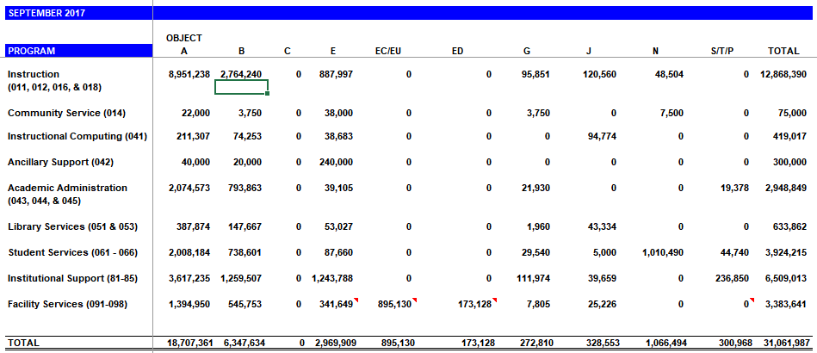
OPERATING BOARD REPORT
The operating board report is produced by using several standard FMS reports:
GA3233 for State Allocation
BA1203 for Budget and Expenditure
BA1201, BA1202 and the BA1204 for Revenue
By using the BA1203 report we are able to combine information to ensure that the budget is balanced and get information collapsed by object and functional classification.

Slide 4
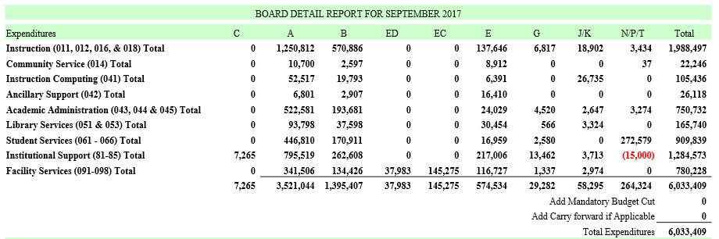
OPERATING BOARD REPORT
By using the BA1203 report we are able to combine expenditure information collapsed by object and functional classification.

Slide 5
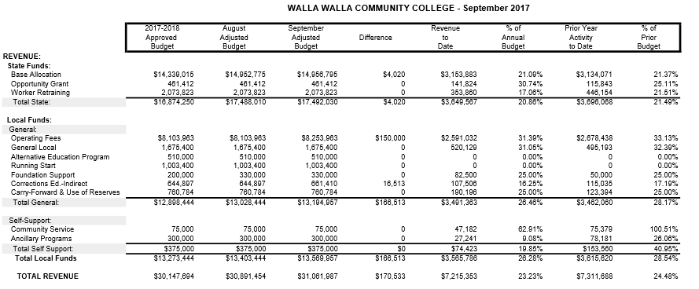
OPERATING BOARD REPORT
This is an example of an official board report for WWCC.

Slide 6
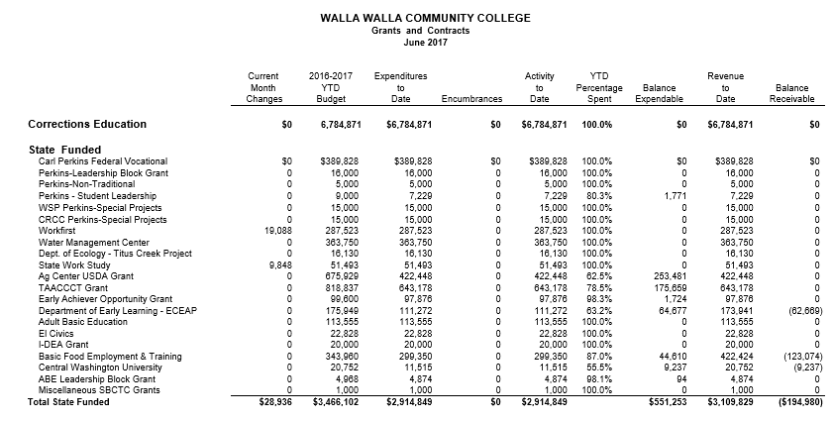
GRANT AND CONTRACT BOARD REPORT
The Grant & Contract Board report is sorted by Corrections Education, State, Federal, Private and Fiscal Agent Contracts. WWCC uses the PM1201 to create this report by sorting documents and combining information on the report.

Slide 7
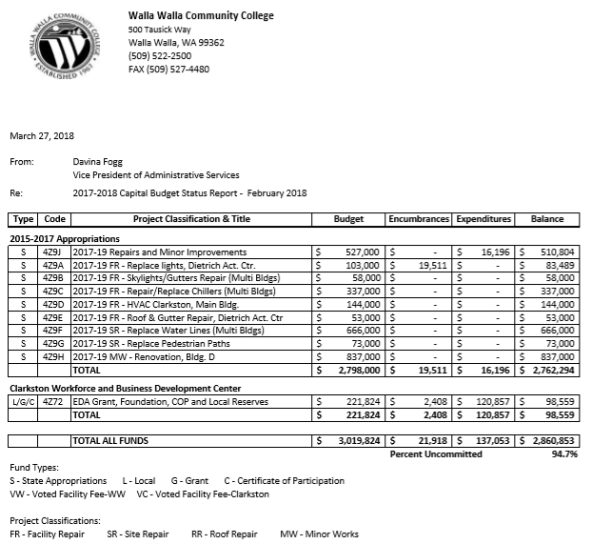
CAPITAL BUDGET REPORT
The Capital board report is a high level roll up of current capital projects that include State and local funding.

Slide 8
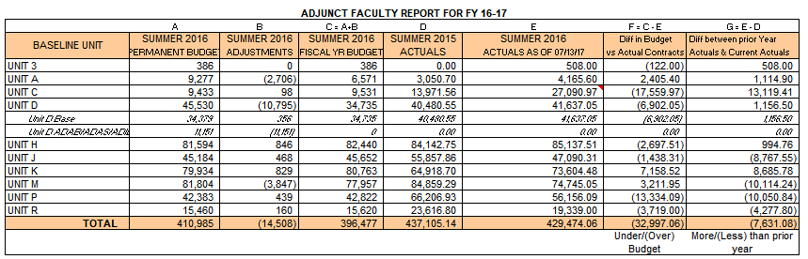
ADJUNCT FACULTY REPORT
The adjunct faculty report was created for instructional managers to track how they were managing their adjunct funding pots. Managers get a quick view of adjunct salary costs by quarter, a cost comparison of the prior year, temporary budget adjustments and a quick projection of annual costs.

Slide 9
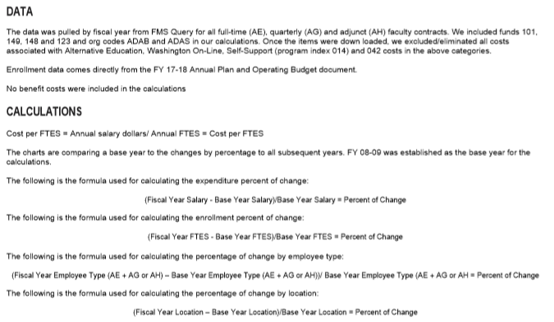
TREND REPORT
The Enrollment/Instructional trend report was created to compare current enrollment and instructional costs to the same point in time.

Slide 10
COMMON BUDGET REPORTS USED BY WWCC
These commonly used reports normally do not contain Grant & Contract/Capital transactions
BA1201 – Budget Status Report
BA1202 – Budget Status Report District by Division (This is organized by the second digit of the Org Index and usually does not include Grant and Contract/Capital accounts in the reports.)
BA1203 – Budget Status Report District by Program
These reports contain information on all accounts
BA1209 - Budget Change Register by Program Index and Organization Index
BA1210 – Budget Change Register by Revision Number
BA1211 – Salary and Wage Expenditure Report
GA2103 – Detail Revenue Report (This is for the month)
GA3230 – Detail Expenditure Report (This is for the month)
PS1120 – Payroll Processing Transaction List
These reports only contain Grant & Contract/Capital information
PM1201 - Budget Status Report - Grant & Contract/Capital Projects

Slide 11
Questions?
Thank You!

