Slide 1
REPORTS & PROCESSES: Loading Allocations, Monitoring Allocations, Loading Budgets
SUE WILLIS, EXECUTIVE DIRECTOR BUDGET AND FINANCE, WWCC

Slide 2
BUILDING THE OPERATING BUDGET
Create Excel Workbooks
Summary Workbook
Differences Workbook
Individual Unit Budget Workbooks
Alternatively, get a high-level roll up
Balance to the revenue page

Slide 3
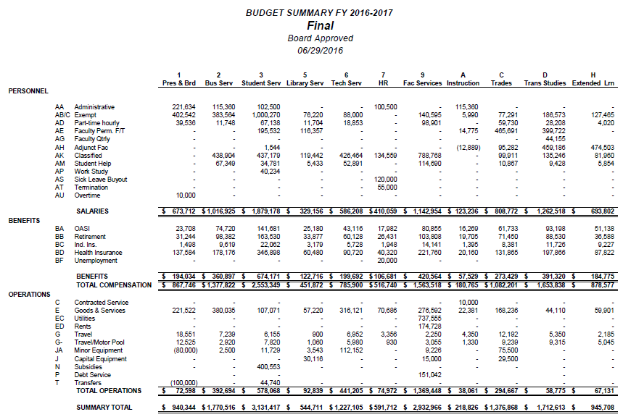
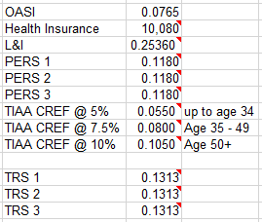
SUMMARY WORKBOOK
Shows budget totals for each unit on one page
Contains the current rates for healthcare, retirement, L&I, and OASI to feed out to the formulas in the individual unit budget workbooks

Slide 4
DIFFERENCES WORKBOOK
High-level change summaries
Per-unit summaries

Slide 5
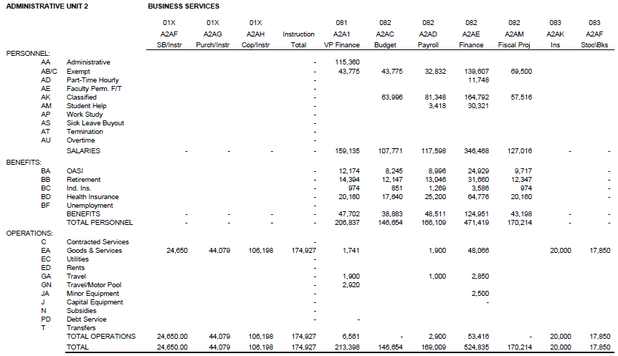
UNIT BUDGET WORKBOOKS
Unit Budget Overview (by Prog, Org)

Slide 6
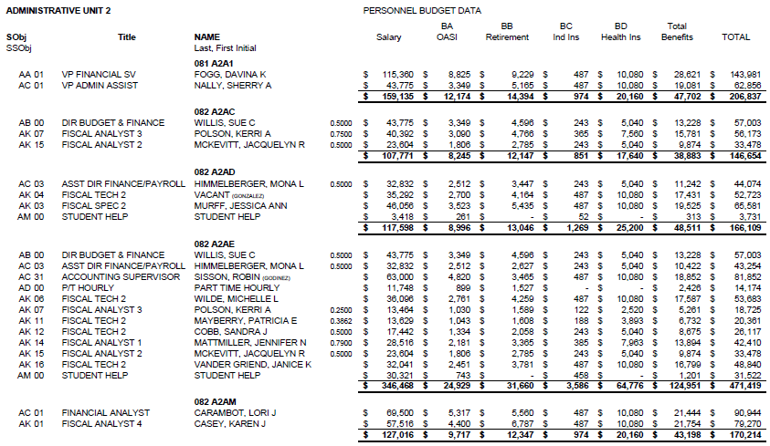
UNIT BUDGET WORKBOOKS (continued)
Salaries and Benefits (by Prog, Org)

Slide 7
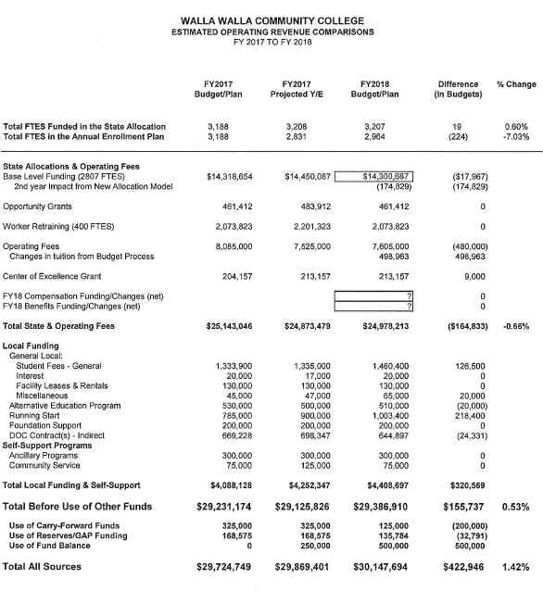
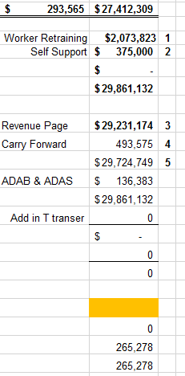
BALANCE THE BUDGET

Slide 8
LOADING THE OPERATING BUDGET
WWCC begins with step 7 of Budget Initialization
Run FG025R (Initialization Phase I)
Run BA1302J (Initialization Phase II)
Leaves report descriptions as they were

Slide 9
BUILDING THE BUDGET INITIALIZATION TABLES Budget Initialization Step 7
Use BA1003 to build the Budget Initialization Table by Fund
Note: the terminal must be accessing the current fiscal year
Budget Initialization Table by Fund is a required table that determines the budget records brought forward into the new fiscal year
Budget records are brought forward only for those funds you entered on BA1003
This screen also defines whether a fund’s budget amounts are brought forward at the permanent (permanent budget amounts) or at zero amounts
Define the initialization options as follows: 0 (zero) = Bring budget amounts forward as zero, Blank = Bring budget amounts forward at the permanent level

Slide 10
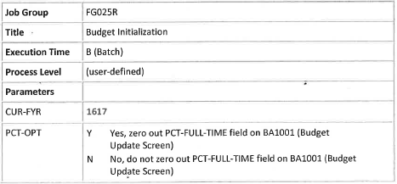
INITIALIZE THE BUDGET, PHASE I Budget Initialization Step 8
Schedule job group FG025R - produces a report of budget records not brought forward
Budget records will not be brought forward if one of the following conditions exist:
Budget Status value on BA1001 (Budget update screen) is not “A” (active)
Project Status value on PM1001 (Grant/Contract Control Table) or PM1002 (Capital Project Control Table) is not “A” (active)
End Date on PM1001 or actual completion date on PM1002 is equal to or prior to June 30th of the current fiscal year
Fund is not listed on BA1003
Schedule FG025R as often as necessary – until no records are bypassed - before running job BA1302J (Phase II)
To Schedule FG025R

Slide 11
INITIALIZE THE BUDGET, PHASE II Budget Initialization Step 9
Schedule job group BA1302J – loads the file created in FG025R into the budget database for online access
New year annual budget reports can be scheduled once BA1302J has completed
To access the new year information in BA1001, the terminal must be set to the new fiscal year
If changes are made to the old fiscal year budget file that apply to the new year, both budget year files need to be updated
To Schedule BA1302J

Slide 12
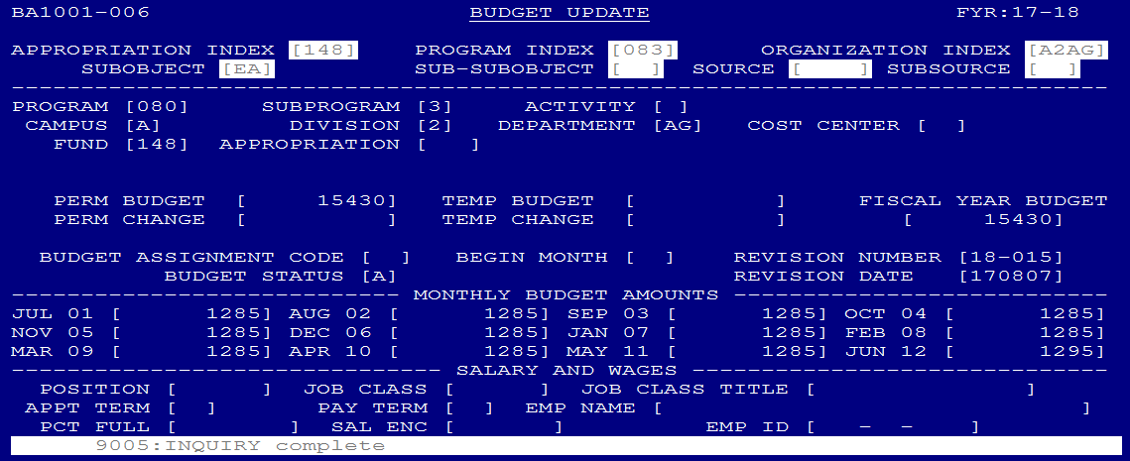
NUMBERING AND KEYING THE BUDGET
The board approved operating budget is hand-keyed in the permanent budget field of the BA1001 screen
Each entry is numbered with the budget year preceeding ( 18-001, 18-002, 18-003….)
Unique numbers are tracked on a shared list and crossed off as used

Slide 13
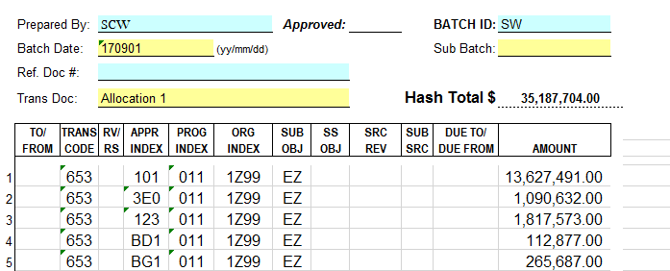
ALLOCATION LOADING

Slide 14
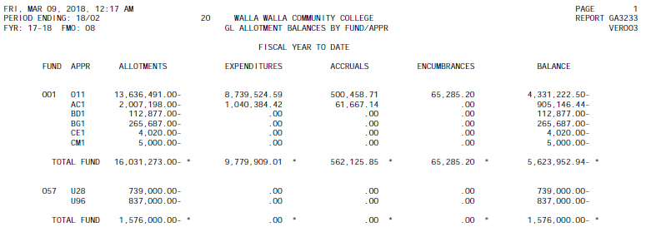
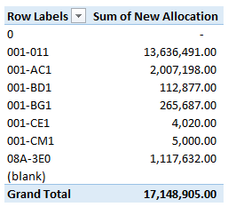
BALANCE GA3233 REPORT TO SBCTC

Slide 15
COMMON BUDGET REPORTS USED BY WWCC
These commonly used reports normally do not contain Grant & Contract/Capital transactions
BA1201 – Budget Status Report
BA1202 – Budget Status Report District by Division (This is organized by the second digit of the Org Index and usually does not include Grant and Contract/Capital accounts in the reports.)
BA1203 – Budget Status Report District by Program
These reports contain information on all accounts
BA1209 - Budget Change Register by Program Index and Organization Index
BA1210 – Budget Change Register by Revision Number
BA1211 – Salary and Wage Expenditure Report
GA2103 – Detail Revenue Report (This is for the month)
GA3230 – Detail Expenditure Report (This is for the month)
PS1120 – Payroll Processing Transaction List
These reports only contain Grant & Contract/Capital information
PM1201 - Budget Status Report - Grant & Contract/Capital Projects

Slide 16
Questions?
Thank You!

