Slide 1
BUDGET REVISIONS, VACANCY SAVINGS, AND ONE-TIME SPENDING
SUE WILLIS, EXECUTIVE DIRECTOR BUDGET AND FINANCE, WWCC

Slide 2
AFTER THE PERMANENT BUDGET
The permanent budget is only a starting point in time and changes are in the works even before it has been officially entered into the system.
For all non-grant and contract/capital budgets in the FMS system, WWCC processes all changes after the official board adopted budget in temporary budget change field of the BA1001.
Grant and contract/capital revisions are processed in the BA1001 screen as negative entries.

Slide 3
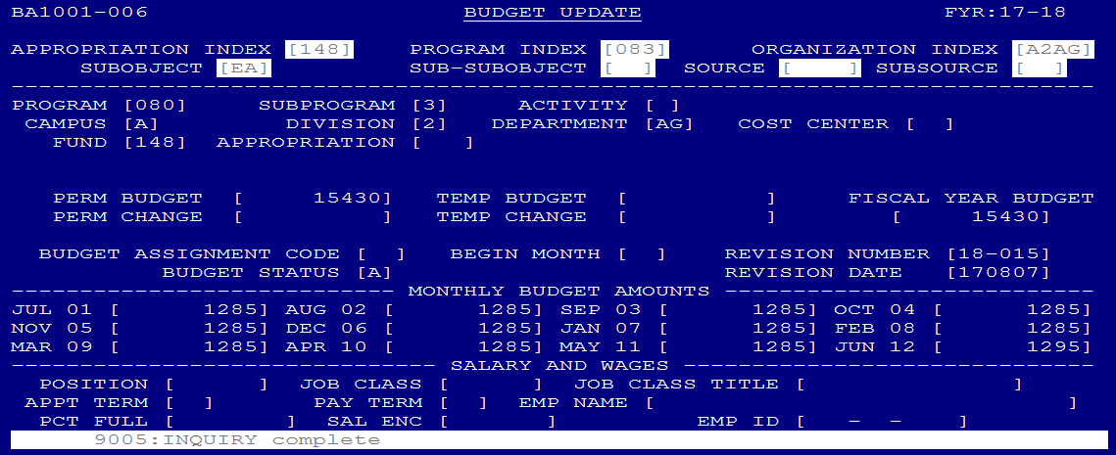
NUMBERING AND BUDGET REVISIONS
Budget revisions are keyed in the temporary budget field in the BA1001 screen
Each entry is numbered with the budget year preceeding (18-001, 18-002, 18-003….)
Unique numbers are tracked on a shared list and crossed off as used

Slide 4
SWEEPING SALARIES AND SALARY SAVINGS
Salary savings come from turn-over of personnel
Items that are considered when sweeping takes place
The increase or decrease between vacating personnel and new hirer
The increase or decrease when a full-time faculty position is covered with adjunct faculty
Sabbatical costs, and the increased cost of coverage
Coverage for release time
Leave without pay
Other considerations that are charged to the sweep pot include:
Part-time hourly costs for non-instructional positions
Advertising and recruitment costs

Slide 5
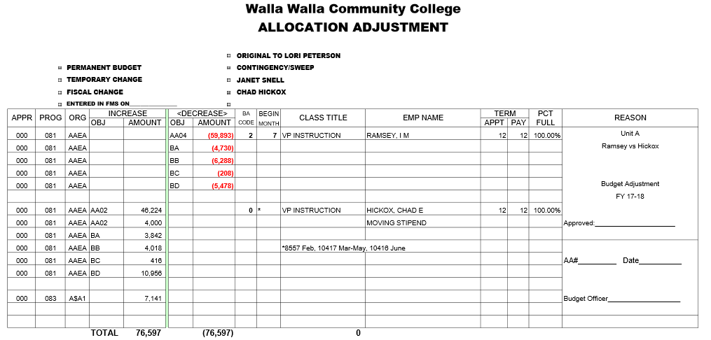
DEPARTING EMPLOYEE VS NEW HIRE
Calculate the difference between the two employees.
1. Sweep the departing employee’s remaining budget
2. Add the new employee to the budget

Slide 6
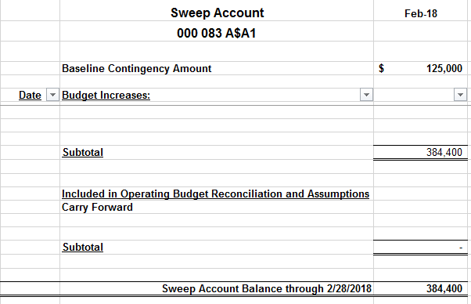
TRACKING SWEEP ACTIVITY
Changes to the sweep account are tracked on a spreadsheet, and copies of the allocation adjustments are kept in a folder for review each month. Sweep balance should tie to the BA1201 report. If balance does not match, BA1209 can be utilized to determine which adjustments are missing.
This is a local college process and not all colleges may have a sweep account

Slide 7
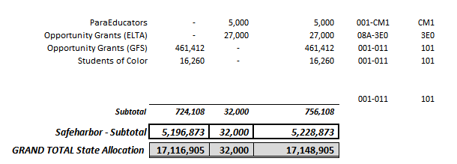
INCREASING ALLOCATION MID-YEAR
State Board can send changes that will either increase/decrease the State allocations mid-year.
Determine the effect on the your allocation
For WWCC, if it’s a decrease not associated with a specific program, we will decrease our sweep account to offset the change in funding
Use the standard process of increase/decrease the budget in the BA1001 screen with an offsetting 653 entry to the GA3233 in the GA1103 screen.

Slide 8
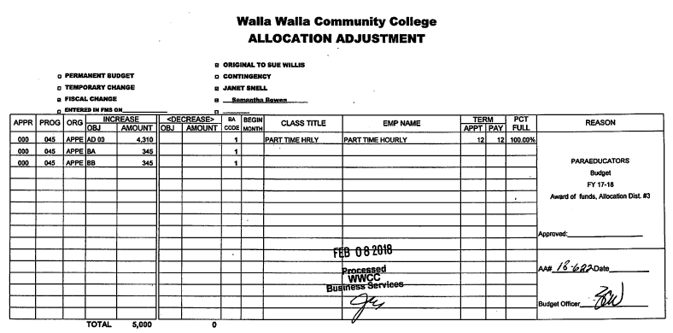
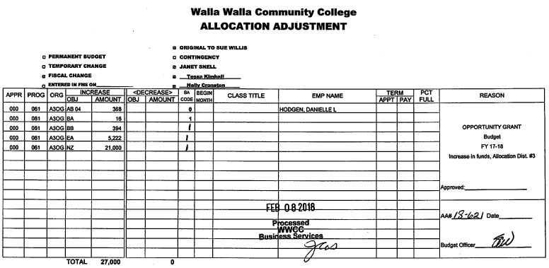
INCREASING ALLOCATION MID-YEAR

Slide 9
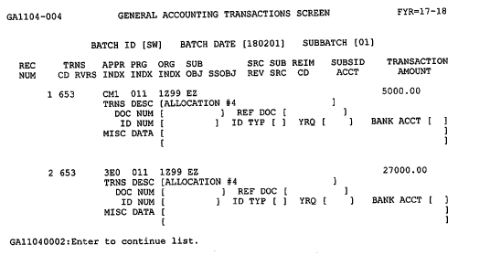

Slide 10
ONE TIME SPENDING
For WWCC, one time spending is often funded from the Sweep Account or the President’s Contingency
Both accounts are tracked and reconciled monthly by spreadsheets and balance to the official FMS report of the BA1201.
Budget is moved from the sweep or contingency account to the appropriate account that will be purchasing the one-time item by adjusting the temporary budget on the BA1201.

Slide 11
COMMON BUDGET REPORTS USED BY WWCC
These commonly used reports normally do not contain Grant & Contract/Capital transactions
BA1201 – Budget Status Report
BA1202 – Budget Status Report District by Division (This is organized by the second digit of the Org Index and usually does not include Grant and Contract/Capital accounts in the reports.)
BA1203 – Budget Status Report District by Program
These reports contain information on all accounts
BA1209 - Budget Change Register by Program Index and Organization Index
BA1210 – Budget Change Register by Revision Number
BA1211 – Salary and Wage Expenditure Report
GA2103 – Detail Revenue Report (This is for the month)
GA3230 – Detail Expenditure Report (This is for the month)
PS1120 – Payroll Processing Transaction List
These reports only contain Grant & Contract/Capital information
PM1201 - Budget Status Report - Grant & Contract/Capital Projects

Slide 12
Questions?
Thank You!

