Slide 1
Capital coa set up

Slide 2
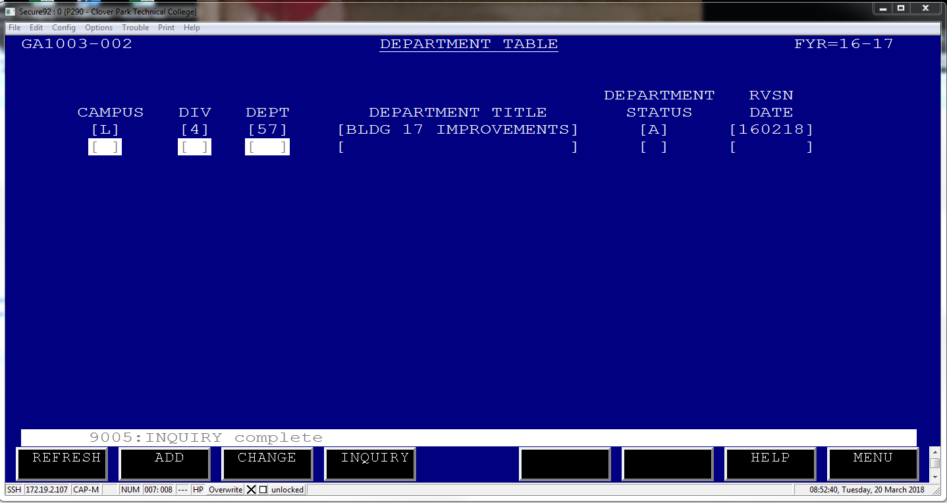
Coa Table setup for capital projects
GA1003 – Department Table
This does not have to be the same as the project
number

Slide 3
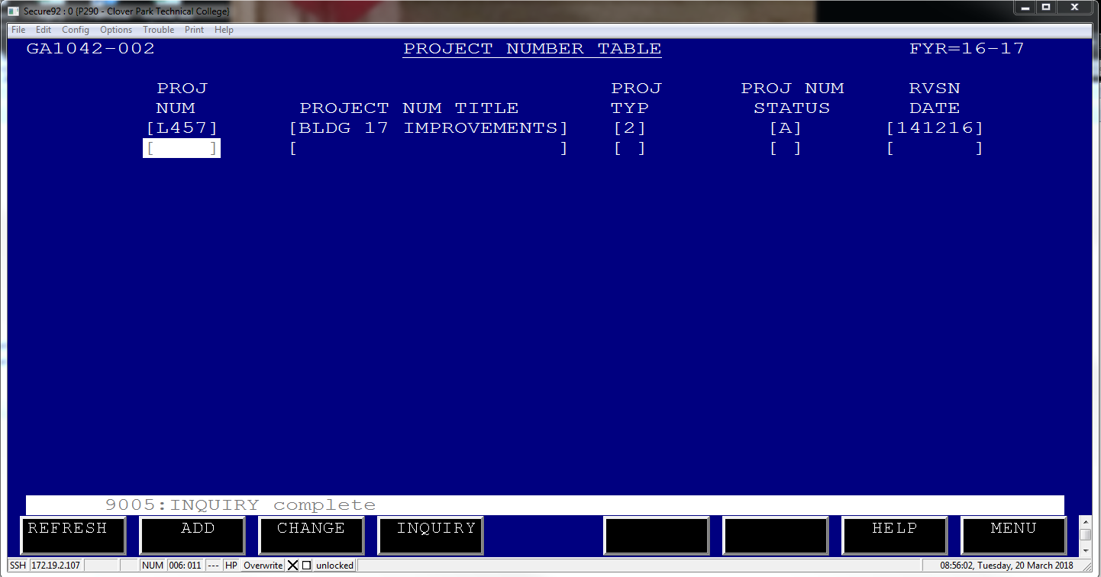
GA1042 – Project Number Table
This does have to be the same as the project
number

Slide 4
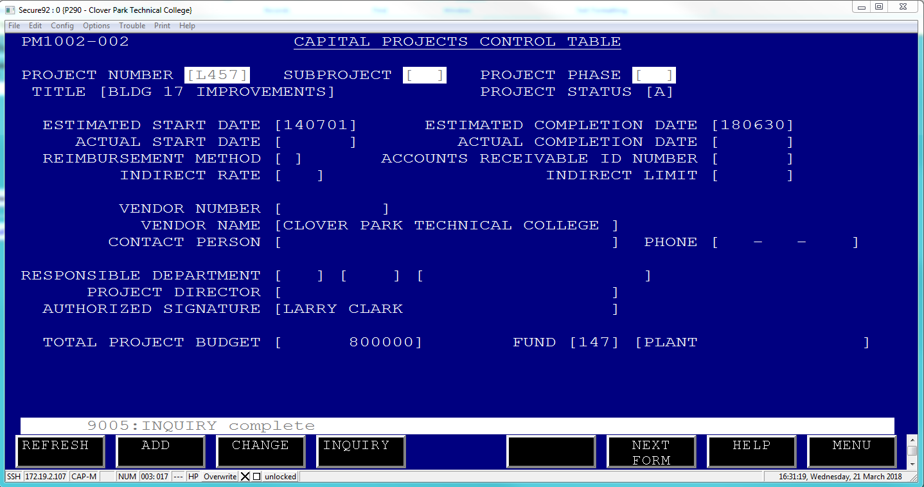
PM1002 – Capital Projects Control Table
This ties your project number to funding source.

Slide 5
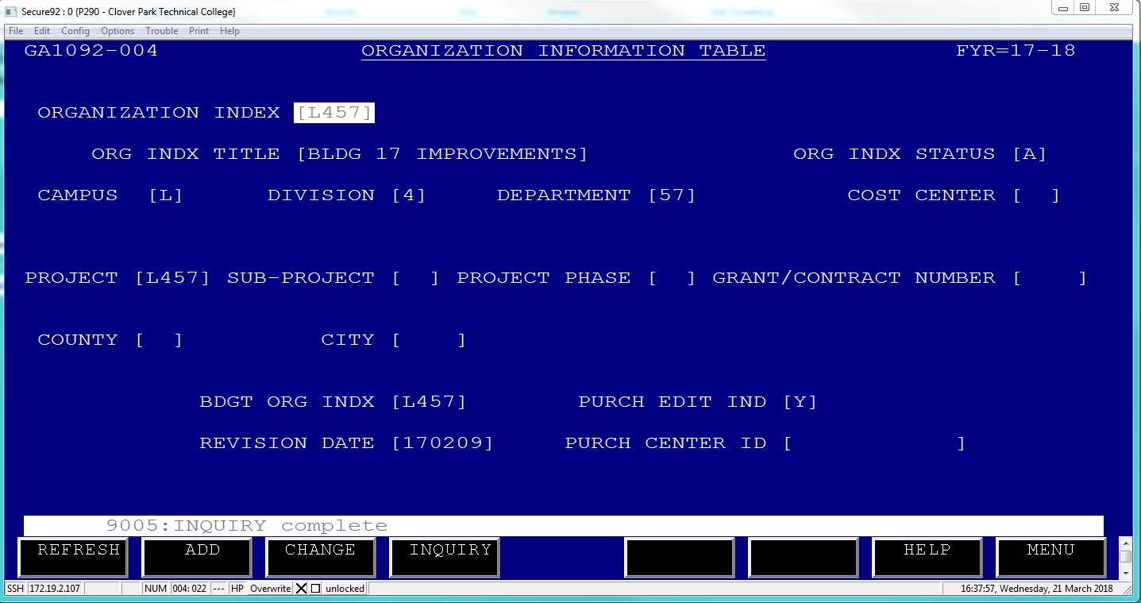
GA1092 – Organization Table
This table allows you to tie the project, sub- project and phase number to your org code

Slide 6
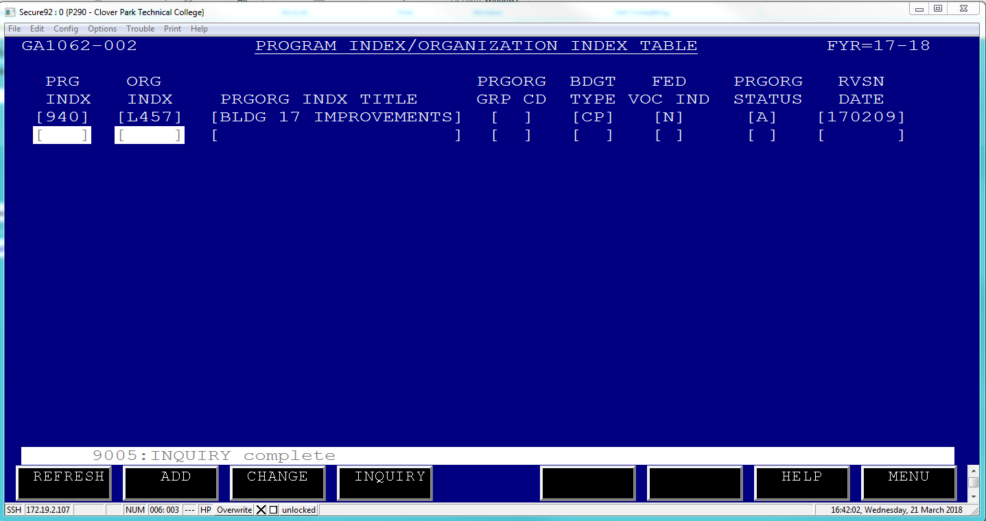
GA1062 – Program Index/Org Index Table
This table allows you to identify what type of account this is. Whether it’s a grant (GC), Capital Project (CP) of general ops. You can also indicated whether it’s federal vocational funding.

