Slide 1
Reports & Processes
Loading Allocations, Monitoring Allocations and Loading Budgets
Back to Basics CS1

Slide 2
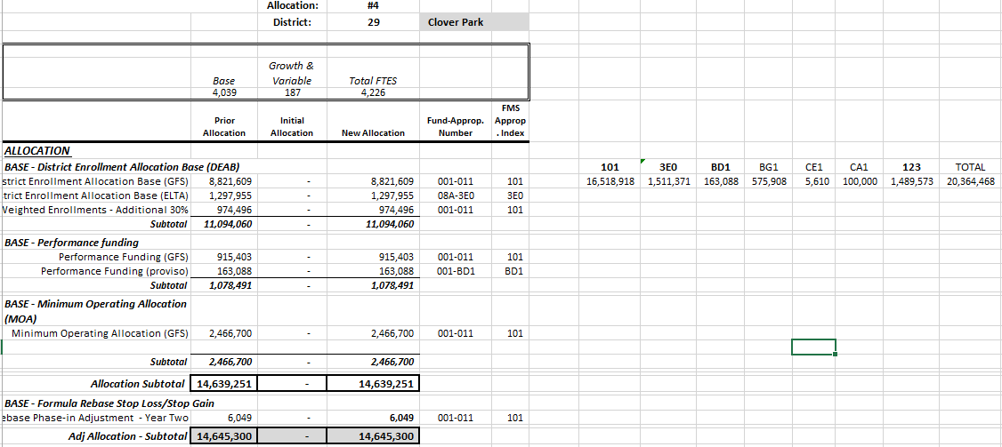
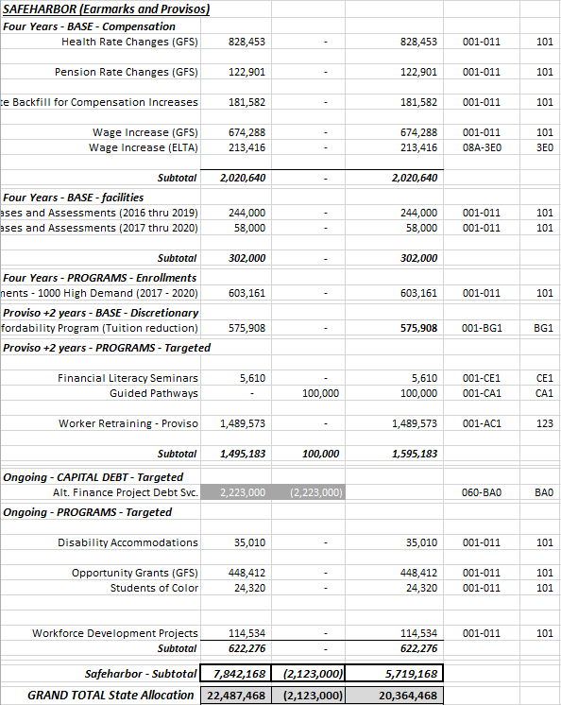
Loading Allocations:
State Allocation Schedule

Slide 3
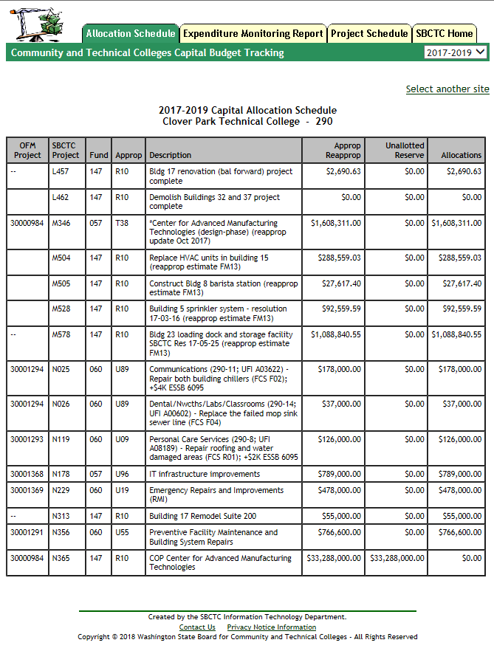
2. Capital Allotment Schedule

Slide 4
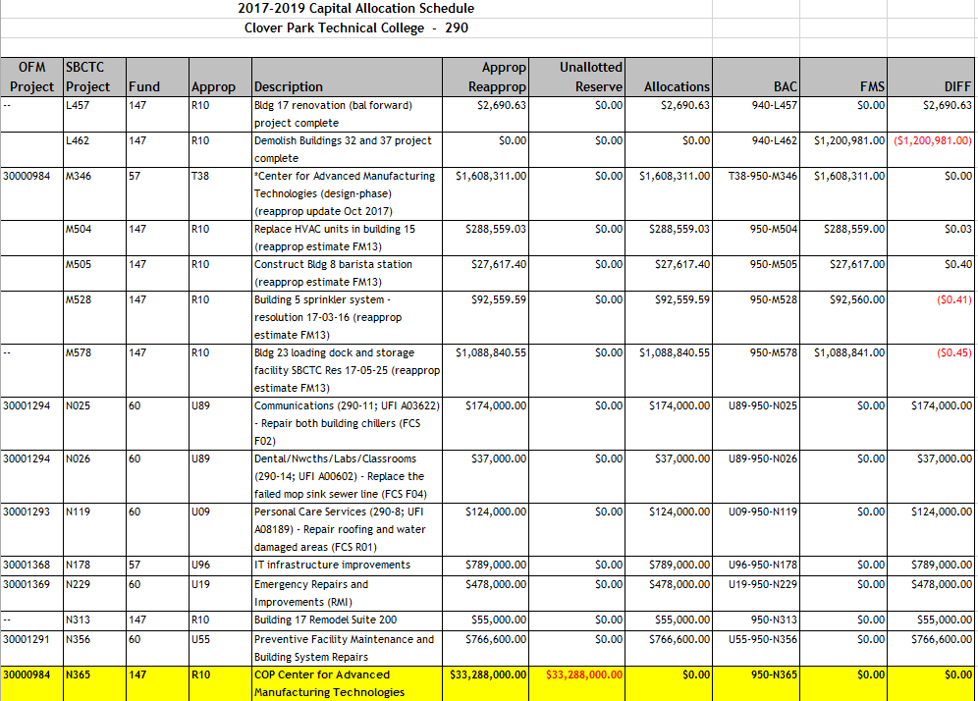
2. Capital Allotment Schedule (Continued)

Slide 5
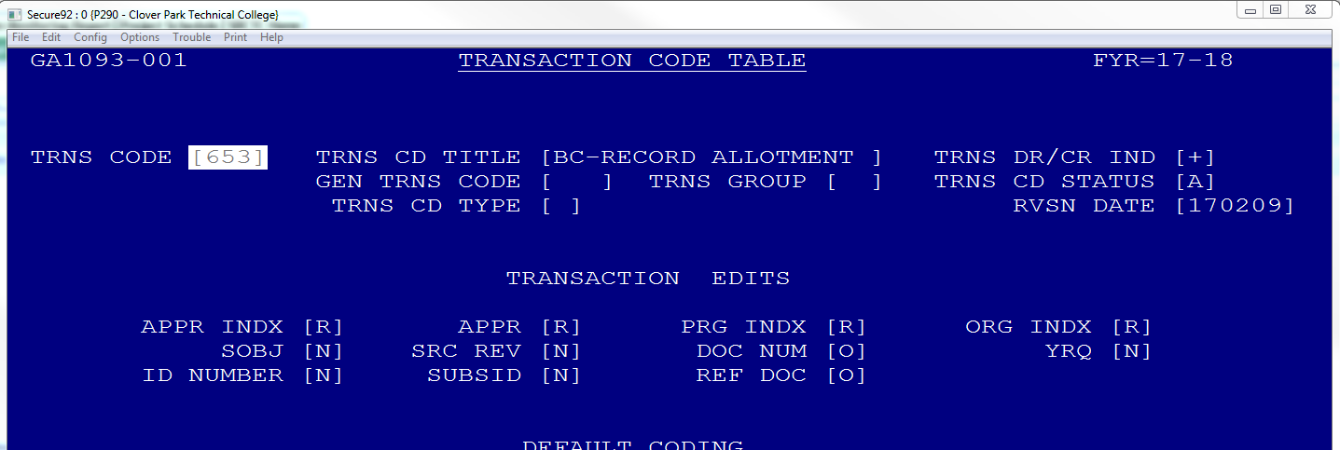
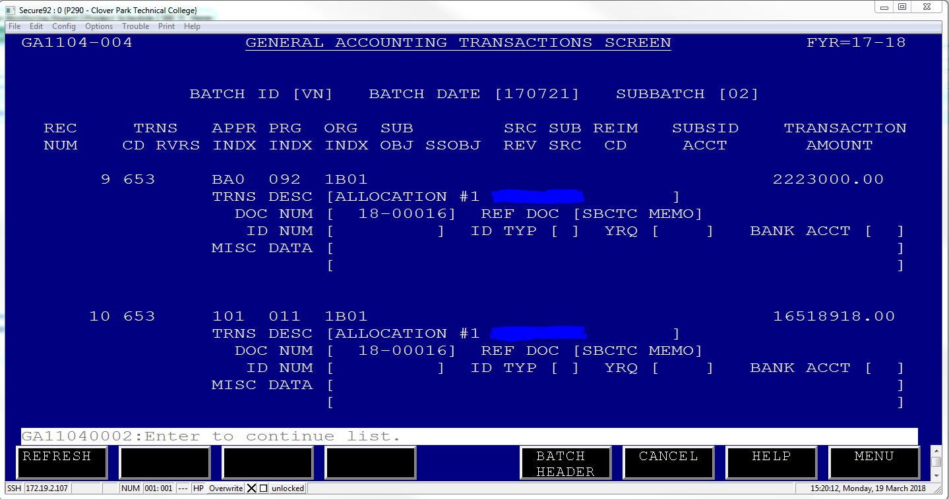
3. Allocation ledger entry
a. Trans Code 653 (9100/6210)
b. Appropriation index
c. Program index
d. Organizational index
e. Sub-Object (if required in the GA1093)

Slide 6
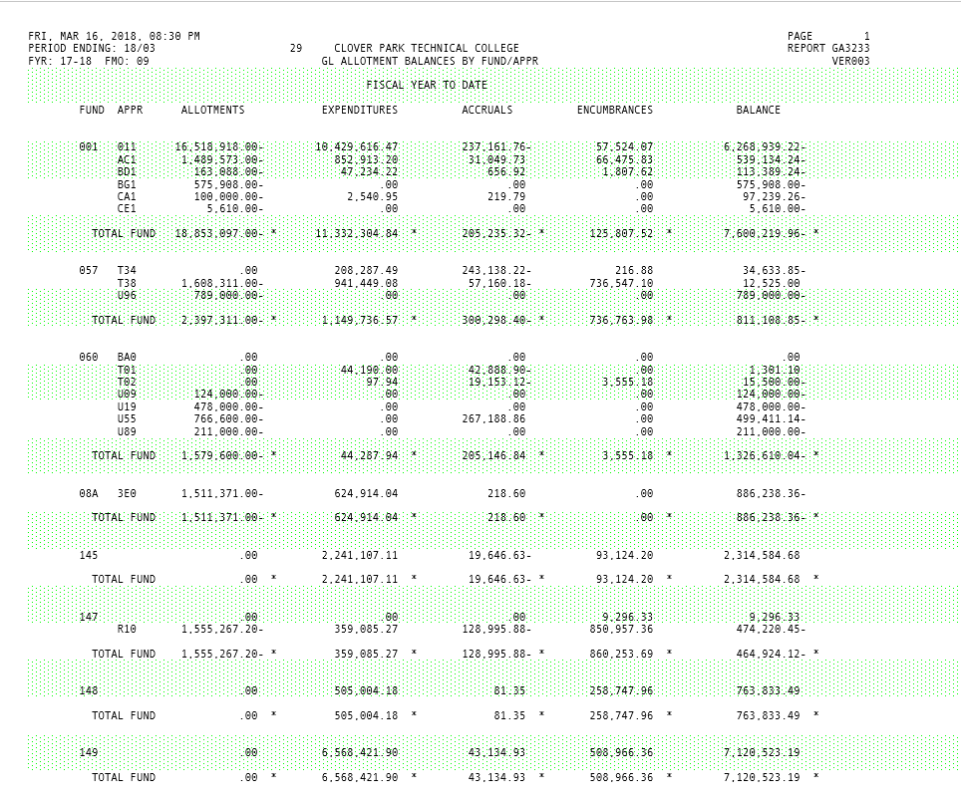
Monitoring Allocations
GA3233 – Allotment Balances by Fund/Appropriation

Slide 7
Loading budgets
FMS Budget Development Module
Excel Upload
Manual Entry in the BA1001
* This recognizes that we each have our own elaborate spreadsheets to develop our budgets
Budget Development Module:
* Several jobs are ran to extract the data for the columns

Slide 8
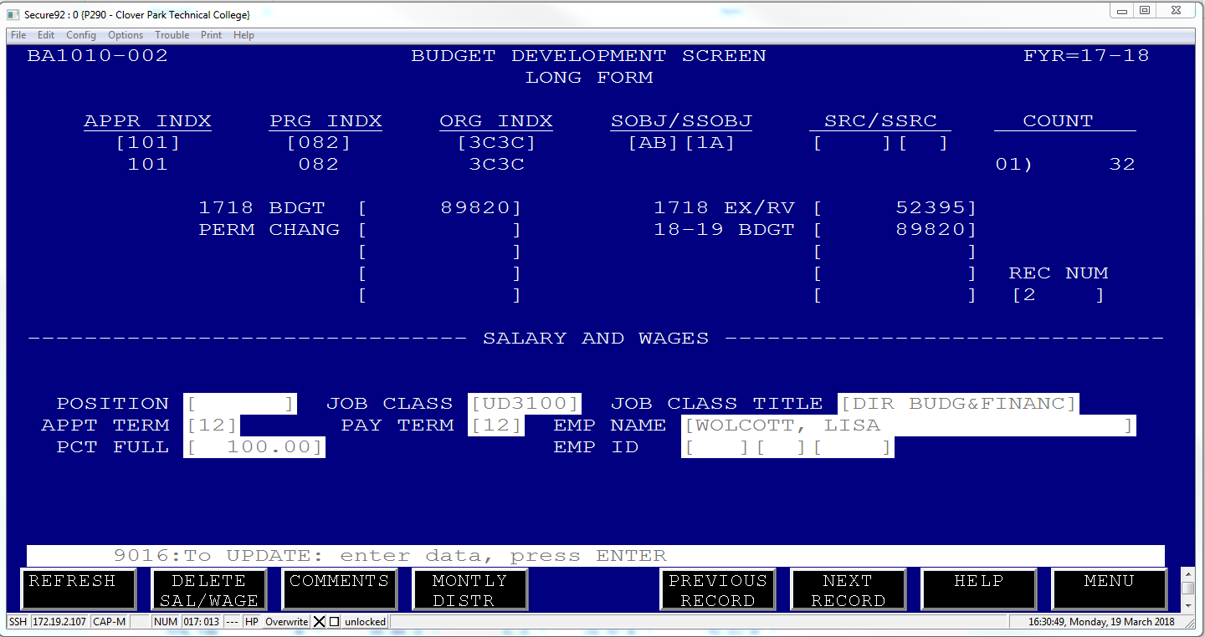
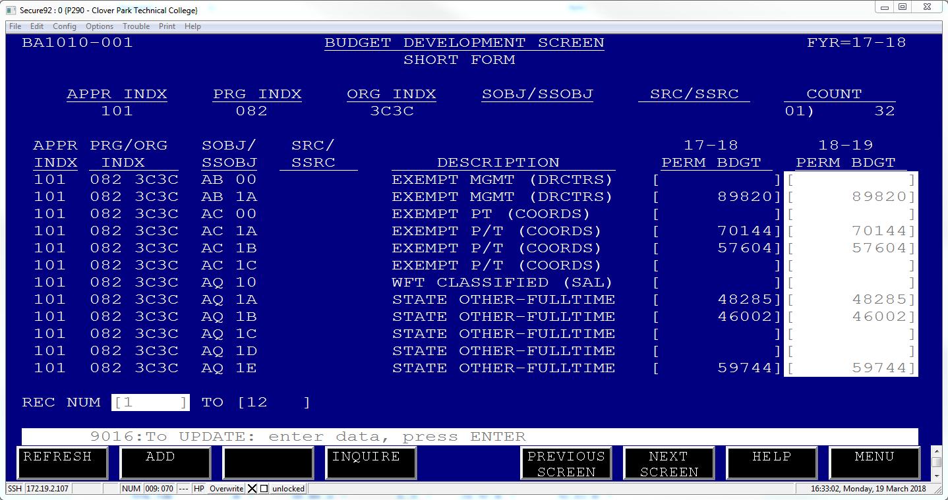
GA1010-Budget Development Screen
Long Form
Short Form

Slide 9
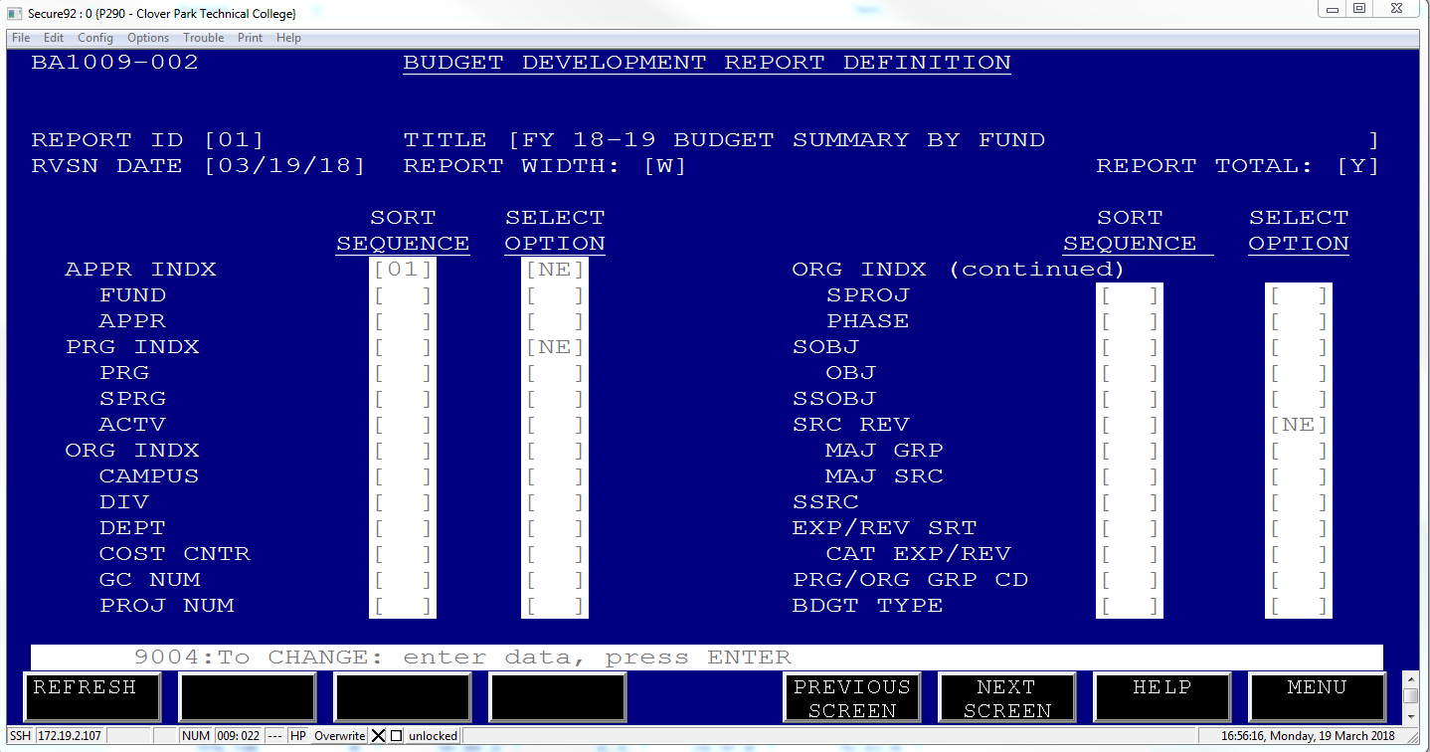
Using the BA1009 Report Writer you can easily check balances at all levels.
Once budget is developed
Run the BA1312J to create the file
BA1313J to upload to the BA1001
BA1290J to upload to the BA1005

