Slide 1
Budget Revisions
Salary Savings one-time spending
Back to Basics CS5

Slide 2
Budget revisions:
Change in the State Allocation Schedule
  Base change
  Variable or Temp
Capital Project Changes
  Increase in funding
  Project completed
  Re-Appropriation Corrections
New Grant or Grant Funding Changes
4. New Program
5. Temporary use of funds
  Salary Savings
  Unforeseen FY Expenses
  One-Time Funding
  Pooled Account Distributions
    Adjunct Faculty
    Unemployment
    Increments
    Buyouts

Slide 3
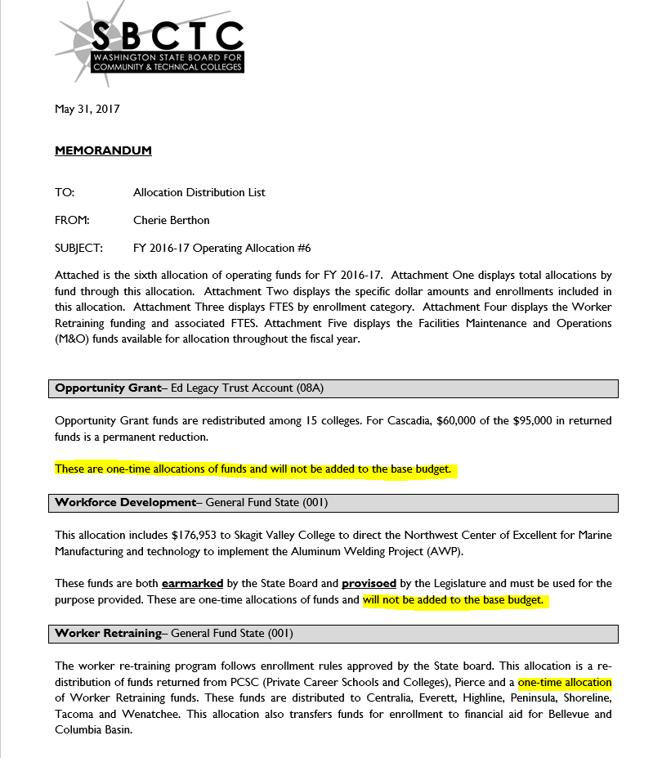
Change in the Allocation Schedule
  Base vs Variable
    This will require both the GL entry and a budget revision

Slide 4
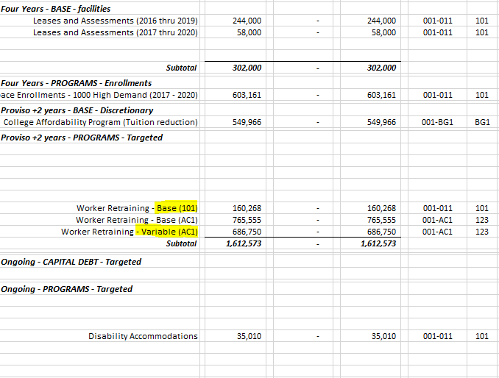
Change in the Allocation Schedule
  Base vs Variable
    This will require both the GL entry and a budget revision
Base changes should be entered as Permanent Budgets
Variable changes should be entered as Temporary

Slide 5
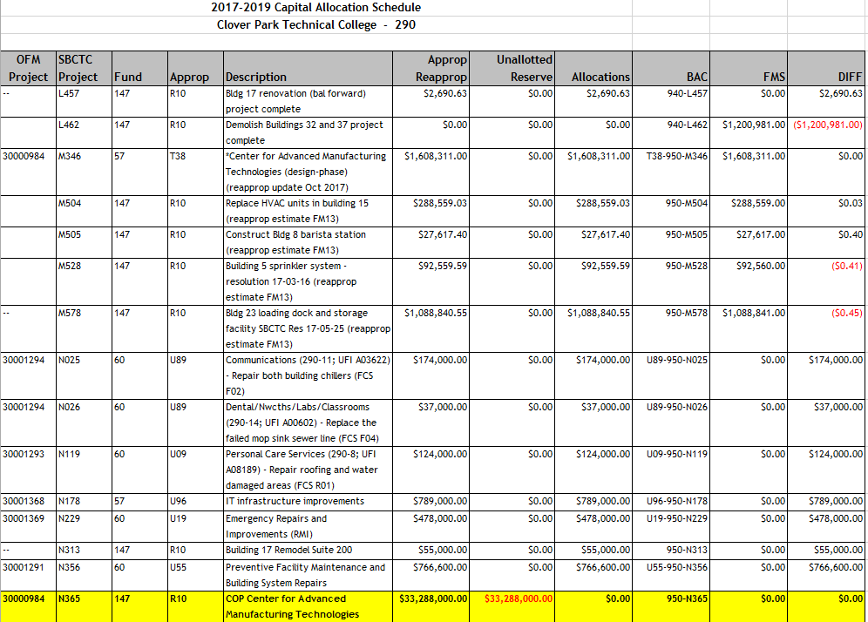
2. Capital Project Changes
a. Project Budget
b. Fiscal Year Budget

Slide 6
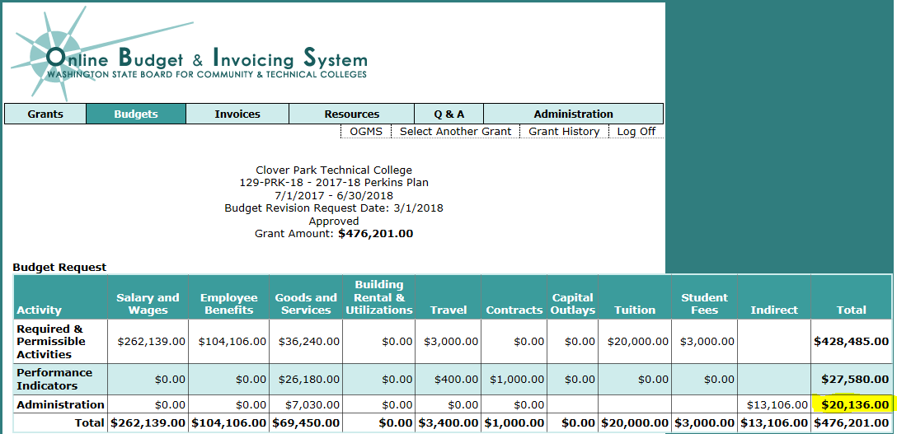
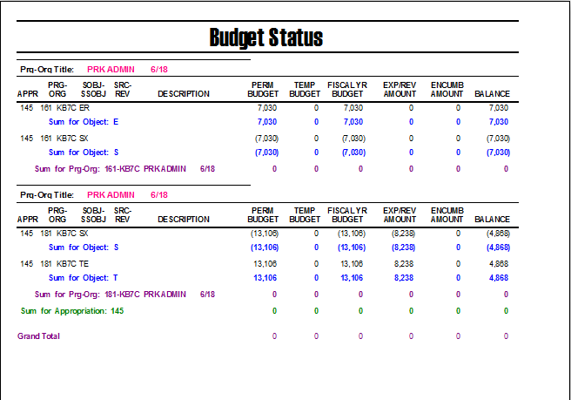
3. New Grant or Contract
OBIS example

Slide 7
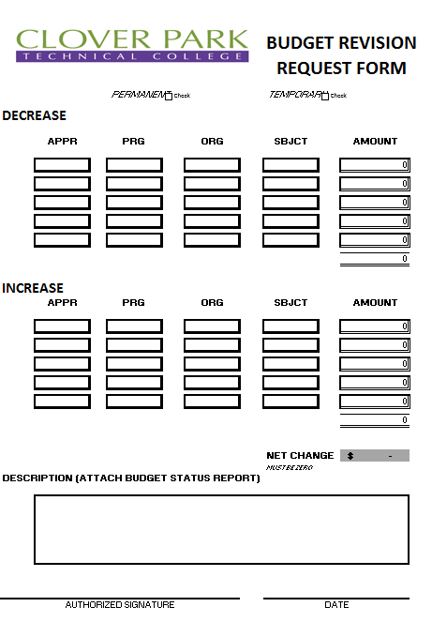
Budget revisions

Slide 8
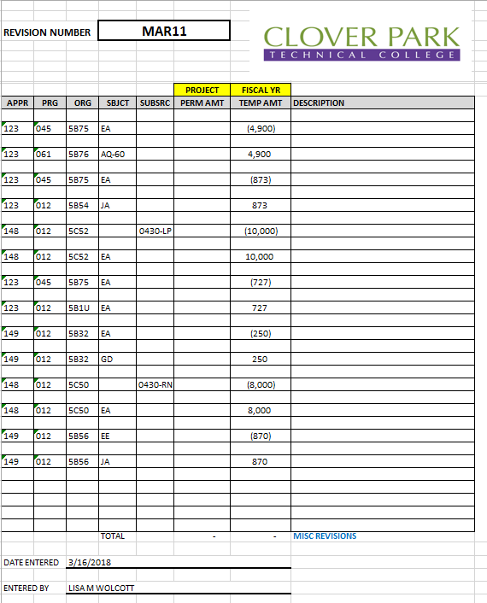

Slide 9
Budget input
1. All funds budgeted use the BA1001 screen
a. Based on COA setup
1. For Grants, Contracts & CP you can
put in a project budget and a fiscal
year budget
2. All other funds you have the option
of permanent or temporary
Budget Revision Review
1. BA1005 – quick and high level
2. Jobs
a. BA1210J; Budget Revision by Revision #
b. BA1209J; Budget Revision by Org
3. Datax Report

Slide 10
Salary savings
Treatment of Salary Savings varies from College
To College
Do you allow salary savings to be used for goods & services?
  CPTC doesn’t unless Exec Staff has approved
  Faculty salary savings is used to supplement the adjunct faculty pool.
  Typically for other departments, savings are used for backfill.
  CPTC sweeps everything at year end.
How often can you sweep for salary savings?
Part of the savings should be the benefits associated with the salary budget.

Slide 11
One-time spending
How do you plan for One-Time spending?
  Conservative budgeting of revenue
  Sweep fund balances
  Fund from Int’l or Running Start Contracts
  Foundation campaign
How do you budget for One-Time spending?
  Who will be responsible for the funds
  Ease of reporting
  Capturing cost associated with a program
How do you monitor your One-Time spending?

