Slide 1
Grants & contracts
Back to Basics CS9

Slide 2
Grant Funds
What criteria is used to determine what is accounted for in fund 145 is as follows:
Funds are designated by an outside grantor
Are restricted in use as designated by the grantor
Have an educational mission rather than a community service focus
The source of funds could originate from the following:
Other State Agencies (DSHS, OSPI, WSAC, L&I)
Federal Agencies
Local Governments
Private Entities
Foundations
Typical Programs that might appear in this fund are:
ABE/ESL
Running Start
International Programs (if contracted)
WorkFirst
Perkins

Slide 3
Federal and State Grants are governed by administrative rules and cost principles
The funding agency establishes dates for when all programmatic and fiscal reports are due.
Future year awards are subject to annual federal appropriations and the project making substantial progress as judged by the funding agency review of the performance reports.
The last date for incurring expenditures on an annual basis is indicated in each award notification.
Grant managers should check grant and matching budgets monthly to ensure that funds are being spent in a timely manner.
All Financial records, supporting documents, statistical records and all other records pertinent to an award shall be retained for a period of 6 years for state, other government and private grants. 10 years for federal.
The college must ensure that any equipment items purchased using grant funds are specifically approved by the funding agency and are tagged and inventoried in accordance with college policies and procedures. Disposition of this equipment during or at the end of the grant period must be in accordance with funding agency and college guidelines.

Slide 4
MONITORING AND MANAGEMENT
Responsibilities
You must be clear about timelines for reporting
Understand the restrictions of the grant
Understand what are the allowable expenses
Adherence to all regulations set forth by the granting agency
Spending the funds effectively
Staying with the grant budget
Resource typical for both Federal and State Grants
2 CFR 200 (OMB Super Circular)
WorkFirst Guidelines
Perkins Guidelines
Perkins Guidelines
ABE/EL Civics Guidelines
Time & Effort Guidelines

Slide 5
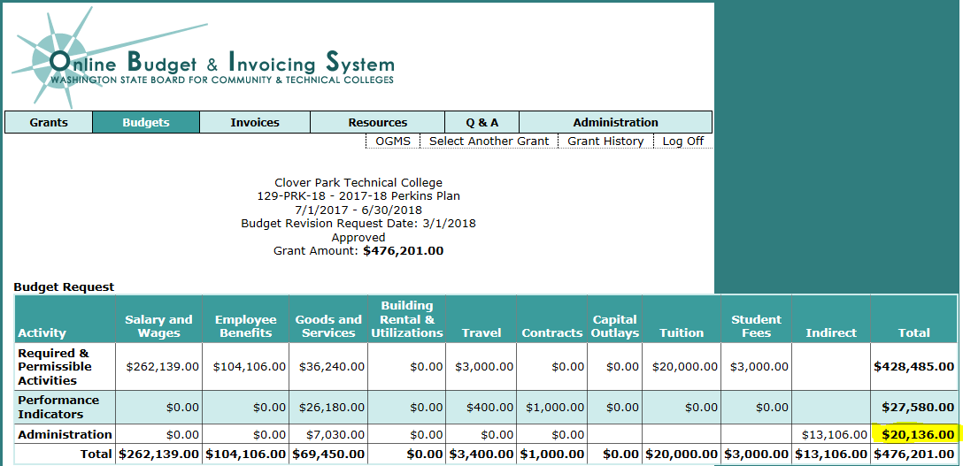
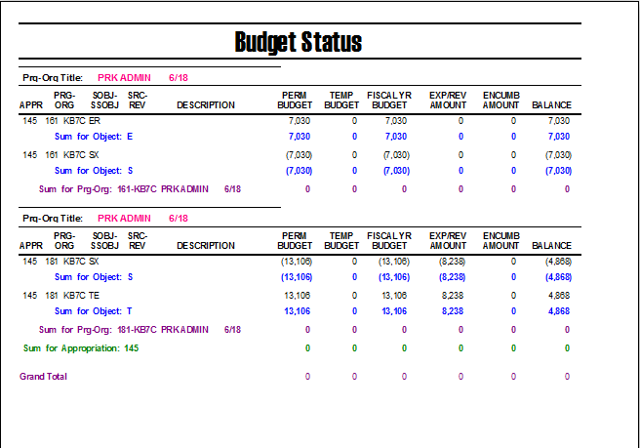
Budgets
Careful and realistic construction of budgets for reimbursement grants
Federal grant budget revisions need authorization from the federal grants officer
SBCTC awarded grant revisions are completed in OBIS
The award budget and the budget in FMS should be aligned

Slide 6
Expenditures
All project expenditures must be in accordance with the approved budget and project timeline.
2. No purchases should be made without prior authorization and a purchase order
3. Travel expenses require travel authorization, and require retention of all travel receipts with the exception of food cost.
4. The terms most government grants include a requirement that the college ensure that the funds are not used to supplant (replace) funds normally available to the college for its operating expenses.
5. To avoid the unnecessary return of unexpended funds to the granting agency, expenditures should be reviewed on a monthly basis, with more comprehensive reviews at midpoint and the three- quarter point of the grant period.

Slide 7
Required Documentation and Record Keeping
A separate file should be maintained for each grant award
  Award notifications, budget revisions, granting agency communications typically are located on one side of the file
  Reimbursement request with supporting financial reports and pay packs are typically located opposite the award.
Federal Grants require time & effort reporting
  Professional/Professorial – requires a quarterly estimate on your effort and then an after the fact certification and the end of the quarter
  Daily – requires daily time & effort which reports 100% of effort, all funding sources and vacation time indicated.

Slide 8
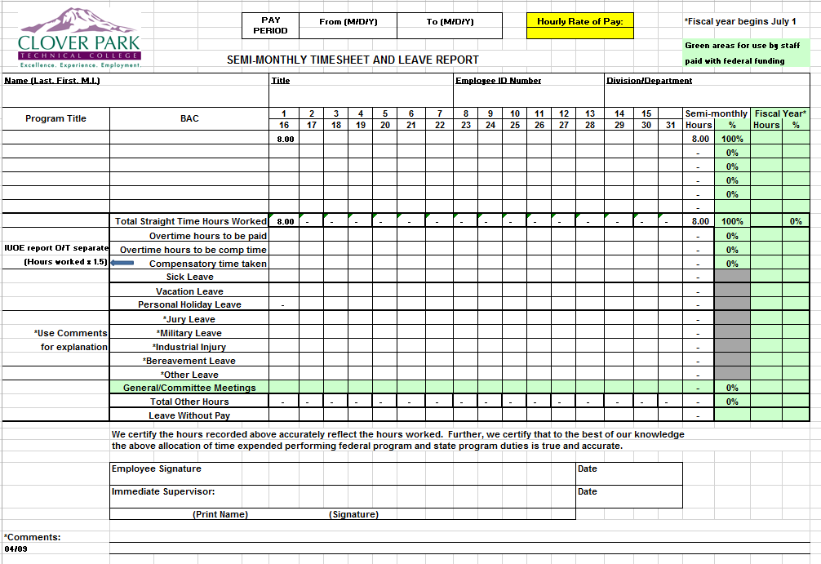

Slide 9
Financial Reports
FMS Month-end reports
advantage: gives a clean month-end cutoff
PM1201 – Cumulative grants & contracts budget status report
BA1211 – Monthly detailed salary & wage report
GA3230 – Monthly detailed expenditure report
GA2103 – Monthly detailed revenue report
FMS Query
advantage: can export in to excel to manipulate based on reporting requirements.
Grants & Contracts/CP status
Detailed Expenditure
Detailed Revenue
Payroll

Slide 10
Closing the grant
Secure record retention of electronic and paper files
Reporting final outcomes in a final programmatic report to be submitted to the funding agency
Final expenditures
Equipment and supply disposition
Time and effort documentation
Matching documentation

