Slide 1
GRANTS AND CONTRACTS
SUE WILLIS, EXECUTIVE DIRECTOR BUDGET AND FINANCE, WWCC

Slide 2
NEW GRANT!!!!!
Good news someone has worked really hard and the check is in the mail! No what happens?
Step one – get on the same page as the grant/program manager and review the proposal, award letter and budget.

Slide 3
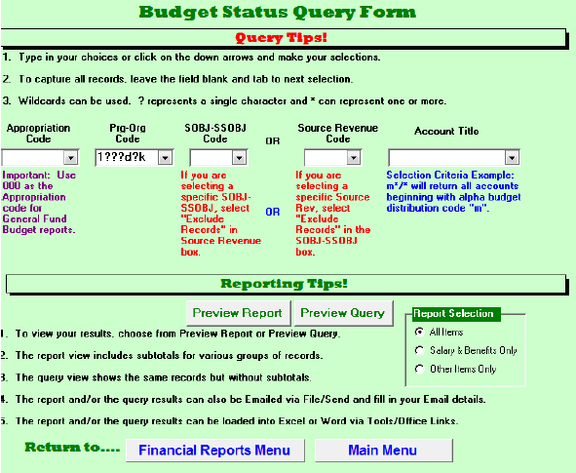
CODING GRANTS
After reviewing the proposal and meeting with the grant/program manager its time to consider what the budget codes will look like. Many times, we try to establish common ways to roll a grants coding together for the multiple program objectives that a grant may need to accomplish.

Slide 4
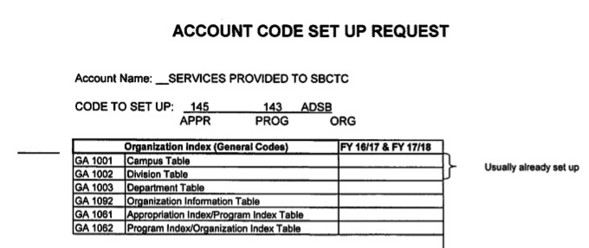
ENTERING THE GRANT CODE
When you set up a grant code, you will use the following screens:
GA1001
GA1002
GA1003
GA1042
PM1001
GA1092
GA1061
GA1062

Slide 5
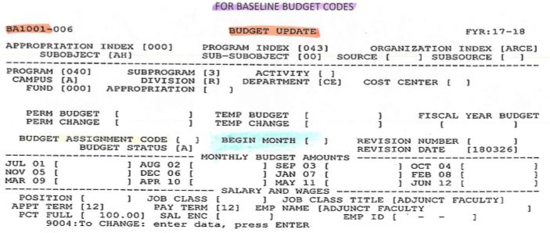
ADDING GRANTS
Grants are entered in the BA1001 screen. For WWCC, each prg-org that is entered will have a revenue or reduction of expense and expenditure budget so that the account’s budget will be zero. The budget assignment code control how the budget will distribute in the BA1001 screen.

Slide 6
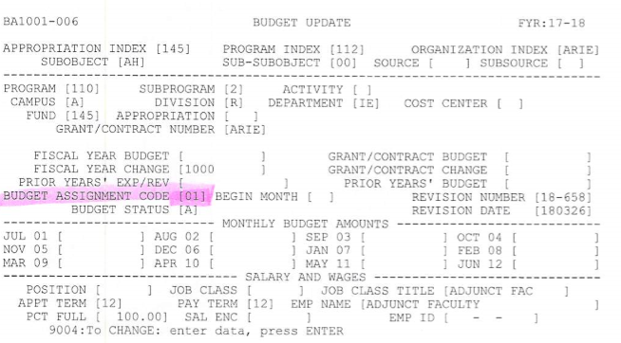
ADDING GRANTS
Here are some examples how the budget assignment code works.

Slide 7
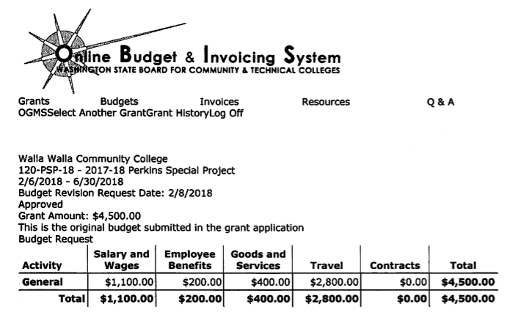
OBIS & FMS
OBIS and FMS should always match. When a budget revision is requested in OBIS, once approval is received, a FMS budget adjustment should be processed.

Slide 8
COMMON BUDGET REPORTS USED BY WWCC
These commonly used reports normally do not contain Grant & Contract/Capital transactions
BA1201 – Budget Status Report
BA1202 – Budget Status Report District by Division (This is organized by the second digit of the Org Index and usually does not include Grant and Contract/Capital accounts in the reports.)
BA1203 – Budget Status Report District by Program
These reports contain information on all accounts
BA1209 - Budget Change Register by Program Index and Organization Index
BA1210 – Budget Change Register by Revision Number
BA1211 – Salary and Wage Expenditure Report
GA2103 – Detail Revenue Report (This is for the month)
GA3230 – Detail Expenditure Report (This is for the month)
PS1120 – Payroll Processing Transaction List
These reports only contain Grant & Contract/Capital information
PM1201 - Budget Status Report - Grant & Contract/Capital Projects

Slide 9
Questions?
Thank You!

