Slide 1
1098T’s
IRS Tuition Statements for Students
Presented by: Roselle Hay - Bellevue College - rhay@bellevuecollege.edu

Slide 2
What is a 1098T?
The 1098-T tax form is a Tuition Statement provided by higher education institutions to all eligible students who pay qualifying tuition and related expenses during the calendar year.
1098-T’s are a requirement of the Taxpayer Relief Act of 1997 and is necessary for students or parents to claim one of these tax credits:
    American Opportunity Tax Credit
    Lifetime Learning Tax Credit
Forms must be sent to the students by January 31st.

Slide 3
Why do colleges need to generate the 1098T?
Colleges are required to generate a 1098T for students who self-paid all or a portion of qualifying tuition and related expenses.
Forms of self-paid would include:
  Cash, Check, Credit Card
  Student Loans – Federal & Private
  Nelnet Payment Plan Payments
  529 College Saving Plans

Slide 4
For whom do colleges not need to generate the 1098T?
The IRS allows exceptions for whom you are not required to generate a 1098T.
  Courses for no academic credit (Continuing Education).
  Nonresident alien students, unless requested and a SSN or TIN is on record.
  Students whose qualified tuition and expenses are fully paid or waived with:
    Grants
    Scholarships
    3rd Party Arrangements

Slide 5
Methods of Collecting Student SSN/TIN’s.
IRS rules require institutions to solicit SSN/TIN’s at least once a year.
  Use a secure website allowing for direct input by the student. Such as the “General Admission Application”.
  Send Campus Email Blast attaching IRS W-9S or customized W-9S.
    Make sure privacy and security precautions are in place if students provide their SSN by return email.
  Recommended practice – Identify students who will receive a 1098-T by scheduling a 1098T test run late November, beginning of December. Send an email blast out to those student with missing SSN’s. Colleges can determine individually how frequent they want to solicit for SSN’s during the calendar year.

Slide 6
Let’s get started..how to run the 1098T job…what information is needed
FMS Job Scheduling
There are 4 components to the 1098 job. Jobs can be run in test mode as many times as needed prior to the final run.
Job #1 - BM1745J - This job extracts student payment information to create the IRS Tuition Tax Credit Extract file. You will need to ask SBCTC-IT to disabled the prior year 1098-T display payment on your college’s website before running this job. This job must complete before running the job #2.
Job #2 - BM1747J - This job creates a 1098-T print file from the data contained in the IRS Tax Credit file (summary format). This job must complete before running any datax reports.
Datax – BM1747R – This creates an excel 1098-T data file summarized by each student.
Datax - BM1745RE – This report can create an excel individaul1098-T file by SID.

Slide 7
Job Scheduling – BM1745J
FMS Job Scheduling
BM1745J – Parameter Selection
Fee Pay Status Exclusions
  Enter any Student FPS that you do not want the job to pick up such as:
    35 - International Contract
    14 - GED Prep
    98 - Community Service
    Etc, (there are likely other FPS that you use)
Important: The Exclusion ONLY looks at Student Fee Pay status, NOT the FPS attached to the class.

Slide 8
Job Scheduling – BM1745J
FMS Job Scheduling
BM1745J – Parameter Selection
  Ususual Action Code Exclusion
    Enter any UA codes that you are using to exclude students from the job.
Example: If you are including your “undetermined students”, coded as FPS 33, you can identify those students based upon their FPS in SMS. The majority of these students may be non-citizens, taking either credit or non-credit. If you want to exclude those students only taking non-credit (non-credit is not 1098 reported), you can put a UA code on them to exclude them from the job.

Slide 9
Job Scheduling – BM1745J
FMS Job Scheduling
BM1745J – Parameter Selection
  Fee Class Inclusion
    This parameter allows you to include entire groups of fee codes based on their associated fee class.
    Example - include all tuition fee classes (10,11, etc), all student fees (14,20,30,etc).
    It is important to note that excluding a FPS does not work when the FPS is on the class (not the student), if you are including that fee class as part of your reporting.

Slide 10
Job Scheduling – BM1745J
FMS Job Scheduling
BM1745J – Parameter Selection
  Fee Code Exclusions
    Use this parameter to include any fee codes that are not eligible for reporting that are part of the fee classes you are including. This is an important field to use when you have included a fee class that has some fee codes that are not reportable.
    Examples might include fee codes used for non-credit courses if you are including the fee class.

Slide 11
Job Scheduling – BM1745J
FMS Job Scheduling
BM1745J – Parameter Selection
  Halftime number of credit definition
    Use this parameter to define the numbers of credits necessary to be considered eligible at half time (ex, 6).
    Ignore clock hours – all colleges use credit. Thank goodness!!
  Financial Aid Program Code Inclusions (FAPC)
    This would include all Student Loans (Federal & Private), the Student Payment Program (Nelnet & STEPP), 529 College Savings Plans (such as GET). This Inclusion parameter allows you to pick up those payments and reflect them as student payments (self-paid) to be included in Tax Credit Extract file.
  Year - This parameter allows you to select the year for reporting. This is based on the IRS tax year, or calendar year (ex,17 for 2017 year)

Slide 12
Example BM1745J

Slide 13
Example BM1745J Cont.

Slide 14
Job Scheduling – BM1747J
FMS Job Scheduling
BM1747J – Creates the 1098-T File
  Parameter Criteria
    Year
      This is the tax calendar year for reporting (ex, 17 for 2017 tax year).
    Final
      Select Y or N depending on whether it is a preliminary run or final run. You will want to do many test runs before the final.
      Only run “Final” after you have completed all the test runs and you are 100% sure the output file is correct.

Slide 15
Job Scheduling – BM1747J
FMS Job Scheduling
BM1747J – Creates the 1098-T File
  Parameter Criteria
    LOC-CD
      The location code for return address. You can leave blank and it will use your college code.
    Phone
      The phone number of a contact person or office to answer student questions related to their 1098-T.
    Web URL
      The web address where students can go to find information concerning their 1098-T. This parameter can also display other messages as well.

Slide 16
Example BM1747J

Slide 17
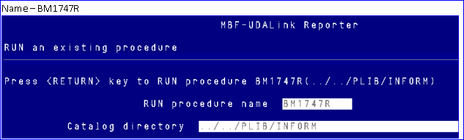
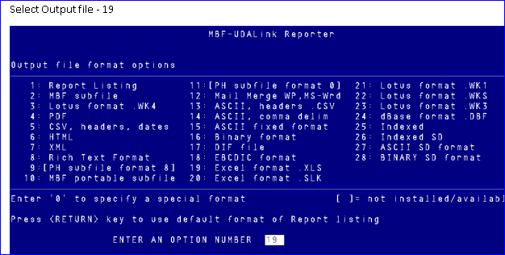
Datax Reports
BM1747R – 1098T file summarized by each student

Slide 18
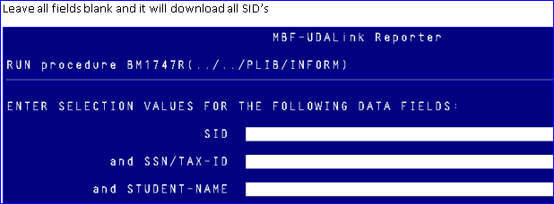
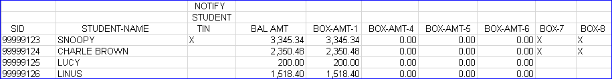
Datax Reports
BM1747R – 1098T file summarized by each student

Slide 19

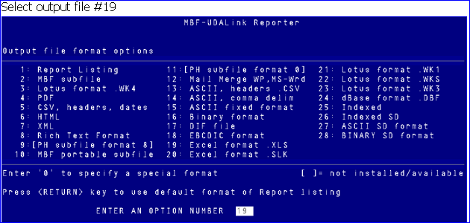
Datax Reports
BM1745RE – Individual 1098T Payment Summary by YRQ.

Slide 20
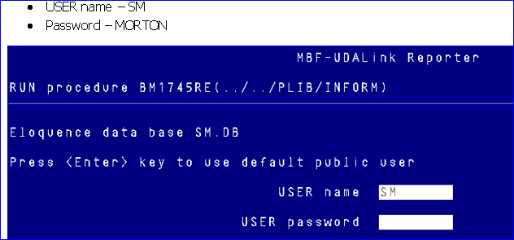
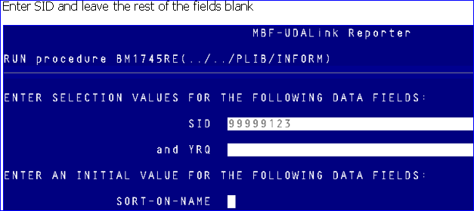
Datax Reports
BM1745RE – Individual 1098T Payment Summary by YRQ.

Slide 21
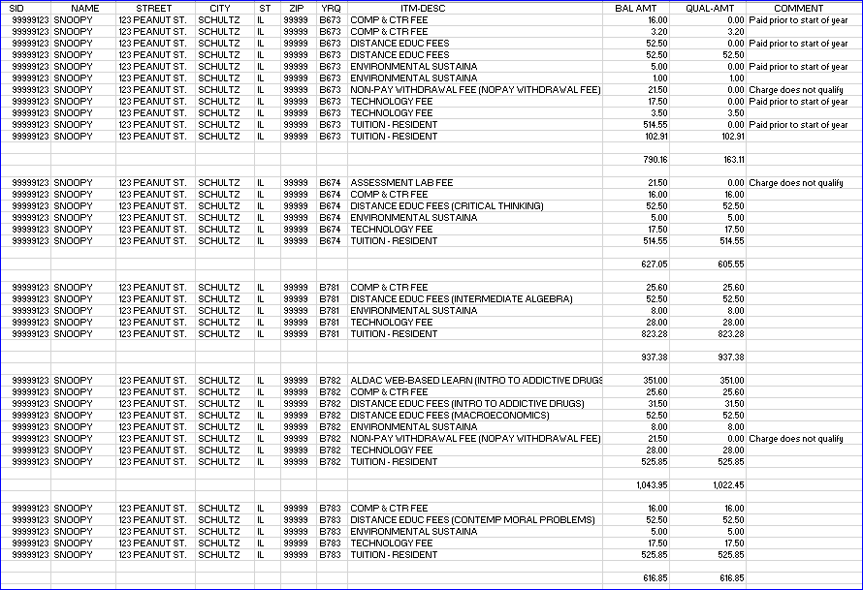
BM1745RE

Slide 22
Helpful Tips
    International Students are typically excluded but may request a 1098T
      Run the job in trial mode and don’t exclude international students.
      Run the datax BM1747R and save the database so you can easily pull the reportable numbers when you receive requests.
      When you run the job in final mode, remember to exclude those students
    Other helpful things…..
      Remember, if you are including a fee class that includes a fee code that isn’t reportable, you must exclude that fee code.
      Be cautious of fee codes that are used for both non-credit and credit courses. This can create issues.

Slide 23
Helpful Resources
IRS website: www.irs.gov
IRS Publication 970 : www.irs.gov
IRS Instructions for forms 1098-T: www.irs.gov
NACUBO website: www.nacubo.org
https://wcm.nacubo.org/Topics/Tax/IRS-1098-T

