Slide 1

A/R SUB-LEDGER
INCLUDING BILLING SCHEDULE

Slide 2
A/R SUB-LEDGER
What is the A/R Sub-ledger ?
The sub-ledger is all of your unbilled and billed receivables for student accounts.
The sub-ledger lists each transaction by student or agency.
The sub-ledger breaks each transaction out by General Ledger number then by account information.

Slide 3
A/R SUB-LEDGER
Why is it important to balance the sub-ledger?
It is important to balance the sub-ledger because it doesn’t take much to throw it out of balance from the general ledger.
Example I: If the wrong debt type was used in billing an agency and someone changed the debt type after it posted to the General Ledger, the payment would be in one place and the invoice would be in another.
Example II: If you are clearing credits against charges but they are not in the same quarter, it will throw the ledgers out of balance.
If you don’t balance the sub-ledger at least once a quarter it makes it harder to find mistakes. Let’s say you cleared credits against a charge from two different quarters and it comes to zero, these transactions will drop off the sub-ledger because they balanced to zero, but your general ledger is showing that it does not balance with the sub-ledger. You would have to go back several months to find when the error happened in order to correct it.

Slide 4
A/R SUB-LEDGER
The reports you will need to balance the A/R Sub-ledger are:
ACCTG 35 (Pierce College)
BM1780
BM1781
Examples below.

Slide 5
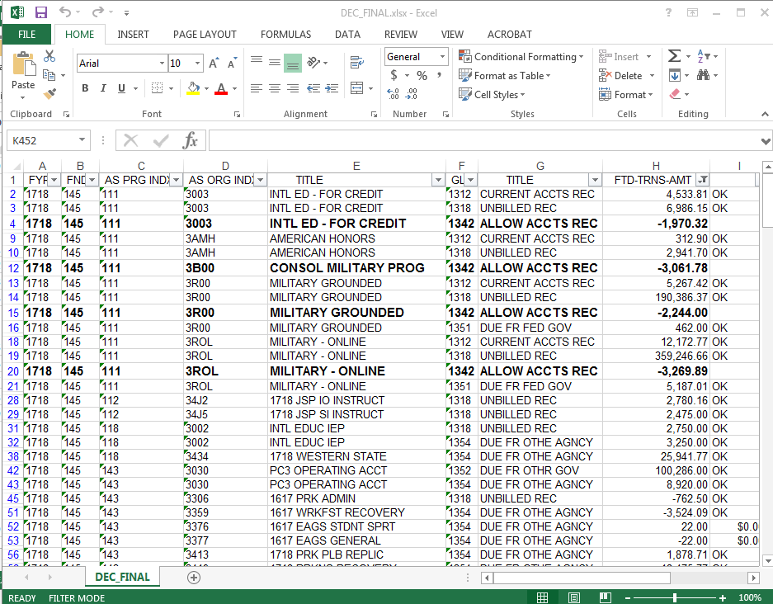
ACCTG 35

Slide 6
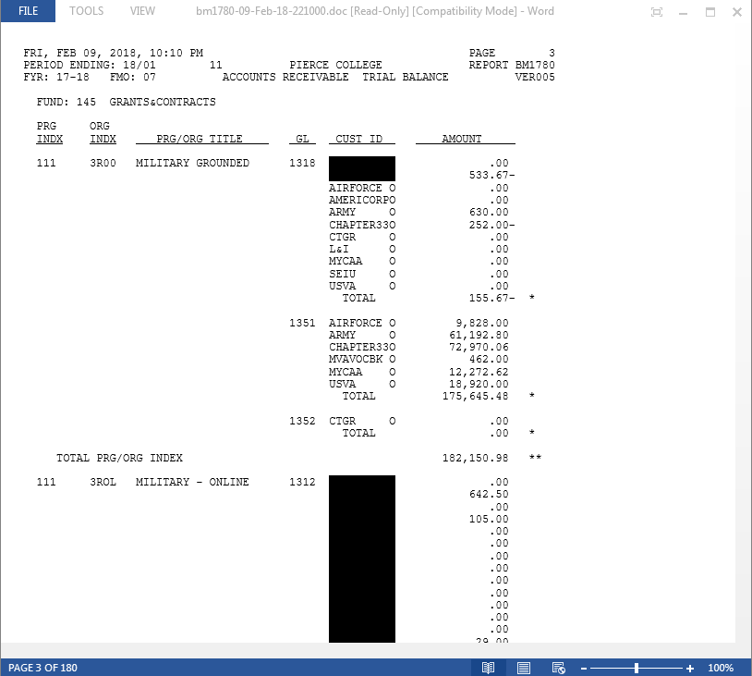
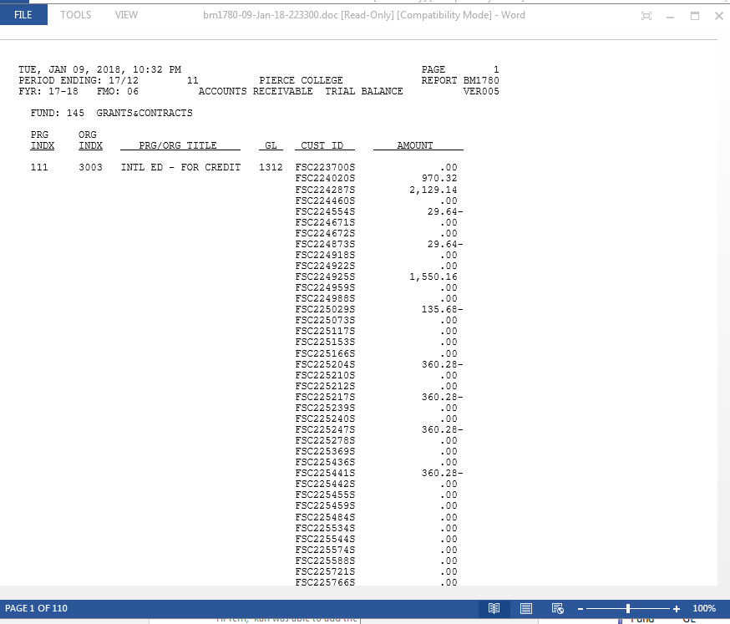
BM1780

Slide 7
Review of the BM1781A/R SUB-LEDGER
Review this report, looking for errors that were not caught when balancing the General Ledger to the Sub-Ledger
You are looking for small balances such as anything as small as 10 cents(over/short) to clear account.
Look for old quarter charges not invoiced.
Credits/refunds that have not been processed.
Accounts that are older than one month and have a zero balance but are not purging off the Sub-Ledger. (These accounts usually do not have the same charge ID and this will prevent the account from purging.)
Any accounts that roll up into the fund balance at year-end, but when the payment comes in it posts to the original account.
You will need to prepare a GAT to correct these items.
If you do these either monthly or quarterly, this will speed up your year-end closing because you have less to correct. ☺ YEAH!!!

Slide 8
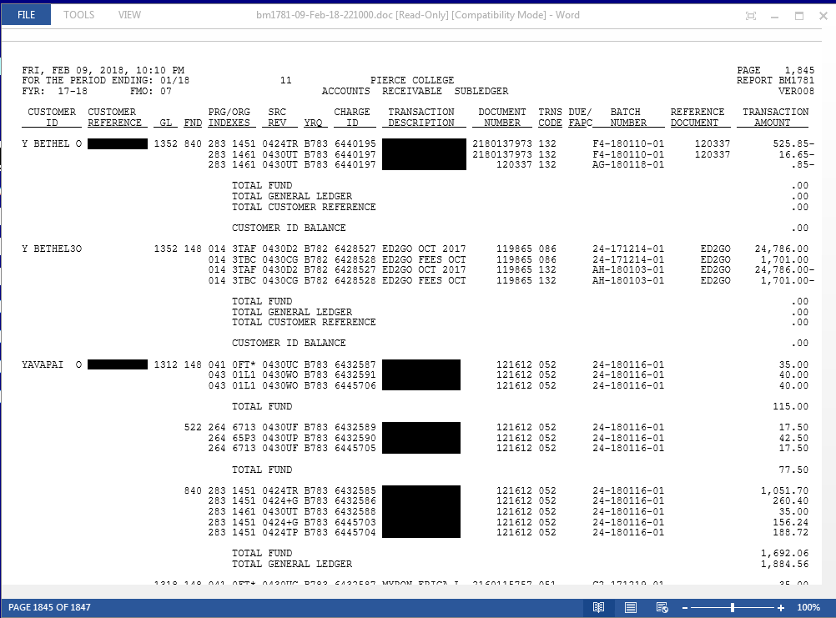
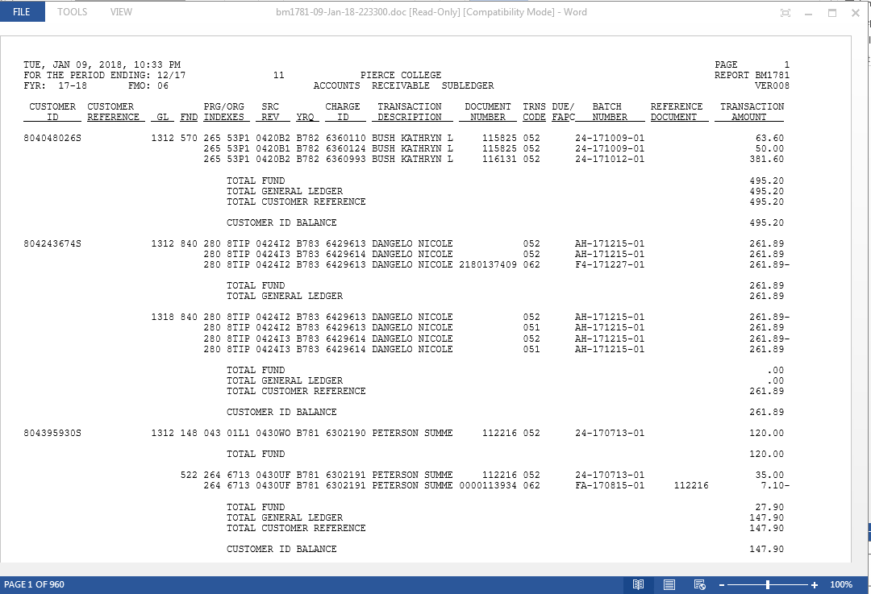
BM1781

Slide 9
A/R SUB-LEDGER BALANCING
You will use the ACCTG35 (Pierce College) and the BM1780 to compare each ledger account. This is the same report you use to set up Allowance accounts.
You only need to balance the A/R accounts, which do not include these accounts 1316,1350,1353,1353,1355,1360-1365,1383 &1399. You can delete these accounts from your ACCTG35 (Pierce College) before you start balancing.
You will match each ledger account to see if the General Ledger is showing the same total/balance as the A/R sub-ledger.
If they don’t balance, figure out the difference and notate it on your spreadsheet until you finish.
You will not be able to balance the allowance ledgers which are 1342, 1344 and 1349. These accounts only show on the General Ledger.
Once you have finished, you should be able to see where one account is over and another is short.
If you can’t, then go back through and recheck your balances.

Slide 10
BILLING SCHEDULES
What and why do I need to know this information?
You need to know this information because it helps with balancing the A/R Sub-ledger and setting up the Allowance accounts.
Depending on when you are balancing the Sub-Ledger and Allowances accounts you would not want Invoicing to run.
By knowing when they will run you can move the job to another day so it does not affect balancing the sub-ledger.
The Billing Schedule screen is the BM1023 (see example below).
Not all College’s will have the same billing schedules. Some Colleges will have more or less then other depending on their Colleges needs.

Slide 11
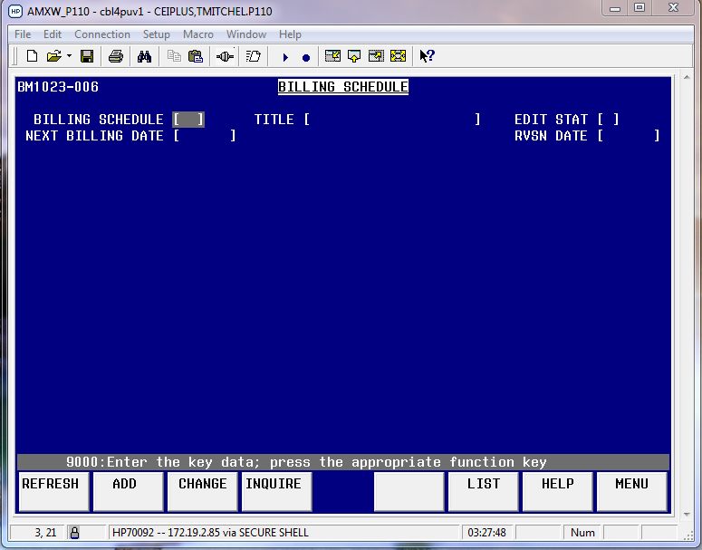

Slide 12
BM1023
If you are not sure what billing schedules are available at your school then you can see them in the BM1023.
Hit (F6) LIST and it will show you all of the billing schedules available for you to use at your College. (see example below)

Slide 13
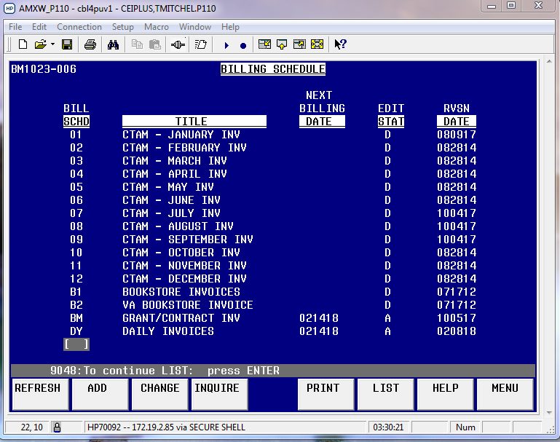

Slide 14
BM1023
SCHEDULING INVOICES
In order to schedule or change a date invoicing runs, you will need to enter the billing schedule you would like to change or move and hit (F3) change.
When you hit (F3) it will say across the top what the billing schedule is such as (Quarterly Invoices).
See Example below.

Slide 15
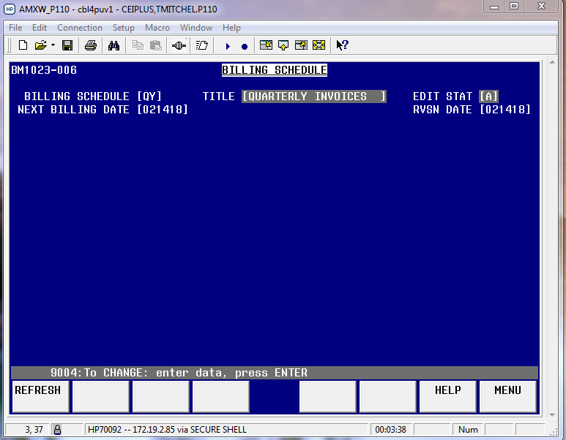

Slide 16
BM1023
SCHEDULING INVOICES
Hit enter and it will take you to the next screen where you will need to change either the billing date or the last billing date. (See examples below)
Please note: it is extremely important that you have billed all your receivables, in order to have accurate information to set up Allowance account and for year-end close.

Slide 17
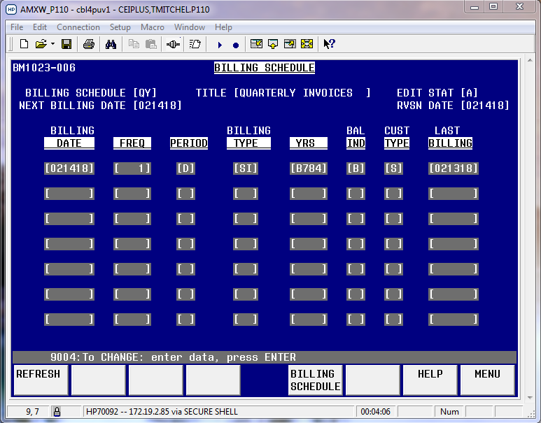

Slide 18
BM1023
If you want to move the billing schedule to a future date, change the date in the Billing Date column.
If you want to run it today, remove the Last Billing date.
You can get the parameters from the SBCTC https://www.sbctc.edu/
In the search section enter FMS (BM1023) and it will bring up all of the screen information for everything for Accounts Receivable, and from there you can look at what each parameter is.
You can also set up billing to auto-bill so your Accounts Receivable folks don’t have to go into the BM1620 and change the charge status.
All they need to do is go into the BM1024 and add the charge status you want the system to bill off of. (See example below)

Slide 19
BM1024
As you can see from the above screen shot, we currently only have charge status (UB ) for student invoicing.
If I add charge status (UO) to this screen the system will automatically run an invoice for the student after we close and be ready to mail out in the next morning.
You can turn this on and off whenever you want but it makes keeping track of your receivable easier for staff.
Any questions?

Slide 20
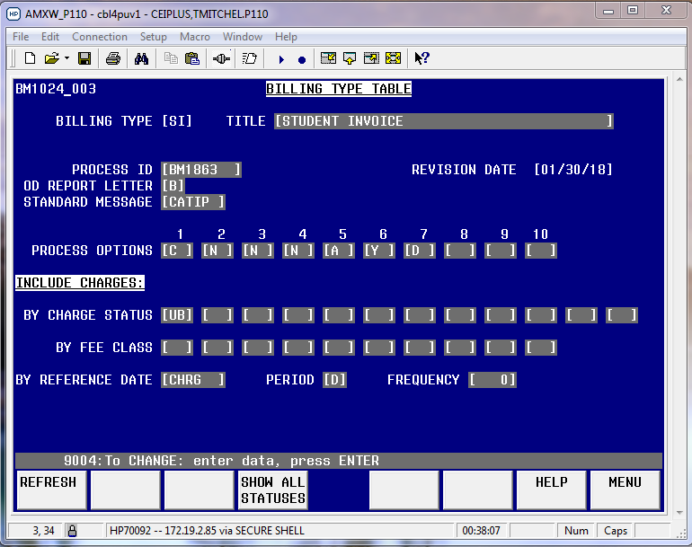

Slide 21
Questions??
Presented by: Terri Mitchell Student Financial Mgr.
If you have questions after you leave please contact me at: tlmitchell@pierce.ctc.edu or by phone 253-964-6715

