Slide 1
Allowances
Allowances for Bad Debt/Write offs

Slide 2
What are Allowances?
Allowances are the dollar amounts which you are estimating you will be unable to collect from your billed receivables.
The ledger accounts for Allowances should always be credits.
(SMART REPORT 112) and the ACCTG35, if they don’t show as credits then you will need to adjust or create a new allowance.

Slide 3
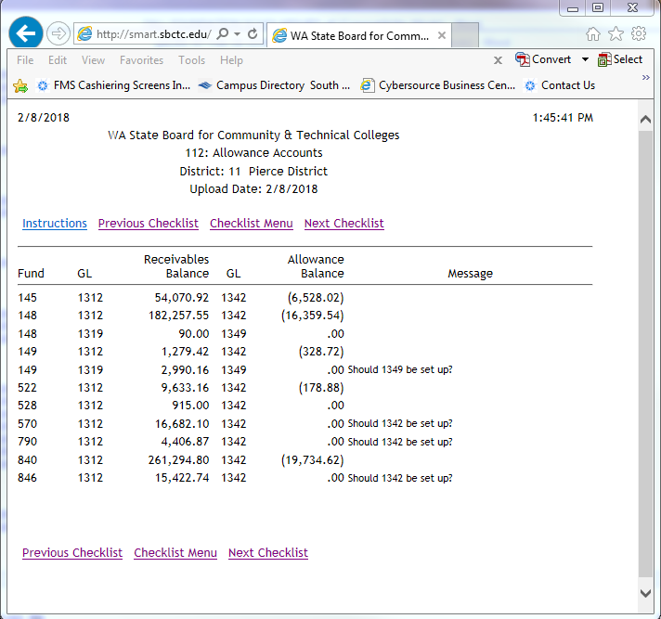

Slide 4
How do my write offs affect Allowances?
When you do write-offs you are removing them from your general ledger and reducing a revenue or budget account.
If you do not have Allowance accounts set up to offset your write-offs, it makes it appear like you lost or misplaced revenue.
With your Allowance accounts in place at the beginning of the year it helps the department or budget manager have a better idea of what they will have available in their budget for spending or holding.
Allowances are subtracted from the beginning balance to ensure that a budget or revenue account is not over spent.

Slide 5
How do I set up Allowance accounts?
In order to set up your Allowance accounts and maintain them throughout the year, you will need to the following reports:
ACCTG 35 (Pierce College Report)
BM1711 Accounts Receivables GL Aging Report
BM1780 Accounts Receivable Trial Balance
BM1781 Accounts Receivable Sub-Ledger
SMART REPORT 112 Allowances Accounts
Samples of each report are below.

Slide 6
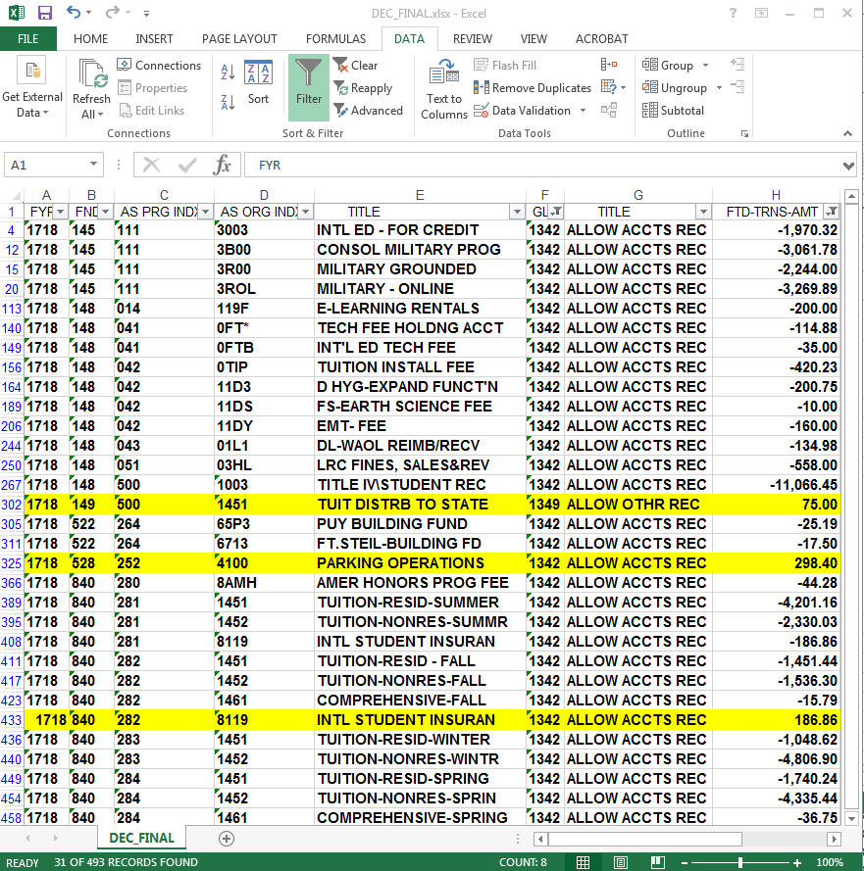
ACCTG 35

Slide 7
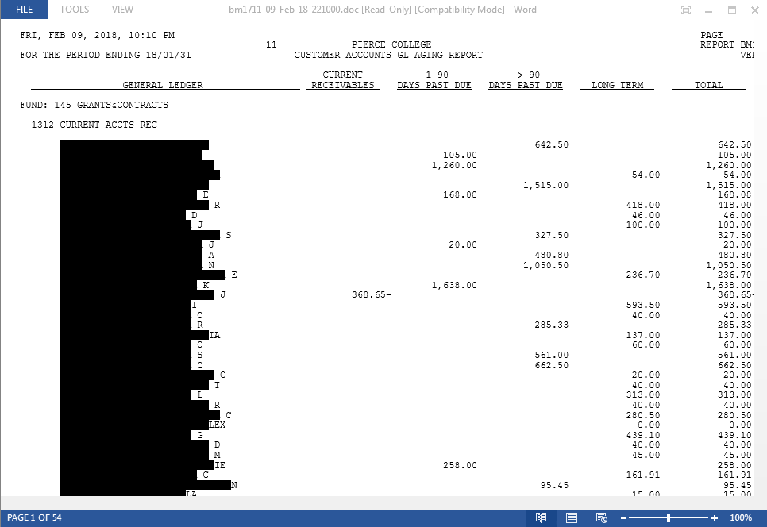
BM1711 Accounts Receivable GL Aging Report

Slide 8
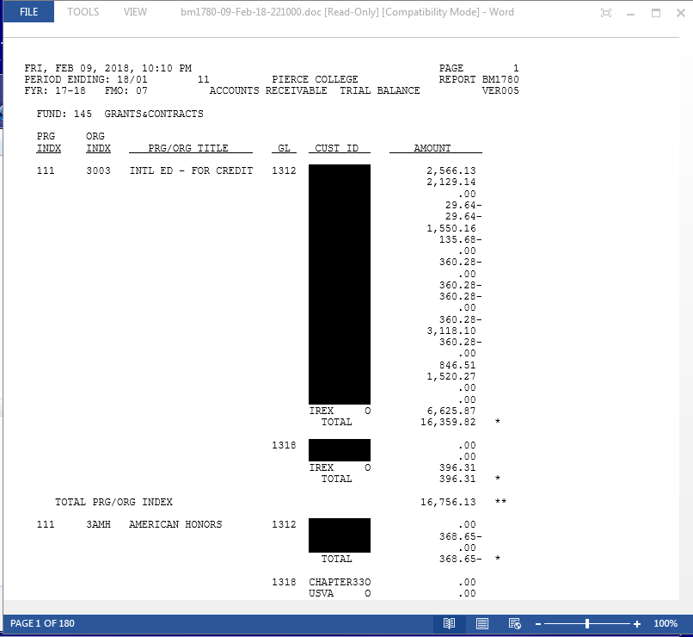
BM1780 Accounts Receivable Trial Balance

Slide 9
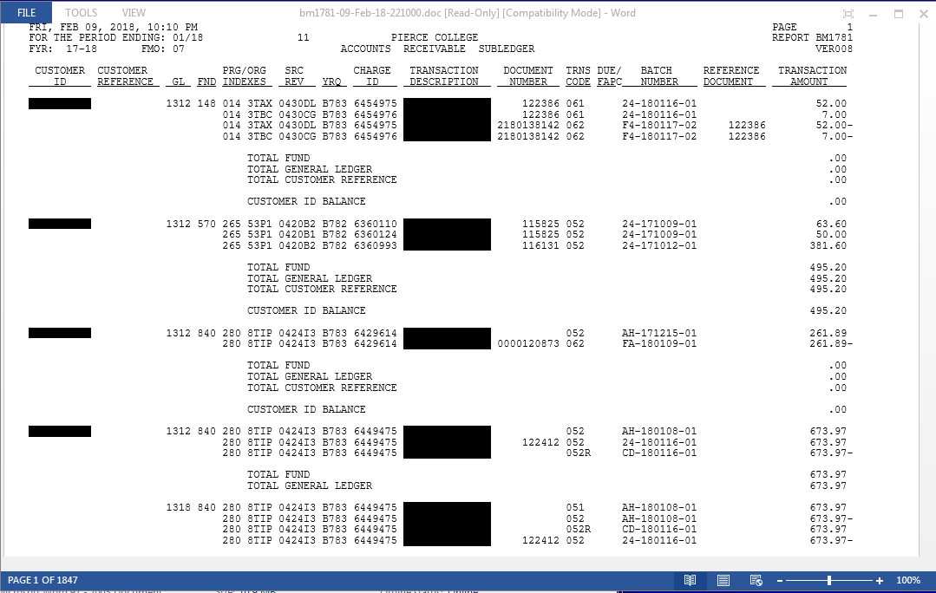
BM1781 Accounts Receivable Sub-Ledger

Slide 10
SMART 112 Allowances Accounts

Slide 11
How will I know if I need an Allowance account set up?
The best way to see if you need to set up an Allowance account is to use your aging report.
Any receivable that is 120 days plus old you will need to set up an Allowance account.
The SMART Report 112 is also a good way to see if you need to set up an Allowance account. On this report it will ask you if you need to set up a 1342, 1344 or 1349.
ACCTG35 also gives you the dollar amounts that were written off and will show as a debt on this account if no allowances were set up. Account Ledger numbers are1342, 1344 and 1349.
You can use the BM1781.

Slide 12
Let’s get started setting up my Allowance account
Most allowances will be a percentage of your unpaid receivables with a few exceptions, such as, library fines and parking tickets. The percentages below are set up for Pierce College, and so your institutions percentages may vary. You will need to adjust the percentages until you can figure out which one is best for your College.
The average percentage on figuring an Allowance account is 35%.
Allowance on a 840 fund account percentage varies from month-end to month-end, depending on the amount of receivables you have in the account.
If you are setting up an allowance on a Financial Aid repay it should be around 80%. If a student hasn’t paid this charge within 90 days there is a good chance you won’t be able to collect it. ☹
Library fines and parking tickets are usually 100%.
You will need to adjust the percentages every few months depending on the dollar amount you need to write-off.
Typically you should not need to set up an allowance account for a State Agency. Just remember to watch deadlines for these agencies so that you can bill everything within the timeline.

Slide 13
Which transcodes do I use to set up my Allowance Accounts
The transcodes used to set up Allowance accounts depend on what ledger you are setting up the Allowance for.
Ledger 1312 transcode 096 = 3205/1342
Ledger 1314 transcode 099 = 3205/1344 (fund type 3)
Ledger 1319 transcode 095 = 3205/1349
For these transcodes you will need to add the source of revenue, ZZ
For funds 60 and 149 you will need to use 0424 ZZ
Fund type 4 = 443,444,448,460,522,524,528,569 and 570 these are considered expenses, so you will need to use Sub Object WC 00
Ledger 1312 transcode 096 = 6515/1342
Ledger 1312 transcode 097 = 6515/1342
Ledger 1314 transcode 099 = 6515/1344
Ledger 1319 transcode 095 = 6515/1349

Slide 14
Back up needed for Allowance GAT
You will use your ACCTG 35 (Pierce College DATAX) showing the allowance accounts are a debit.
You will also need to use the SMART Report 112 (Screen shot)as backup.
You may also use the write-off list as part of this backup. This will show an Auditor what was written off and why you changed your Allowance amount. (If you had one set up)

Slide 15
Preparing your Allowance GAT
Once you have determined what the dollar amount for your allowance is going to be for each ledger account, you are ready to fill out your GAT.
In the Reference Doc section you need to use ADJ ALLOW.
The ID number will be the tax ID for your School and Type will be O.
The rest of the GAT is the account information and general description.
See example below.

Slide 16
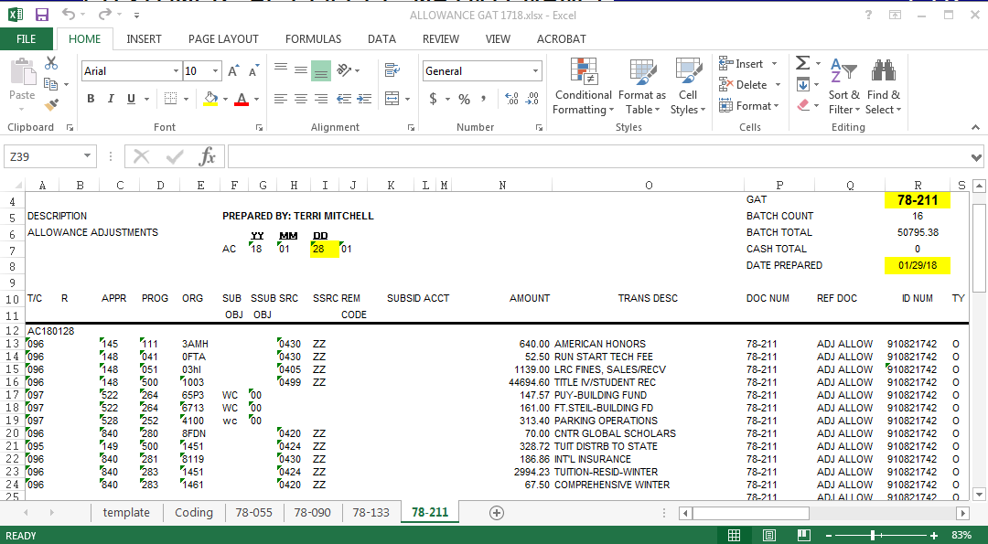

Slide 17
Now ☺ you are ready to upload you GAT
Once you have uploaded your GAT you will need to wait until the next morning.
Now you can check your GAT to see if there are any errors. If no errors, then it is ready to be closed.
The next time your college uploads the information to SMART you will be able to check the SMART Report 112. If you corrected everything it will look like the example below.
If it looks like the example below, you are done. Please note just because the SMART 112 asks if an allowance account needs to be set up, it does not mean you need to set one up.

Slide 18
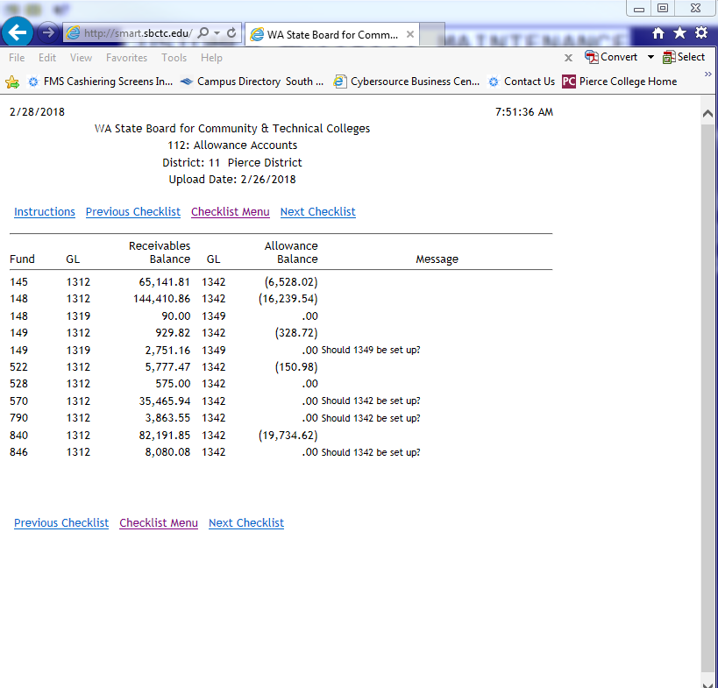

Slide 19
QUESTIONS??
Presented by: Terri Mitchell Student Financial Mgr.
If you have questions after you leave please contact me at: tlmitchell@pierce.ctc.edu or by phone 253-964-6715

