Slide 1
Afrs in-process & rejections
Sue Willis
Interim ctc-Link System Accounting Manager

Slide 2
TODAY….
Office of Financial Management (OFM)
  Who are they and what is their role?
AFRS
What is it?
Why should a college care?
What is the difference between “in-process”
and rejection?

Slide 3
Office of financial management
  The Office of Financial Management (OFM) provides vital information, fiscal services and policy support that the governor, Legislature and state agencies need to serve the people of Washington.

Slide 4
OFM (continued)
  OFM:
    Plays a central role in budget planning, policy development & fiscal administration for the executive branch
    Prepares the executive budget proposal and monitors budget implementation
    Develops and maintains state administrative & accounting policies
    Prepares Annual Comprehensive Financial Report (ACFR)
    Monitors the state’s economy and labor force
    Manages the statewide human resource policy functions including classification and compensation.

Slide 5
WHAT is afrs and why do we care?
AFRS is the Agency Financial Reporting System and is the central hub for the State of Washington’s accounting information.
As a system, we are required to accurately transmit our financial data monthly to OFM. This information is used by OFM for fiscal monitoring, budget preparation and legislative reporting as needed.

Slide 6
In-process VS rejections
The term in-process applies to state allocated funds. It is the variance between what has been reported by the system as treasury cash and what the treasury (OST) shows as amounts drawn (A-7) and/or returned by each college through the VPA process.
A rejection is an accounting entry that needs to corrected in order for it to be reported to OFM.

Slide 7
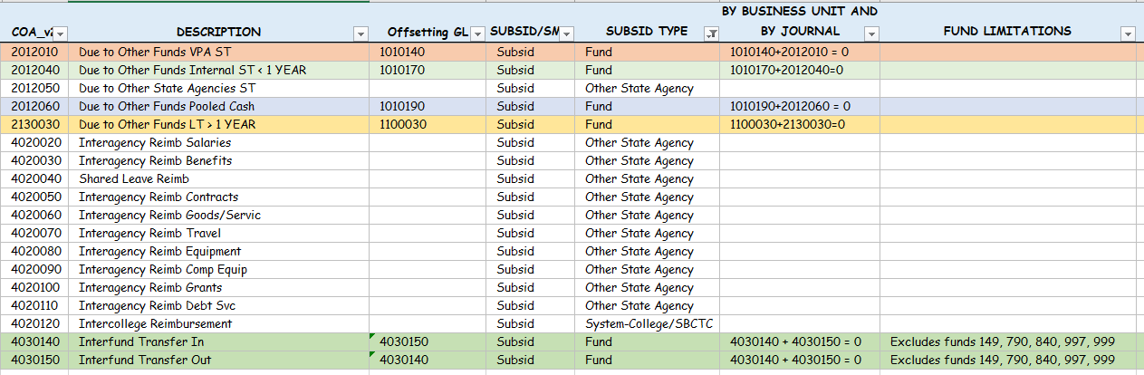
In-process VS rejections (continued)
Most common rejections occur from the following:
Use of an account with a subsid requirement in AFRS.
Reporting an incorrect subsid type with the transaction.

Slide 8
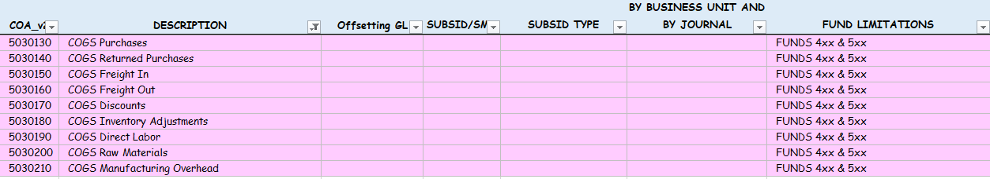
In-process VS rejections (continued)
3. Impermissible use of Cost of Goods Sold (COGS) accounts (Limited to funds 4xx & 5xx)

Slide 9
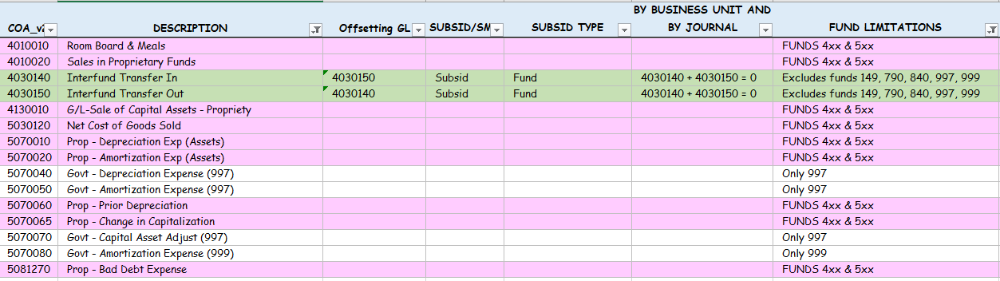
In-process VS rejections (continued)
3. Use of invalid appropriation indexes
4. Use of accounts that have fund limitations

Slide 10
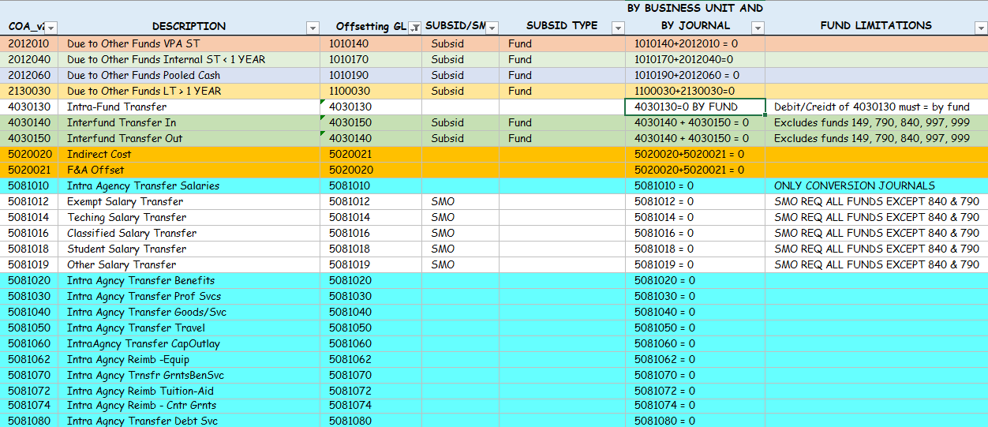
Prepare for yearend
Check the SMARTER reports weekly and make corrections.
Balance accounts that have special requirements to zero out across the individual business unit

Slide 11
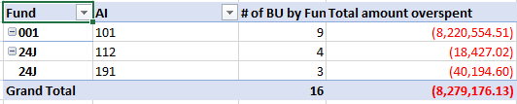
Prepare for yearend (continued)
3. Monitor your state allocations using SMARTER 210 – Overspent Op Fund and the CAP Track. Currently there are several colleges with an overspent allocation/allocations. Please get these corrected ASAP.

Slide 12


Prepare for yearend (continued)
4. Re-establish the subsidiary fund numbers in period 133 for the pooled cash and VPA funds using internal cash and the below accounts. Pooled cash is in fund 841 and VPA is in fund 840.
Once the subsids have been re-entered into the system, reverse the entries in the current period to eliminate the pooled cash and VPA from the accounts. Please complete these entries prior to yearend as we would like to eliminate this GL from OFM’s records.
5. Keep your “T” transfers in balance.

Slide 13
Prepare for yearend (continued)
Colleges that were on Legacy during FY22 will need to ensure the following:
All in-process and AFRS rejections from Legacy entries are corrected in PeopleSoft. Please send an email to Truc Le and myself with journal number that is making the correction so that we can remove it from our list.
FY21 adjusting entries that were not completed in Legacy will need to be addressed in period 133 to avoid duplicating the entries in AFRS.
Clean up conversion data to address missing data such as appropriation indexes, project and activity. (Colleges that have not completed this process in FY21 should continue to working to clear up your data).

Slide 14
Questions
Do we have any questions?

Slide 15
Other support & resources
  PeopleSoft GL Query
  BAR RESOURCES
  BAR SUBJECT MATTER EXPERTS

