Slide 1
Requisition and PO Reconciliation
Thomas Oliver
May 19, 2022

Slide 2
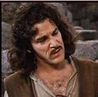
The essential presentation opening

Slide 3
What are we doing here
Hello, my name is Thomas Oliver
The end is near
Let me ease your passing

Slide 4
Principally Purchase orders
Requisitions are part of the path to a PO
Requisitions pre-encumber, but don’t encumber
Closing a PO closes the attached requisition
POs are what I know best

Slide 5
Why Closing Purchase orders is important
Releases unnecessary encumbrances
The dead wood will bury you
  300 item max on ctcLink searches
  Finding relevant information – needle in a haystack

Slide 6
Batch Closing Purchase Orders
Path = Nav > Purchasing > Purchase Orders > Reconcile POs

Slide 7
Batch Closing Purchase Orders
Record-Level Criteria | Qualifying Setting or Status
PO Status | The Close Purchase Orders process verifies that the purchase order has a status of D (dispatched) or X (canceled). Statuses of O (open) and A (approved) enable the process to close a purchase order when other applicable criteria are met. The other criteria that must be met are: Receiving is not required for the purchase order. Matching is not required for the purchase order. The purchase order schedule date plus close days has already passed (last activity date <= system date). Statuses of I (initial), PA (pending approval), and C (completed) do not enable the process to close the purchase order. You can view the purchase order status by writing an SQL statement against PS_PO_HDR.
Activity Date The system updates this date on the purchase order when you create a change order and save your work, and also when you cancel a purchase order through the Buyer's Workbench. | The Close Purchase Orders process uses these calculations to determine whether the purchase order's last activity date enables the process to close the purchase order: (Activity Date) ≤ (Current Date) - (Close Days). (Activity Date) ≤ (Current Date) - (Cancel Days). You can view the activity date value by writing an SQL statement against the PS_PO_HDR record and looking at the ACTIVITY_DATE field.
Match Status | The Close Purchase Orders process verifies that, if matching is required for the purchase order, the match status of the purchase order is M (matched), N (no match is required), P (partially matched), and T (to match). In cases where the MATCH_STATUS_PO and MATCH_STATUS_LN_PO never reaches a status of M (matched), the Close Purchase Orders process checks the purchase order schedule (PO_LN_SHIP_MTCH) for quantity matched. A matching status of P (partially matched) does not qualify the purchase order for closure. A purchase order with a header match status of T (to match) will be closed by the Close Purchase Orders process if the match status on the associated lines is M (matched) if matching is required. When matching is required on a purchase order, there can be several vouchers against a purchase order. One of the vouchers might be matched, but the status (MATCH_STATUS_PO) on the purchase order remains P (partially match) until the final voucher is matched. The purchase order status then changes to M (matched). The Close Purchase Orders process considers a purchase order fully matched and available for closure when the quantity ordered for each line on the purchase order is less than or equal to the total quantity received and matched. You can view the match status value by writing an SQL statement against the PS_PO_HDR table and viewing the value in the MATCH_STATUS_PO field.
Distribution Line Status | The Close Purchase Orders process verifies that the distribution line statuses for the purchase order are O (open), P (processed), or X (canceled).
Amount Only | The Close Purchase Orders process checks to see whether the Amount Only check box (AMT_ONLY_FLG) is selected for the purchase order line. If the purchase order line is to be received by amount only, the Close Purchase Orders process sums up the merchandise amounts in supplier currency recorded in receipt transactions and compares the total to the merchandise amount on the purchase order to determine whether the purchase order has been fully received.
Receiving Required setting | The Close Purchase Orders process verifies whether the Receiving Required field is Receiving is Required for the purchase order line on the Maintain Purchase Order - Details for Line page. The process uses this setting in conjunction with the due date value at the record level to determine whether it can close the purchase order. You can view the receiving required value by writing an SQL statement against the PS_PO_LINE.RECV_REQ field.
Due Date | The Close Purchase Orders process uses this calculation to verify that the due date on the purchase order schedule line (PO_LINE_SHIP.DUE_DT) is less than or equal to the calculated close date: (Due Date)≤ (Current Date) - (Close Days) The Close Purchase Orders process verifies that the due date value for purchase orders when the Receiving Required field is Receiving is Optional or Do Not Receive. This includes PeopleSoft Order Management direct shipments.
Voucher Status | The Close Purchase Orders process verifies that associated vouchers have been posted, deleted, or closed. If matching is not required for the purchase order (that is, the match status of the purchase order is N), then the purchase order can close even if the voucher is not posted.
Entry Event Status | If you enable commitment control, the Close Purchase Orders process verifies that you have checked the row for entry events.
Business-Related Criteria | Qualifying Setting or Status
Close Days The Close Days field on the Purchasing Definition - Business Unit Definition page specifies the number of days beyond a purchase order's last activity date during which the purchase order cannot be closed. The close days value creates a grace period during which you can change the purchase order before the purchase order closes. If you leave the Close Days field blank, the system uses zero close days. Note: The Close Days value that you define for the business unit is for purchase order reconciliation and has no relationship to the close days value on the Close Short Run control pages. | The Close Purchase Orders process verifies that the number of close days defined for the purchase order's purchasing business unit has elapsed. The system adds the value for the Close Days field to the last activity date to determine whether the required number of grace period days has passed. For example, for a Close Purchase Orders process run date of August 31, 2006, suppose that the last activity date for the purchase order is August 25, 2006 and the value for the Close Days field is set to five days. In this example, the process closes the purchase order. You can view the value in the Close Days field by writing a Structured Query Language (SQL) statement against PS_BUS_UNIT_TBL_PM.
Cancel Days The Cancel Days field on the Purchasing Definition - Business Unit Definition page specifies the number of days beyond a purchase order last activity date during which the canceled purchase order cannot be closed. The value for the Cancel Days field creates a grace period during which a canceled purchase order cannot be closed. If you leave the field blank, the system uses zero cancel days. Cancel days is a business unit attribute; therefore, the system omits the calculation for the Cancel Days field when the Close Purchase Orders page specifies a specific purchase order number. | The value in the Cancel Days field works the same way in which the value in the Close Days field does but for canceled purchase orders. The Close Purchase Orders process verifies that the number of cancel days defined for the purchase orders purchasing business unit has elapsed. The system adds the value for the Cancel Days field to the last activity date to determine whether the required number of grace period days has passed. You can view the value in the Cancel Days field by writing an SQL statement against PS_BUS_UNIT_TBL_PM. Note: The Close Purchase Order process does not change the line status from Canceled to Complete. However, it does change the header status to Complete. The purchase order line status remains Canceled, so that you can distinguish canceled lines from closed lines.
Close PO Under Percent Tolerance The Close PO Under Percent Tolerance value defines the acceptable percentage of the total purchase order quantity or amount that can be outstanding while still allowing the purchase order to be closed. This setting enables the Close Purchase Orders process to close a purchase order even if the received quantities or amounts are less than the purchase order quantity or amount. The Close Purchase Orders process compares the tolerances based on quantity or amount according to the distribution method on the purchase order. This value is set at these levels: The business unit specific attributes level on the Purchasing Attributes - Purchasing Controls page. The purchasing attributes level when using the Item Master enterprise integration point on the Data Definition Maintenance - PO Attributes - Purchasing Controls 2 page. The item categories level on the Item Categories - Category Definition 2 page. Note: These system levels are ordered from specific to generic. The percent tolerance value set at a more specific level in the hierarchy overrides the setting at the more generic level. | The Close Purchase Orders process uses these calculations to verify that the Close PO Under Percent Tolerance value has been met so that the process can close the purchase order: (Quantity Received) ≥ (Quantity Ordered) - ((Quantity Ordered) x (Percent Tolerance)) (Amount Received) ≥ (Amount Ordered) - ((Amount Ordered) x (Percent Tolerance))

Slide 8
Batch Closing Purchase Orders
Pros and Cons
  Yeah batch processing!
  Blunt instrument
    May take out POs you don’t want closed (but you can undo that)
    May NOT take out POs you want closed
      Various criteria not met (e.g., Timing not right)
      Residual encumbrances

Slide 9
Closing Individual Purchase orders
Path = Nav > Purchasing > Purchase Orders > Reconcile POs
Buyer’s Workbench (Nav > Purchasing > Purchase Orders > Buyer’s Workbench)
  Can do smaller “batches”
  More selective (Zero Encumbrance POs)

Slide 10
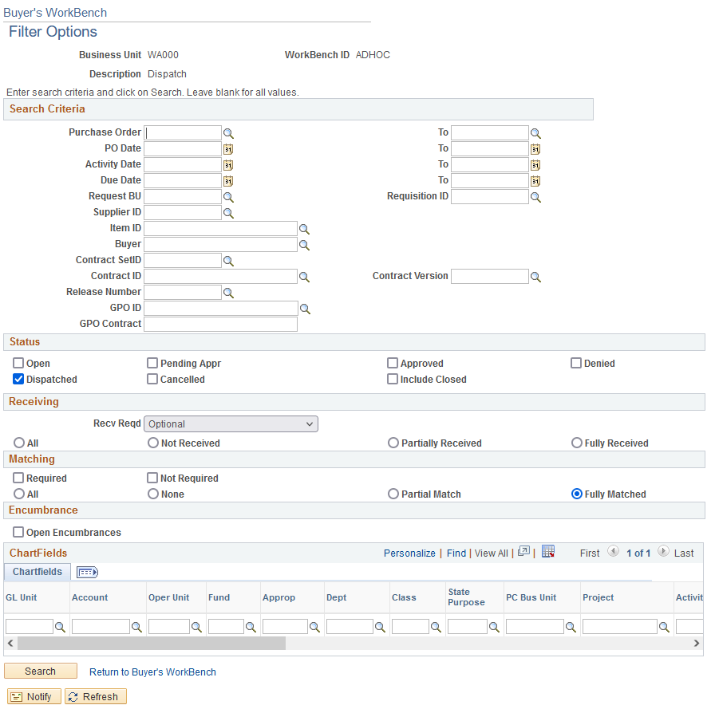
Zero Encumbrance Purchase Order Search in Buyer’s Workbench

Slide 11
Closing Individual Purchase orders
Path = Nav > Purchasing > Purchase Orders > Reconcile POs
Buyer’s Workbench (Nav > Purchasing > Purchase Orders > Buyer’s Workbench)
  Can do smaller “batches”
  More selective (Zero Encumbrance POs)
  Pros and Cons
    Override!

Slide 12
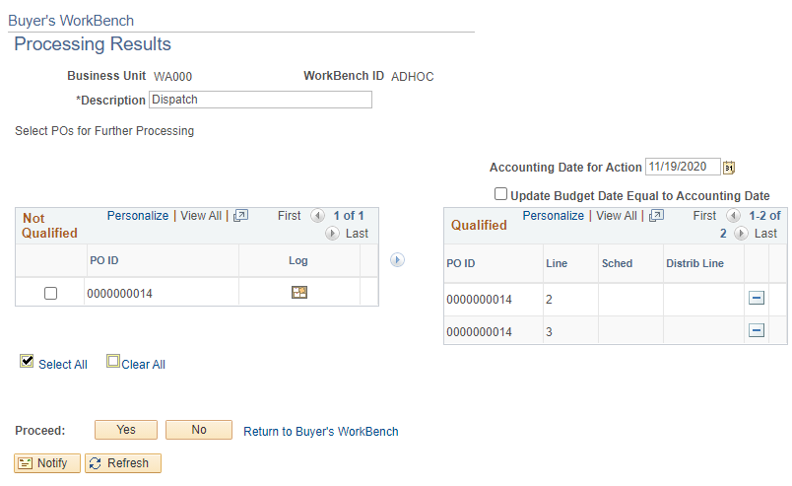
Override in Buyer’s Workbench

Slide 13
Closing Individual Purchase orders
Path = Nav > Purchasing > Purchase Orders > Reconcile POs
Buyer’s Workbench (Nav > Purchasing > Purchase Orders > Buyer’s Workbench)
  Can do smaller “batches”
  More selective (Zero Encumbrance POs)
  Pros and Cons
    Override!
    Need to run budget check after closing

Slide 14
Rolling over Purchase Orders
Why?

Slide 15
Rolling over Purchase Orders
Why?
  Double Dipping

Slide 16
Rolling over Purchase Orders
Why?
  Double Dipping
  Multi-Year POs

Slide 17
Rolling over Purchase Orders
Batch Process – 6 step process
    Go to Purchasing>Purchase Orders>Year End Processing>Request PO Roll View.
Select the date range (generally the entire previous fiscal year), and make sure that the GL business Unit is set to WA000. Run the process and monitor to completion.
The PO Rollover session recording (and other recordings) are found within the Canvas ctcLink Work Session Information course.
Here’s a quick guide how to add the Work Session course to your existing Canvas Courses: https://docs.google.com/document/d/12DNKhEoouryjVjwMAeiYOfKrPzlQ6Sju/edit

Slide 18
Rolling over Purchase Orders
Batch Process – 6 step process
    Go to Purchasing>Purchase Orders>Year End Processing>PO Rollover Workbench.
Select the name of the report that you ran in the previous step and search.
From the list that comes up, select the check box(es) of the POs that you wish to roll forward. Save.

Slide 19
Rolling over Purchase Orders
Batch Process – 6 step process
    Go to Purchasing>Purchase Orders>Year End Processing>Request PO Rollover1.
Make sure that you have the business unit and dates all set correctly and select run.
Monitor the process. When complete, go to the next step.

Slide 20
Rolling over Purchase Orders
Batch Process – 6 step process
    Budget Check all of the POs that you processed in the previous step. This can be done in the Buyer's Workbench or in the Budget Check process.
    Go to Purchasing>Purchase Orders>Budget Year End Processing>Request PO Rollover2.
    Budget Check all of the POs that you processed in the previous step. This can be done in the Buyer's Workbench or in the Budget Check process.

Slide 21
Rolling over Purchase Orders
Individual – Building It from Scratch/What’s Going On
    Determine expended and residual encumbrance
    Add a line with the residual encumbrance with the Budget Date in the new fiscal year
    Reduce the original line to the expended encumbrance in the current fiscal year (Budget Date).

Slide 22
recommendations
Close as you go, don’t wait to year end.
When possible, write POs to end at the fiscal year end.
If you need a multi-year PO, separate the years, and make subsequent years a small amount. When the next year comes, roll the PO and adjust the new current year amount to the required sum.

Slide 23
recommendations
Regularly review outstanding POs
  Stuck POs
    Approved but not dispatched
    Open but not submitted
    Pending but not approved
    Pending Cancel but not fully cancelled
    Cancelled but not closed

Slide 24
recommendations
Regularly review outstanding POs
  Old POs
    Unused
      Won’t be used? > Cancel
      Will be used later? > Roll
    Partially Used
      Budget Dust? > Close with override
      Changed My Mind? > Close with override
      Will be used later? > Roll
    Zero encumbrance > Close

Slide 25
recommendations
The batch roll process seems to work better in the new FY, than it does in the end of the old FY.
Regardless, both years need to be open, and the budgets need to exist for all of the chart strings involved.
The process is finicky. It is probably better to be done by one person, than by all Buyers.

Slide 26
Final Slide
Contact Information:
  Thomas Oliver
  360-704-4388
  toliver@sbctc.edu
Questions?

