Slide 1
BAR Meeting Presentation October 24, 2024 Financial Data Accessibility for Department Managers & Financial Services Staff Bill Storms Centralia College

Slide 2
The players
Nikki Sprague – Director, Fiscal & Business Services
Cliff Frederickson – Director, Budgets
Carrisa Brown – Assistant Director, Fiscal & Business Services
Bill Storms – PT/Special Projects/Recovering IT Director

Slide 3
Topics
Where data resides
Options for accessing data
Examples of Posting useful information to Sharepoint - Cliff
Examples using Tableau
Examples using Access (FMSQuery meets FINQuery)

Slide 4
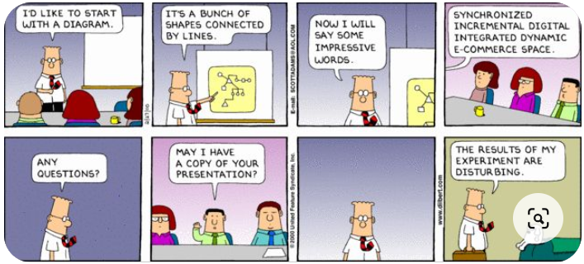
Hopefully this is not how this turns out.

Slide 5
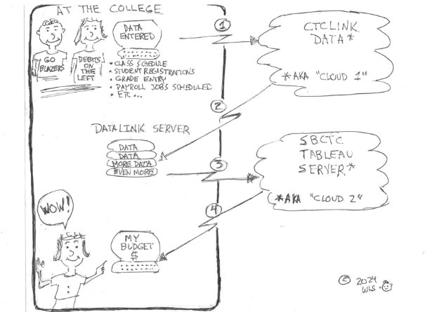
Where Data Resides?

Slide 6
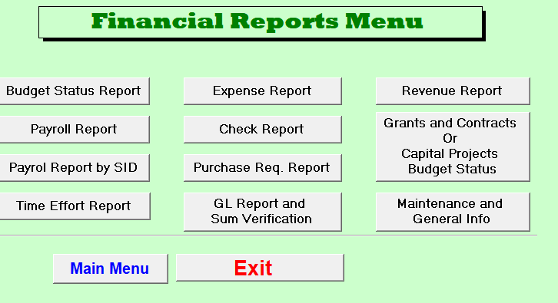
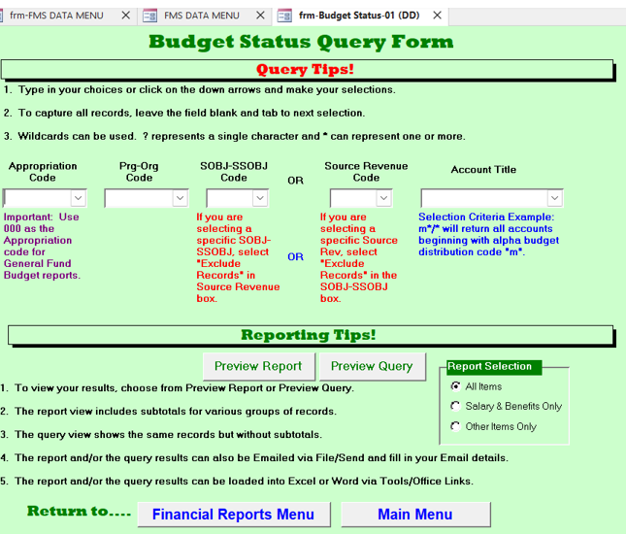
At the College (usually)

Slide 7
2. Options for Accessing Data
Posting to Sharepoint – Cliff
CTCLINK PSQUIRIES /REPORTS
Tableau Dashboards (or similar)
Microsoft Access (FMSQuery-like)

Slide 8
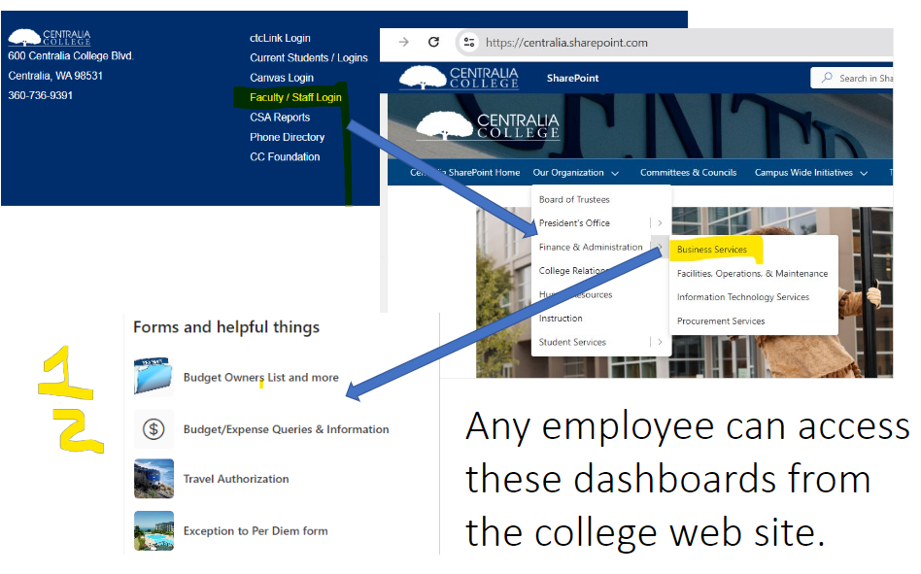
Centralia College’s Approach

Slide 9
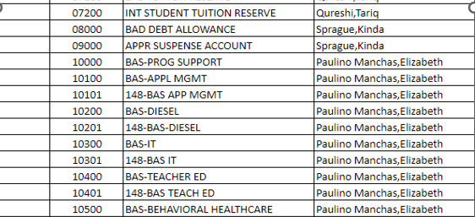
Cliff’s useful worksheet in Sharepoint:
Cliff

Slide 10
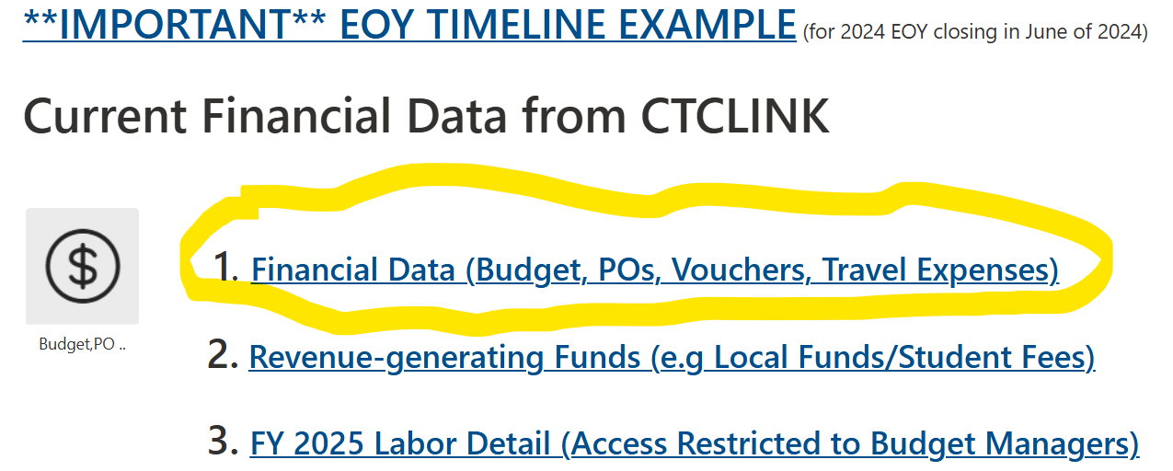
Operating Revenue & Expenses

Slide 11
Operating Revenue & Expenses
Budget = Budget, Encumbrances, Expenditures, Available Budget
Purchase Orders Details = Items that were or are on order
Voucher Details = Payments made (non-payroll)
Expense Report Details = Travel & related expenditures
Payroll by Date = Salary & Benefits by employee by pay period
Payroll to Date = Salary & Benefits by employee YTD

Slide 12
Budget Status Screen

Slide 13
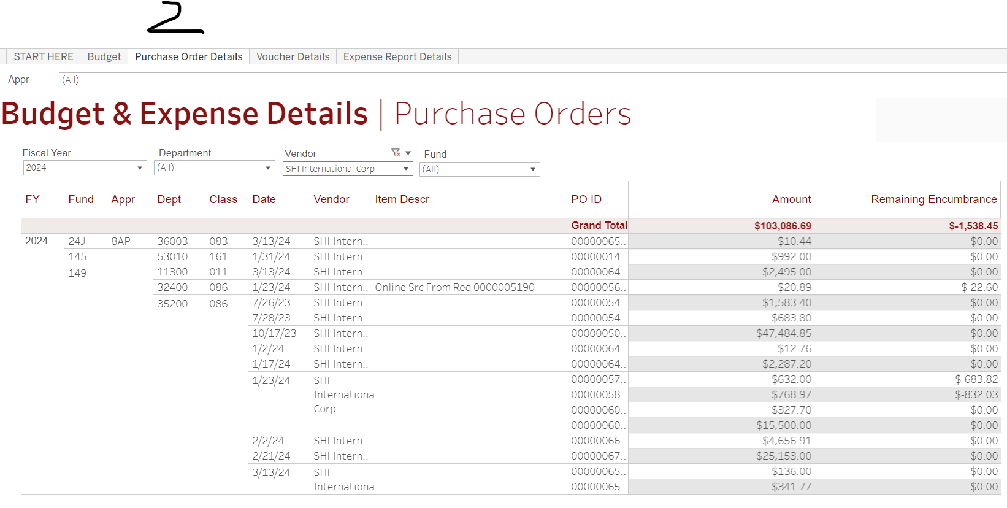
Purchase Order Screen

Slide 14
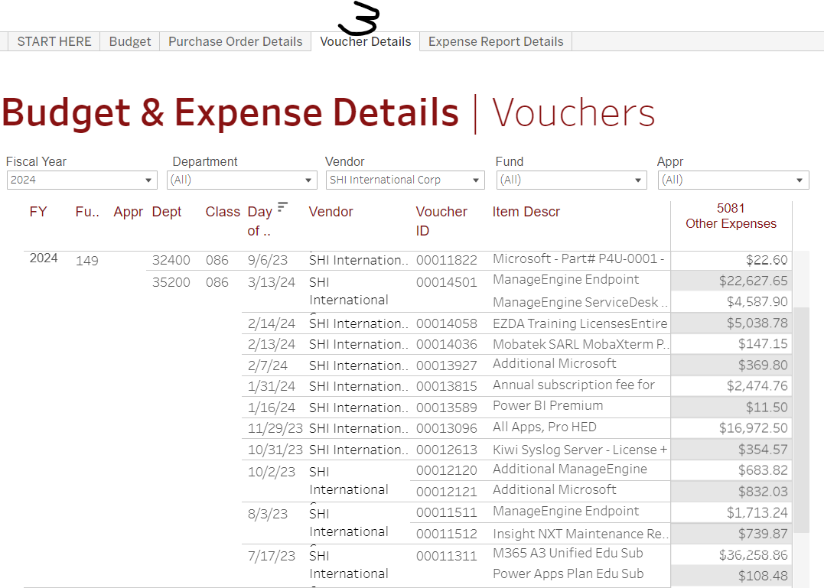
Voucher (Payments) Screen

Slide 15
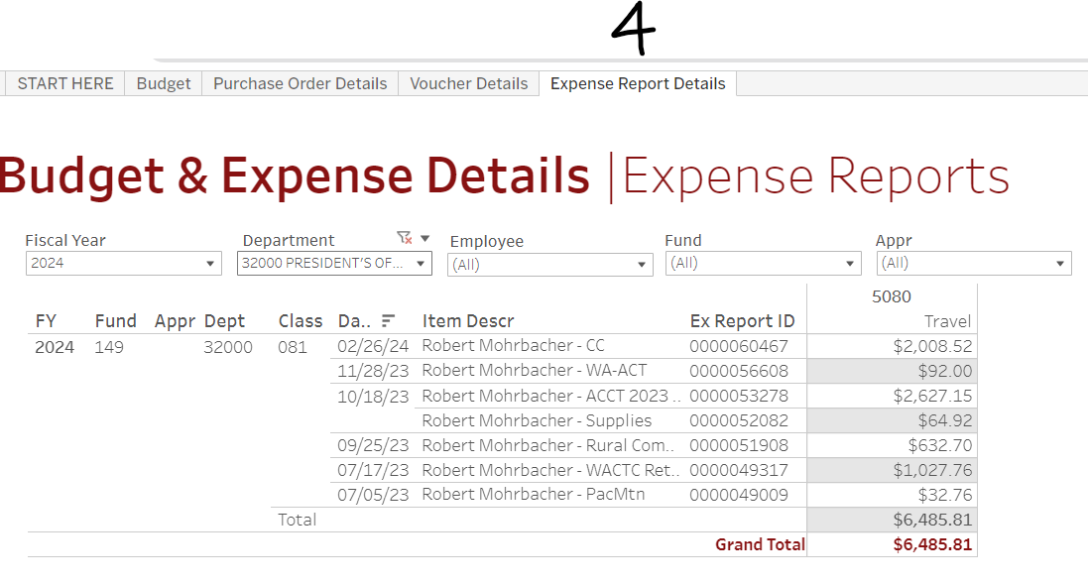
Travel (Payments) Screen

Slide 16
Payroll (Salary & Benefits) by Pay Period
Under Discussion as to access

Slide 17
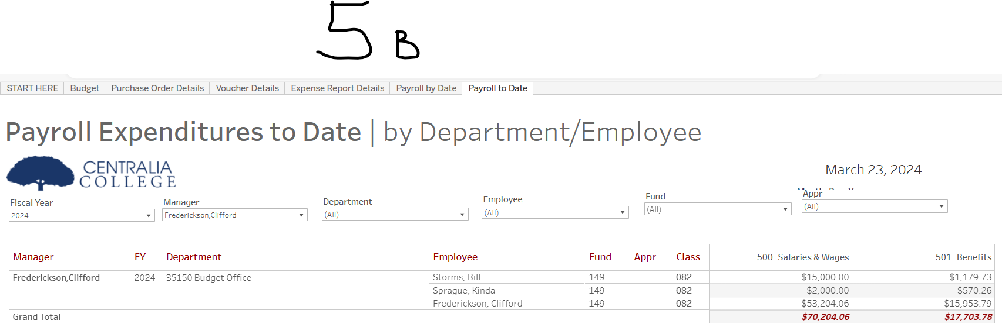
Payroll (Salary & Benefits) YTD
Under Discussion as to access

Slide 18
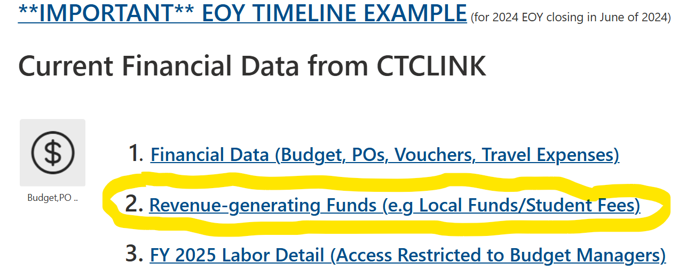
Revenue Generating Departments/Funds

Slide 19
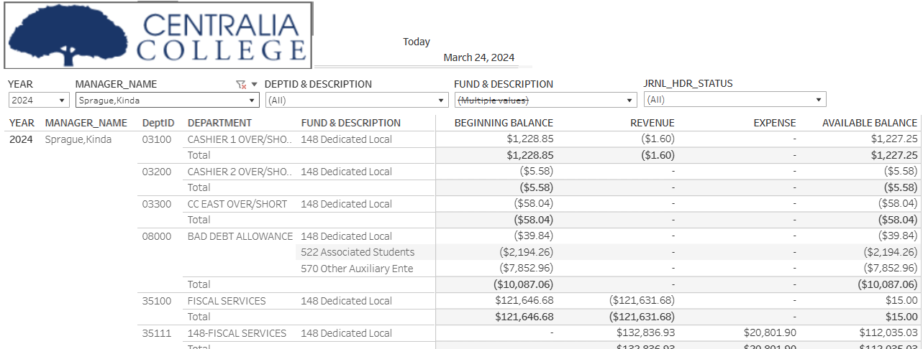
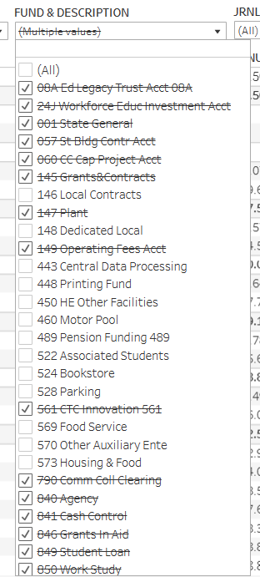
And also this: Revenue-Generating Local Funds
Under Discussion as to access

Slide 20
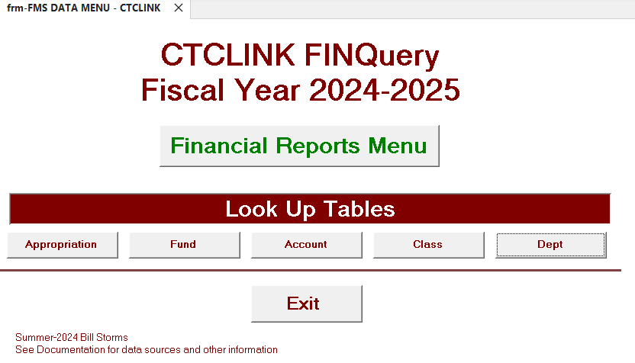
FINQuery – FMSQuery revisited

Slide 21
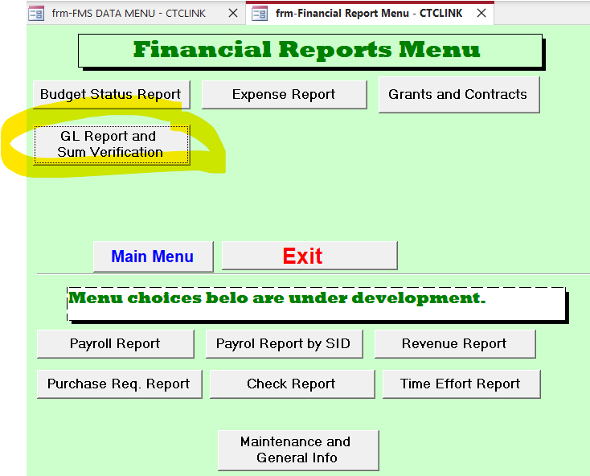
FINQuery – FMSQuery revisited

Slide 22
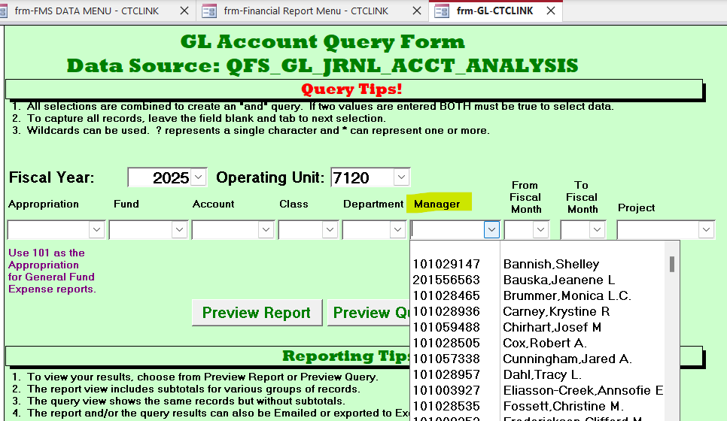
FINQuery – FMSQuery revisited

Slide 23
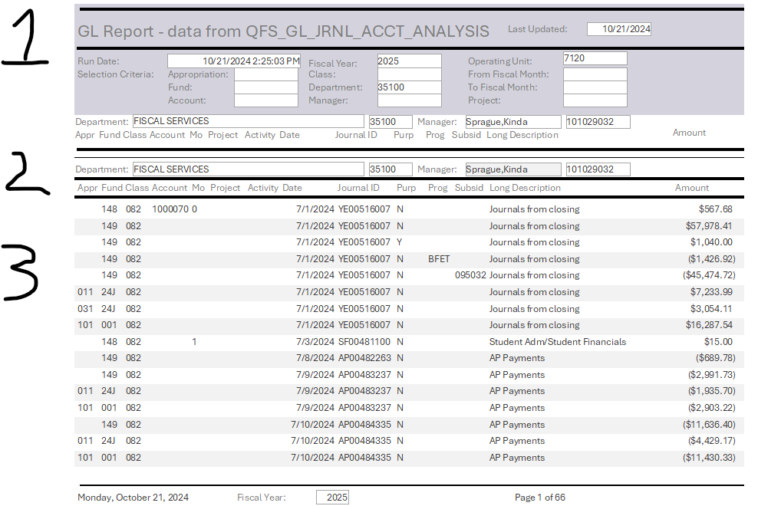
FINQuery – FMSQuery revisited

Slide 24
FINQuery – FMSQuery revisited

Slide 25
How we did things in the past may have been different and then there was: CTCLINK Ransomware Covid Staff Turnover

Slide 26
“Consultants"

Slide 27
Managing a Budget – Best Practices

