Slide 1
Student Financials and the General Ledger SMARTer, Untrue Refunds, FARC/FARP
State Board Student Financials Customer Support & ABS SF Accounting
Fall 2024 BAR Meeting
October 23, 2024

Slide 2
INTRODUCTIONS
Jackie Thoms
SBCTC ctcLink Business Analyst (SF/FIN)
Amy Lanser
SBCTC Functional Analyst (Student Financials)
Brandon Reed
SBCTC Student Financials ctcLink Customer Support Associate Director

Slide 3
AGENDA
SMARTer Reports – SF errors
Untrue Balances
Financial Aid Repayments – FARC/FARP
Questions

Slide 4
SMARTer
- and Student Financials

Slide 5
SMARTer
What is SMARTer?
SMARTer is a query based system for finding errors in your General Ledger
https://www.sbctc.edu/colleges-staff/programs-services/accounting-business/

Slide 6
SMARTer – con’t
All queries are run in the FSCM module
In Query Manager or Query Viewer, search for Folder Name beginning with “SMART” to pull all available queries:

Slide 7
SMARTer – con’t
Queries relating to Student Financial transactions:
305A, 305B, 305C

Slide 8
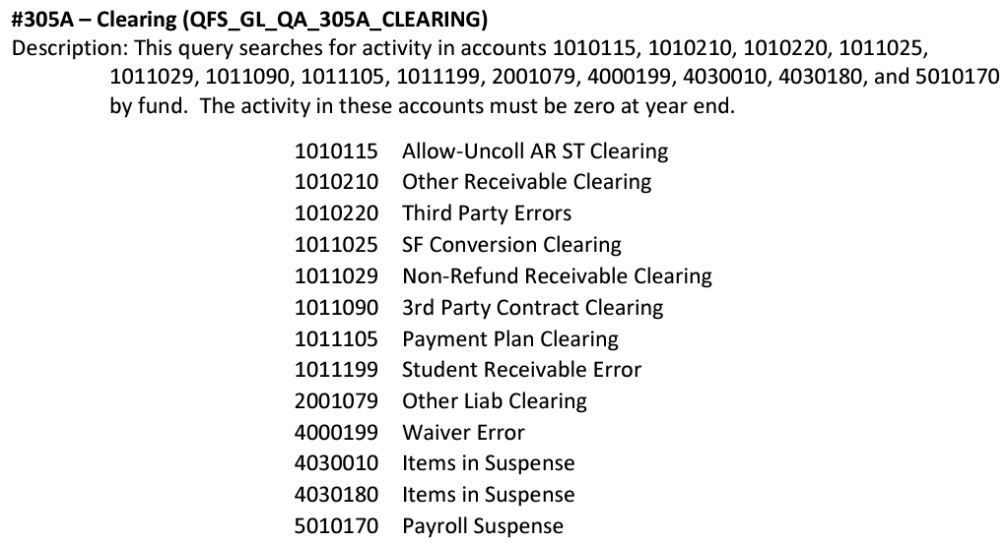
SMARTer – #305A
Notes:
Looking for things that are “stuck” or unapplied

Slide 9
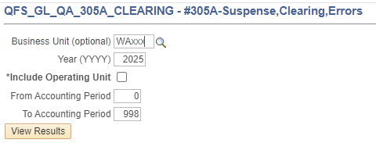
SMARTer – #305A
This query is looking for payments that are “stuck” or unapplied

Slide 10
SMARTer - #305A
- Third Party Errors

Slide 11
SMARTer – #305A TPC
CS NavBar>Student Financials>View Customer
Pull up student account and there is an unapplied TPC
For this example, the fix is simple - the student should be set to cancelled on the TPC Assign page.

Slide 12
SMARTer – #305A TPC
Other Examples
Amount eligible on the TPC/Assign page needs to be reduced
The TPC itself might need changes such as adding Tree Nodes/Item Types in order for them to be paid
The system can be sassy, as we all know, so canceling then activating a student on the TPC Assign page

Slide 13
SMARTer - #305A
- Payment Plan Errors

Slide 14
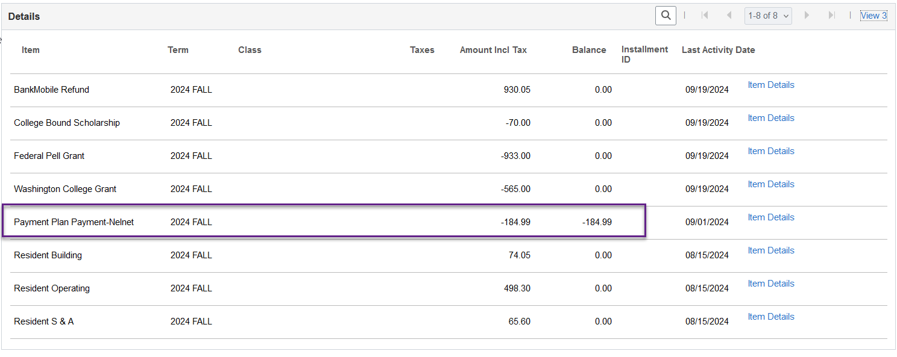
SMARTer - #305A Payment Plans
Nelnet Item Type is on our list to fix as, unlike the delivered Payment Plan Item Types, these have dollars behind them. This means until the refund is processed it will show on the SMARTer repor

Slide 15
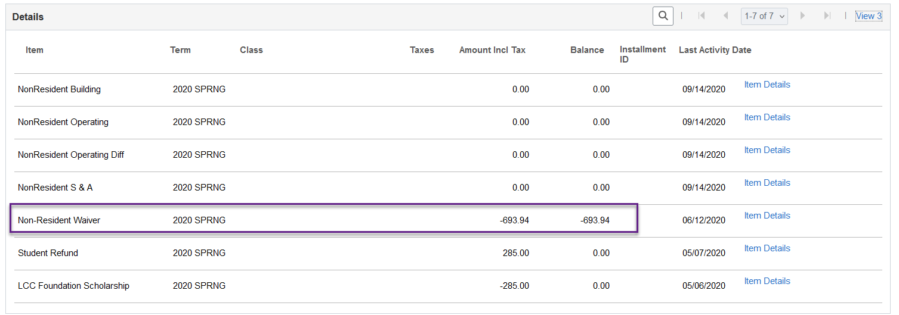
SMARTer - #305A Payment Plans
Examples from the SF side:
Unapplied Wavier causing error, should be removed via criteria

Slide 16
SMARTer - #305A
- Waiver Errors

Slide 17
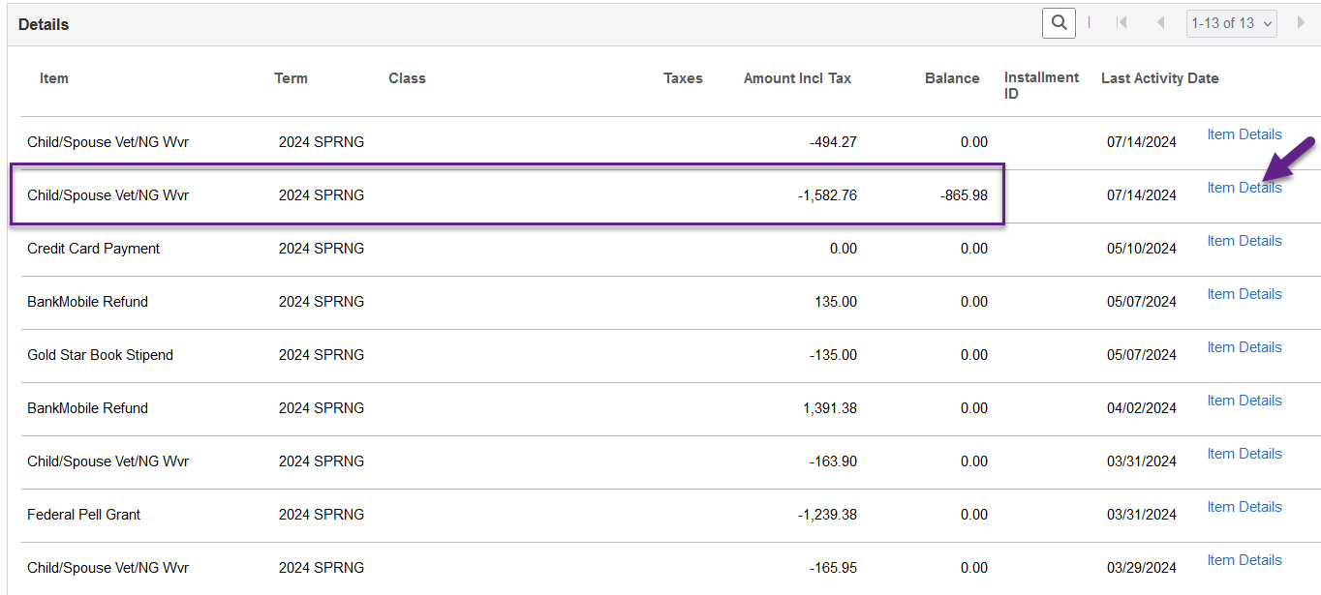
SMARTer - #305A Waivers
Two Separate line Items for a Waiver
Drill down on the unapplied Waiver Line Item using the Item Details hyperlink

Slide 18
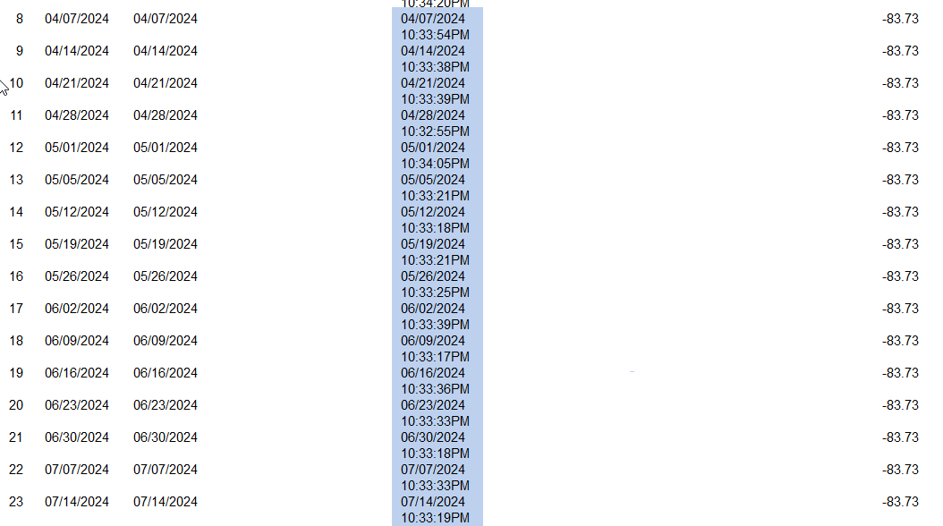
Waiver is being reversed and reposted every Sunday…hmmm

Slide 19
Favorite Tuition Calc Trick

Slide 20
More FIXING
If a waiver has an unapplied credit with an outstanding charge, it can be one of the following:
The charge Item Type is not on the (Charge Priority List) CPL
This requires a jiggle of the system and a ticket to SF Support
The Waiver is not attached to the Term Fee on the Tuition Group
The charge is not eligible to be waived but at one point is was set as eligible
This requires a jiggle of the system and a ticket to SF Support

Slide 21
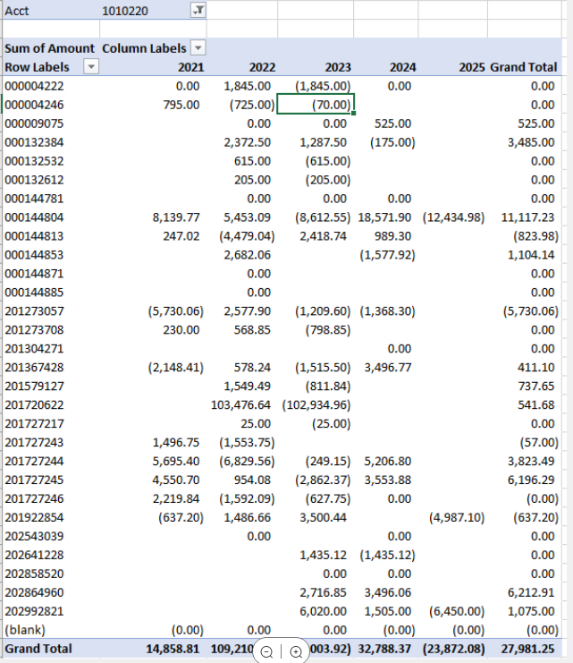
#Pulldanamy

Slide 22
SMARTer - #305B
- Non-tuition Revenue in a Tuition fund

Slide 23
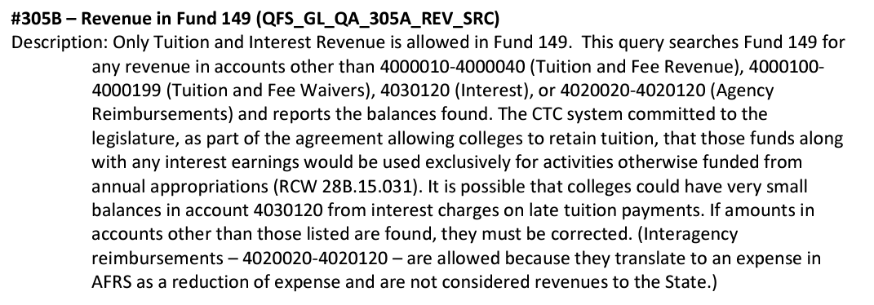
SMARTer – #305B
Notes:
Looking for non-tuition revenue in a tuition fund (149) – e.g. fee waivers

Slide 24
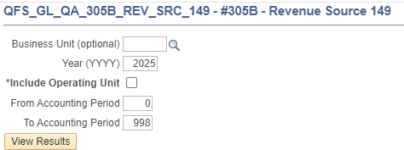
SMARTer – #305B
The 305B query is looking for non-tuition revenue in a tuition fund (149) – e.g. fee waivers

Slide 25
SMARTer – Tuition vs. Fees
What revenue is allowed in a Tuition Fund?
Only those accounts used specifically for tuition are allowed in a Tuition Fund:
4000010 – Tuition and Fees
4000020 – Resident Tuition
4000030 – International Tuition
4000040 – Non-Resident Tuition
Any other revenue accounts in a Tuition Fund will not be allowed and will create SMARTer errors:
4000050 – Dedicated Student Fees
4000060 – Misc. Student Fees

Slide 26
SMARTer – #305B
How are these fixed?
Research to see what item types are creating these entries. The GL chart strings on the item type itself will most likely need to be corrected to a tuition revenue account

Slide 27
SMARTer - #305C
- Tuition Revenue in a Non-Tuition fund

Slide 28
SMARTer –con’t
Notes:
Looking for tuition revenue in non-tuition funds

Slide 29
SMARTer – Tuition vs. Fees
What funds are allowed to have tuition revenue?
The following funds are the only funds permitted to have tuition revenue:
060 – Building Fee Revenue
149 – Local General
522 – Student and Activities
561 – Innovation Fund
860 – Institutional Financial Aid
Any other funds, such as those listed below will create SMARTer errors:
148 – Dedicated Fee revenue
524 – Bookstore
528 – Parking
Etc.

Slide 30
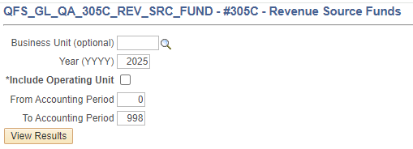
SMARTer con’t
The 305C query is looking for Tuition revenue in Non-tuition funds – e.g. tuition waivers in funds 146, 148, 524, 528, etc.

Slide 31
SMARTer – Tuition vs. Fees
What does the State consider “Tuition and Fees”?
Per RCW 28B.15.020:
Tuition:
Operating fees, building fees and the services and activities fees combined are considered ‘tuition and fees’
Operating fee
Building fee
S&A fee (tuition portion only)
Innovation fee
3.5% Institutional Financial Aid
Fees:
Amounts collected that are dedicated to the support of specific courses or activites – e.g. lab fees, continuing education fees, technology fees

Slide 32
SMARTer – #305C
How are these fixed?
The vast majority of these errors are coming from Waiver payments. Our current guidance is to review the item types generating these entries.
If they are coming from waiver payments, note that as such and ignore the error warnings.

Slide 33
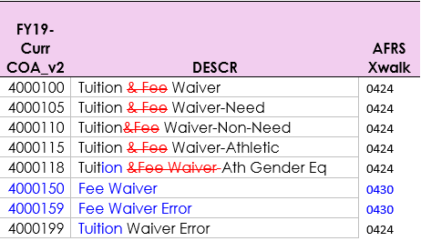
SMARTer – #305C
In the Future:
- New GL Accounts and Account Names
- SF Adjustment Waivers for fees
*coming FY 2025
Notes:
Tuition waivers will waive only Tuition Charges, Adjustment waivers will waive fees – per college BoT regulations

Slide 34
SMARTer – #305C
The New GL account codes and Adjustment waivers will allow colleges to apply Tuition waivers to Tuition charges and Adjustment waivers to Fee charges. That should resolve the errors we are seeing with the SMARer #305C report.
Notes:
Tuition waivers will waive only Tuition Charges, Adjustment waivers will waive fees – per college BoT regulations

Slide 35
Untrue Balances
- and the Student Account

Slide 36
SF and GL – Untrue Balances
Untrue Balance Queries:
QCS_SF_UNTRUE_ZERO_BAL
QCS_SF_UNTRUE_BAL_TOT_LINE
What is Untrue about them?
These show accounts with unapplied credits and unpaid charges, making the overall surface level balance appear different than the sum of unpaid charges.
This will impact credit history and what the student sees in self service. Example a student would receive a notice they owe BUT on Self Service it shows nothing to pay.
This is also impacts GL Recon, as “Payment” item types are setup with pick up receivable from charge.
A existing credit not being applied to a charge makes for an incomplete GL message

Slide 37
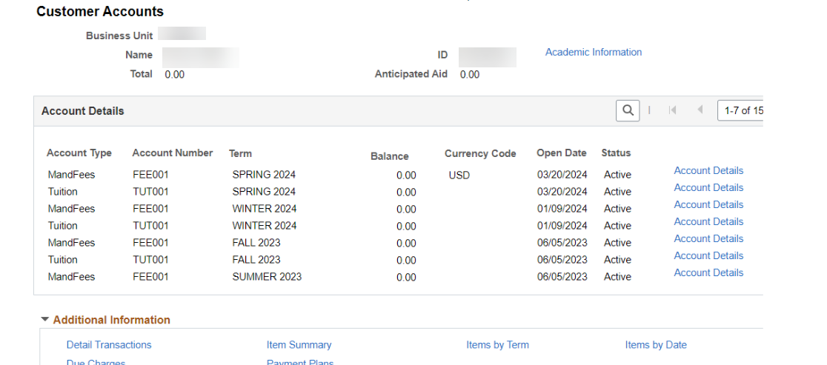
SF and GL – Untrue Balances
The Student Account

Slide 38
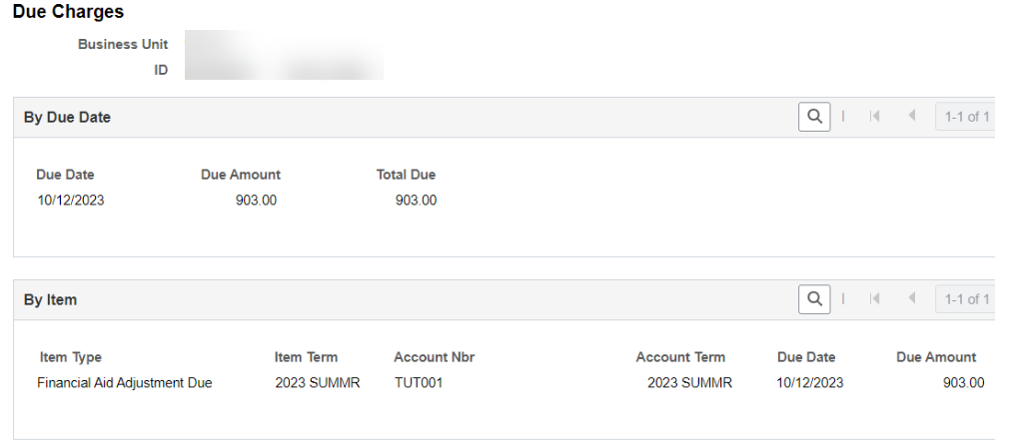
SF and GL – Untrue Balances
The Student Account

Slide 39
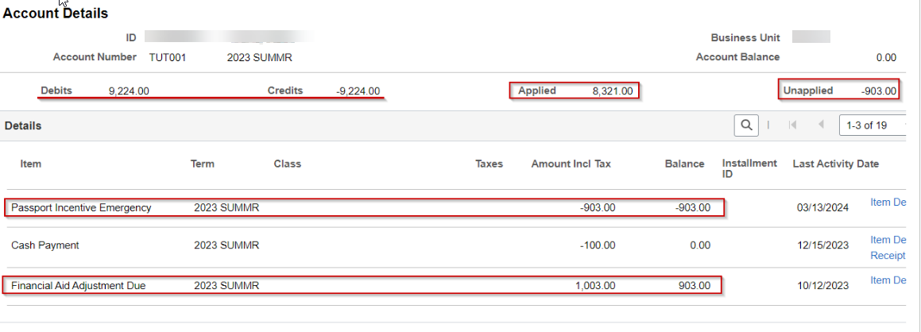
SF and GL – Untrue Balances
The Student Account

Slide 40
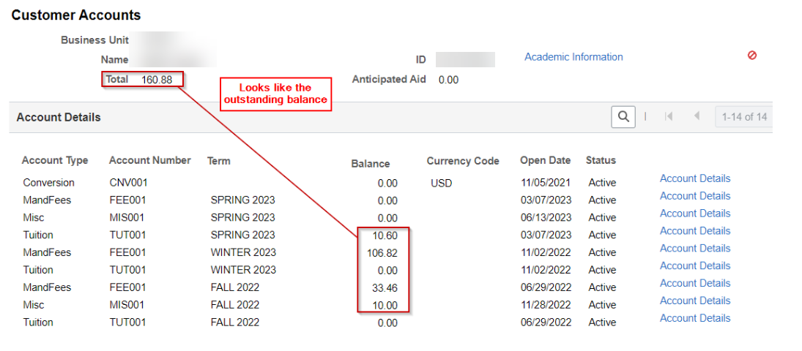
SF and GL – Untrue Balances
The Student Account

Slide 41
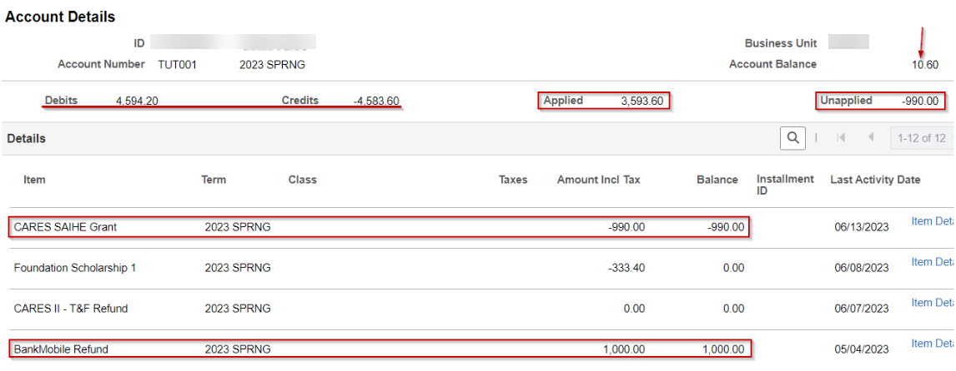
SF and GL – Untrue Balances
The Student Account

Slide 42
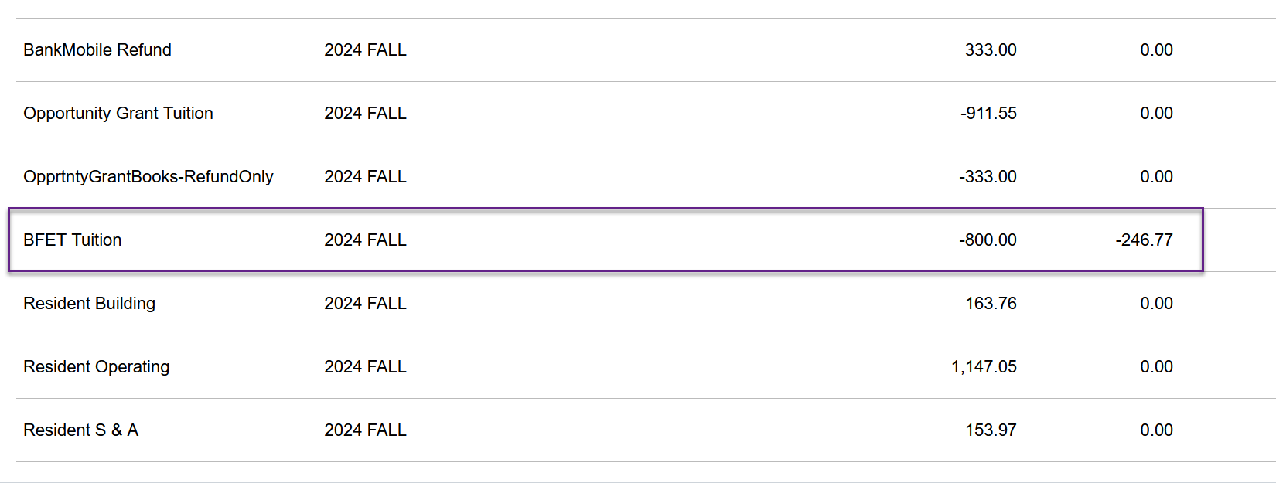
Unapplied FA Refund vs Reduction

Slide 43
Financial Aid
Finally any FA unapplied credits would be reviewed by that team prior to any fixing.
Some but not all of the following might be the fix
If eligible, send the credit to the student - my favorite
Reduce the aid to what was paid out, removing the credit from the account
If the charge is eligible then updating the CPL and a ticket to SF Support
Fixing it in the FA module, I won't use words because they could be incorrect

Slide 44
Financial Aid Repayments (FARP/FARC)
- and Internal Cash

Slide 45
FARP/FARC
What is FARC/FARC and how is it used?
When a student receives a refund of financial aid, then has that aid reduced (due to dropped classes, etc.) the reduction of aid appears as a “credit” refund, which can be confusing to the student
To clean up the account, Student Financials staff must apply the FARC and FARP item types:
FARP - Financial Aid Refund Payment – this payment clears the credit refund from the FAID refund line
FARC - Financial Aid Refund Charge – This charge (in the exact same amount as the FARP payment) is added to the student account and must be paid back to the college
Notes:
Tuition waivers will waive only Tuition Charges, Adjustment waivers will waive fees – per college BoT regulations

Slide 46
FARP/FARC
FARP/FARC Item Types:
709610000000 Financial Aid Refund Adjust - ‘FARP’ FA repayment to apply to FA student refund balance owed (any FA refund - Student Refund or Bank Mobile Refund)
496100000000 Financial Aid Adjustment Due - ‘FARC’ FA repayment charge item type to apply
Notes:
Tuition waivers will waive only Tuition Charges, Adjustment waivers will waive fees – per college BoT regulations

Slide 47
FARC/FARP
Reconciling FARP/FARC and Internal Cash
If the FARC/FARP item types are not applied equally, and at the same time, your internal cash will be out of balance
Suggested Queries:
QCS_SF_E214_ACCTG_LN
CTC_SF_ACCTNG_LN_WITH_PROMPTS
Notes:
Tuition waivers will waive only Tuition Charges, Adjustment waivers will waive fees – per college BoT regulations

Slide 48
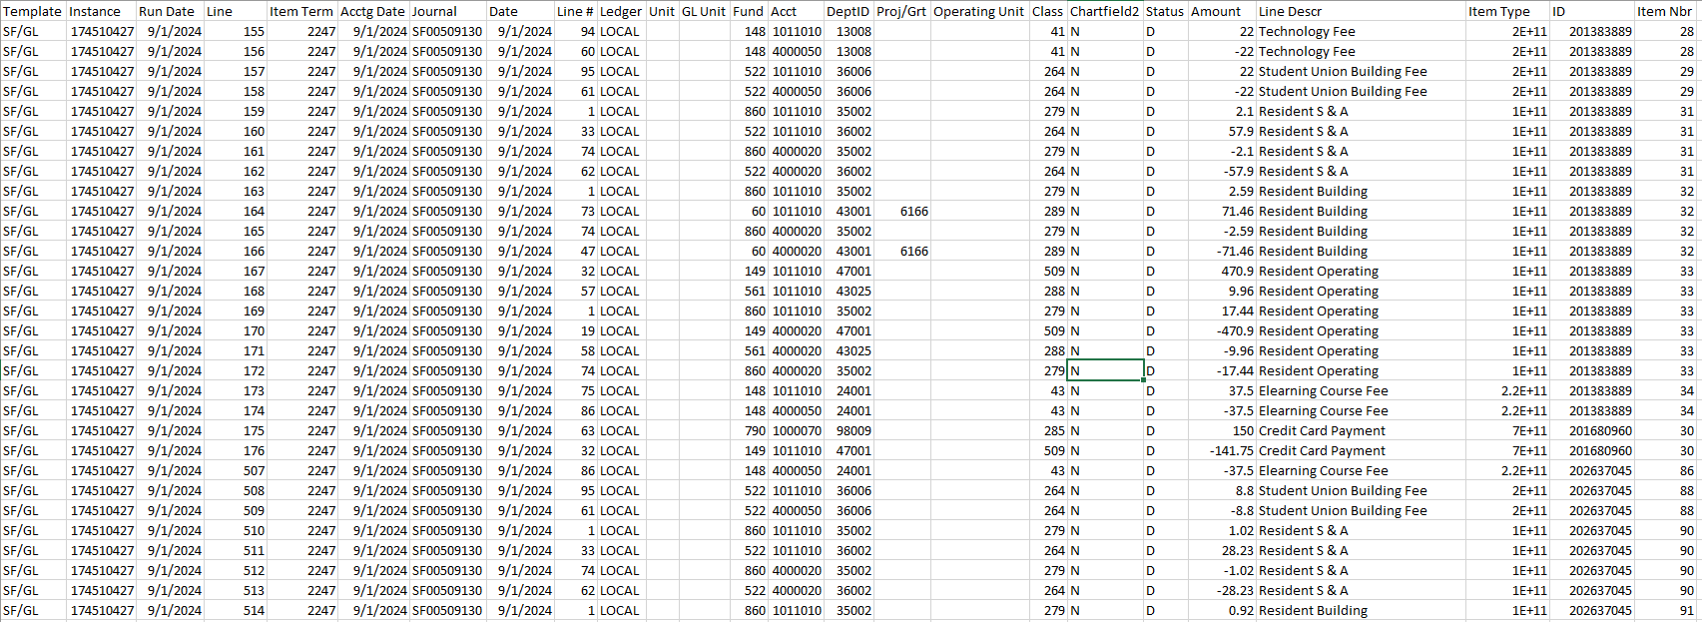
FARC/FARP
Run the E214 for the month/week/day in question
Notes:
Tuition waivers will waive only Tuition Charges, Adjustment waivers will waive fees – per college BoT regulations

Slide 49
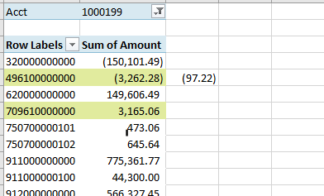
FARC/FARP
Pivot the E214 data by Item Type
Look for differences in the amounts of internal cash hitting 496100000000 and 709610000000
Notes:
Tuition waivers will waive only Tuition Charges, Adjustment waivers will waive fees – per college BoT regulations

Slide 50
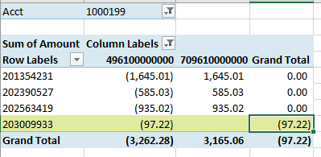
FARC/FARP
Pivot the E214 data by EMPL ID
You can see there is one student with a FARC but no FARP
Notes:
Tuition waivers will waive only Tuition Charges, Adjustment waivers will waive fees – per college BoT regulations

Slide 51
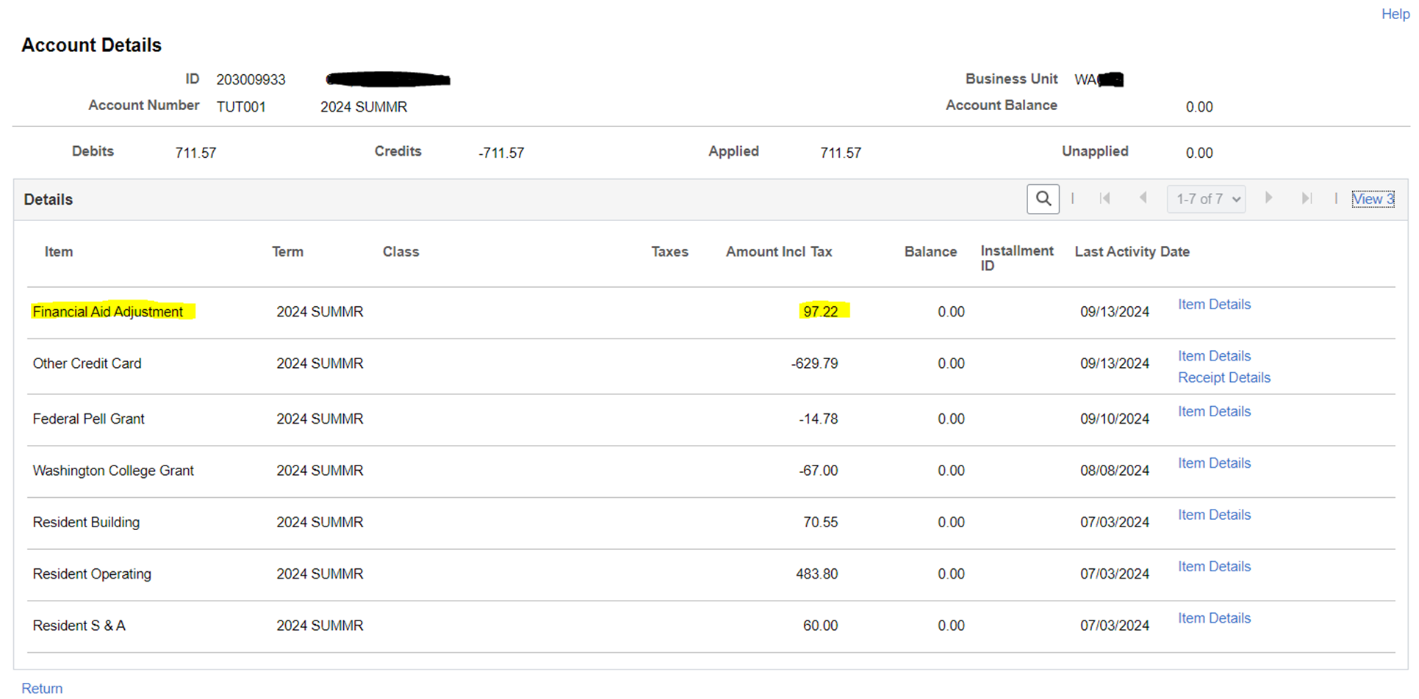
FARC/FARP
Review the Customer Account to making sure it agrees with what you are seeing in the GL.
Notes:
Tuition waivers will waive only Tuition Charges, Adjustment waivers will waive fees – per college BoT regulations

Slide 52
FARC/FARP
These differences must be corrected in Student Finance and allowed to flow through to GL
Please work with both your Student Finance and Financial Aid staff to determine what needs to be done.
Possibilities could include:
Additional aid was applied and FARC was removed but not FARC (or vice versa)
Have aid that can be applied to a charge? Reverse both FARC FARP item types first!
When the clean up was done only one item type was added – remember, these two must always be together
Financial Aid Refund Adjustments QRG
Notes:
Tuition waivers will waive only Tuition Charges, Adjustment waivers will waive fees – per college BoT regulations

Slide 53
Questions? Comments?

Slide 54
THANK YOU
SBCTC Accounting Support
and
SBCTC Student Financials
SFSUPPORT@SBCTC.EDU

