Slide 1
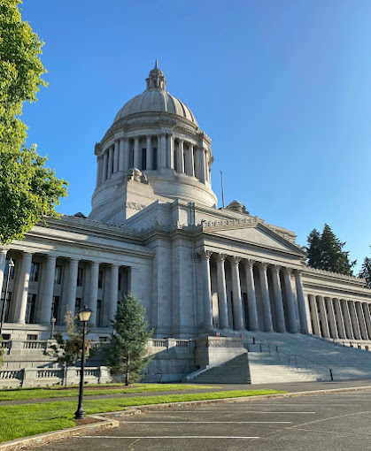
One Washington
Statewide Accounting newsletter
https://ofm.wa.gov/sites/default/files/public/accounting/ConnectionNewsletter/Fall24.pdf
SAAM changing to WAAM
Status of go-live
Attestation is still a thing of the future (Near? Maybe / maybe not?)

Slide 2
Year-end close for FY24
The good the bad and the ugly…
Need to work on
Wins
Follow cut-off / due date requirements
Addressing cleanup work timely rather than at YE
Not using reports and tools that are available
Not having enough staff to get things done timely
We did close and OFM accepted our data before the very last day (first time in a long time)
Direct loans were recorded better
OFM exception reports were significantly less than previous years

Slide 3
What can we do to prepare for next year?
Don’t procrastinate!
Make sure you have cleaned up all inactive funds / ai’s
Watch your error reports monthly (and do the fixes)
Complete balance sheet reconciliations
What will cut-off’s look like for closing next year – knowing that we will eventually be going live with One Washington?

Slide 4
What is on the agenda for SBCTC System Accounting for FY25?
State Board offices have moved
Reconciliation help on Thursdays at 10am
New grant from NOAa
Rumors about travel rules
Best Practices
One-time suppliers
One-time customers
Where are we with CLAM (accounting) and sPAM (payroll)
https://www.sbctc.edu/colleges-staff/programs-services/accounting-business/
System changes:
Control Accounts
New journal types
SF account changes
Asset value changes

