Slide 1
BUDGET REQUEST PROCESS

Slide 2
First and most important step
Do we have money to do it?
  Review last year’s financials
  Review YTD financials
  Year End forecast
  Upcoming expenses (large expenses, projects, consulting, etc.)
  Review Grants (Reductions, ending, new)
  State allocations and legislation changes
  Organizational Restructure
  Amount available for requests

Slide 3
Budget Planning & Development Calendar
DATE | ACTIVITY
Jan 2026 | Student fee proposals submitted to Board of Trustees (BOT)
February 6, 2026 | Budget Advisory Council (BAC) initial meeting
February 27, 2026 | Request BOT's approval of student fees (for upcoming academic year)
February 24, 2026 | Executive Cabinet to finalize budget planning objectives & priorities
February 26, 2026 | BAC feedback on budget planning objectives & priorities
Feb - Apr 2026 | Campus budget planning @ division level
April 7, 2026 | Campus Budget Forum #1
April 30, 2026 | All budget requests due
May 7, 2026 | EC budget presentations to Budget Advisory Council
May 15, 2026 | Budget Advisory Council to provide budget feedback & recommendations
May 29, 2026 | Executive Cabinet to draft Fiscal Year Budget
June 2, 2026 | Campus Budget Forum #2
June 11, 2026 | FY Budget updates to BOT
June 25, 2026 | DRAFT FY Budget completed
July 16, 2026 | PRELIMINARY FY Budget presentation to BOT
July - August | Budget fine-tuning
September 17, 2026 | Request BOT's approval for adoption of Fiscal Year Budget

Slide 4
Who is involved in the process?
All employees
Executive cabinet
Budget Advisory Council
Strategic Planning Committee

Slide 5
Budget Advisory Council
Group of employees from different programs and employee classifications that meets once a month during budget season and makes budget recommendations and feedback on budget planning to Executive Cabinet based on the college’s strategies and priorities.

Slide 6
Strategic Planning Committee
The Strategic Planning Council (SPC) provides institutional leadership and oversight for Highline College’s Strategic Plan for Equitable Student Success. The Council ensures that the college’s strategic planning process is equity-centered, data-informed, participatory, and aligned with accreditation standards and institutional mission fulfillment.

Slide 7
TOOLS
Each VP gets a copy Budget by Manager query
Our budget and expense dashboard
Meetings with Budget director and managers

Slide 8
Budget Request Template
  Name and program requesting additional funds
  Amount requested
  Specify if it is a one-time vs recurring funding
  Align request to the Strategic Goals/Priorities of the College
  Purpose & Justification
  Impact on the program and the institution
  Attach a copy of the budget and expenses for the previous and current year

Slide 9
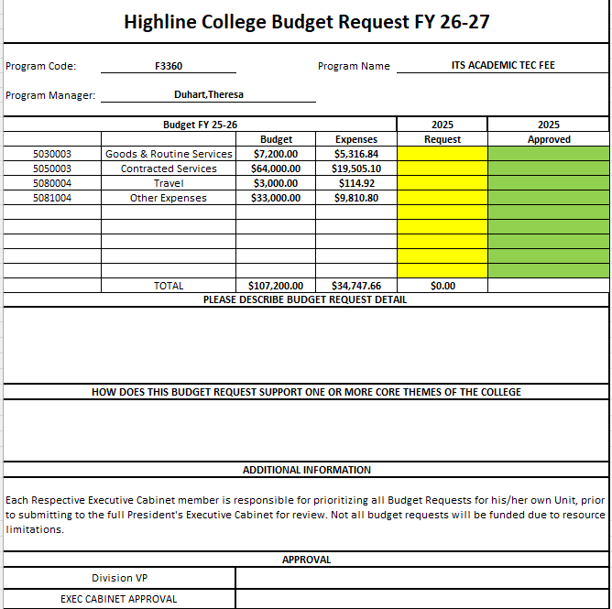
Salary increase, new staff or reclassifications are processed separate

Slide 10
How are requests processed and reviewed?
Requests are submitted by the program manager
All requests are submitted to the respective VP
VP reviews, rank and approve requests. Top priority requests are moved forward to Executive Cabinet.
Executive Cabinet to meet and present to the Budget Advisory Council.
BAC meets and discuss the presentations and submits decisions to EC.

Slide 11

THANK YOU!

