Slide 1
DES Contract for Professional Auditing & Financial Services (05825)
Chelsea Clark, Enterprise Contracts and Procurement Specialist
February 19, 2026
Notes:
Good Morning. It is my pleasure to present about the DES contract for professional auditing & financial services – known as 05825
My name is Chelsea Clark, I am an Enterprise Contracts and Procurement Specialist with the Washington Department of Enterprise Services.

Slide 2
AGENDA
What is DES?
Scope and Contract Awards
Contract Review
Performance Requirements
Contract Summary Page
Open Forum
Notes:
For today’s agenda,
We will go over what the Department of Enterprise Services is
And who can purchase from DES contracts
We’ll review the contract scope and Contract Awards
And then we will go over contract highlights including
Performance Requirements and where you can locate specific information
Followed by a quick tour of the contract summary page
Wrap up with any questions you may have

Slide 3
What is DES?
The Washington Department of Enterprise Services
Authority to create contracts for the state
Procurement bridge between purchasers (customers) and contractors
State Procurement Priorities
Notes:
Enterprise Services is the only state agency empowered to create Contracts for use by all Washington state agencies.
Using statewide contracts, Enterprise Services enables customers to acquire the goods/services they need – efficiently and cost-effectively – to perform their mission.
Some contracts focus on state procurement priorities such as:
Green product preferences (PCBs, recycled content, etc.)
Small and veteran business inclusion preferences
Economic & Social preferences – e.g., pay equality; wage theft, diverse subcontractor inclusion, etc.

Slide 4
ELIGIBLE PURCHASERS
Who are the customers of these contracts?
WA State Agencies
WA Political Subdivisions (such as cities, counties, towns…)
Tribes in WA
Federal Agencies in WA
Public Benefit Nonprofits in WA
Organizations with Current Contract Usage Agreements
Notes:
Who are the customers of these contracts?
Washington State Agencies.
Washington Political subdivisions – e.g., Cities, Counties, Towns
Tribes located in Washington
Federal Agencies
Public Benefit Nonprofit Organizations
Organizations with Current Contract Usage Agreements

Slide 5
PROCUREMENT SCOPE
This contract is for Professional Auditing & Financial services – which are performed in accordance with Generally Accepted Government Auditing Standards (GAGAS), and the AICPA Professional Standards where applicable.
Categories:
Category 1 – Financial Auditing and Services: This category includes the analysis of an entity's financial statements and accompanying disclosures.
Category 2 – Grant Compliance Auditing: This category ensures grantee, and all sub-grantees are compliant with the requirements and stipulations of a grant and that funds are spent in accordance with the approved budget provided in a grant application.
Notes:
This contract is for Professional Auditing & Financial services – which are performed in accordance with Generally Accepted Government Auditing Standards (GAGAS), and the AICPA Professional Standards where applicable.
The scope has been broken down into seven categories, which we will briefly go over.
Category 1 – Financial Auditing and Services: This category includes the analyses of an entity's financial statements and accompanying disclosures.
Category 2 – Grant Compliance Auditing: This category ensures grantee, and all sub-grantees are compliant with requirements and stipulations of a grant and that funds are spent in accordance with the approved budget provided in a grant application.

Slide 6
PROCUREMENT SCOPE (CONT)
Categories continued:
Category 3 – Health Care Compliance/Auditing: This category involves the analysis of identifying any incorrect or missing documentation that could have negative results for the audited facility e.g. loss in accreditations, physician’s licenses or Medicare status and medical payments.
Category 4 – Forensic Auditing: This category is the examination and evaluation of a firm's or individual's financial records to derive evidence that can be used in a court of law or legal proceeding.
Category 5 – Accountability/Compliance Auditing: This category is an evaluation of internal controls designed to ensure public assets are safeguarded and compliant.
Notes:
Category 3 – Health Care Compliance/Auditing: This category involves the analysis of identifying any incorrect or missing documentation that could have negative results for the audited facility e.g. loss in accreditations, physician’s licenses or Medicare status and medical payments.
Category 4 – Forensic Auditing: This category is the examination and evaluation of a firm's or individual's financial records to derive evidence that can be used in a court of law or legal proceeding.
Category 5 – Accountability/Compliance Auditing: This category is an evaluation of internal controls designed to ensure public assets are safeguarded and compliant.

Slide 7
PROCUREMENT SCOPE (CONT)
Categories continued:
Category 6 – Higher Education Auditing. This category is for the financial, auditing, and technical assistance of services of higher education programs and systems, including but not limited to accreditation compliance, revenue sources, grants, auxiliary operations.
Category 7 – General and Other Auditing Services: This category is primarily intended to capture auditing services that don’t fit into any other category, including allowing Bidders to list other specializations for financial, compliance, or other types of auditing such as: commodity commissions financial audits and passenger facility charge audits.
Notes:
And lastly,
Category 6 – Higher Education Auditing. This category is for the financial, auditing, and technical assistance of services of higher education programs and systems, including but not limited to accreditation compliance, revenue sources, grants, auxiliary operations.
Category 7 – General and Other Auditing Services: This category is primarily intended to capture auditing services that don’t fit into any other category, including allowing Contractors to list other specializations for financial, compliance, or other types of auditing such as: commodity commissions financial audits and passenger facility charge audits.

Slide 8
Awarded Contractors
05825 was Awarded to:
Nineteen (19) Contractors
Four (4) are Washington Small Businesses
One (1) is a Washington Veteran-Owned Business
Notes:
This contract was awarded to nineteen contractors. Four of them are Washington small businesses, and one is a Washington veteran-owned business.
Each contractor will vary in the categories they offer services for, and where they can provide those services. This information is broken down on the contract summary page, which we will be reviewing later on.

Slide 9
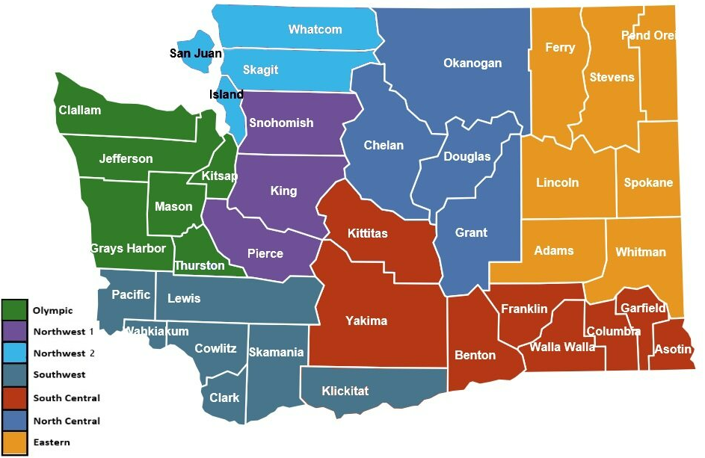
Regional Map
Notes:
05825 contains the following geographic service areas : statewide (all Washington state counties) and seven regions (each comprised of various Washington state counties).
Most of the nineteen awarded contractors cover the entire state of Washington.
For each of the seven regional areas, there will be up to two contractors for those areas.
The intent behind these regional awards is in case any customer is seeking in-person auditing services, this may help connect them with a Contractor faster at a better rate.

Slide 10
Contract Term
Contract term: Initial 3 Years (2029)
Extensions: Two 3-year performance-based extensions
(Maximum term to 2035)
Notes:
The contract term is in section one of DES contract 05825:
Contract term: Initial 3 Years (2029)
Extensions: Two 3-year performance-based extensions
(Maximum term to 2035)

Slide 11
Contract Highlights
Price Ceiling (3.4.)
Data Security (9)
Invoicing & Payment (10)
Contract Management (11)
Exhibit A: Included Goods/Services
Exhibit B: Prices for Goods/Services
Exhibit C: Insurance Requirements
Notes:
Price Ceiling (3.4.) – Contractors cannot charge higher than the contracted rates.
Data Security (9) – Stronger data security terms were a common ask for this new contract. These terms can be found in section 9.
Contract Management (11): This is where contact information can be found for the contractor’s administrator, as well as the DES contract administrator – for this contract, it is Maree George, who has joined us today in case you have any questions for her as well.
Exhibit A: Included Goods/Services: Additional scope information, contractor performance requirements, and responsibilities can be found in this exhibit.
Exhibit B: Prices for Goods/Services: This is one location where you can find the contracted rates for the services. Contract amendments might have the most current rates, where applicable.
Exhibit C: Insurance Requirements: These is where you can find the required insurance limits for this contract.

Slide 12
Performance Requirements
DES monitors:
If contractors have the required coverage
Contractor payment of a quarterly fee
Quarterly Sales Reports
Notes:
As a part of DES’ contract management, DES actively checks if contractors have a current and sufficient certificate of insurance on file, that they are paying the DES vendor management fee on time, and they are reporting their sales on time.
These performance metrics, also found in section 1 of the contract, are required to be met for contract extension.

Slide 13
Performance Requirements (Cont)
Contractor licensure and professional experience
A current CPA firm license, or they have practice privileges in the State of Washington
If the engagement is conducted under the AICPA, a partner with a CPA license will be assigned to sign off on reports
Contractors have done business in a related scope of work for at least three years
Special Category Requirements (Health Care Compliance/Auditing and Forensic Auditing)
Notes:
The contract also has other performance requirements, found toward the end of the contract in Exhibit A, including:
* Contractors currently possess a valid CPA firm license, or they have practice privileges in the State of Washington
If the engagement is conducted under the AICPA, a partner with a CPA license will be assigned to sign off on reports
Contractors have done business in a related scope of work for at least three years
Category 3 (Health Care Compliance/Auditing) and Category 4 (Forensic Auditing) have additional performance requirements

Slide 14
Performance Requirements (CONT)
Contractor Responsibilities
Standard of Work
Work Timeliness
Project Timeline Changes
Staffing Changes
Notes:
Also in Exhibit A of DES Contract 05825 are contractor responsibilities – these responsibilities also contribute to the performance requirements and include:
Standard of Work: Meeting Generally Accepted Government Auditing Standards (GAGAS), AICPA Professional Standards where applicable to the services performed.
Work Timeliness: They need to perform their work by the deadline agreed upon with the Purchase Order’s specifications.
Project Timeline Changes: Contractors need to notify Customers of any timeline changes.
Staffing Changes: Contractors need to notify Customers of any Staffing changes, including unscheduled absences or vacancies, and work with Customers regarding any training requirements, transition of work,
additional delays and project timeline impacts, or other needs.

Slide 15
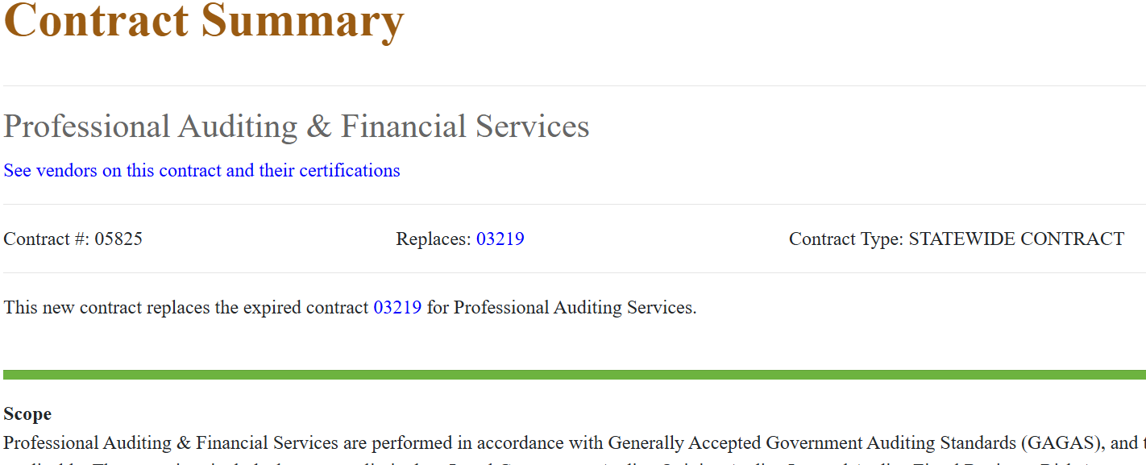
Contract Summary Page
Link: https://apps.des.wa.gov/DESContracts/Home/ContractSummary/05825
Notes:
For this final portion of the presentation, we will review the contract summary page and actual contract together.

Slide 16
thank you
Chelsea.Clark@des.wa.gov
Maree.George@des.wa.gov
descontractsteamapple@des.wa.gov
360-407-9276
Website
Notes:
Thank you very much for joining me today. It has been a pleasure to review this contract together. DES is here to help. If you’re interested in learning more about this contract, please don’t hesitate to reach out.
Does anyone have any questions?

