Slide 1
Operating Budget Process
EDMONDS COLLEGE

Slide 2
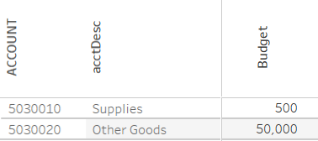
A quick overview of the process & timeline
It takes cooperation across several departments, including IT and IR
Edmonds uses Google and IT is involved in the data upload & download
Budget details are verified and a snapshot of the current FYR is taken in January
FYI: Edmonds budgets to the specific account code level
Data is imported to individual google spreadsheets & distributed to budget managers
Several rounds of budget planning & review take place between February & April
Approved budget plans are presented to the Board of Trustees in May
Fiscal details are reviewed and moved to Excel for upload into ctcLink

Slide 3



Starts with the current year budget plan
Run query for all current operating budgets
Review and sort data, making any necessary adjustments
IT creates and distributes individual google sheets to each budget manager

Slide 4
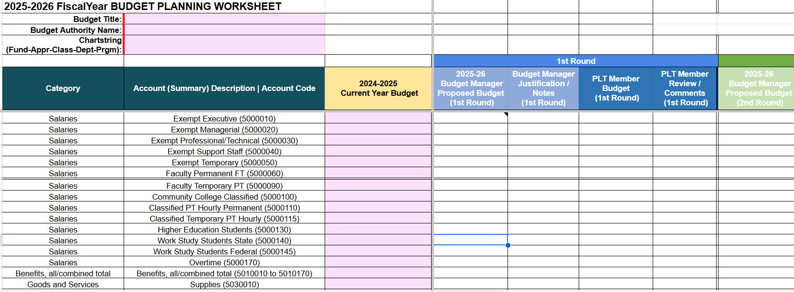
The budget planning template fields in pink are pre-populated

Slide 5
February to April
The process for the campus begins with each budget manager indicating their proposed budget plans for the upcoming fiscal year (the 1st round)
Each budget plan should be discussed with their supervisors/members of the President Leadership team in relation to the whole, leading to conversations to approve or reduce initial proposals
Administrative review of the overall total request may lead to calls for reductions, which would result in a 2nd round, and possibly a 3rd
Final decisions brought to the Board of Trustees for approval
Budget Managers input budget requests for the upcoming
fiscal year
Reviewed by President Leadership
May go through several round
Final budget approved by BOT

Slide 6

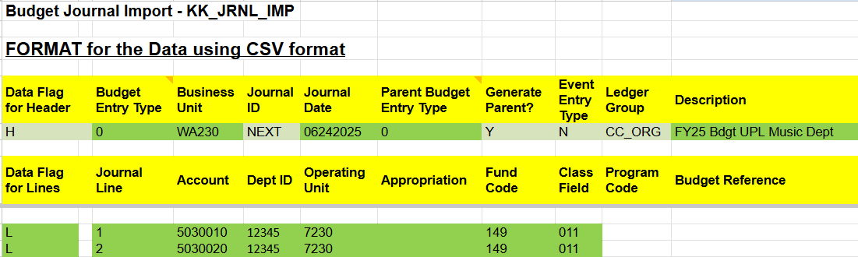
New fiscal year budget plans
The final approved budget plans are consolidated into one Excel spreadsheet
Details are reviewed by the Budget Office, with adjustments as necessary
Utilizing the budget upload template, plans are imported to ctcLink

Slide 7
Thank you for your time
ANN MARTIN-CUMMINS
BUDGET DIRECTOR
EDMONDS COLLEGE
ann.martin-cummins@edmonds.edu

