Slide 1
WIN-WIN: How Fiscal Services, Athletics & Student Life Work Effectively Together to Achieve Student Success
Sean Cooke, Director of Student Life – Puyallup
Cameron Cox, Director of Student Life Fort Steilacoom
Duncan Stevenson, Director of District Athletics

Slide 2
What is Student Engagement?
Student engagement represents the time and effort students devote to activities empirically linked to the intended outcomes of college and what institutions do to both provide these activities and induce students to participate in them (Kuh,2009).

Slide 3
Student Engagement = Student Success
Student engagement is generally considered to be among the better predictors of learning and personal development (Carini, Kuh, & Klein, 2006).
Student involvement in co-curricular activities such as student organizations, leadership positions, and activity in campus residence halls has a positive correlation with retention and academics (Kuh and Pike, 2005).

Slide 4
How do we do it?
Activities and Events
Clubs and Organizations
Student Government
Committee Participation
Alternative Breaks
Other Leadership Programs: Identity Culture and Inclusion Cert., Multicultural Leadership Institute, etc.

Slide 5
Activities and Events
Often planned by a group of student leaders
Great opportunity to meet and interact with other students/build relationships
Exposure to new ideas that may challenge their worldview and promote development
Events and promotion efforts are constantly evolving to meet new trends and attract student participants. How can we say YES!

Slide 6
Clubs and Organizations
Amazing student leadership experiences
Create campus communities that can provide vital support to students throughout their time at the college
Fundraising! Yay.
Outside-the-box events and activities
We do everything we can to say YES!

Slide 7
Student Government/Council
Amazing leadership experience for students involved
Manage the allocation of S&A Funds, Tech Fee Funds, etc. as well as contingency funds.
Initiatives often push into unexplored territory, which is often challenging.
What can we do to say Yes?

Slide 8
Student Funds and Fees
Services and Activities Fees, Student Tech Fee, Etc.
Lots of money for lots of stuff going lots of places.
Who ensures that proposed projects are viable?
How is money managed after allocation?

Slide 9
Connections: Finance, Student Life, & Athletics
Budget training with Student Leaders & Staff
Participate on committees
Internships for students in your office?
Provide context AND listen for context

Slide 10
INTERCOLLEGIATE
ATHLETICS

Slide 11
Who We Are
Athletic Directors
Longevity (7 months to 31 years)
11 year average
B.A. in Journalism to M.A. Education
How we started
Coach (15)
AD (9)
Head Coaches
Less than 1 in 5 are full time employees (18%)

Slide 12
What We Do
Manage program operating budgets
Special events management
Fundraising
Compliance, Eligibility & Risk Management
Academic monitoring and support
Hire, train and evaluate coaching staff
Federal and State reporting requirements
Alumni relations

Slide 13
About our Operating Budgets
Student Fees – S&A / 522
Institutional Funding
Foundation
Booster Club
Fundraising Activities
More Fundraising….

Slide 14
How Can We Help Each Other
Build rapport between offices
Understand why we do what we do
Help us understand the local rules & processes
Give us the tools to be better budget managers
Improved communication and empathy builds TRUST
Finding a way to “YES”

Slide 15
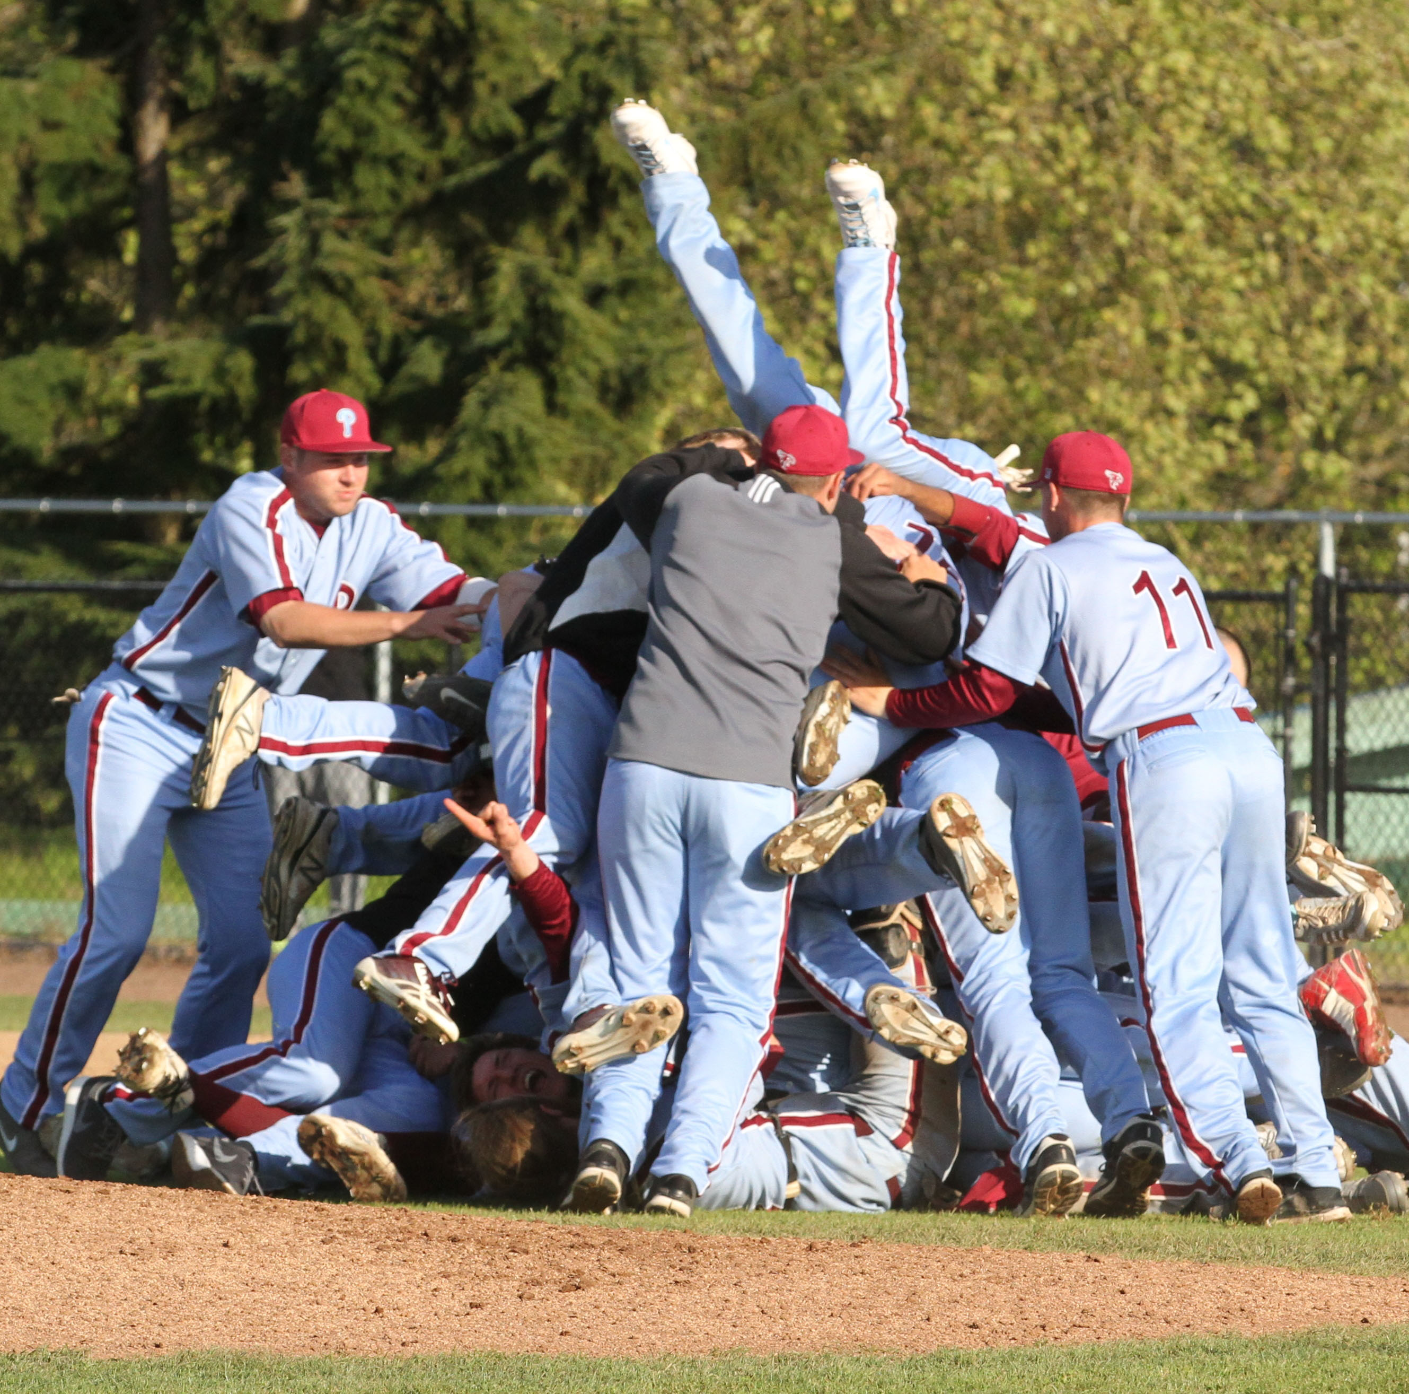
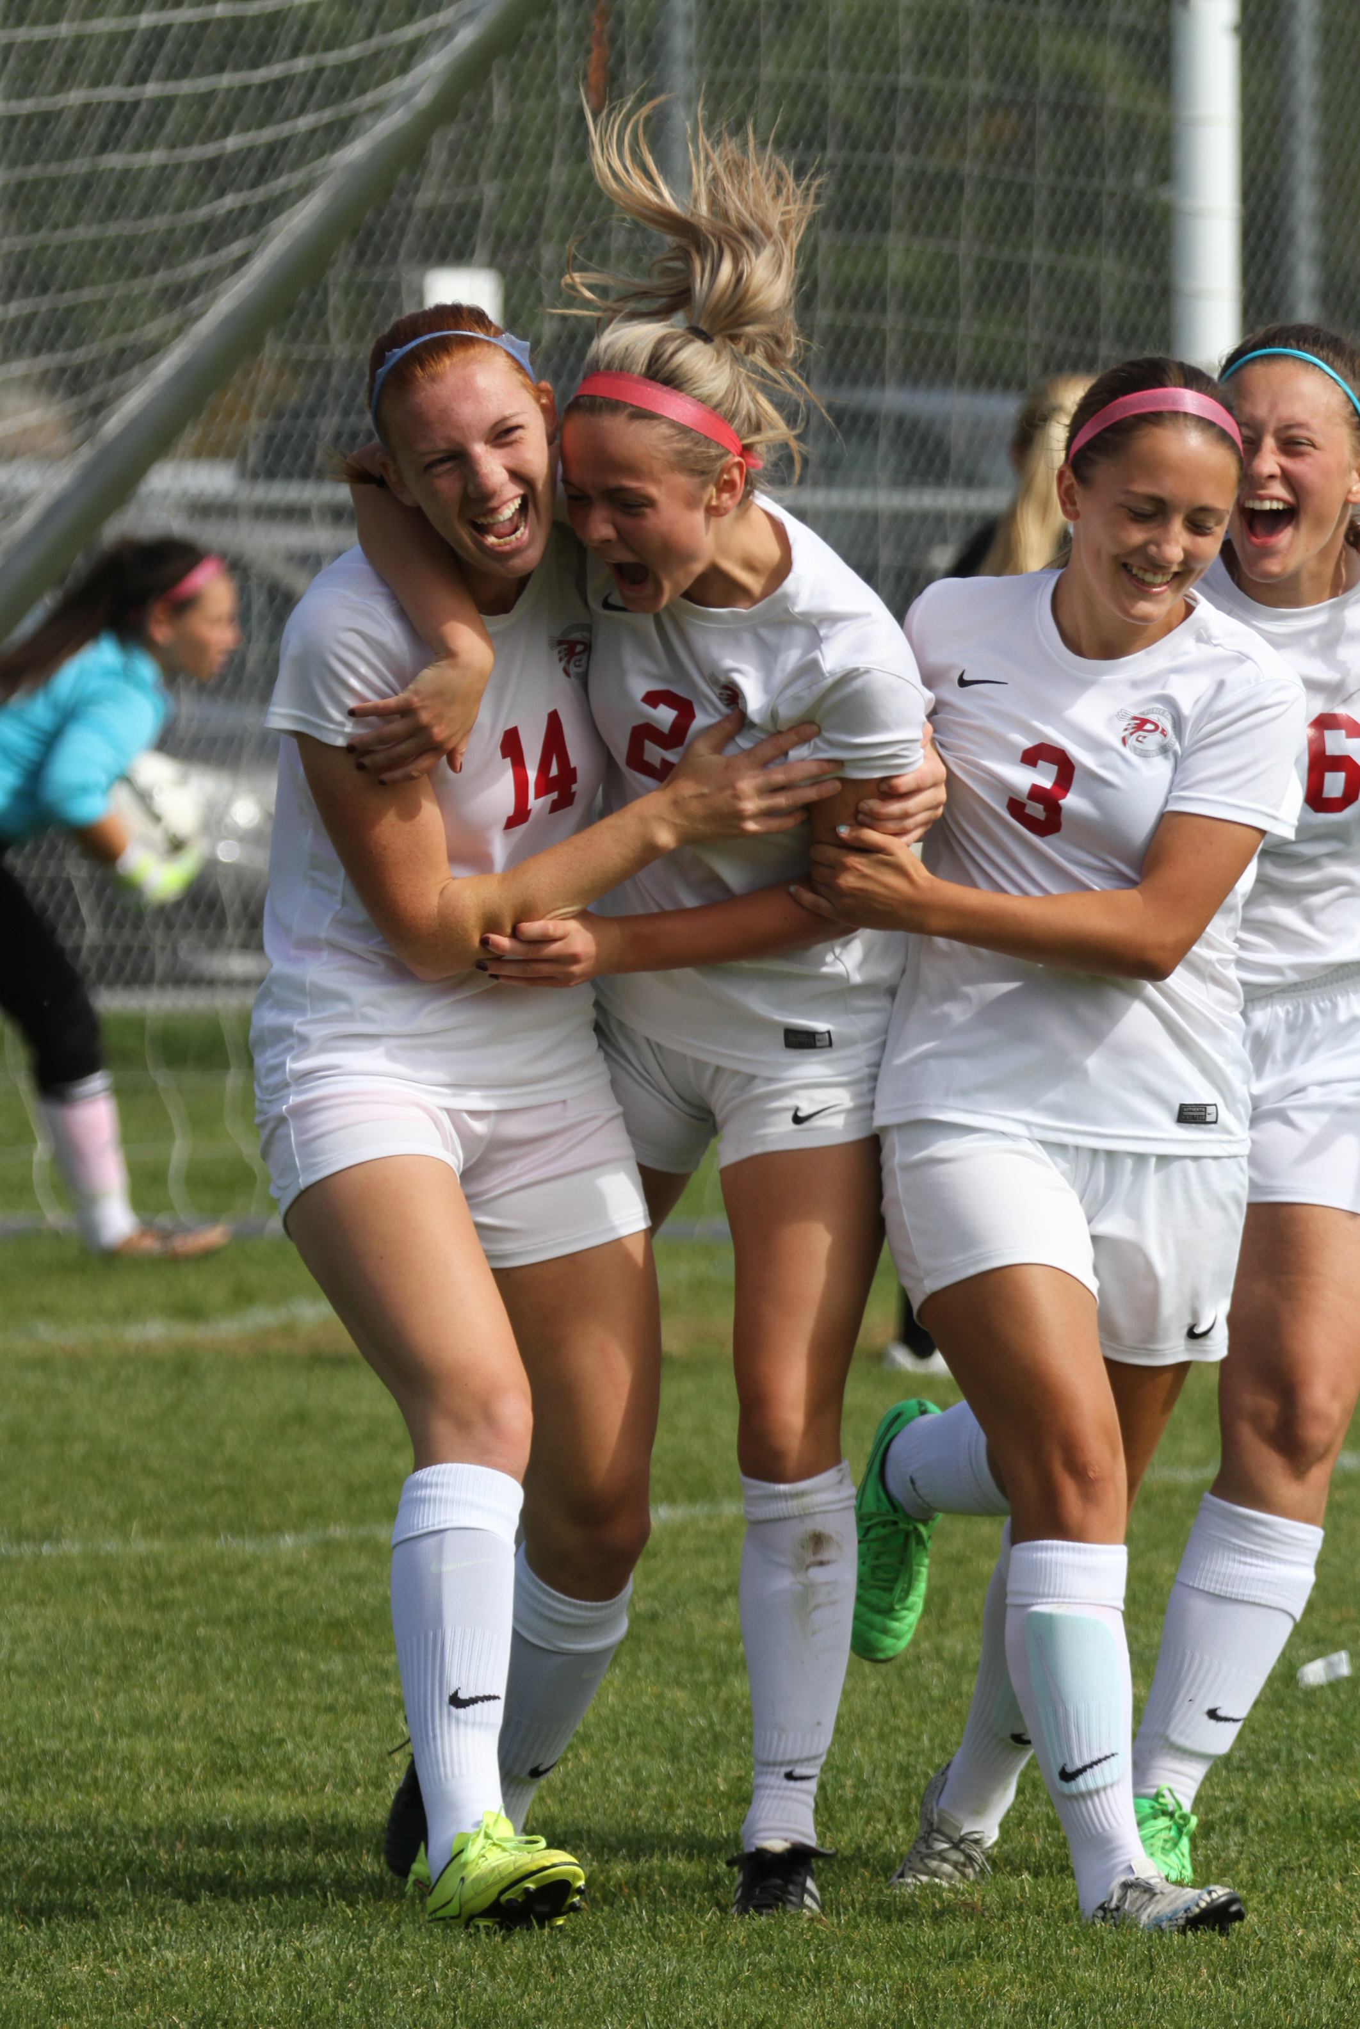
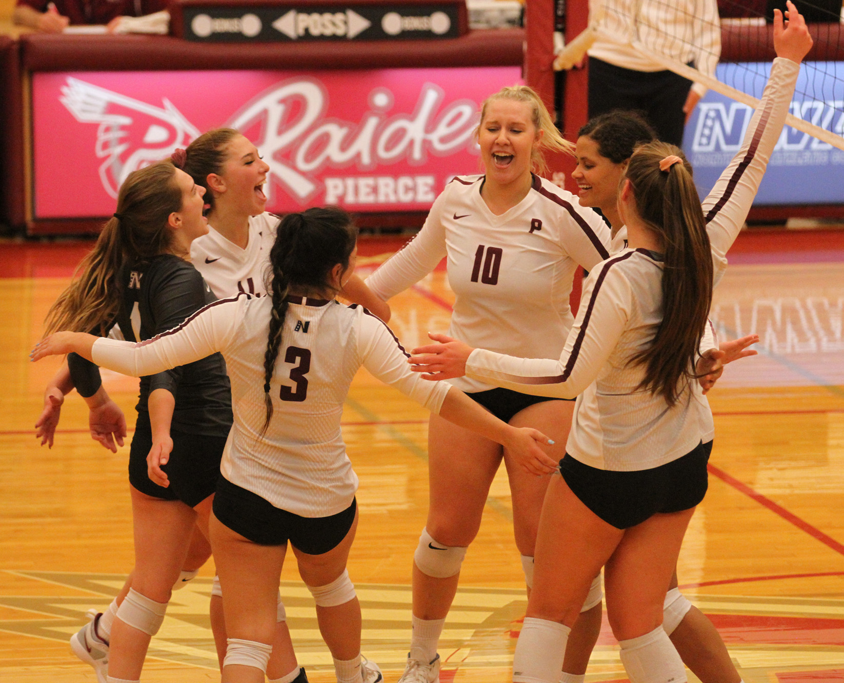
Why We Do It
WIN-WIN!

