Slide 1
Overview of the Allocation Model
Stephanie Winner SBCTC Operating Budget Director
January 2024

Slide 2
State Board vs. District fiscal Responsibilities
General supervision and control over the state system
Prepare a single budget for the support of the system
DISTRICT TRUSTEES
RCW 28B.50.100-140
College operations - hires president
Prepare local priorities for operating and capital budgets and submit to State Board
STATE BOARD
RCW 28B.50.090
Establish guidelines for the disbursement of funds; and receive and disburse such funds for operations and capital support of college districts
Establish new campus facilities
Establish fees
Spend operating and capital allocations consistent with local priorities and Legislative/State Board guidance

Slide 3
How the dollars flow…
Legislative
Appropriation Act
Tuition, Fees,
Grants, & Contracts
SBCTC - Allocation Model
MOA
DEAB
SAI
Weighted Enrollment
SBCTC – Safe Harbor
Provisos & Earmarks
College District - Budgeting Process
College Departments

Slide 4
What is in the allocation model
  MINIMUM OPERATING ALLOCATION
  Minimum amount for operations - $2.85 million per campus (includes some M&O provided
  in the capital budget due to
  a Legislative fund swap in
  early 2000)
  STUDENT ACHIEVEMENT INITIATIVE
  PERFORMANCE FUNDING
  $5.25 million in budget bill.
  State Board policy allocates 5%
  of total state appropriations
  $61 million in FY 25
MOA
SAI
  WEIGHTED/PRIORITY ENROLLMENT FTE
  Four enrollment
  categories receive an
  additional weight of .3
  per student FTE:
  Adult Basic Education
  STEM
  Upper-Level BAS
  Skills Gap
DEAB
WEIGHTED
PRIORITY
FTE
  DISTRICT ENROLLMENT ALLOCATION BASE
  Provides base funding
  and an annual enrollment
  target based on a rolling,
  3-year average of past state
  enrollments. If no colleges are
  over target, colleges retain their target from the prior year.

Slide 5
What is outside the model – safe harbor
BUDGET PROVISOS
Language in appropriations act that places conditions from legislature on the use of the funds
COMPENSATION M&O
LEASES
STATE BOARD EARMARKS
Program or population-specific funds identified by the State Board
Examples: Opportunity Scholarship, Centers of Excellence, Workforce Development Projects, funds for Disability Accommodations and Students of Color
Reviewed annually, funds can remain in safe harbor indefinitely
Compensation funding includes wage increases, health benefit rate changes, paid family leave and pension rate change
Compensation funds are distributed based on each district's share of salary or benefit expenditures in the prior fiscal year
Compensation, M&O, and Leases are held in safe harbor for four years.
Examples: Guided Pathways, Worker Retraining, MESA, I-BEST, and college-specific projects such as Wildfire Prevention Program at Wenatchee Valley College

Slide 6
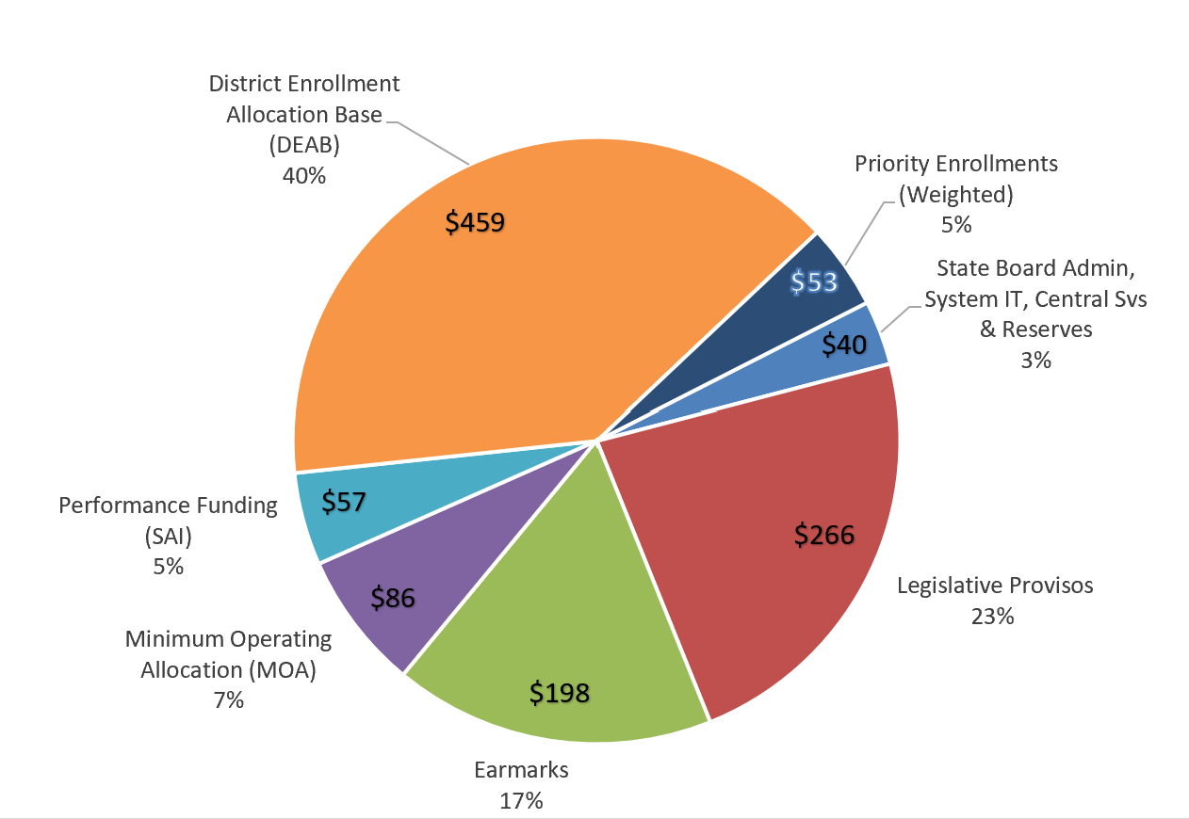
2023-24 Operating budget allocation
$ IN MILLIONS

Slide 7
Stephanie Winner
Operating Budget Director
360-704-1023
swinner@sbctc.edu
questions?

