Slide 1
ER#266 – Student Financial Responsibility Agreement (SFRA)
2024

Slide 2
AGENDA
Introduction and Purpose
Functionality – Attributes of Process
Resources

Slide 3
ER# 266 – SFRA: Intro & Purpose
Introduction
The implementation of a global Student Financial Responsibility Agreement (SFRA) is essential to ensure compliance with state and federal laws, mitigate institutional financial risks, and provide a consistent framework across all community and technical colleges (CTCs) in Washington. The SFRA will address the critical need for statutory compliance while enhancing the operational efficiency and consistency of financial processes within the system.
Under its legislative and operational mandates, the State Board for Community and Technical Colleges (SBCTC) must establish system-wide standards where statutory compliance is necessary. Following consultations with the Assistant Attorney General (AAG), it has been determined that SBCTC will configure the SFRA globally within ctcLink to assist in compliance while simplifying administrative processes and eliminating redundancies across colleges.
Purpose of a Global Student Financial Responsibility Agreement
Regulatory Compliance: A standardized agreement ensures all colleges can comply with the applicable Revised Code of Washington (RCW) statutes and federal laws, as advised by the states AAG.
Operational Consistency: Colleges currently have varying practices, which create inconsistencies in policy enforcement, administrative processes, and potential for financial risk. A global SFRA provides a uniform standard, enhancing system efficiency and student understanding.
Risk Mitigation: Without a consistent SFRA, colleges face increased financial burden from unpaid student debts, delayed collections, and legal vulnerabilities.

Slide 4
ER# 266 – SFRA: Intro & Purpose
Legal & Policy Basis
This student Financial Responsibility Agreement is designed to comply with the following laws:
RCW 28B.10.293: Permitting educational institution to impose reasonable financing and late charges, as well as debt collection charges, but only if so provided for in an agreement signed by the student debtor. The statute addresses transcript holds for certain circumstances. See SSHB 2513 (2020)
RCW 43.17.240: Requiring state agencies and institutions to impose a financing charge of 1% a month on unpaid accounts starting on the date the unpaid account becomes past due.
RCW 19.16.500: Authorizing state agencies and institutions to refer delinquent accounts to a collection agency and to require the debtor to pay reasonable collection agency fees and costs.
U.S. Bankruptcy code, 523(a)(8): Student educational debts are generally non-dischargeable in bankruptcy without a court order based on undue hardship, but may garden-variety student debts (bookstore purchases, for example) remain dischargeable in bankruptcy unless the student signs a promissory note or other agreement to pay the debt.

Slide 5
ER# 266 – SFRA: Functionality
Key attributes of SFRA process:
Universal Student Agreement: All students* who are charged and may owe a balance should submit an SFRA.
Annual Agreement Submission: Agreements should be obtained once per academic year for each active student.
System Integration and Management: Agreement data will be stored and managed using the delivered functionality within ctcLink, ensuring consistent tracking and availability across all colleges.
College Staff Operations: College staff will have the capability to accept signed SFRA agreements and update ctcLink accordingly.
Support and Communication: SBCTC will host a dedicated webpage explaining the SFRA, providing resources and information for both colleges and students. ctcLink Support will provide a Quick Reference Guide (QRG.)

Slide 6
ER# 266 – SFRA: Functionality
Central attributes of SFRA process (cont.):
Principles for not including a student population
Extensive barrier to enrollment for populations that typically are not charged tuition/fees (BEdA, Open Doors, DOC, etc.)
*Moving forward & recognizing this is a new process, we’ll proceed with these exclusions as the best approach based on the information available, while remaining open to refinements as we gain more insights.
Colleges are responsible for attaining an SFRA if past due balances are incurred. Reports will be if provided to identify students who are enrolled with no SFRA on file along with collection agency placement reports indicating terms the SFRA has been signed.

Slide 7
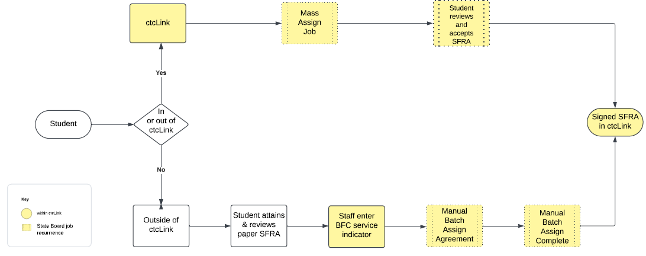
ER# 266 – SFRA: Functionality

Slide 8
ER# 266 – SFRA: Functionality
General description of process: How will students sign the SFRA?
Students using ctcLink to enroll will be required to accept the SFRA conditions prior to registration. In ctcLink, a hold blocking enrollment titled “Financial Agreement Required” will include a link to a page that will be used to relay the SFRA terms and conditions. Upon selecting the link, the student will be asked to accept the terms and conditions listed on the page. Upon acceptance, the student will immediately be able to register for classes.
OR
Students who don't use ctcLink to enroll should be required to sign a paper version of the SFRA. Upon reviewing the signed document, college staff should update ctcLink and retain the agreement for safekeeping. This agreement may be reviewed by State Auditors to ensure that manual entry of the SFRA into the system of record (ctcLink) is validated/reconciled. To update ctcLink, staff will apply a hold (service indicator) into ctcLink that will update the system to reflect a SFRA has been submitted. This hold will not impact on student services.

Slide 9
ER# 266 – SFRA: Functionality
SBCTC
The State Board SF Team will be responsible for managing the below listed mass assign/release SFRA jobs in ctcLink through which most students will be processed. This task includes monitoring the jobs account for completion. Additional tasks will include updating verbiage/language and updating the activity guide as needed.
Mass assign job
Assign newly term active students the SFRA service indicator (SFA hold)
Assigns service indicator to students registered w/ no SFRA on file for academic year (fall through summer)
Timing = Daily at 12:00pm & 8:00pm
Mass release job
Releases previous term active SFA service indicators on students not registered
Timing = Daily 9:00pm
Manual Batch Assign Agreements job
Job to update ctcLink that a paper SFRA has been signed/received & assigns the activity guide (works off existence of the BFC service indicator)
Timing = Daily at 8:00pm
Manual Batch Assign Agreement Complete
Job to update ctcLink that a paper SFRA has been signed & completes the activity guide (works off the existence of the BFC service indicator)
If the student has an outstanding SFA hold, this process will also be released
Timing = Daily 8:30pm

Slide 10
ER# 266 – SFRA: Functionality
College Staff
College staff will be responsible for updating ctcLink when paper forms are submitted, reviewing & working exception reports, and assigning/releasing service indicators.
Manual assign job
Attain printed/signed copy of SFRA & update student’s account with a service indicator of BFC
Staff may enter service indicators individually or in mass via spreadsheet
File SFRA paper document for save keeping (audit reviews)
Manual assign option 2
Assign student SFA hold to agree in ctcLink to allow student to use ctcLink for agreement
Manual Service Indicator Release
Release SFA hold (if completed agreement is in ctcLink)
Reports/Queries
Agreement exceptions
Collection agency extracts

Slide 11
ER# 266 – SFRA: exclusions
Student Group | CtcLink Hold Query Parameter
Under 18 years old | Does not exist in VCS_BIO_PRIORTY ((Months between SYSDATE and Birthdate) divided by 12) < 18.
Running Start | Does not exist in STDNT_GRPS_HIST where EFF_Status is A and STDNT_GROUP IN ('SRSR','SRSL')
Department of Corrections (DOC) | Does not exist in STDNT_GRPS_HIST where EFF_Status is A and STDNT_GROUP IN ('SDOC','BDOC')
Continuing Education (CNED) | Does not exist in STDNT_CAR_TERM where ACAD_CAREER = 'CNED' and does not exist ACAD_CAREER = 'UGRD' for the same term
Students taking 100% BEDA Courses | Does not exist in STDNT_ENRL where STDNT_ENRL_STATUS = 'E' and Class NBR taken is within CRSE_ID in COURSE_LIST = '000000001' and does not exist STDNT_ENRL Class NBR's outside of this Course List. Other tables used to achieve. CRSE_LST_DTL_SF and CLASS_TBL
Open Doors | Does not exist in STDNT_GRPS_HIST where EFF_Status is A and STDNT_GROUP IN ('SHS1')

Slide 12
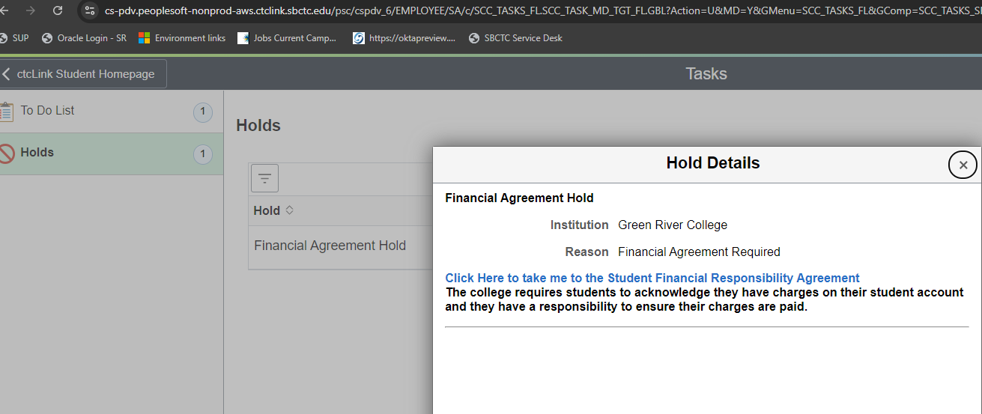
ER# 266 – SFRA: Functionality
Screenshot of student service indicator (hold):

Slide 13
ER# 266 – SFRA: Functionality

Slide 14
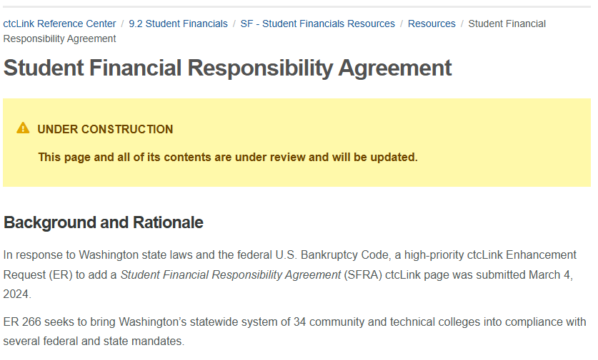
ER# 266 – SFRA RESOURces

Slide 15
ER# 266 – SFRA
Questions/Concerns/Comments?

