Slide 1
WELCOME TO:
Public Funds Investing Methods
and Practices
Presented by: Aaron Bonck, CFA
Vice President, Investment Adviser
9725 3rd Ave NE Suite 610
Seattle, WA 98115
206-365-3003; 877-707-7787
aaron.bonck@timevalueinv.com
For Institutional Investors only, not to be used with the general public.
Securities offered through Cetera Advisor Networks LLC, member FINRA/SIPC. Advisory Services offered through Cetera Investment Advisers LLC, a registered investment adviser. Cetera is under separate ownership from any other named entity.

Slide 2
What can you invest in?
Short term:
LGIP
Bank Liquidity Accounts
Local Bank CDs
US Treasury bills and notes, agency and supranational agency discount notes, and commercial paper
Repurchase agreements
Long term:
US Treasury notes
US Government Agency bonds
Supranational Agency bonds
Municipal bonds
Corporate notes
Local Bank CDs
Source: RCW 39.58, 39.59

Slide 3
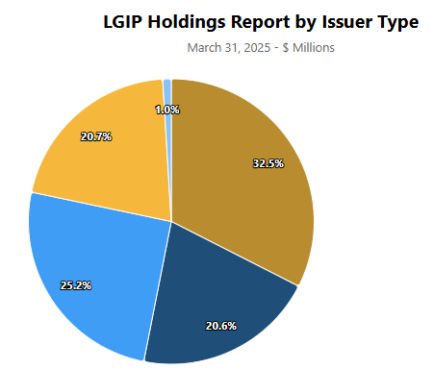
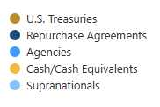
What is the LGIP investing in?
Source: WA State Treasurer

Slide 4
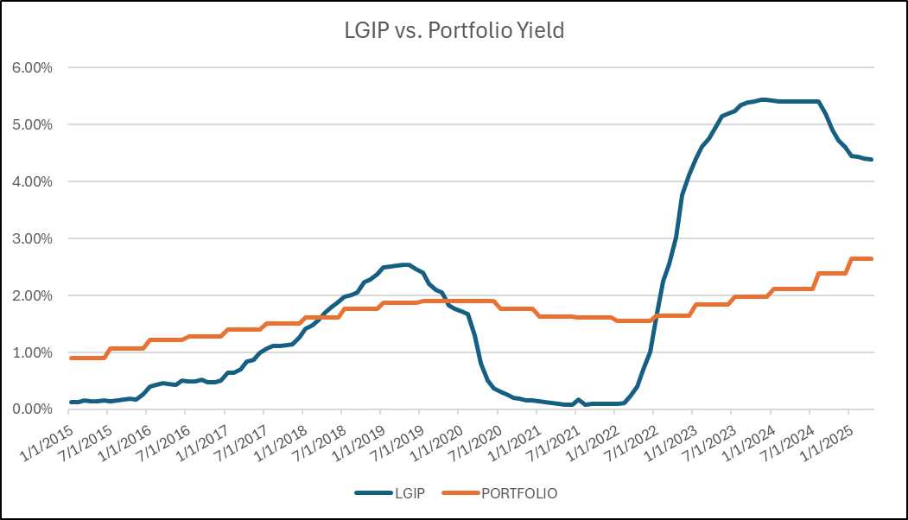
Laddered Portfolio vs. LGIP 2015-2025
Source: WA State Treasurer; Bloomberg

Slide 5
Laddered Portfolio
Created January 2015
This table assumes a laddered portfolio of US Treasury securities with maturities every 6 months established in January 2015. The “Yield” column shows the fixed annualized yield each bond would earn through the maturity date.
Here is the same portfolio 1 year later in January 2016. Notice that the 6-month and 1-year Treasury bills matured. At the time of each maturity, those funds were reinvested into a new 5-year Treasury to replace that rung in the ladder.
Source: Bloomberg

Slide 6
Maturity Diversification is key
“Maturity Diversification” means staggering, or laddering, bonds at relatively regular intervals based on maturity dates.
This strategy can create a steady, predictable flow of interest payments and maturities over time, simplifying portfolio tracking and monitoring.
With staggered maturities, funds will be reinvested in the future in various interest rate cycles where rates might be higher or lower
Over time these situations should average out and provide a portfolio yield that is more stable and fluctuates less than interest rates in the broader market.
This strategy also precludes investors from trying to “time” the market and always buy at the perfect time. Even the experts can’t do that consistently!

Slide 7
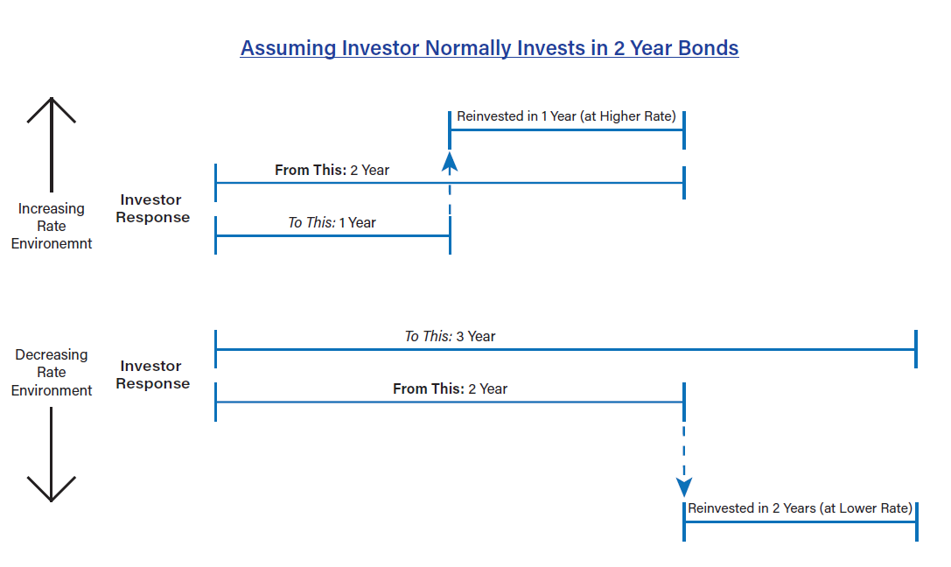
Simple tactical strategies to use within laddered portfolio

Slide 8
But, can we actually predict interest rate movements?
  If you think interest rates are going to go up:
    Purchase shorter maturity bonds to take advantage of higher yields sooner as interest rates rise.
  If you think interest rates are going to go down:
    Purchase longer maturity bonds to lock in yields for longer periods of time as interest rates fall.
Operative words: “RATES ARE GOING TO…”
Are we confident adjusting portfolio structure according to where we think interest rates may or may not be in the future? What if we’re wrong?

Slide 9
Where can it go wrong?

Slide 10
How do you buy a bond?
Investor |  |  |  |  |  | Wall St Dealer Inventory
 |  |  | Broker
Gives
Purchase Request
Bond Is
Purchased

Slide 11
How do you buy a bond?
Investor
 | Confirmation (Receipt) |  |  | Broker

Slide 12
How do you buy a bond?
 |  |  |  | Safekeeping Bank
Investor |  |  |  | Bond
 | Confirmation |  |  | Broker
Forwards
Confirmation
and
Wires $

Slide 13

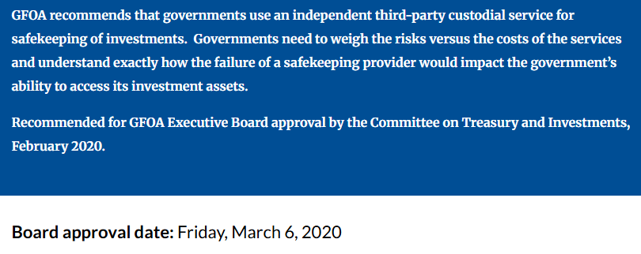
GFOA recommends third party safekeeping
Source: https://www.gfoa.org/materials/using-safekeeping-and-third-party-custodian-services

Slide 14
Thank You!
For institutional investors only. The opinions contained in this material are those of the author, and not a recommendation or solicitation to buy or sell investment products. This information is from sources believed to be reliable, but Cetera Advisor Networks LLC cannot guarantee or represent that it is accurate or complete. This is for informational purposes only. Because of individual client requirements, it should not be construed as advice designed to meet the particular needs of any client. This information should not be used as the primary basis of investment decisions.
For a comprehensive review of your personal situation, always consult with a tax or legal advisor. Neither Cetera Advisor Networks LLC nor any of its representatives may give legal or tax advice. Investors cannot invest directly in indexes. The performance of any index is not indicative of the performance of any investment and does not take into account the effects of inflation and the fees and expenses associated with investing. All investing involves risk, including the possible loss of principal. There is no assurance that any investment strategy will be successful.

