Slide 1
Unrelated Business Income Tax
Carl Ingram, Tax Compliance Manager
Eastern Washington University
5/15/25

Slide 2
Unrelated Business Income Tax
The basics:
Established in 1950
Intended to level the playing field between exempt and tax paying organizations
Generally, a tax on revenues that are earned from operating trades or businesses outside of the scope of the organization’s exempt purpose
Reported annually on form 990-T
Automatic 6-month extension available
Flat 21% tax rate
Notes:
Due date is the 15th day of 5th month –
calendar year = May 15, extend to 11/15
6/30 year end = November 15 extend to May 15
Automatic extension
Estimated payments required – if anticipated tax for the year is $500 or more
calendar year = 4/15, 6/15, 9/15, 12/15
6/30 fiscal = 10/15, 12/15, 3/15, 6/15

Slide 3
Unrelated Business Income
Taxable activities are:
A trade or business,
Regularly carried on,
And not substantially related to exempt purpose

Slide 4
Exemptions and Exclusions
Types of Income
Dividends
Interest
Royalties
Activities
Convenience of the members
Volunteer work
Government research
Qualified sponsorship payments
Tie-in to exempt purpose - participation by students
Providing a service which would otherwise be unavailable

Slide 5
Rentals
Real Property
Exempt unless
Debt financed – less than 85% used for exempt purpose
Rent is percent of lessee sales or profits
Space only – exempt
Personal property less than 10% - exempt
Personal property 10% or greater
Less than 50% is personal property – personal property is taxable
50% or greater is personal property – entire taxable
Services rendered
Related to exempt purpose – exempt
Unrelated – taxable

Slide 6
Common UBIT Activities
Advertising income
Catering
Child-care facilities
Research – nongovernmental, nonpublic
Substantial return of benefit – exclusive provider
Bookstore – sales of items with a useful life greater than 1 year if not a novelty item
Parking
Use of facilities by the general public
Investment in partnership or S-corporations

Slide 7
Expense Allocations
Direct expenses
Indirect expenses
Reasonable allocation
Gross to gross
Usage
Rensselaer – actual usage in denominator
Square footage

Slide 8
Direct Pay
Exempt organizations able to claim Inflation Reduction Act benefits
Prevailing wage and apprenticeship
House Ways and Means Committee – removal of commercial vehicle credit, credit for charging stations, and technology neutral investment tax credit (solar, wind, and geothermal)
Section 179D allocations

Slide 9
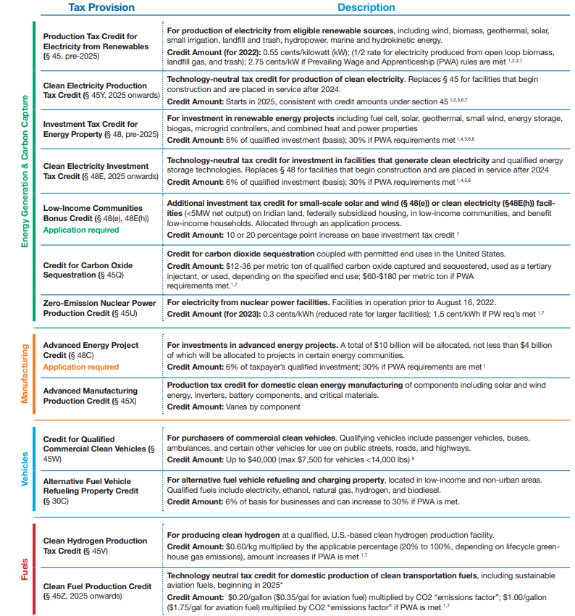

Slide 10
Future State
Parking tax
Royalty tax
IRS budget cuts
501(c)(3) status issues

Slide 11
State UBIT
Operations in other states
Establishment of nexus
Physical location
Sales
Public Law 86-272 and South Dakota v. Wayfair
Payroll

Slide 12
Managing UBIT
Determine responsible parties and centralize duties
Assess current UBIT footprint
Create environment of awareness
Establish procedures
Annual surveys
Revenue review
Contract review
Stay current on IRS guidance
OPEN AND RESPOND TO IRS CORRESPONDENCE!
Stay audit ready

Slide 13
Thank you
Carl Ingram, CPA Tax Compliance Manager
cingram1@ewu.edu | Office: 509.359.6922 | ewu.edu
307D Showalter Hall, Cheney, WA 99004

