Slide 1
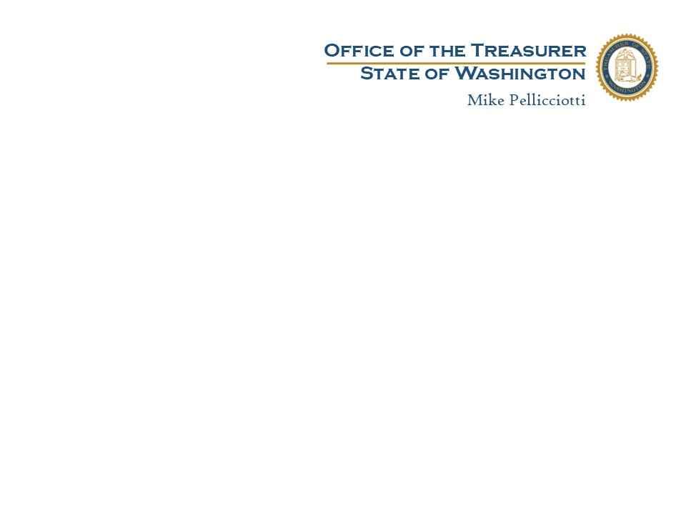
Banking and Merchant Services
Ryan Pitroff
Manager, Cash Management Division
Vicki Boudia
Warrants and Banking Services Administrator

Slide 2

The Role of the Treasurer Cash Management
RCW 43.08.015 Ensure effective cash management of public funds and the authority to represent the state in all contractual relationships with financial institutions.
RCW 43.88.160 The Treasurer shall coordinate agencies’ acceptance and use of credit cards and other payment methods.

Slide 3
Payment Method Values Federal Reserve Payments Study (FRPS) 11/24
FRB Retail Payments Study 2024
Debit cards held the largest share of payments by number but the smallest share by value. Credit cards were the second largest by number and the second smallest by value.
At the other end of the distributions, ACH credit transfers held the smallest share by number but the largest share by value. ACH debit transfers were the second smallest by number but the second largest by value.

Slide 4

Internet Payment Acceptance Options
ACH – Automated Clearing House
National Electronic Payment Network
Governed by Nacha Rules
a.k.a. direct debit, internet check, e-check
Bankcards – Credit or Debit Cards
Most recognized/requested internet payment
Rewards cards
Greatest cost to College of any payment option
In the Fiscal Year 2024, State Agencies collected $31.4 billion using agency supported ACH at a cost of approximately $60,000 in banking fees.
To collect the same amount using bankcards it could have cost almost
$600 million dollars!

Slide 5




Merchant Services Contract Office of the State Treasurer
The current state master contract for Merchant Bankcard services is with Key Bank Merchant Services as the Acquirer for VISA, MasterCard, Discover and PIN Debit
WA State holds a separate Agreement with American Express
Contract allows the use of many processors – must be compatible and settle to one of Fiserv’s platforms.
Choice of processor depends on college needs and funds
Tuition payments are centralized in a process managed by the SBCTC

Slide 6
Merchant Bankcard Services Definitions
Credit Card – A card that may be used to buy products and services on credit – Uses the Credit Network
Debit Card – A card issued by a bank that allows access to a bank account. Issued with a PIN that allows access on the Debit Network. Often is issued as a “branded” card that allows the card to be used on the Credit Network.
EMV Card – “Chip” Card for In-Person processing only. More secure method of payment than magnetic stripe transactions
Merchant – Business or entity that accepts bankcards for payment
Processor – A partner with the Merchant that allows access to the authorization networks and is used to authorize and settle transactions.
Acquiring Bank – A partner with the Merchant that provides access to the card associations (VISA, MasterCard, Discover), coordinates processing options, and handles settlement of transactions.

Slide 7
Choosing a Processor Internet
State Agencies have the choice of processors with KeyBank
Key Bank Ebill & Collect: ACH and Bankcards:
Fully hosted payments, service fee is available to offset costs.
•CyberSource
•Authorize.net
•Card Connect
•Clover
•Core Commerce
•Blue Snap
•Tempus
•PayPoint
•Rectangle Health (Healthcare)
•Trust Commerce (Healthcare)
Hardware Payment Options
•Stand Alone Hardware Terminals
•Clover Suite of product (Station, Go, and Flex)
•Verifone
•Ingenico
•Pax
Option to procure your own processor:
Be fully compliant with the Payment Card Industry Data Security Standard (PCI-DSS)
Use merchant identification numbers issued by Key Bank Merchant Services through the Office of the State Treasurer and authorize and settle transaction through one of Fiserv’s platforms
(ie: North, South, Buypass, Nashville, etc)

Slide 8
Bankcard Acceptance Guidelines Internet
Internet Transactions
Can only accept cards that use the credit networks
Typical College Internet process: College has own “Storefront” and uses the processor’s payment button.
Best Practice is to use a processor that uses the “Hosted Payment” model

Slide 9
Choosing a Processor In-Person
In-Person – Card Present transactions:
All the processors we offer can also support in-person transaction through a “virtual terminal” on a computer screen. This is a good option if you want to use the same processor for both internet and in-person processing.
Hardware Terminals – Stand-alone devices using an Ethernet connection (preferred) or using a dial-up analog phone line..
Point of Sale Unit - The Clover Station is an “all in one” Point of Sale system with cash drawer.
Mobile Options – The Clover Flex 4 is an all-in-one device that uses a wireless signal to serve customers efficiently.
Notes:
Confirm w Rebecca
Clover station duo?
Is this all still true

Slide 10
Bankcard Acceptance Guidelines In-Person
In-Person Transactions
Requires specialized Hardware to read Cards:
PIN Debit Cards
EMV “Chip” Cards
Stand Alone Equipment: Hardware Terminals can be either dial up or Ethernet capable.
Point of Sale Systems: Terminals that provide POS functions with cash drawers, mobile POS and mobile devices
Colleges can procure their own machines and software so long as the bankcard processing is compatible with the State’s Master Bankcard Contract.

Slide 11

Payment Card Industry Security Standard PCI-DSS Data Security Compliance
Colleges that accept bankcards as a payment option are subject to annual compliance and testing through the PCI Security Standards.
The Payment Card Industry Data Security Standard (PCI DSS) was
developed to encourage and enhance cardholder data security and
facilitate consistent data security procedures.
https://www.pcisecuritystandards.org

Slide 12
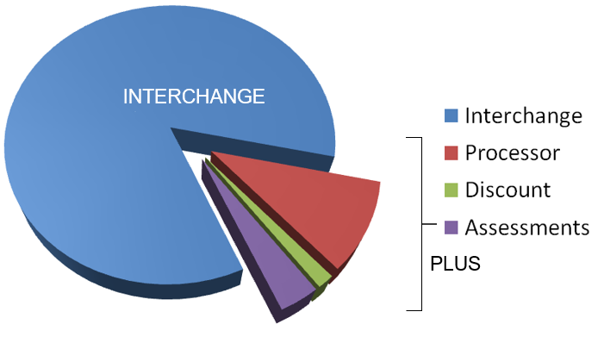
Pricing for Bankcard Processing
State Contract with Key Bank is based on “Interchange Plus” Pricing and averages 1.95% per transaction:
Interchange: based on card type presented
Authorization Fee: $0.175 per transaction
Processor Charges: depends on processor chosen
American Express
American Express is 2.15% per transaction
Notes:
1.95 best case

Slide 13
Managing Costs for Bankcards
Government Service Fee Programs –
VISA/MC/Discover all allow government to charge a “service fee”
All require the same fee to be charged for their card type as is charged for their competitors
Registration is required with our acquiring bank to participate in the government service fee program
Notes:
All interchange fees a

Slide 14
Rules for Government Service Fee
Visa Service Fee Program Rules:* * usa.visa.com/dam/VCOM/download/about-visa/ visa-rules-public.pdf • Merchant registration is required for the Visa Service Fee program • State and/or Local laws may prohibit merchants from assessing convenience fees. Merchants should consult their legal counsel for restrictions • The fee must be disclosed clearly to the cardholder as a charge for the alternative payment channel convenience • The fee must be disclosed before the completion of the transaction and the cardholder is given the opportunity to cancel • The service fee can be charged by a limited number of merchants under certain category codes (For example, Colleges/Universities, Courts Fines, Misc. Government and Taxes) • The fee can be charged on in-person payments or recurring/installment payment transactions. Examples of recurring charges include, but are not limited to, insurance premiums, subscriptions, internet service provider monthly fees, membership dues and utility charges • The payment and service fee must be submitted as two separate transactions when using a third-party to charge the fee for card not present transactions. In all other scenarios, a single transaction can be submitted • A variable service fee may be charged to consumer credit and commercial transactions • The fee can be charged by the merchant or third-party service provider that provides goods or services to the cardholder • The fee amount can be a flat amount, percentage, or tiered, based on the transaction amount • The service fee may be different for each payment type (That is debit cards, credit cards, ACH or eCheck) • The service fee is not required to be printed on a transaction receipt • For Debit, Credit and Commercial cards, the service fee must be the same for all consumer and commercial cards regardless of card brand type (For example, Visa, Discover and MC and so on) • The fee can differ across payment channels (For example, Web, phone, point-of-sale (POS))
Mastercard Convenience Fee Program for Education and Government Entities:* * Mastercard Rules – 19 December 2019 Guide • No registration is required for participating in the Mastercard Government/Education Convenience Fee Program. Merchants using this program are subject to a variation of the general rules regarding Mastercard convenience fees • State and/or Local laws may prohibit merchants from assessing convenience fees. Merchants should consult their legal counsel for restrictions • The Convenience fee can be charged by a limited number of merchants under certain category codes (Elementary Schools, Colleges/Universities, Courts Fines, Misc. Government and Taxes) • The Convenience fee must be disclosed clearly to the cardholder as a charge for the alternative payment channel convenience • The Convenience fee must be disclosed before the completion of the transaction and the cardholder is given the opportunity to cancel • The convenience fee can apply to any transaction. It can be applied to in-person, Mail Order/Telephone Order, internet or kiosk • The fee can be a flat amount, percentage of, or tiered, based on transaction amount. The fee must not discriminate against or discourage the use of Mastercard cards in favor of any acceptance brand deemed by Mastercard to be a competitive brand (That is Visa, Amex and Discover) • The fee can be charged on in-person payments or recurring/installment payment transactions. Examples of recurring charges include, but are not limited to, insurance premiums, subscriptions, internet service provider monthly fees, membership dues and utility charges • The fee may be combined into one transaction or submitted as two separate transactions. For education/government merchants, submitting the convenience fee as a separate transaction is highly recommended • The convenience fee is not required to be printed on a transaction receipt • The convenience fee may be different for each payment type. For example, the convenience fee for consumer debit and commercial debit cards can be different than the convenience fee assessed for consumer credit cards and commercial credit cards; provided the convenience fee for consumer credit and commercial credit cards are the same • The convenience fee cannot be higher than any other card-based payment • The fee can differ across payment channels (For example, POS, Web and phone) • The fee can be charged by the merchant or third-party service provider that p
American Express General Convenience Fee Rules:* * American Express Merchant Regulations – U.S. 2018 Guide • No registration required for charging a convenience fee under the general rules. Merchants are subject to following the card brand rules regarding convenience fees • State and/or Local laws may prohibit merchants from assessing convenience fees. Merchants should consult their legal counsel for restrictions • The Convenience fee can be charged by various merchants under most merchant category codes • The Convenience fee must be disclosed clearly to the cardholder as a charge for the alternative payment channel convenience • The Convenience fee must be disclosed before the completion of the transaction and the cardholder is given the opportunity to cancel • The fee amount must be the same for all applicable forms of payment accepted in the payment channel • The fee can be charged on in-person payments or recurring/installment payment transactions. Examples of recurring charges include, but are not limited to, insurance premiums, subscriptions, internet service provider monthly fees, membership dues and utility charges • The fee may be combined into one transaction or submitted as two separate transactions • The fee amount can be a flat, percentage or fixed amount based on the transaction amount • The convenience fee is not required to be printed on a transaction receipt • The fee can be charged by the merchant or third-party service provider that provides goods or services to the cardholder American Express – Convenience Fee Program for Education and Government Entities: *American Express Merchant Regulations – U.S. 2018 Guide • No registration required for charging a convenience fee. Merchants are subject to following the card brand rules regarding convenience fees • State and/or Local laws may prohibit merchants from assessing convenience fees. Merchants should consult their legal counsel for restrictions • The Convenience fee can be charged by a limited number of merchants under certain category codes (Schools, Colleges/Universities, Courts Fines, Misc. Government) • The Convenience fee must be disclosed clearly to the cardholder as a charge for the alternative payment channel convenience • The Convenience fee must be disclosed before the completion of the transaction and the cardholder is given the opportunity to cancel • The fee amount must be the same for all applicable forms of payment accepted in the payment channel • The fee can be charged on in-person payments or recurring/installment payment transactions. Examples of recurring charges include, but are not limited to, insurance premiums, subscriptions, internet service provider monthly fees, membership dues and utility charges • The convenience fee must appear as two separate charges on the cardmember’s statement. Program Merchants must obtain separate authorizations and approval codes for each of the payment charge and the convenience fee • The fee amount can be a flat, percentage or fixed amount based on the transaction amount • The convenience fee is not required to be printed on a transaction receipt • The fee can be charged by the merchant or third-party service provider that provides goods or services to the cardholder
Discover General Convenience Guidelines:* *Discover Merchant Operating Regulations R11.1 General Requirements Guide Discover has not published specific rules for handling convenience fees when processing payment transactions using a Discover card. As a result, the only Discover guideline provided for handling fees is under the Section 2.4 of the Discover’s Merchant Operating Regulations R11.1 document. Equal Treatment of Cards with Other Payment Cards; Equal Treatment of Card Issuers “Other than with respect to discounts as permitted in Section 2.5 (Surcharge), merchants may not institute or adopt any practice, including any discount or in-kind incentive, that unfavorably discriminates against or provides unequal and unfavorable treatment of any Issuer, Cards operating on the Discover network versus cards operating on other payment networks, or any Person who elects to pay using a type of Card (For example, credit, debit, prepaid) versus any payment card of the same type that you accept (except for any proprietary payment card issued by you or any payment card issued under a formal co-branding relationship between you and a card issuer), except to the extent such restrictions are prohibited by Requirements of Law or permitted as set forth in Section 5.11.” The statement above requires the merchant to not discriminate against the use of the Discover card. Not charging a convenience fee for a Visa transaction but assessing one for Discover, would violate this rule. Merchants can comply with the Discover requirements for convenience fees by following the Visa Convenience Fee general rules. Recommended Convenience Fee Guidelines for Discover Transactions: • No registration required for charging a convenience fee under the general rules • State and/or Local laws may prohibit merchants from assessing convenience fees. Merchants should consult their legal counsel for restrictions • The fee can be charged on in-person payments or recurring/installment payment transactions • The Convenience fee can be charged for a bona fide convenience in the form of an alternative payment channel (That is, mail, telephone, eCommerce) outside the merchant’s customary payment channels (That is, not solely for the acceptance of the card) • The Convenience fee must be disclosed clearly to the cardholder as a charge for the alternative payment channel convenience • The Convenience fee must be disclosed before the completion of the transaction and the cardholder is given the opportunity to cancel • The convenience fee can apply to any transaction. It can be applied to in-person, Mail Order/Telephone Order, internet or kiosk • The fee can be charged by the merchant or third-party service provider that provides goods or services to the cardholder • The fee amount must be a flat or fixed amount, regardless of the value of the payment due • The fee must be applicable to all forms of payment accepted in the payment channel • The fee must be included as part of the total amount of the transaction (combined into one transaction) • The convenience fee is not required to be printed on a transaction receipt • The fee can be charged on in-person payments or recurring/installment payment transactions. Examples of recurring charges include, but are not limited to, insurance premiums, subscriptions, internet service provider monthly fees, membership dues and utility charges

Slide 15
Government Service Fee Considerations
Can you support the program without charging a fee?
Will your customers accept an additional fee?
Analyze your true costs to determine your service fee
Determine what business lines in your organization will be assessing the service fee
When is your target “go-live” date?
Based on current market timeframes, VISA is taking up to 45 days to approve a new program. Which means the average implementation time from start to finish can be to four to six months.

Slide 16
Approvals Process
Office of Financial Management Approval
Required for significant investments as defined in SAAM 80.30.88
http://www.ofm.wa.gov/systemsapproval/default.asp
OFM Economic Feasibility Study Approval
Required for acceptance & disbursement of electronic payments per RCW 43.41.180
http://www.ofm.wa.gov/policy/40.htm
WaTech Approval
WaTech involvement and approval varies depending a colleges’ delegated authority & associated risk per RCW 43.105

Slide 17
Economic Feasibility Study Decision Matrix
Electronic Payment Type | Customer Type | EFS for Acceptance of Payments? | EFS for Disbursement of Payments?
ACH created by AFRS & OST | Business or Non-Business | No | No
ACH created by a third-party vendor or the agency (includes e-checks/internet checks) | Business | No | Yes
ACH created by a third-party vendor or the college (includes e-checks/internet checks) | Non-Business | Yes | Yes
Credit cards, debit cards, smart cards, stored value cards or lockbox services | Business | No | Yes
Credit cards, debit cards, smart cards, stored value cards or lockbox services | Non-Business | Yes | Yes
https://ofm.wa.gov/sites/default/files/public/legacy/resources/ecommerce/efs_Criteria.pdf

Slide 18
Questions about EFS Requirements
Contact:
Office of Financial Management
Pam Valencia
360-974-9237
pam.valenica@ofm.wa.gov
Chapter 40.40 of the SAAM Manual
http://www.ofm.wa.gov/policy/40.40.htm
OFM E-Commerce resource web page
http://www.ofm.wa.gov/resources/ecommerce.asp

Slide 19
College Banking Services Agreements
RCW 43.08.015 Ensure effective cash management of public funds and the authority to represent the state in all contractual relationships with financial institutions. The state treasurer may delegate cash management responsibilities to the affected agencies.
OST has delegated authority to all colleges. . . But:
Many of those delegations are years overdue
Many of the banking contracts have reached the end of their term and are now month to month
Colleges are now at the mercy of their banks when it comes to fee increases and service changes
Prefer to have the colleges:
Draft their Request for Proposal(RFP)
Request and receive delegate authority
Conduct their RFP and then contract for banking services

Slide 20
College Banking Services Agreements
What to Include in your RFP:
Treasury Services
Depository Services
Check writing with positive pay
ACH (both direct deposit AND direct debit)
Wires
Merchant Bankcard Services
Colleges can use either OST’s master contract with Key Bank; OR
Include merchant services under their banking contract
Other Services
Check Cashing
Investments
ATM
Cash/Change Service

Slide 21
OST Contacts
Kelly Millner
Bankcard Coordinator
360-902-8910
bankcards@tre.wa.gov
Vicki Boudia
Warrants & Banking Services Administrator
360-902-8988
vicki.boudia@tre.wa.gov
Ryan Pitroff
Manager, Cash Management Division
360-902-8917
Ryan.pitroff@tre.wa.gov

