Slide 1
BAR2025 - SF & AR
ctcLink Student Financials Support Team
Updated: October 16, 2025

Slide 2
AGENDA
Welcome and Introductions
SF Team Thoughts on Student AR
Questions

Slide 3
Welcome & Introductions
Brandon Reed - Assoc. Director Student Financials
Charles Velasquez - Senior Analyst Student Financials
Pauline Smith - Student Financials Trainer
SF Survey - Please we want feedback on topics like collections!
https://forms.office.com/Pages/ResponsePage.aspx?id=ldeuR3W5mUCbNzejpAARmRPePep-7TZOk0UkQXAsyp9UQ0lUUEZTREg3T05EUUU1RzBHQTVLN1E0US4u

Slide 4
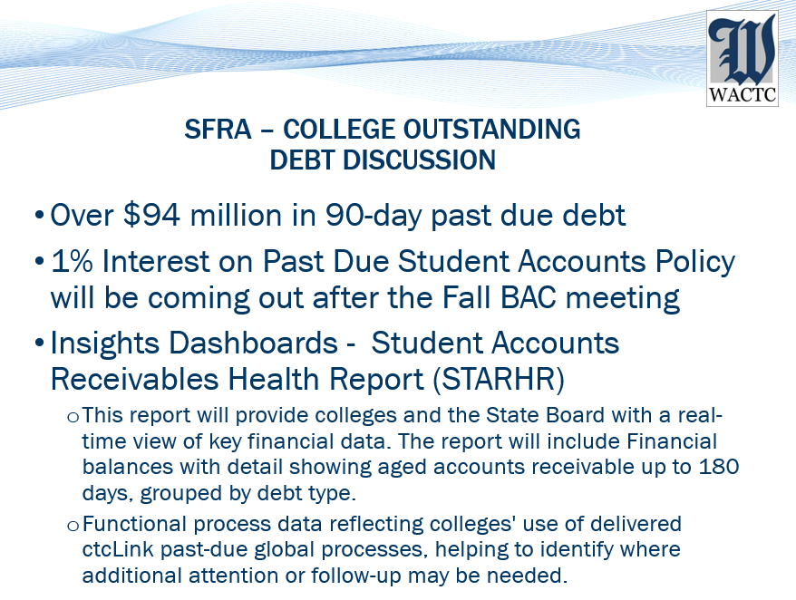

Slide 5
BAR = Budget, Accounting, Reporting.
Planning, Stay the course, Share Outcome/progress

Slide 6

Student Accounts Receivables
Holistic processing while considering nuance situations with tact.

Slide 7
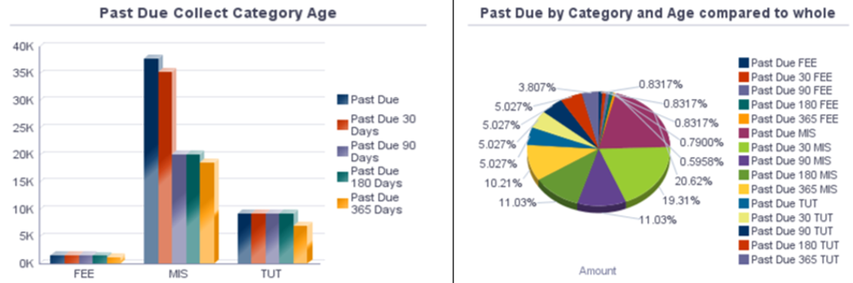
Having a pulse on outstanding receivable types.

Slide 8
Consider communications with dynamic messaging
Dynamic language: (imagine conditional paragraph when charges 1 year or more past due for example. )
(Your ctcLink Community College) has recently begun processing communications to inform students of outstanding balances in a timely manner. We are ensuring we are communicating with all persons that have a past due balance even if date of the item due is notably in the past. You may not have been aware of this outstanding balance, so we are making effort to inform you as we begin to inform all students in a timely manner so payment arrangements can be made prior to (Your ctcLink Community College) needing to send your account to outside collection agency.

Slide 9
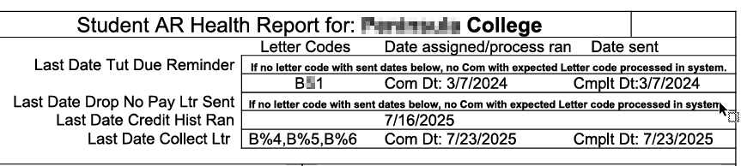
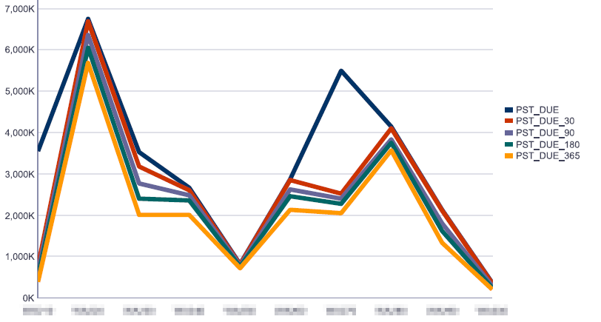
Trend analysis to inform your next steps

Slide 10
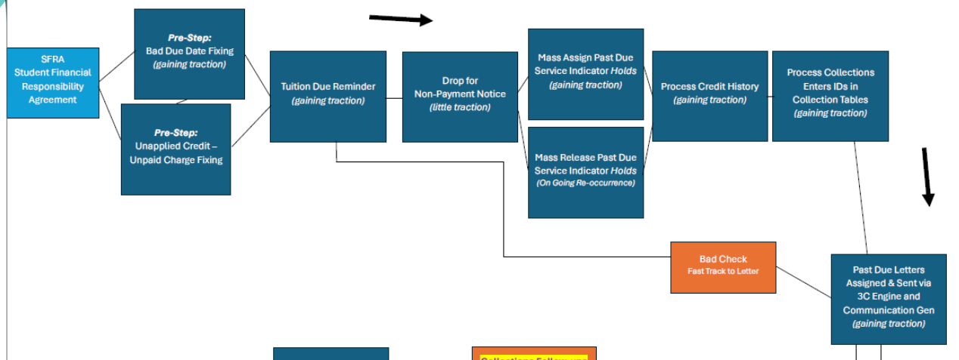
Holistic Communication opportunities

Slide 11
Holistic Communication opportunities

Slide 12
Holistic Communication opportunities

Slide 13
Holistic Communication opportunities

Slide 14
Holistic Communication opportunities

Slide 15

Plan improvements based on data.

Slide 16

Let us know when our collective improvements have had an impact.

Slide 17
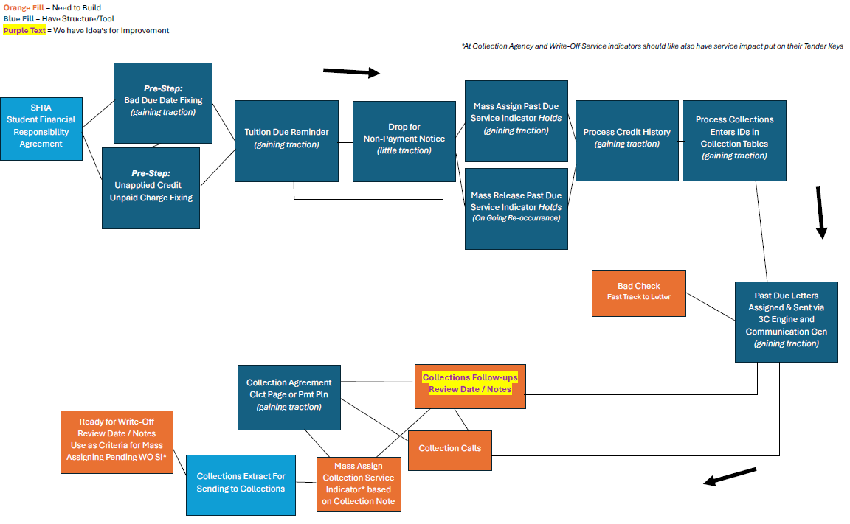

Slide 18
QUESTIONS?

Slide 19
AGENDA

Slide 20
AGENDA
Pre-collections cleanup
Credit History
Template Reviews and SFRA
Process Collections
Process Collection Letters
Collection Agreements
Sending accounts to Collection Agencies
Write-off Uncollectible Accounts
Resources

Slide 21
Pre-Collections Cleanup
Enrollment Cancellation
  How often do you run this process?
  Do you have a last day you run this?
Tuition Due Reminders/Sending Student Statements
  Do you communicate with students on tuition due dates?
  How often do you send these communications?
Review Aging Amounts in Setup SACR
  Verify entry and exit amounts are correct

Slide 22
Pre-Collections Cleanup Continued
Due Date Updates
  Looks for null/blank values (01/01/2500 is the null date) and updates the due date to match the effective date (including refund lines)
  QCS_SF_ITEM_CHARGE_NO_DUE_DATE: SF charges without a due date.
Payment Plan balance review (delivered plans)
  QCS_SF_PMT_PLN_PRG_BI: Shows Payment Plan Progress (best to schedule since it’s used with the BI report setup)
  Or run the BI Publisher Report CTCSF_PMTPRG
  Curious about sending payment due reminders for delivered plans? Let us know!

Slide 23
Pre-Collections Cleanup Continued
Cleanup credit balances (Helpful Queries)
  QCS_SF_UNTRUE_BAL_TOT_LINE: Accounts with unapplied pmts and may still owe.
  QCS_SF_UNTRUE_ZERO_BAL: Accounts that appear ‘paid’ at the surface level.
  QCS_SF_COLLECTION_ACCOUNTS: Students with B06
  QCS_SF_ITM_TYP_CREDIT_BAL_SI: Credit balance item type + SI
  QCS_SF_SERVICE_IND_ACCT_BAL: Service Indicator Account Balance
  QCS_SF_ITEM_TYPE_CREDIT_BAL: Open credit balances
  QCS_SF_CREDIT_BAL_NONREF: credit balances on non-refundable item types
  QCS_SF_ITEM_TYPE_CREDIT_AMT: student w/item type credit amounts
  QCS_SF_UNAPPLIED_WVR_AMTS: Waivers with unapplied amounts

Slide 24
Pre-Collections Cleanup Continued
Assigning Service Indicators (SI)
  Do you Assign a B01? Others? Mass assign/release? (Mass Assign QRG)
  Make sure the NOCAN is on your Nelnet/payment plan SI to prevent them from receiving a student reminder of a past due balance for their current term tuition and fees.
  Adding NOPDL and NPDL impacts to your Payment Plan SI helps with letter maintenance.

Slide 25
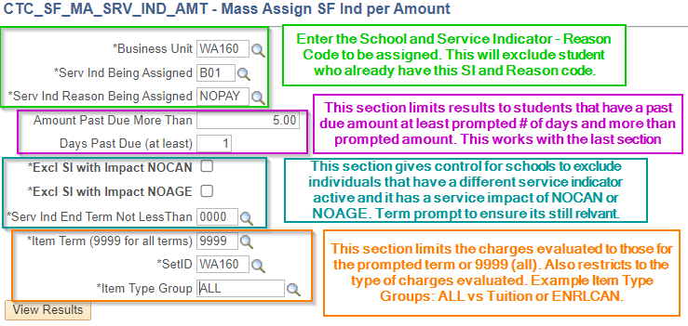
Mass Assign/Release Service Indicator Queries

Slide 26
Review Letter Templates
Global vs Local Letter Codes
  Ability to update templates on your own with local letter codes
    Local letter configuration means less subject copying on the third comm tab.
    One letter template for both email and hardcopy.
    Simplifies the processing steps when it’s a local template.
  Link local letter codes to Message Center
  Help with Researching Communication Errors
  Global still works with configuration

Slide 27
Student Financial Responsibility Agreement (SFRA)
Students are required to sign/agree once per academic year.
  Excludes under 18 and Department of Corrections (DOC) students
Uses Activity guide functionality to assign tasks to students.
Assigns the SFA SI that prevents enrollment.
Staff are able to collect hard copies from students.
  Assign the BFC SI to show manual/in-person collection.
SF Support runs a nightly process to assign/release the SIs.
Completion of SFRA shown on extract report (near future work).

Slide 28
Running Credit History and Process Collections
Credit History should be run once a month (OFM 85.54.50)
  Best to utilize the Temp Table option
    Speeds up the process
    Relies on a query to age accounts
    Looks for students with past due balances, those existing in the collections tables, and those ready to be aged out.
    Query is also looking to exclude anyone with a NOAGE service impact linked to a service indicator (ex: B70 for payment plans)
Process Collections
  Moves students in and out of the collection tables.
  Past Due letters refer to the collection tables this process populates.

Slide 29
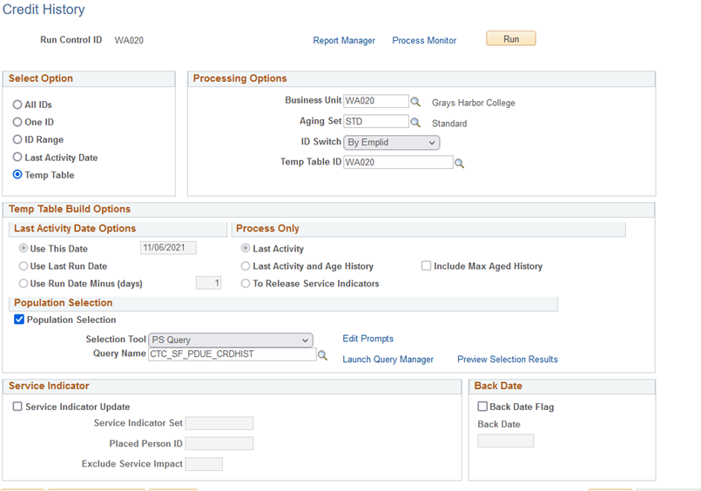
Credit History (who is it run for)

Slide 30
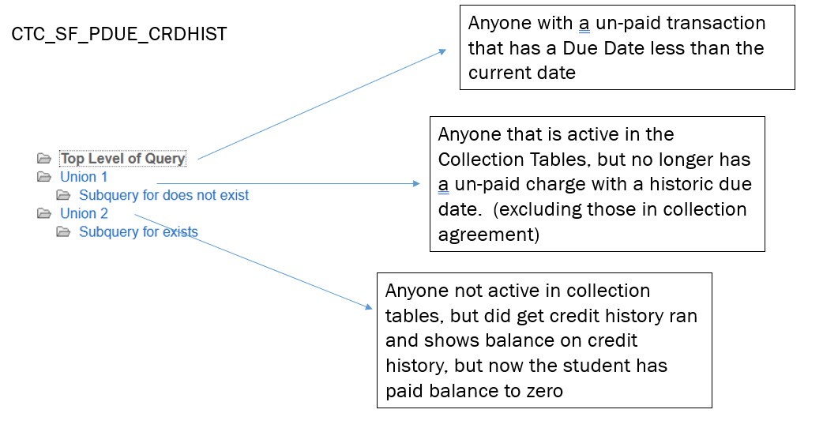
Credit History (who is it run for)

Slide 31
Sending Communication Letters
Queries do look at the collections tables and communication tables to assign appropriate letter code.
Want certain students to be skipped?
  B08 (Prevent Credit History)
    Can add the NPDL/NOPDL service impact to this Service Indicator
Query considers which letter the student previously received and sends the next letter in sequence.
Do you need to get ctcLink caught up with outside letters?
  We do have a way to mark those students with the letters in the system.

Slide 32
Questions?

Slide 33
Using Collection Efforts
Great way to track actions with students
  Set follow up dates and how best to contact the student
Possibly track Collection Agency designation (near future work)
Assign Comments on student accounts
DO NOT assign/populate the letter code value.
  Have the option to select from all configured letters for your institution.
  This can send the student the letter.
No Checklist functionality at this time.

Slide 34
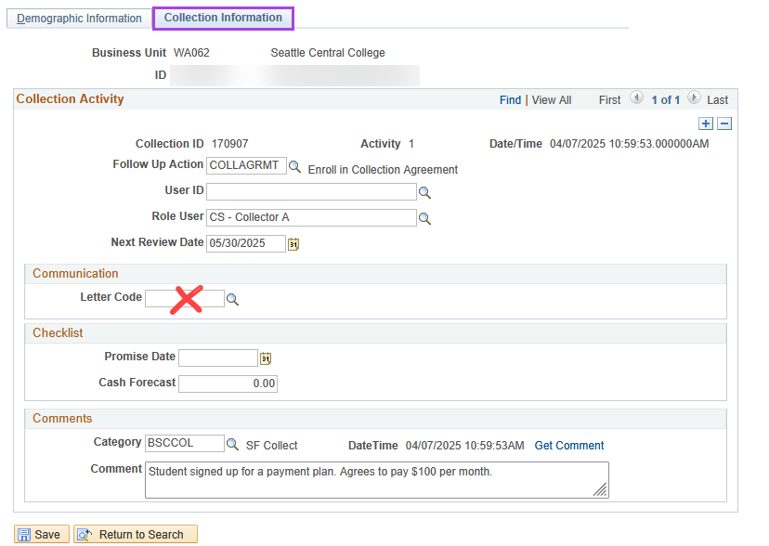

Slide 35
Collection Agreements/Payment Plans
Use the Delivered Payment Plan Functionality
  Collection Agreement page ignores business unit in the background
    Limits Agreements to one per student
  Bit more flexibility in Payment Plan pages
  Have various plans based on needs (1098-T vs non 1098-T balances)
    May need 2 separate payment item types
  Option of sending a Collection Agreement Letter (Bn7) that states the student has made arrangements with you.
    The Collection Agreement Letter also prevents the student from getting additional past due notices.
  Leverage Payment Plan Due Reminder letters to communicate due dates to students.

Slide 36
Collection Agreement Cont’d
QCS_SF_3C_MCS_PMT_PLN_MPMT

Slide 37
Sending Students to Collection Agencies
Do a final pass through of credit balances (just in case)
QCS_SF_PAST_DUE_COLLECTIONS:
  Information on letters sent, aging categories, some bio demo information.
QCS_SF_AGENCY_EXTRACT: useful for data analysis after Collection Effort notes have been entered. CLCT follow up actions
Want to prevent students in collections from paying their balances?
  Assign Service Indicator (B06)
  Can also assign service impacts to tenders linked to cashiering

Slide 38
Processing Write-offs
Use item type: 800000007500
QCS_SF_WO_GROUP_POST
  Will show “FIX PMTPLAN” if student’s balance is related to a payment plan amount.
    Must Cancel the student from the payment plan prior to applying write-off.
    Don’t worry, the payments will apply to tuition and fees and leave a balance outstanding that can then be written-off.
Assign Service Indicators (BP9 and B09)
Need to use it with Third Party Balances? Let us know!

Slide 39
Resources
Collections QRGs: SF Collections
  SFRA QRG (Includes session recordings)
OFM Table of Contents
RCW Collection of Debts (28B.10.293)
Canvas links to past sessions/trainings
  Write-Off Worksession (05/23/2024)
  Collections through Write-Offs (02/24/2025)
  Collections Fundamentals (01/22/2024)
  Enrollment Cancellation (01/08/2025)
BAR Debt Collection slidedeck (04/25/2024)
CLAM (Student Financials)

Slide 40
Under Construction processes
1% Interest charges
Collection Agency tracking on the Collection Effort Page
Corporate/Third Party Account Aging and Collections Letters
  Write-off configuration, if needed

Slide 41
Questions?

