Slide 1

Student Financials RECEIVABLES - Reconciliation OF FEES -
BAR Meeting October 16, 2025
Presented by:
Jennifer McMillan, Bellevue College

Slide 2
Agenda
What are we reconciling?
Trial Balance to General Ledger
General Ledger to E214 (Student Financials Accounting)
E214 to Student AR Query (BICS)
Student AR Query (BICS) to Student Outstanding Charges (SOC) query
What is the timing?
Trial Balance to General Ledger is reconciled separately as End-of-Month timing
Why? Because Trial Balance report is EOM dated
All other data is reconciled as Point-in-time (NOT as-of date!) timing
Why? Because the Student Outstanding Charges query is point-in-time
Example: All queries/reports in Step 2 are run between 9:15-9:20 am. Run all through current date.
What is the process? (to be continued)

Slide 3
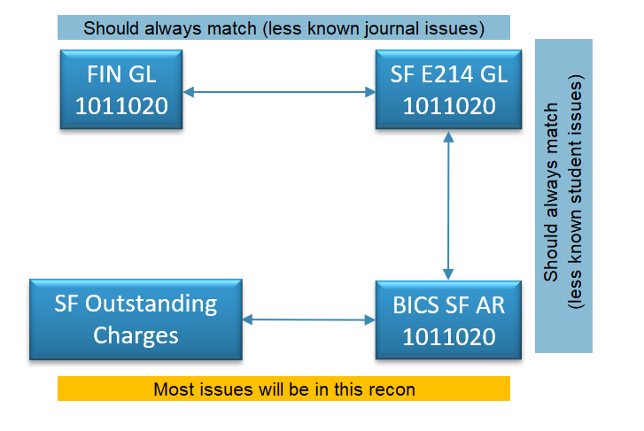
Reconciliation map

Slide 4


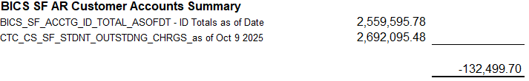
Reconciliation summary
As of October 9, 2025
(SOC)

Slide 5
Queries
Query Name | Query Description | Use
QFS_GL_ACCOUNT_ANALYSIS | GL Account Analysis | for GL data
CTC_CS_SF_STDNT_OUTSTDNG_CHRGS | Student Outstanding Charges | for outstanding student charges on Customer Accounts
BICS_SF_ACCTG_ID_TOTAL_ASOFDT | ID Totals as of Date | Accounts Receivable balances per student as of selected date
QCS_SF_E214_CF_ACCT_TERM | SFAcctgLines with AcctDt&Term | E214 Data by Journal
QCS_SF_ACCTNG_LN_ACCT_TERM | Student Fin Trans w Acct Term | E214 Data by Student Research for Individual Student
QCS_SF_E214_ACCTG_LN_JGEN | Lines not Jrnl Gen by Run Dt | E214 not yet generated
PLUS… THE LATEST TRIAL BALANCE REPORT!

Slide 6
Gathering data
Prepare large queries is separate file, append data with new dates. Copy and Append new data to “GL Reconciliation…” (master recon file)
QCS_SF_ACCTNG_LN_ACCT_TERM (E214 data by student)
CTC_CS_SF_STDNT_OUTSTDNG_CHRGS (Student Outstanding Charges)
QCS_SF_E214_ACCTG_LN_JGEN (E214 not yet generated)
All other queries, append to appropriate tabs in master file (except BICS)
QFS_GL_ACCOUNT_ANALYSIS
QCS_SF_E214_CF_ACCT_TERM
BICS_SF_ACCTG_ID_TOTAL_ASOFDT (replace, not append)

Slide 7
Reconciliation map

Slide 8


Reconciliation summary – GL vs e214
As of October 9, 2025

Slide 9
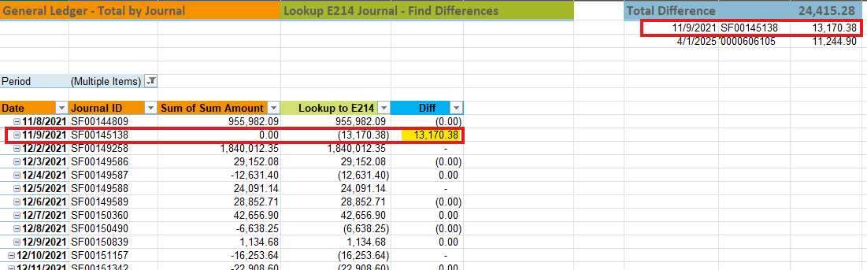
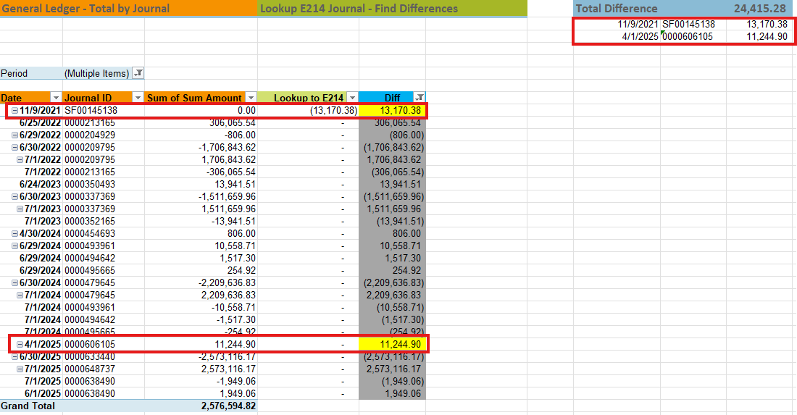
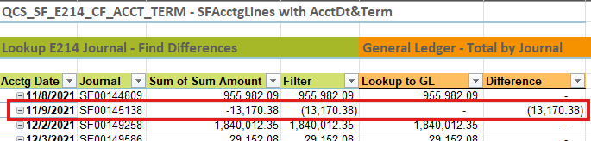
GL vs e214 recon details
GL vs E214
E214 vs GL

Slide 10
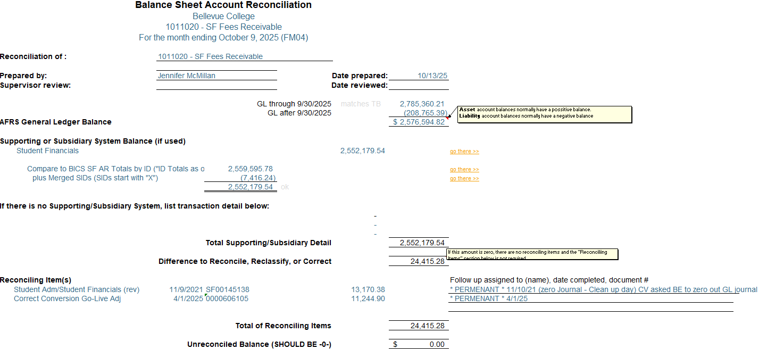
Balance sheet account reconciliation

Slide 11

Reconciliation summary – e214 vs bics ar sf
As of October 9, 2025

Slide 12
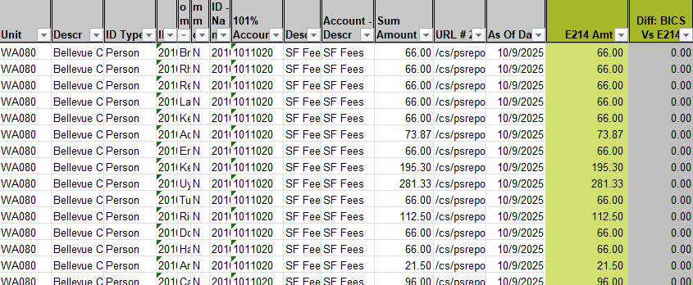
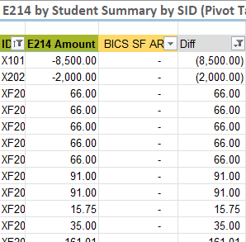
E214 vs bics sf ar - detail

Slide 13
Balance sheet account reconciliation

Slide 14
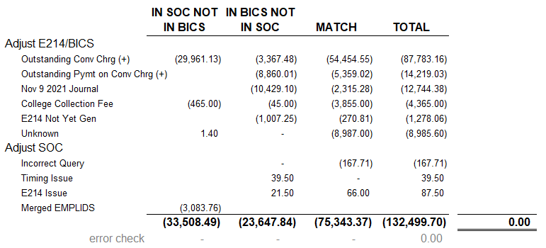
Reconciliation summary – bics vs cust accts
As of October 9, 2025

Slide 15
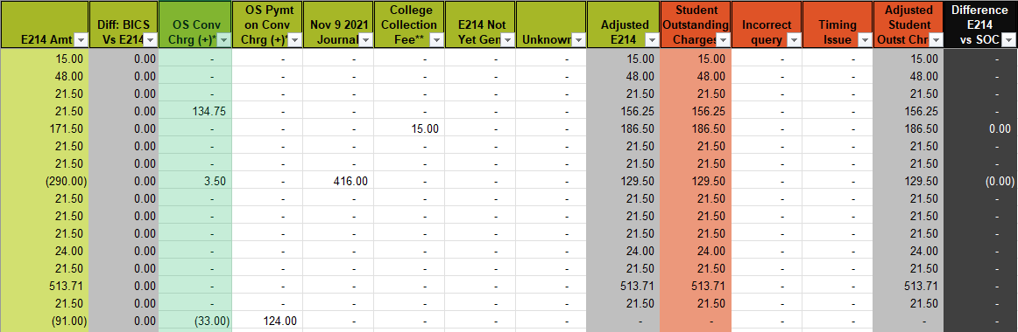
bics vs cust accts recon - details
These columns are summed in the Reconciliation Summary based on if the EMPLIDs are present in both datasets (Match), or
if they are in BICS SF AR and not in Student Outstanding Charges (In BICS Not In SOC).

Slide 16
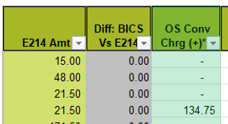
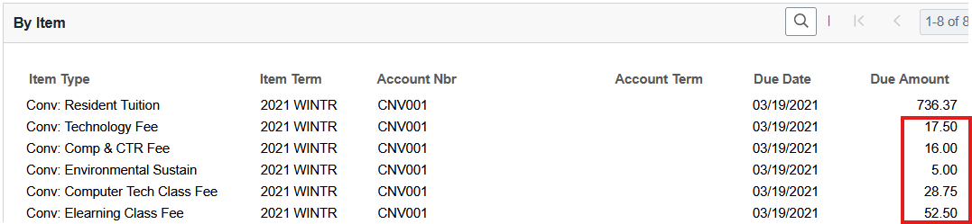

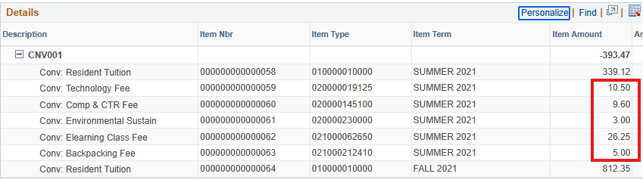
Analyzing student accounts
Customer Accounts – Due Charges
Does the Student Outstanding Charges Query match the Customer Account screen?
Analyze Customer Account screen to find the offending item type.
Analyze Payment Details screen to find the offending payment.
Run an E214 query and analyze GL data
Then mark the appropriate column in the Recon file.
View Payments – Payment Allocation

Slide 17
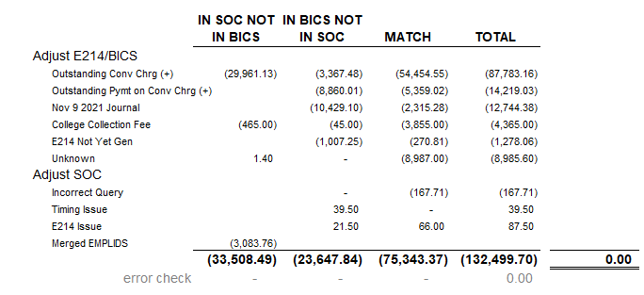
Reconciliation summary – bics vs cust accts

Slide 18
Thank you!
Contact:
Jennifer McMillan, Finance Manager
Bellevue College
425-564-4281
jennifer.mcmillan@bellevuecollege.edu
Questions? Suggestions?

