Slide 1
Daily Cash Balancing
Business Services

Slide 2
Step 1 – Run Queries
FIN pillar - QFS_GL_JOURNAL_LINE_DIST (Input wildcard % in Journal ID in order to pull all journals to cash, posted and unposted)
-Filter results to only include particular day
-Create Pivot to display Journal ID total (exclude “AP*” journal IDs which are reconciled at month-end)
- Add categories / cashiers to balancing file (Branch Deposit, Credit Card Machine, Web Credit Card, ACH/Wire and BankMobile

Slide 3
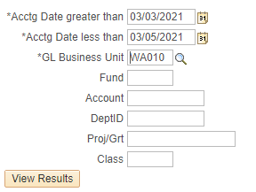
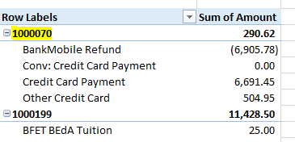
Step 1 – Run Queries (Continued)
CS - QCS_SF_E214_ACCTG_LN_CF_DTL (Contains detailed “SF*” journal transactions)
Create Pivot to display Account with Item ID Description total

Slide 4
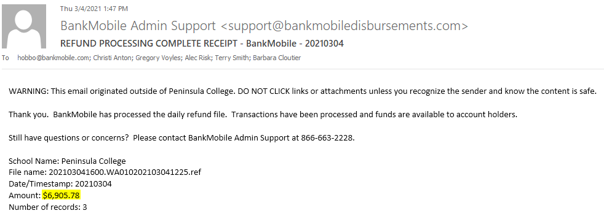
Step 2 – Acquire Supporting Documentation
Cybersource Download (Note transactions that occurred after 10:30 PM)
BankMobile Wire

Slide 5
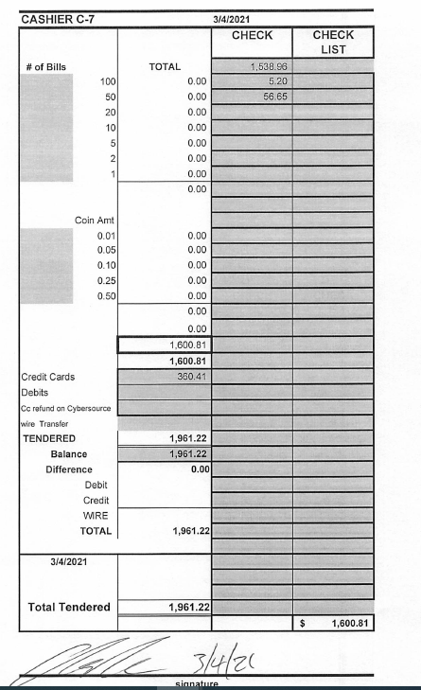
Step 2 – Acquire Supporting Documentation (Continued)
Cashier Reports detailing Method of Payment (sent to me via
email by main cashier with information on miscellaneous
receipts and A/R payments
(This may also contain A/R Payments, Wires,
Third Party Payments, Bookstore Receipts, etc.)

Slide 6
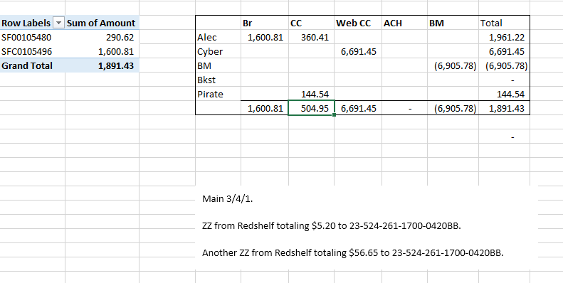
Step 3 – Enter Information into Balancing File
Breakdown by category of bank receipt to aid in monthly recon
Note any items that may have been placed in suspense that need to be recoded on the “SFC*” journal (i.e. no speed type, infrequent receipt, etc.)

Slide 7
Step 4 – Investigate Differences
If there are errors on the “SF* journal (invalid chart strings, etc.), correct them on that day’s journal. (example: debit & credit accounts don’t match)
You will need to investigate the Item Type with the error and submit a ticket to SBCTC to fix the error for future activity
Use Query QCS_SF_ITEM_1ST_2ND_ACCOUNTS to investigate issues
If you need to look for cashier transactions use CS query CTC_DAILY_CASHIER_RECEIPTS to drill down to receipt numbers
There may be instances where GL journal generation failed or payments are incomplete through no fault of the user (may need to submit service desk ticket)

Slide 8
Step 5 – Validate and Post journals in ctcLink
Be sure to post the particular month entries prior to month-end close
Save all backup documents to either the “SF*” or “SFC*” journal for easy reference

Slide 9
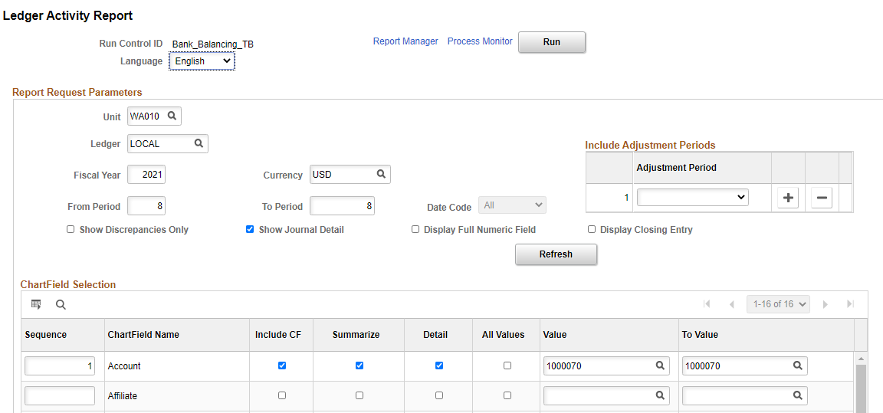
Monthly Bank Reconciliation
Download reports:
Bank Activity and Positive Pay for Outstanding Check Listing
Merchant Services processing (we use B of A Clientline)
FIN query QFS_AP_CHCK_ISSUE_CANCEL
General Ledger -> General Reports -> Ledger Activity

Slide 10
Monthly Bank Reconciliation (Continued)
Verify “AP*” journal totals equal the results of FIN query QFS_AP_CHCK_ISSUE_CANCEL as well as ACH payments during the period
Verify all “ARPY*”, “SF*”, and “SFC*” match totals in daily balancing files (Column G)
Verify manual GL entries clear (bank charges, wire transfers, etc.)
Additional useful queries:
QFS_GL_AP_ACCTG_LINE, QFS_GL_AR_ACCTG_LINE, QFS_BI_BILLING_INVOICE_RPT

Slide 11
Monthly Bank Reconciliation (Continued)
List Outstanding Checks and reconciling items
Balance to Zero
*We perform a separate monthly reconciliation for Internal Cash Account 1000199 which gets merged with Account 1000070 at year-end

