Slide 1
Finance Payroll
Payroll’s Impact on Finance Modules
SBCTC Accounting Washington State Community and Technical Colleges

Slide 2
Finance Payroll
Today’s Discussion Topics:
Understanding Payroll dates
Processing Payroll Vouchers
State VPA draw for Payroll Expenditures
Payroll Journal
Relieving of Net Pay Liability

Slide 3
Understanding Payroll Cutoff Dates

Slide 4
Payroll Cutoff Dates
Understanding the Importance of Payroll Cutoff Dates;
What are Payroll Cutoff Dates?
Example: Cutoff Date 9/15 but Payroll Date is 9/25
Why are they important?
Notes:
Payroll cuts off on the 15th and EOM.
This means a journal will be created on the cut-off date with the expense/liability costs (PAY Journal). These journals must be posted “as is” before the month closes.
We will talk later about Combo codes and corrections to these journals.
Paydates are 10th & 25th.
This means, these are the dates that you release paychecks and relieve your liabilities & Net pay.
Why is understanding these important?
- Year end – no accruals are required because the PAY journal will post them.
- Grants runs off expense dates – PAY journals are posted in the month that the expense is incurred.
- Billing runs off expense dates
- Accounts Payable
- General Ledger (PAY Journal)

Slide 5
Processing Payroll Vouchers

Slide 6
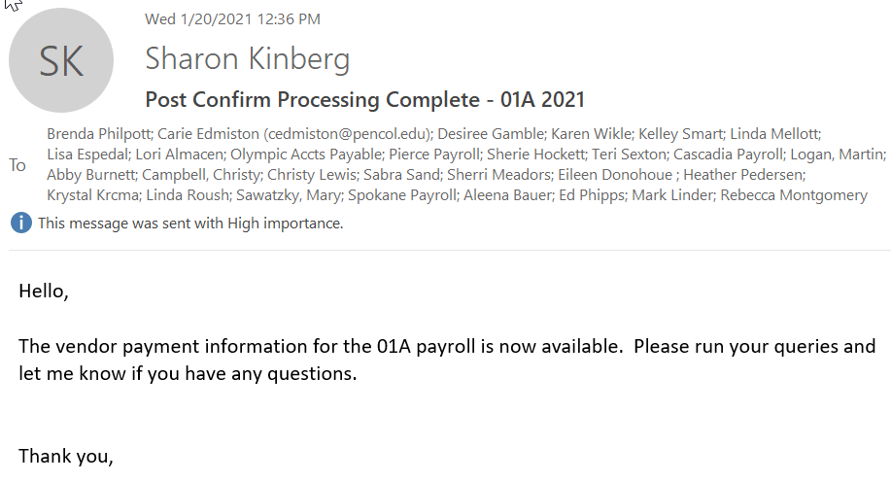
Email Notice Received
Finance Payroll processing begins by an email from SBCTC:
Notes:
You should see this email after Payroll confirm happens in your payroll department AND SBCTC reconciles. Usually somewhere around 4 days before payroll is paid.

Slide 7
Processing Payroll Vouchers– 1
A/P Voucher Process
QRG: 9.2 Processing Payroll Vouchers (http://ctclinkreferencecenter.ctclink.us/m/72571/l/794686-9-2-processing-payroll-vouchers)
Create the Voucher
Run Voucher Build
Budget Check
Vouchers automatically approve (do not go through local AWE)

Slide 8
Processing Payroll Vouchers– 2
Review List of Payments
HCM Pillar QUERY: CTC_AP_EXTRACT_SUMMARY
Original Vouchers should be posted without changes
If Changes:
Create a new Voucher to modify the payment amount; or
Create a Journal Voucher to modify the distribution lines
Utilize Selective Payment Update to:
Comments to the payment remittance
Change payment dates
Split payments
Notes:
Utilize this query as a communication between Payroll and Accounts Payable.

Slide 9
Processing Payroll Vouchers – 3
Vouchers paid OUTSIDE of PeopleSoft (IRS)
Mark as a Manual Payment
1. Single Voucher – utilize Selective Payment Update
2. Multiple vouchers – Utilize Manual Payment Worksheet (very similar to AR worksheets)
Dates for Payments for Vouchers are important
Why important?
Notes:
Dates for making payments are important…
All vendor payments are due the day after payroll (with the exception of Federal/State Taxes, which are due on paydate).
Please note: Some suppliers require receipt from all colleges before they will post the employees account. So, if you do not pay your part on time, you could be effecting not only your college employees, but also other college employees, getting to their money.

Slide 10
State VPA Draw for Payroll Expenditures

Slide 11
State VPA Draw for Payroll Expenditures
Best practice:
https://www.sbctc.edu/colleges-staff/programs-services/accounting-business/default.aspx
Why use the AR Module rather Banking?
Creation of AR Online Pending Items for Credit Balances
For Items that you are unable to use to reduce vouchers such as TIAA or HCA
Notes:
In Accounting and Business Services – ctcLink Accounting – you will find the documentation for State Reimbursement Process (VPA). This documentation includes both the PAY vpa and non-pay vpa.
Creating a rule or External Transaction is difficult as they are not meant to be for multiple lines. Also, this doesn’t create a good audit trail.
By utilizing the AR module for the VPA collected on behalf of your school, you are creating a good audit trail, it is made to have multiple lines, and, it can be made prior to the payroll date. This will then create a transaction in banking that will allow appropriate reconciliation.
There are a number of HCM suppliers that we are not able to take credits against the amounts owed. For instance, TIAA or HCA. If a credit exists, a request has to be sent to them requesting payment be reimbursed. By creating a receivable for these amount, you are not only recording all amounts owned to your college, but also providing your AR department a place to deposit the payment when it arrives. Without this, the AR department will have to have an incomplete deposit in PS until a correct string and document can be provided.

Slide 12
Payroll Journal

Slide 13
Payroll Journal- 1
The HCM pillar has a table called the HR Acctng Line. This is the foundation of HCM’s integration into the Fin Pillar General Ledger. The HCM table pushes summary accounting detail to FIN, creating a table, also called the HR Acctng Ln.
Queries (in HCM Pillar):
CTC _HR_ACCTNG_LINE_PAY_PERIOD
CTC_HR_ACCTG_LINE_EE_DIST
Notes:
The difference between the HCM HR Acctng Line and the FIN HR Acctng Line tables: Detail. HCM houses all of the different distribution lines. Where the FIN table has only summary accounting line, no employee information.
It is from the FIN table that the PAY journal is actually created.
It is helpful for FIN to have view access in HCM to be able to run queries. For any reconciliation or correction, you will need to be able to query the HCM HR Acctng Line table for distribution detail.

Slide 14
Payroll Journal- 2
Payroll Combo Codes:
Creation of Combo Codes – If the Combo Codes are created by HCM Payroll, Finance, or a combination of both
QRG: 9.2 Uploading a Combo Code Spreadsheet
QRG: 9.2 Inactivating a Combo Code
QRG: 9.2 Deleting a Combo Code
QRG: 9.2 Creating a New Combo Code
Notes:
Combo codes are the Budget lines for payroll. HCM uses combo codes to represent the chartstring, rather than typing out each individual charfield value. When Combo codes are entered in an employees Job Data, they can only have effective dates for payroll that haven't been paid yet. For instance, if today you created a combo code, you could not use an effective date any further back than1/16/21 (as that payroll has not been processed yet). It is important that you confirm with your Payroll department when are making changes close to payroll processing dates (usually a week before paydate), to confirm that it is still okay to make changes.
Combo codes are created in HCM, so anyone that has the ability to create them, must have HCM security. SBCTC chose to do a combinate of both. Our Budget Manager creates the Combo Code and provides them to our HR department. HR inserts the Combo code into the employee record.
Go-live colleges – Some combo codes have to be created AFTER go-live. Unfortunately, there isn’t much time between go-live and the first payroll. So, this needs to be a high priority.

Slide 15
Payroll Journal - 3
Posting a PAYXXXXX Journal Entry:
Making Corrections -
Corrections effects the General Ledger
State Draw needs to equal Journal
Watch out for the domino effect – Expenses need to hit the correct Liability
Best practice: Use a separate Journal Entry to modify the PAYXXXXX Journal Entry
Notes:
PAY journals should be posted without modification. If corrections need to be made, they should be done by creating a new journal entry and transferring the expenses and cash.
Making changes directly to the PAY journal have effects to:
GL Accounts – HCM vouchers relieve the chartstring from the combo codes. If you modify the expense/liability journal, then you will also need to change each of the AP journals with corresponding relief of those liability accounts. This creates a large opening for errors that will have be fixed with journals entries. This also creates a deviation from the HCM Acctng Ln table in FIN Pillar.
VPA draw – Central payroll draws VPA for each college based upon the HCM Pillar HR Acctng Line table. In FIN, the VPA calculation does not include the PAY journal. Therefore, manual adjustments will need to be made to this report for any changes made directly in the PAY journal.
The best way to make corrects is to use a separate Journal entry. This will keep the Acctng Ln table equal to the PAY journal and make the VPA draw correct. In Legacy, used T account transfers. PeopleSoft is similar. We use account 5081010 – Intra Agency Transfer Salaries and 5081020 Intra Agency Transfer Benefits. As with all journals, you will want to create off-sets to the cash account 1000199.
I would like to make this a requirement rather than a best practice, however, there are times when you are not going to have to change the PAY Journal. For instance, the Combo code you create in HCM doesn’t do any validation. Therefore, if you forget something (usually the State Purpose), it will process through the HCM Pillar, and will error when the Journal reaches the GL in the FIN pillar. You will not be able to post this journal without modification.

Slide 16
Relieving of Net Pay Liability

Slide 17
Relieving of Net Pay - 1
Relieve Cash for Net Pay via creation of A/P Voucher:
Pros & Cons using Voucher Upload vs. Journal Entry
Where is the Payroll CEMLI going?
QRG: Create Voucher Using a Voucher Upload Process
HCM Query: CTC_HR_ACCTG_LINE_NETPAY
Notes:
Currently, some of you are using a GL Journal upload to relieve the Net Pay Liability account against cash. However, this doesn’t create an entry that can be reconciled in your banking. To solve that problem, you have created a rule or use an External Transaction to create a transaction that can be reconciled.
Issues with this process: No true reconciliation, audit trail, extra steps
Currently, there is a pending CEMLI modification that will send a voucher to AP with all the other HCM Payables.
Until this available, we have the configuration to create an upload (similar to the GL Journal upload) that will create a voucher for AP to build. This process creates a true reconciliation for banking, an audit trail, and in fewer steps.

Slide 18
Relieving of Net Pay - 2
Required Security for AP Voucher Upload:
ZZ Voucher Upload
Note: Security admin will need to go to the user profile of the user uploading vouchers in PS and set a password on their user profile. This is not your regular access password.
Notes:
This would be the same password as you use in uploading GL files or dispatching payments in Financial Gateway.

Slide 19
Questions
PeopleSoft

