Slide 1
EDI Panel & Discussion
May 2023

Slide 2
Purpose & Introduction
Purpose: Showcase 3 programs that have taken different types of action to address inequity and racism. Provide ideas and inspiration for those who “don’t know where to start.”
Agenda:
Purpose & introduction
Panelists
Q & A
Reflection & Discussion
Share-out
Notes:
Lyn & Jennifer

Slide 3
Panelists

Slide 4
Panelist 1: Edmonds Pre-College Division
PARAT: Precollege Antiracism Action Team was created to advance the work of dismantling structural racism within our division and college by doing the following:
Identifying an action oriented individual antiracism goal
Defining our spheres of influence and focusing our work where we can affect actual change
Identify the college’s racist policies and practices and work to change them
Hold each other accountable
Notes:
15 min

Slide 5
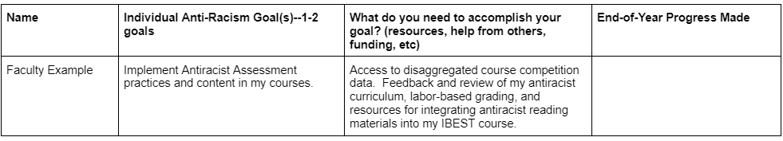
Work on advancing our personal, division, and college antiracism goals
How we do this?
Each year, every member of our division creates individual antiracism goals that are put onto a shared document and each quarter we check in as a group and discuss the progress of our individual goals holding each other accountable
EXAMPLE:
Template for individual antiracism goals shared google doc

Slide 6
Defining our spheres of influence and focus our work where we can affect actual change & Identify the college’s racist policies and practices and work to change them
How do we do this?
Create an inventory of college policies and practices perpetuating structural racism
  Ask the following: What is it? Is it policy or practice or something else? Whose sphere of influence? Who are the policy makers? What's wrong with this policy? What are the issue(s) with this policy? What would be a better alternative?
Brainstorm and identify where each of us have a connection, relationship and or access to groups or individuals that make policies on campus
Work directly with the people involved in the decision and policy making and provide alternatives and implementation strategies
Example: One of our faculty works closely with the foundation and brought our concerns about the scholarship application process forcing students to relive trauma and biased scoring rubrics. A small group of precollege faculty and staff worked on revising scholarship questions to be more strength based, equity focused, as well as, TILTED the application and reviewed the scoring rubric with an equity lens.
Template for Inventory of College Policies and Practices

Slide 7

Panelist 2: Community Action of Skagit County (Sandi)
Diversity, Equity, and Inclusion: Where do we start?
Notes:
15 min

Slide 8
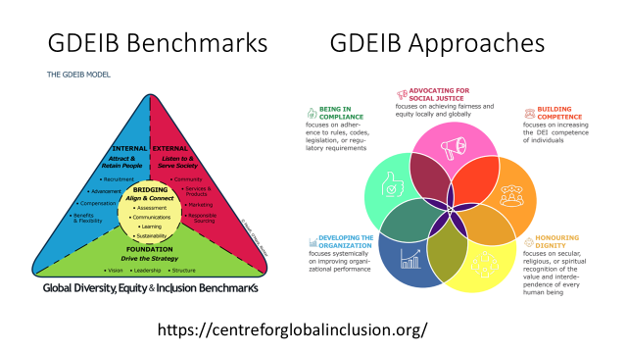

Slide 9
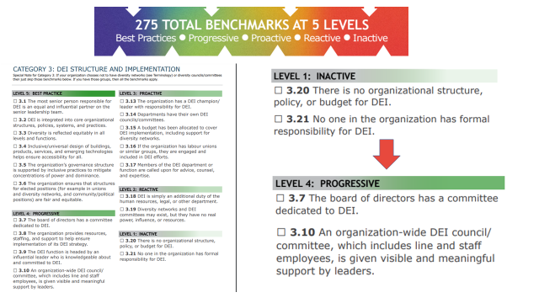

Slide 10
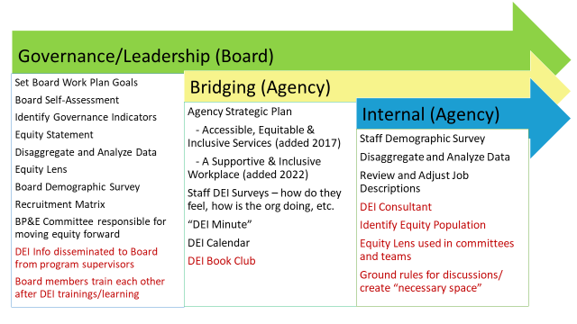

Slide 11
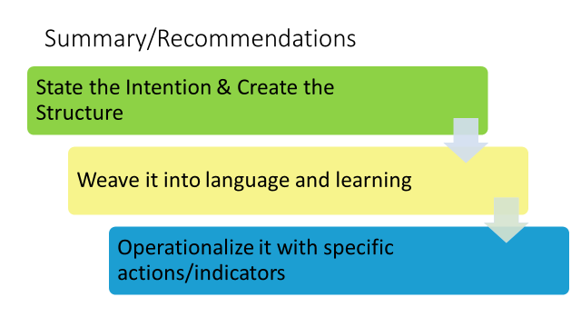

Slide 12
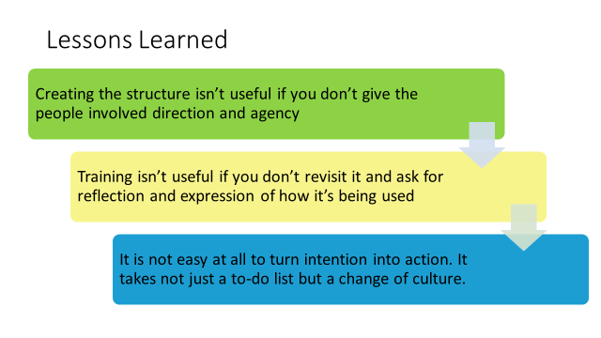

Slide 13
Panelist 3: Seattle Central College (Sy and Katie)
College Spark Grant:
Education Equity in
Basic & Transitional Studies
Notes:
15 min

Slide 14
Seattle Central College, continued
  Develop culturally-responsive and culturally-sustaining curriculum and pedagogical practices across BTS classes and pathways.
  Cultivate communities of practice and professional development opportunities that center cultural responsiveness and a commitment to equity, diversity, and inclusion.
  Center student voices and sustain opportunities for student community-building/belonging.
What is the College Spark Grant project in Basic & Transitional Studies at Seattle Central?
A $180,000 Education Equity Fund grant distributed over three(+) years that supports our division to:

Slide 15
Seattle Central College, continued
College Spark Outcomes:
  Develop curriculum models.
  Implement anti-racist practices.
  Revise courses.
  Measure student satisfaction.
  Increase key academic outcomes.

Slide 16
Seattle Central College, continued
What steps have we taken so far?
  Established a Core Team (one full-time ABE faculty member, one full-time ESL faculty member, one part-time ESL faculty member with ABE experience, and the Associate Director).
  Developed a collaboration framework in the Core Team, influenced by principles of emergent strategy.
  Collaborated with South End Stories to begin division-wide work in culturally-responsive/culturally-sustaining education: two professional development day workshops so far with more activities to come.
  Established student voice-focused reading groups division-wide.

Slide 17
Seattle Central College, continued
What have we been learning?
  It takes time to shift institutional culture, values, and priorities.
  Incremental growth is meaningful.
  It’s useful to identify different layers of participation for this work: core team, book groups, division-wide trainings and discussions, connections with existing committee projects and initiatives . . . a blend of opt-in activities and division-wide activities.
  Everyone has a unique relationship to racism, inequity, education, and the institution, and we show up in different ways. Make space for unexpected and emergent needs for self and group.

Slide 18
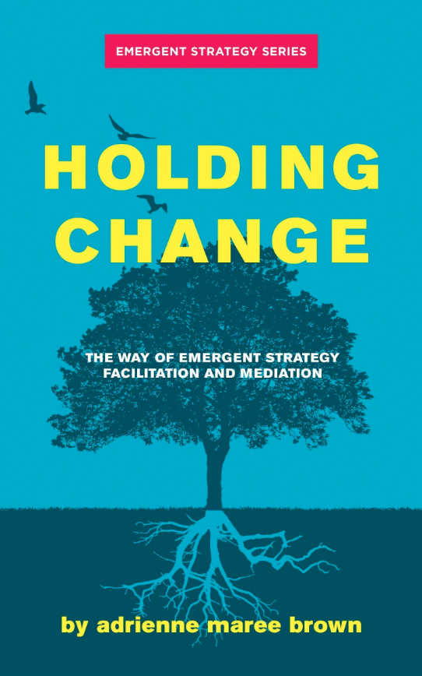

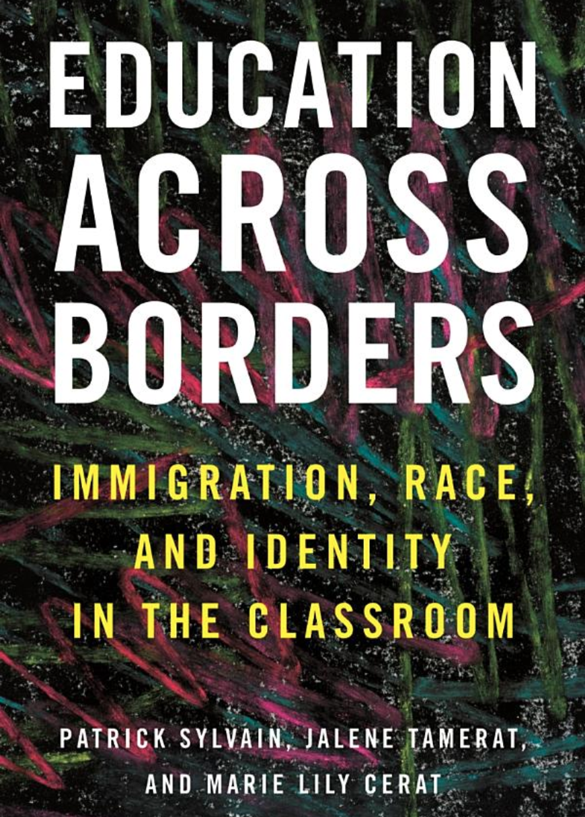
https://collegespark.org/
Resources
https://www.southendstories-artsed.com/

Slide 19
Q & A with panelists
Notes:
10 min

Slide 20
Reflection & Discussion
Notes:
10 min

Slide 21
Reflection & Action planning: Write on sticky notes
What were your takeaways from the panel presentations?
What was new for you?
What inspired you to action?
What is something within your control that you can commit to doing at your own institution?
What are some barriers to taking that action?
What are ways that you can get around those barriers?
Notes:
Kelli/Lyn; 15 min

Slide 22
Share & Discuss
Add your sticky notes to the large posters around the room.
Gather and discuss where you’re inspired.
Notes:
Kelli/Lyn 15 min

Slide 23
Thank you!
Notes:
Lyn/Jennifer

