Slide 1
NRS Descriptors and Examples
ESL 31 (3A) – Elinor Appel, North Seattle College
NRS Levels 2 (Beginning Basic) and 3 (Low Intermediate)
Notes:
Abilities vary widely in this clustered class. Most students are working at CCRS B (Beginning Basic) and others are ready for or working at CCRS C (Low Intermediate) when they start the class. I believe the book, Ventures 2, aligns best with CCRS B. I supplement with additional material, including a reader for which I make my own assignments and a grammar packet.

Slide 2
NRS Writing - Beginning Basic (3A) - Appendix B
Writing: Individuals ready to exit the Beginning Basic Level are able to write opinion pieces on topics or texts, supporting a point of view with reasons. They are able to write simple informative texts in which they examine a topic and convey information clearly. They also are able to write narratives with details that describe actions, thoughts, and feelings. They use transition and temporal words (e.g., also, another, more, but) to link ideas and signal event order. Individuals ready to exit this level are able to use technology to produce and publish writing as well as to interact and collaborate with others. They are able to conduct short research projects and summarize their learning in print. This includes taking brief notes from both print and digital sources, and sorting evidence into provided categories.

Slide 3
NRS Writing - Low Intermediate (3B) - Appendix B
Writing: Individuals ready to exit the Low Intermediate Level are able to write opinion pieces on topics or texts, supporting a point of view with facts and logically ordered reasons. They are able to produce informative texts in which they develop a topic with concrete facts and details. They convey information clearly with precise language and well-organized paragraphs. They link ideas, opinions and reasons with words, phrases, and clauses (e.g., another, specifically, consequently, because). They are also able to use technology (including the Internet) to produce and publish writing as well as to interact and collaborate with others. They are able to conduct short research projects, making frequent use of on-line as well as print sources. This includes the ability to draw evidence from several texts to support an analysis. They are able to summarize or paraphrase information from and provide a list of those sources.

Slide 4
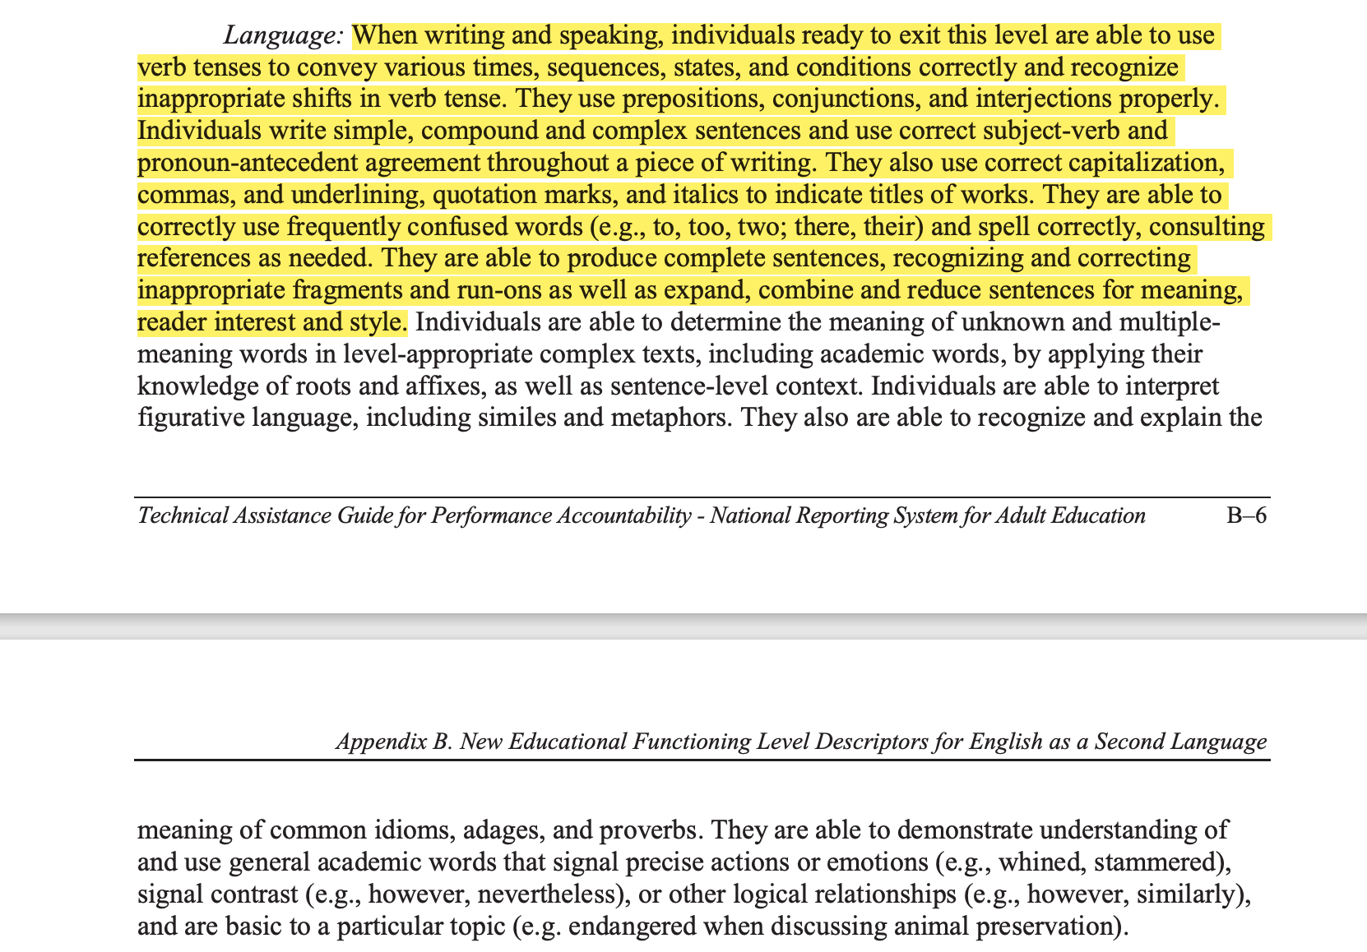
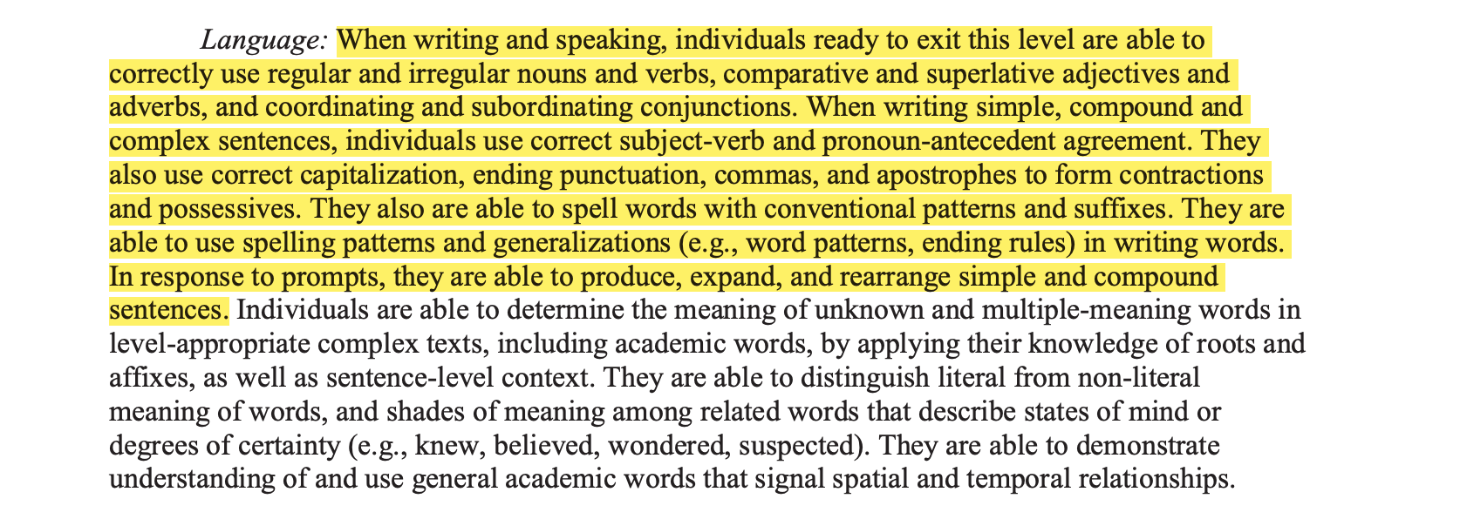
NRS: Language (Levels 2 and 3)
This work is part of the previous examples.
- Appendix B

Slide 5
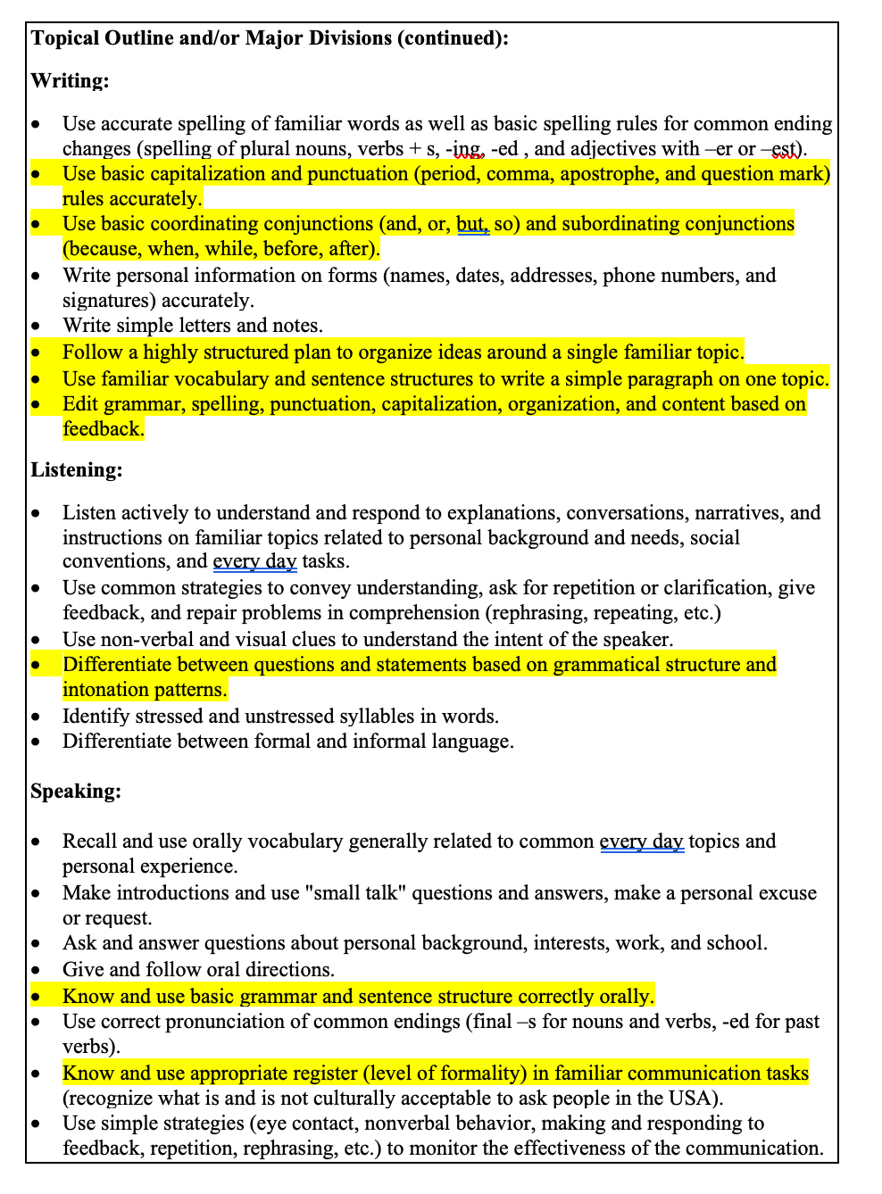
NSC Master Course Outline – Class Outcomes: ESL 31 (3A)

Slide 6
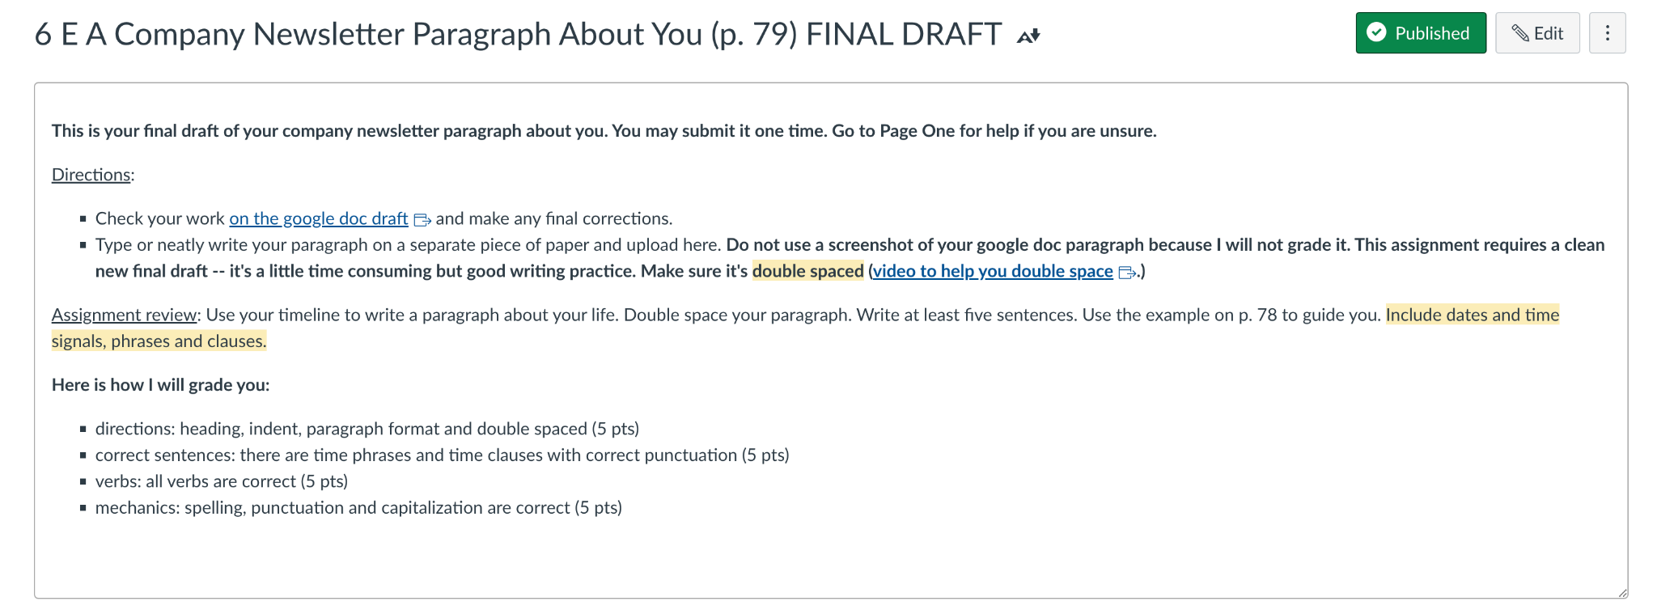
Sample Assignment

Slide 7
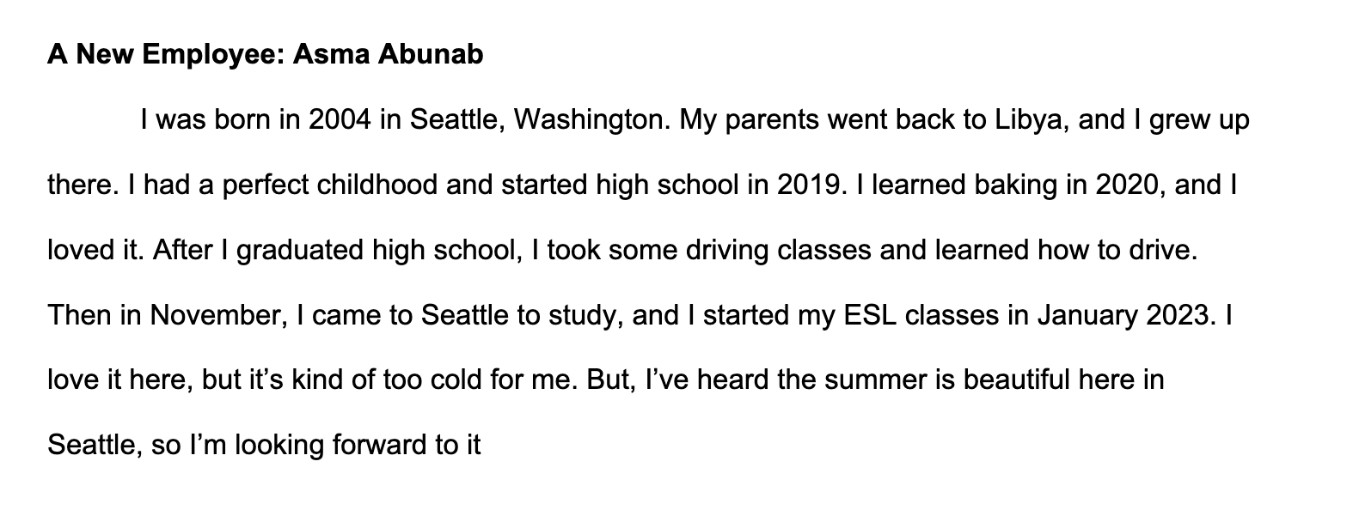
Student Sample (3A)

Slide 8
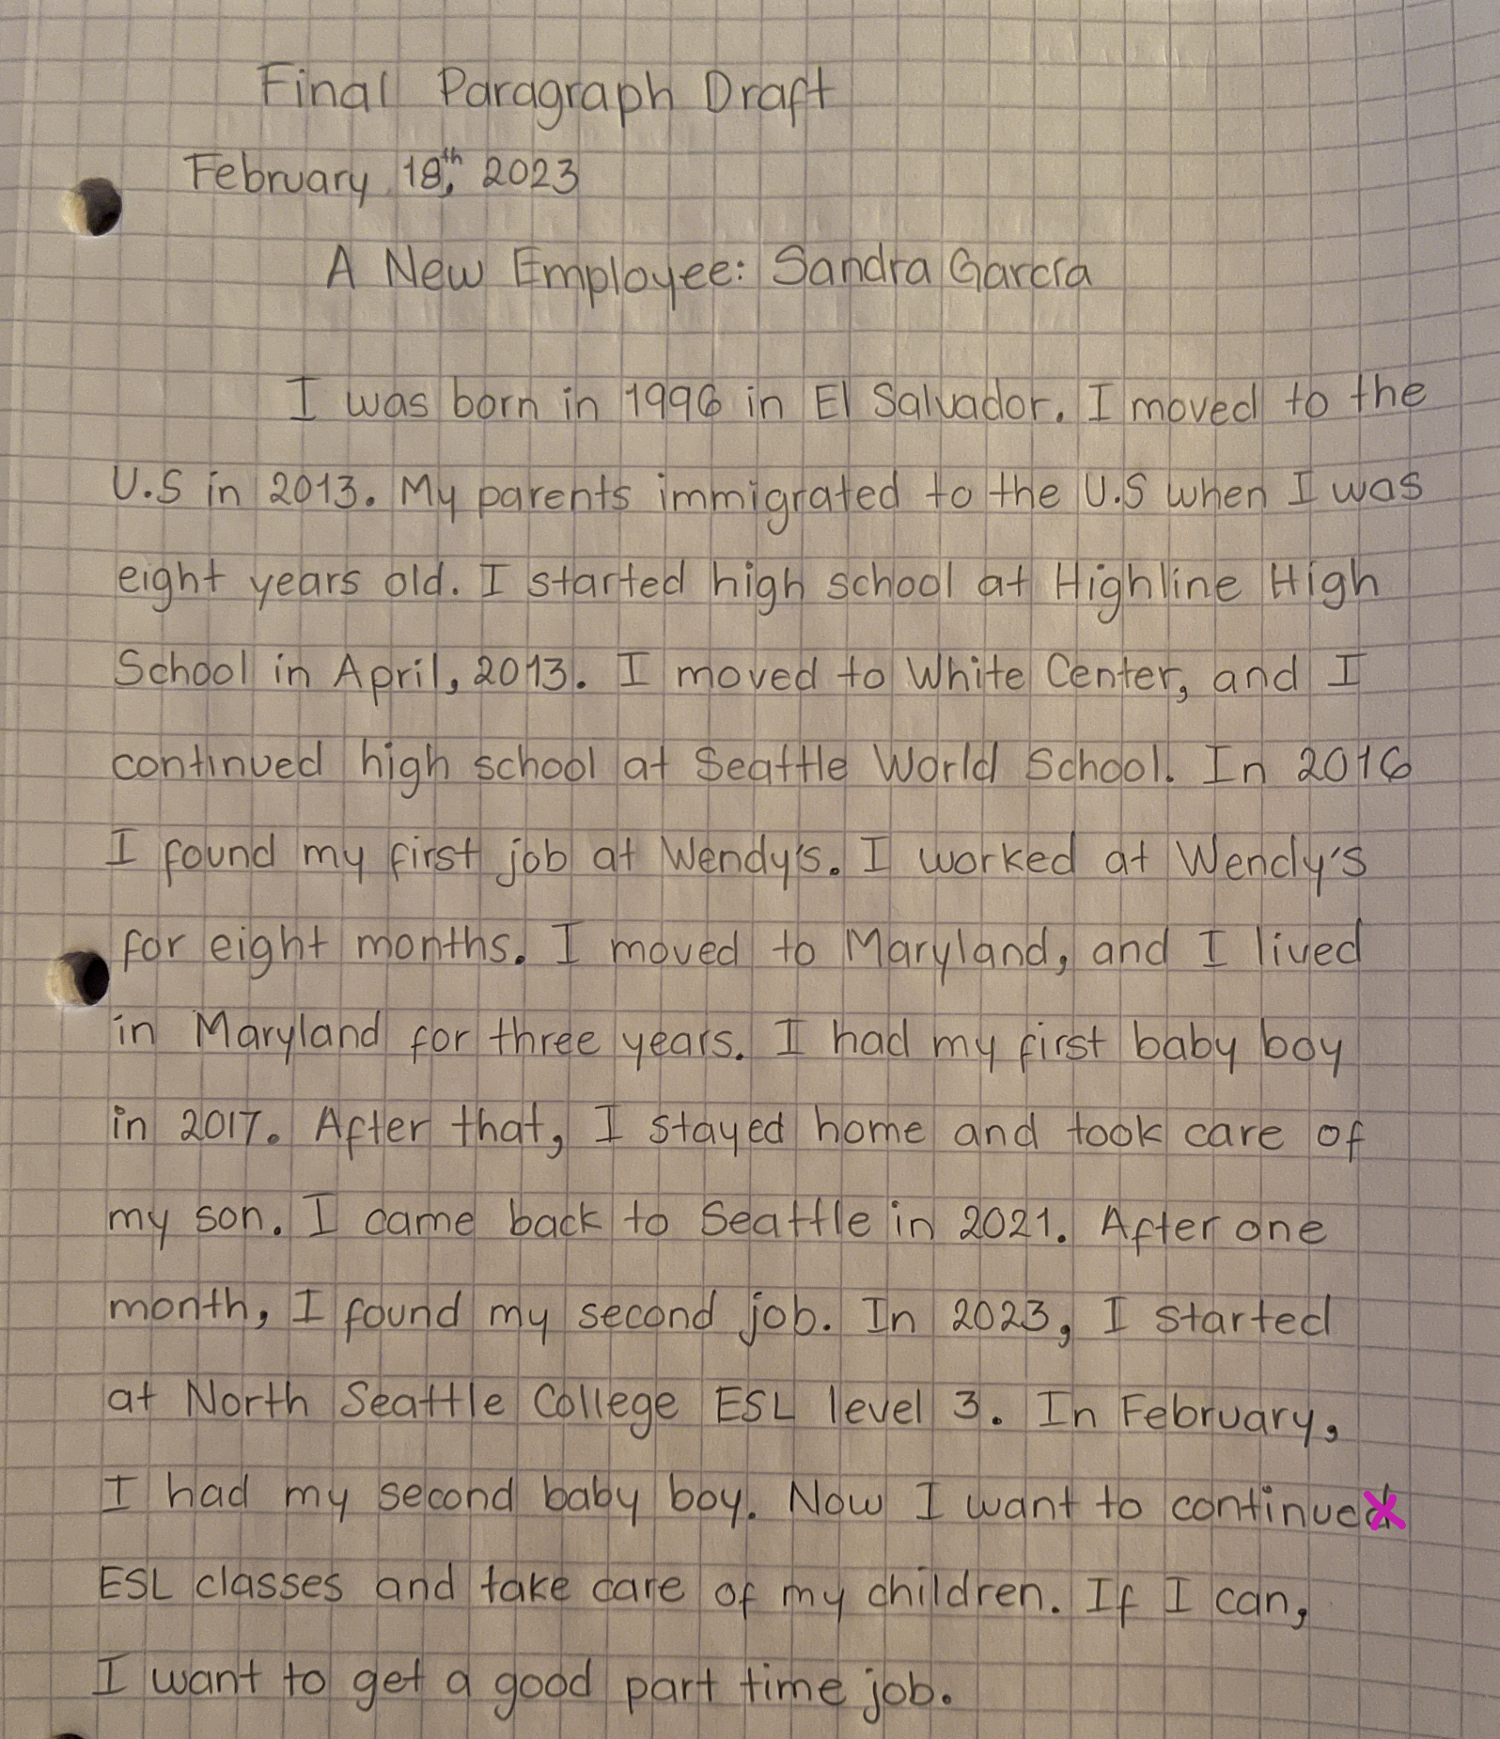
Student Sample (3A)

Slide 9
NRS Writing - Technology for Levels 2 & 3
Writing: Individuals ready to exit the Beginning Basic Level are able to write opinion pieces on topics or texts, supporting a point of view with reasons. They are able to write simple informative texts in which they examine a topic and convey information clearly. They also are able to write narratives with details that describe actions, thoughts, and feelings. They use transition and temporal words (e.g., also, another, more, but) to link ideas and signal event order. Individuals ready to exit this level are able to use technology to produce and publish writing as well as to interact and collaborate with others. They are able to conduct short research projects and summarize their learning in print. This includes taking brief notes from both print and digital sources, and sorting evidence into provided categories.

Slide 10
ESL 31 (3A) Technology Coursework Examples:
Students read and reply thoughtfully to their classmates’ Canvas posts.
Students work together to write answers together on a shared Google Slide for an in-class assignment.
Students write, format, and double space a paragraph draft on a shared Google Doc then read and revisie based on feedback on the Google Doc
Students work together to sort grammar structures or complete a similar task in a shared Google Jamboard
Students respond to a grammar prompt and respond in Zoom chat (formative assessment).

Slide 11
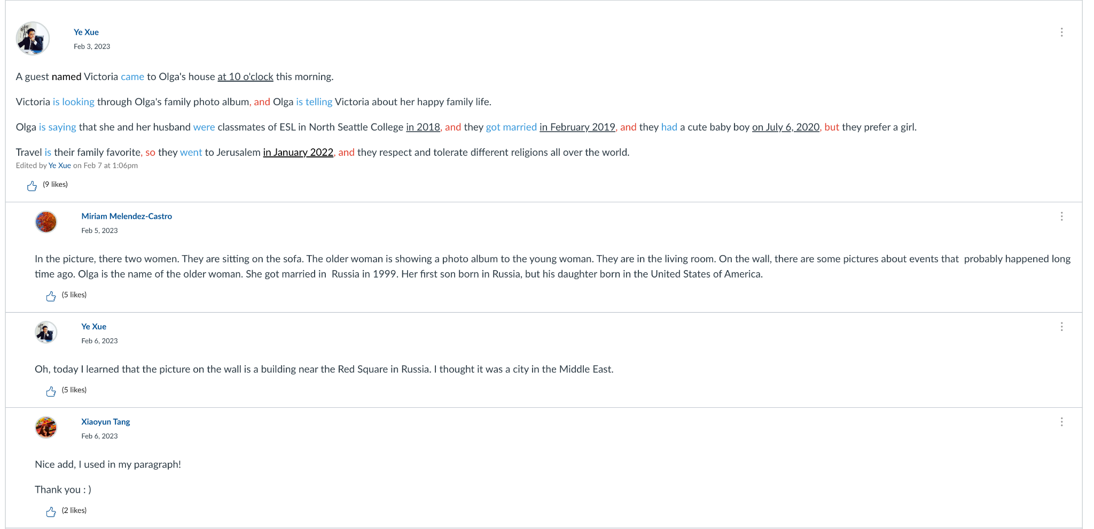
Example: Using Technology to Interact (Canvas)
For this assignment, students are graded on sentence structure, verb control, and thoughtful responses to their classmates.

Slide 12
Examples: Groups type answers to questions on a shared slide.

Slide 13
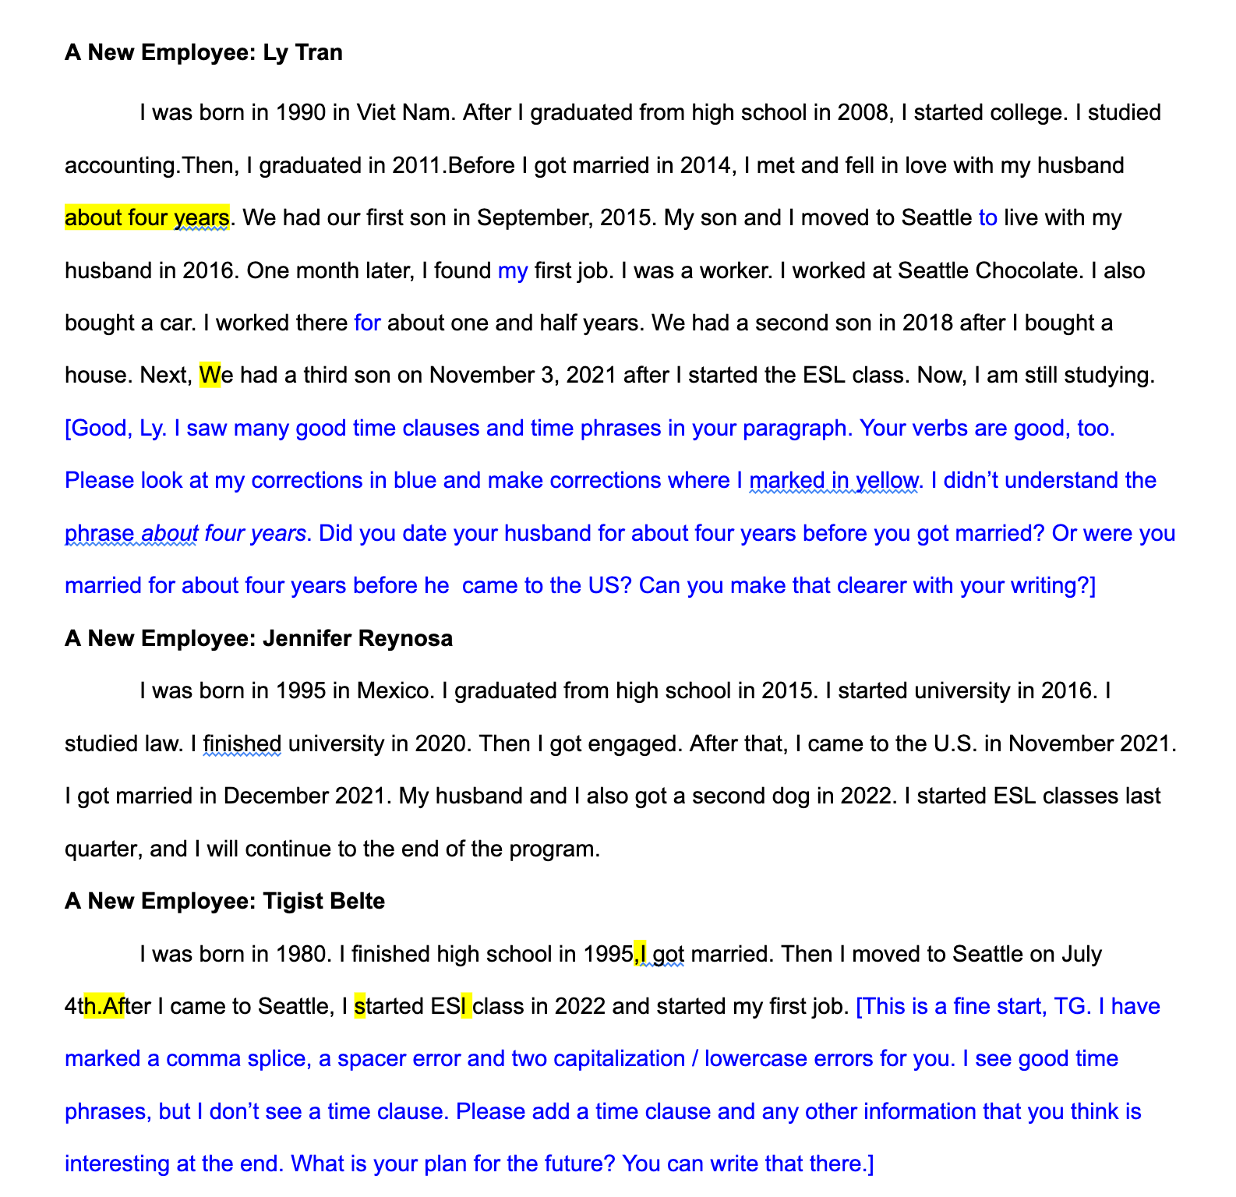
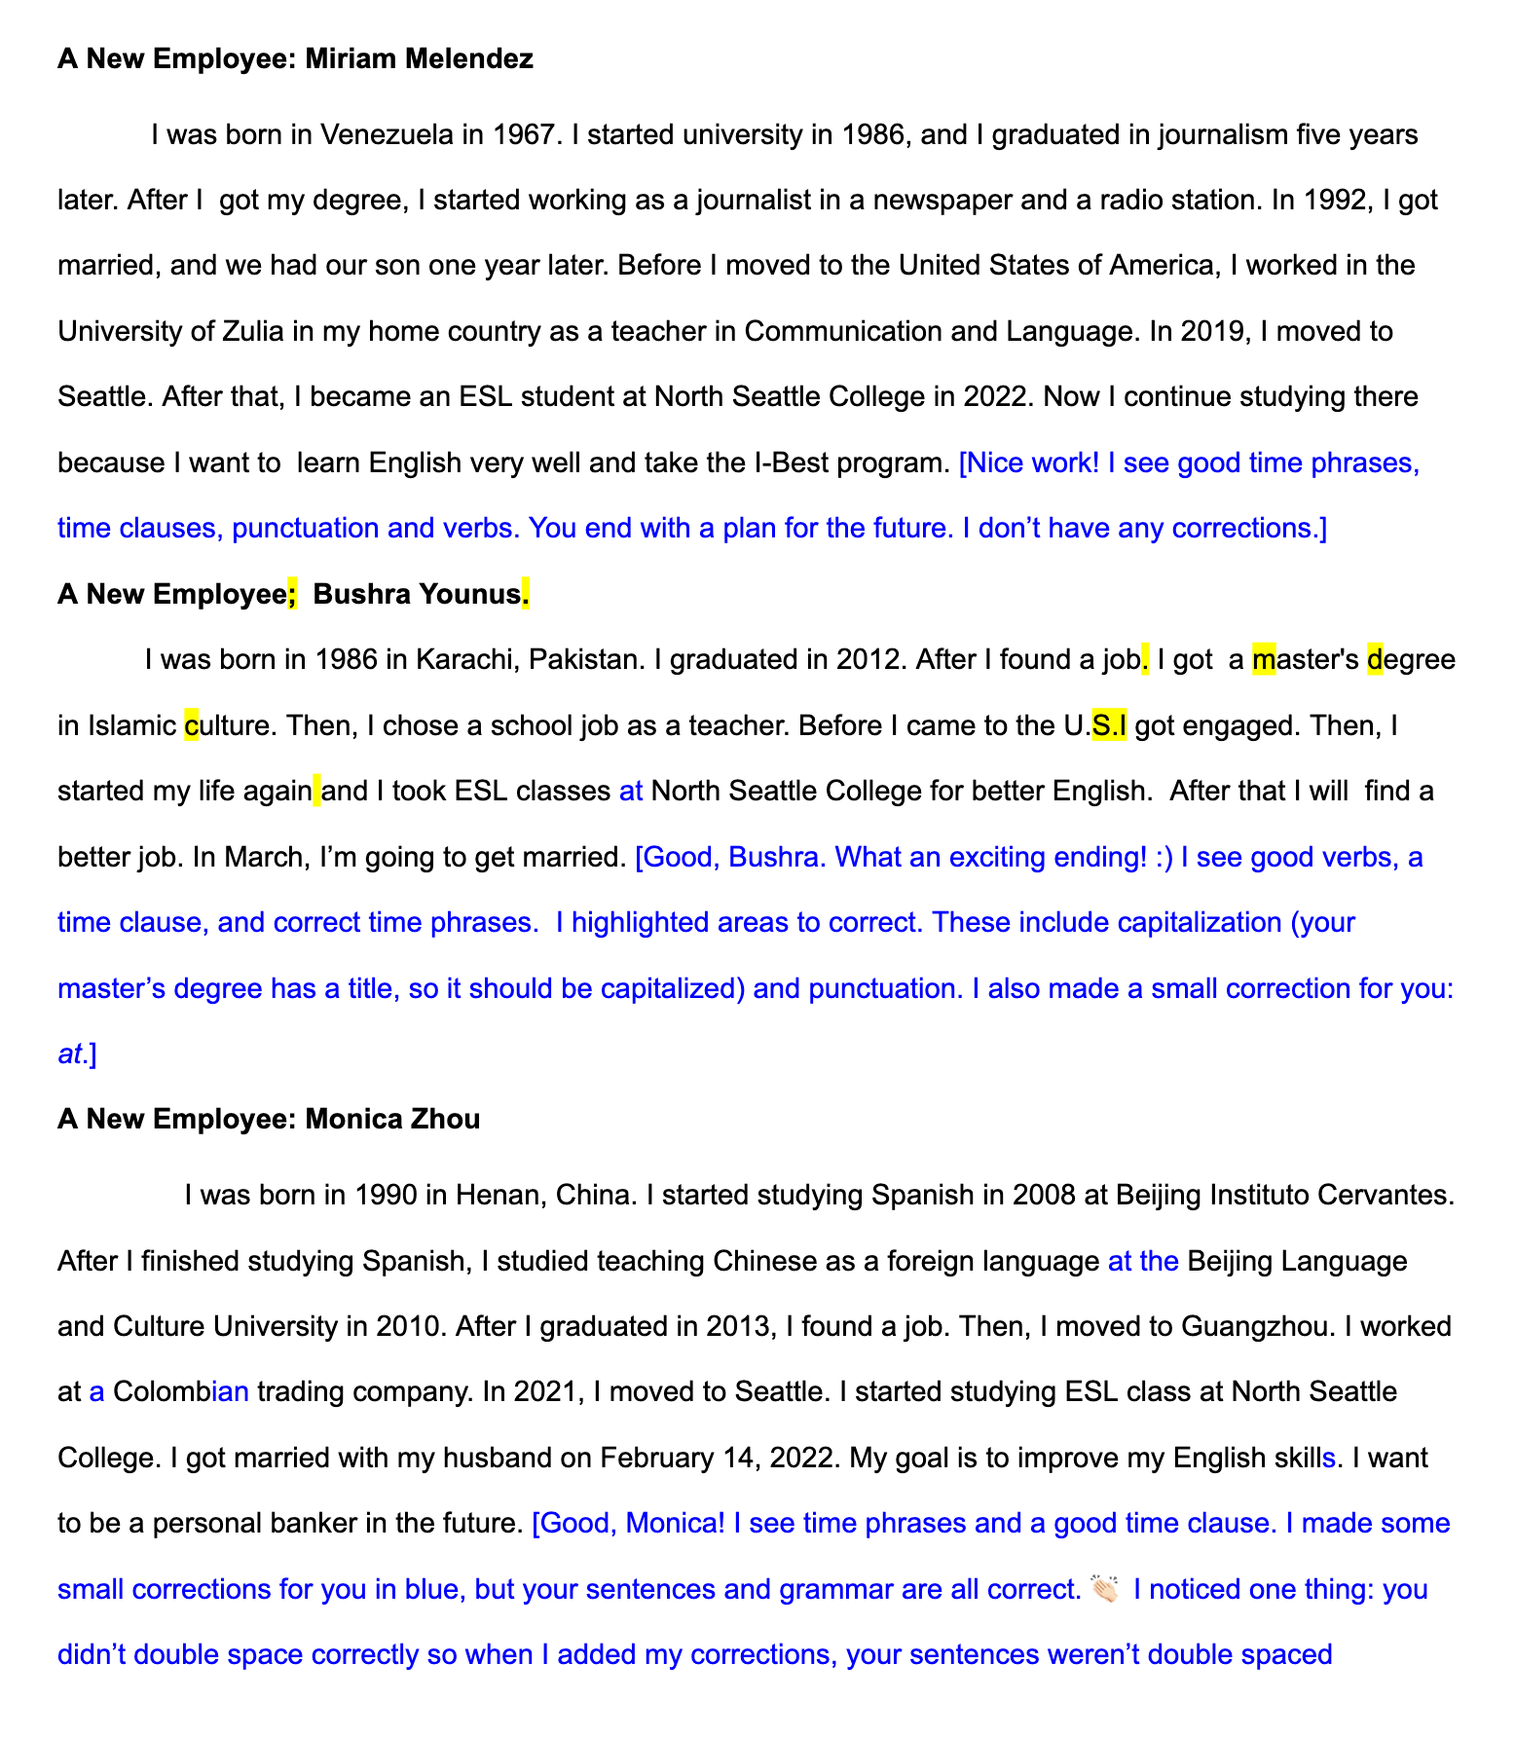
Example: Typing a paragraph draft on a Google Doc

Slide 14
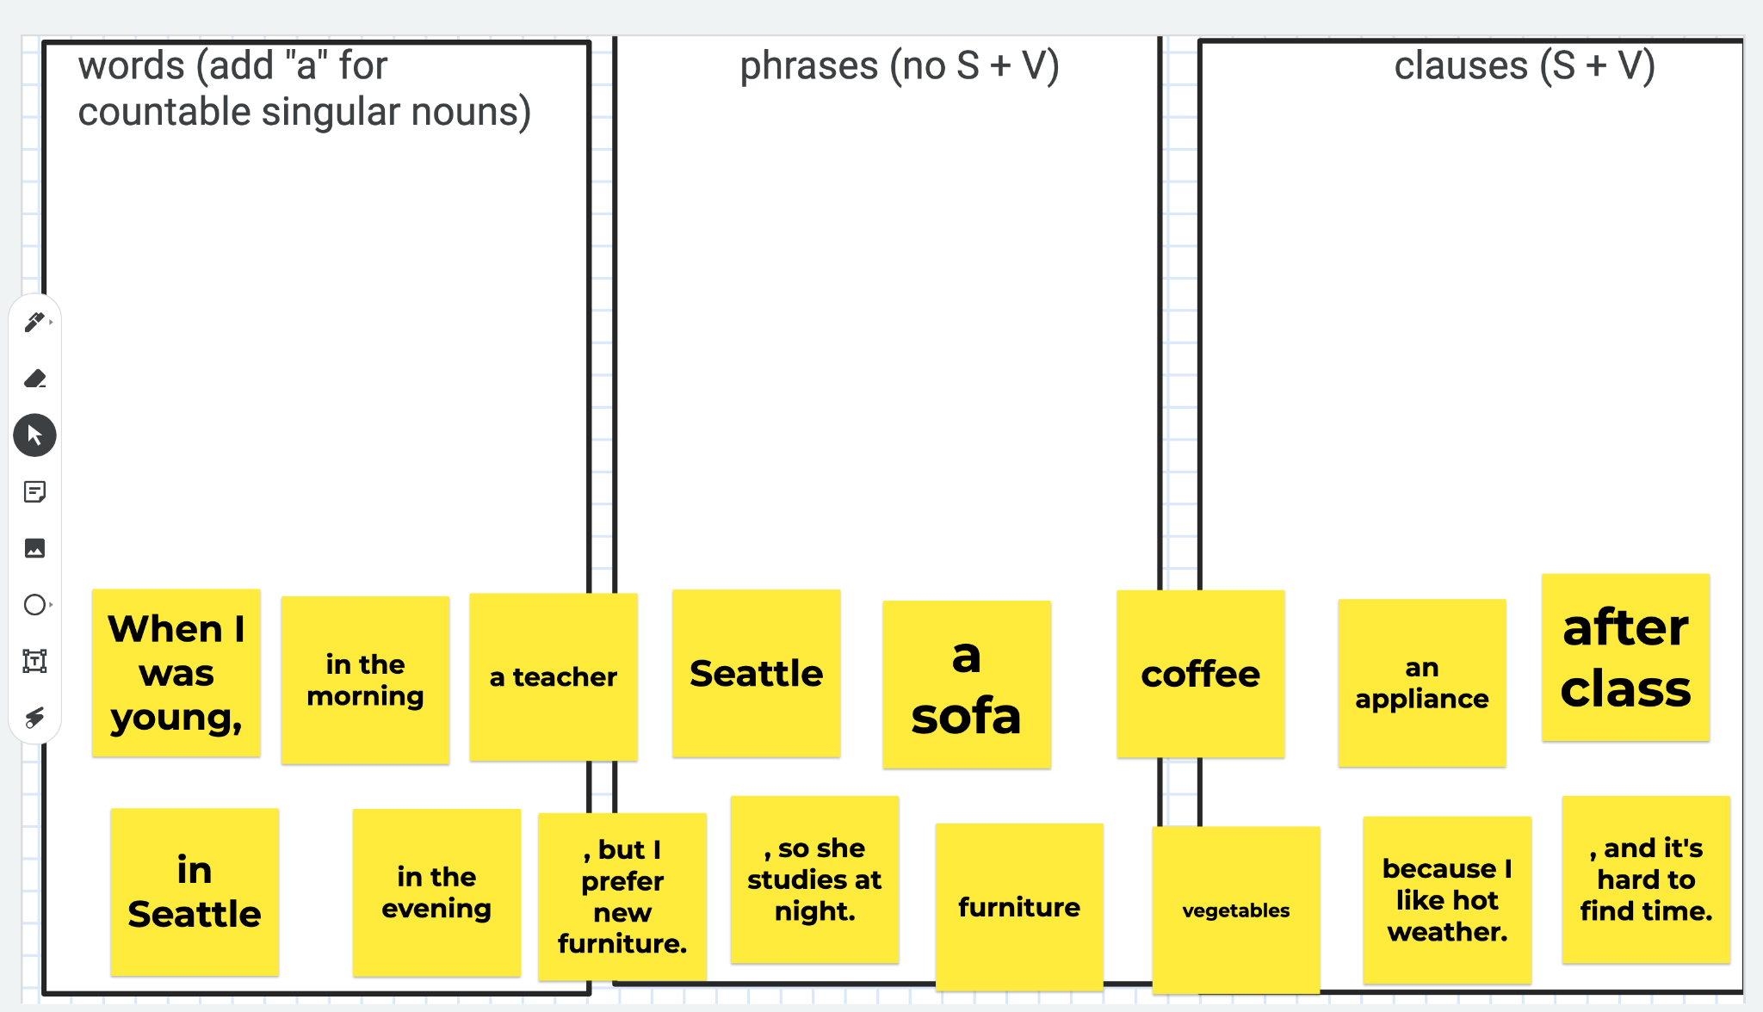
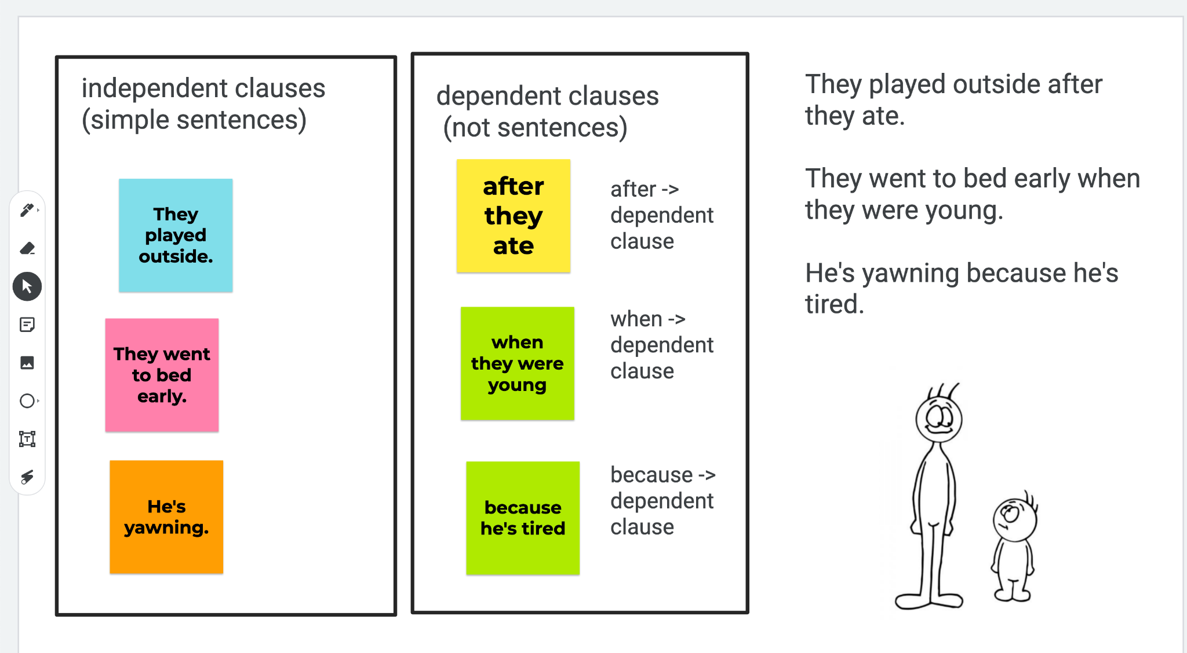
Student Collaborate on Jamboards (Sorting Work)
an unsorted exercise
a completed exercise
Note: this is practice, not an assessment

Slide 15
Speaking and Listening, NRS Levels 2 and 3

Slide 16
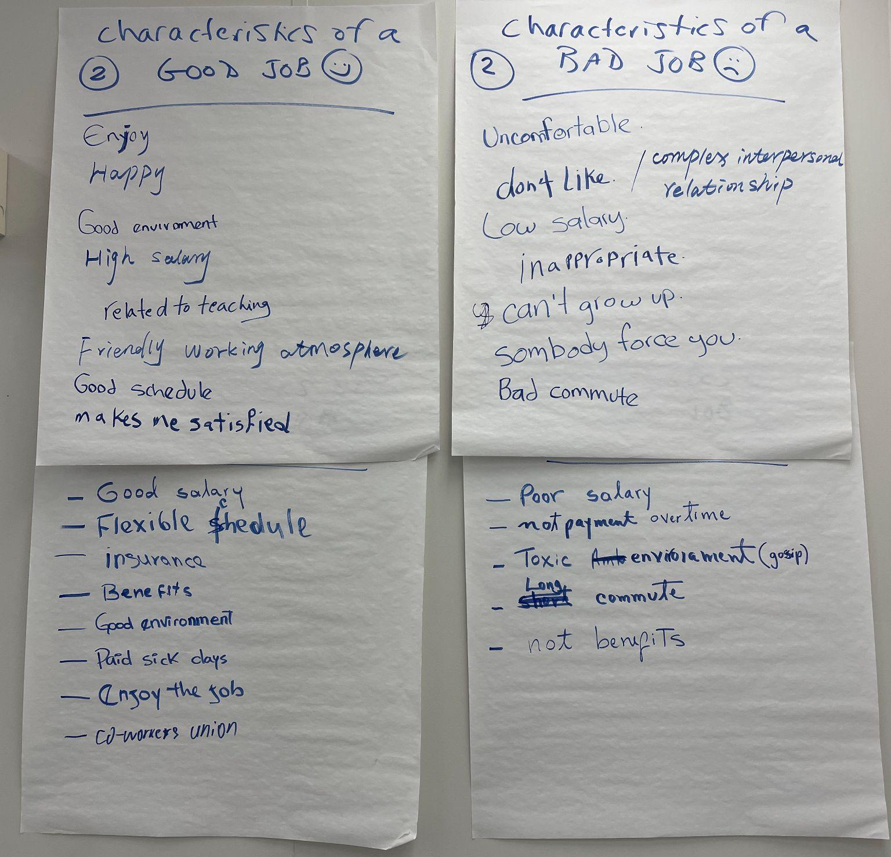
Example: 3A Discussion and Report Out by Group
Group Discussion:
What are the characteristics of a good job?
What are the characteristics of a bad job?
Discuss
Write
Report (summary and examples)

