Slide 1
Advancing Student Success and Equity:
Guided Pathways as a Framework
Monica Wilson
Director | Student Success Center & Strategic Initiatives
May 16, 2024

Slide 2

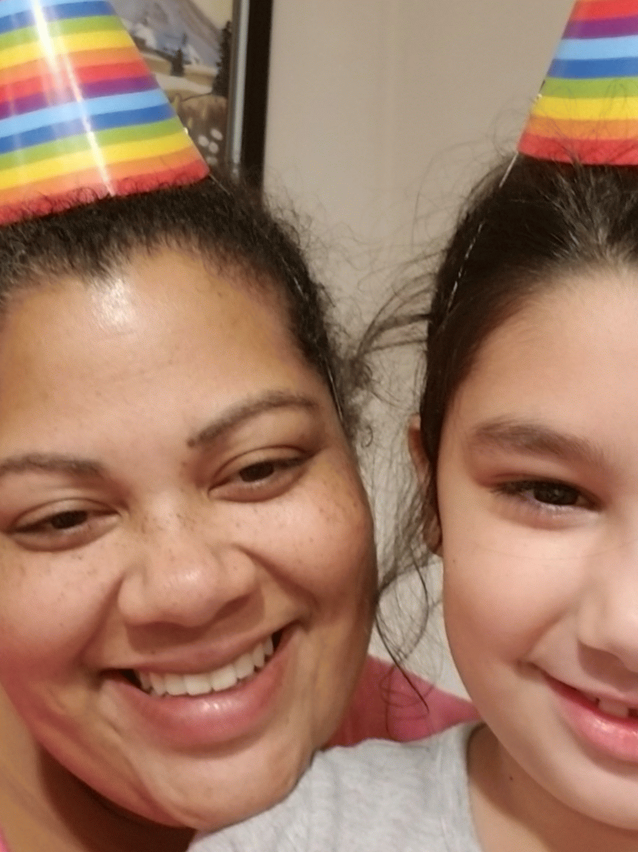
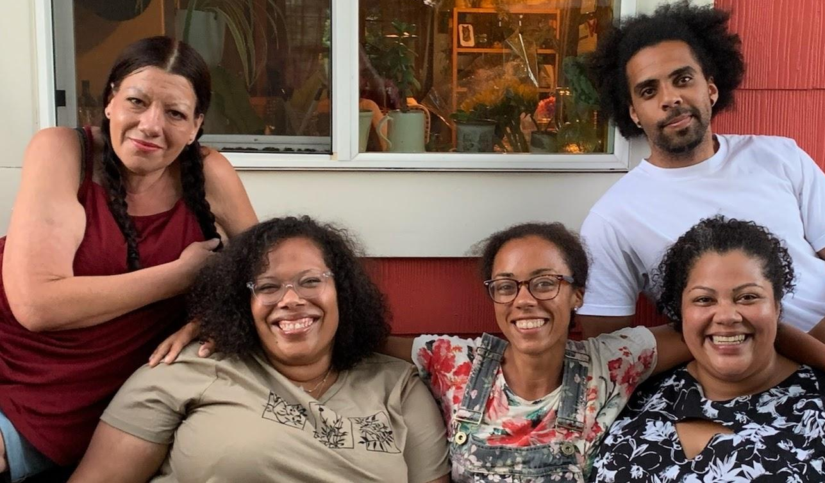
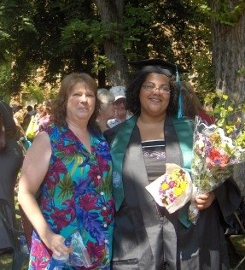

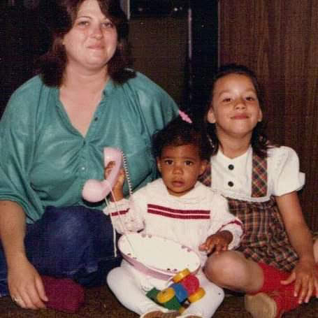
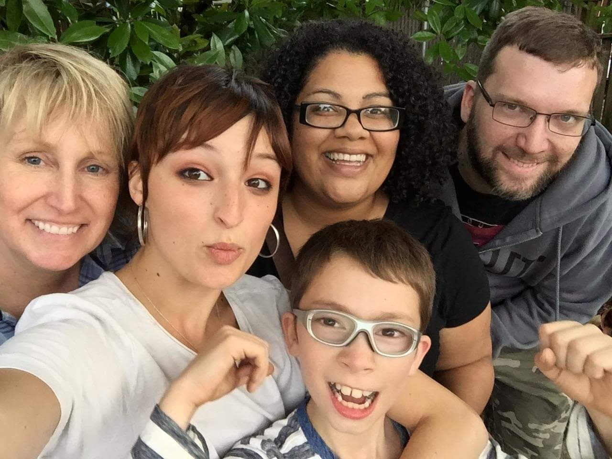
Monica Introduction
PNW born and raised
Mixed and blended families
#AUNTIEGANG
Garden nerd
First Generation Graduate
Community College educated
Survived DVED Math/English
Self-Advised
10 years to bachelors degree
Notes:
At the end of the day, this work is very personal to me.

Slide 3
Student Success Center Team Support
Monica Wilson
Director
Brook Bane
Policy Associate
Pathway Navigation
Guava Jordan
Policy Associate
Faculty Development
Ensured Learning
Dawn Draus
Policy Associate
Math Pathways
Placement
Student Services Liaison
System Engagement
Strategic Initiatives
Program Specialist
Professional Development
Coaching
Vacant
Administrative Assistant
Professional Development
IDEAL Fellowship
Amunoo Tembo

Slide 4
Our why: advancing equity and Justice
SBCTC Vision
Leading with racial equity, our colleges maximize student potential and transform live within a culture of belonging that advances racial, social, and economic justice in service to our diverse communities.
Guided Pathways Vision
A system that advances racial, social, and economic justice by achieving equitable student aspiration, access, economic progress, and educational and career attainment.
Guided Pathways Mission
Create an equitable system that prepares all learners to engage in a diverse society and workforce, achieve economic mobility through educational attainment and contribute to a socially just society.

Slide 5
Guiding Principles
Culturally responsive commitment to racial and social equity by dismantling systemic policies and practices that perpetuate inequities.
Intentional collaborative learning through partnerships,
professional and resource development
Focus on learning and outcomes aligned with community
values and industry needs.
The voices of students, faculty, staff and community members are essential to fully engage in adaptive problem focused inquiry processes leading to meaningful action and sustained systemic change.
Urgent, radical, equity-minded, transformative organizational change.

Slide 6
What is guided pathways?
Guided Pathways is a research-based framework that simplifies choices for students. Courses are grouped together to form clear paths through college and into careers, whether students enter those careers directly after graduation or transfer to a university for more study in their chosen fields.
Necessary shifts in how the student experience is structured to support equitable student aspiration, access, economic progress, and educational and career attainment.

Slide 7
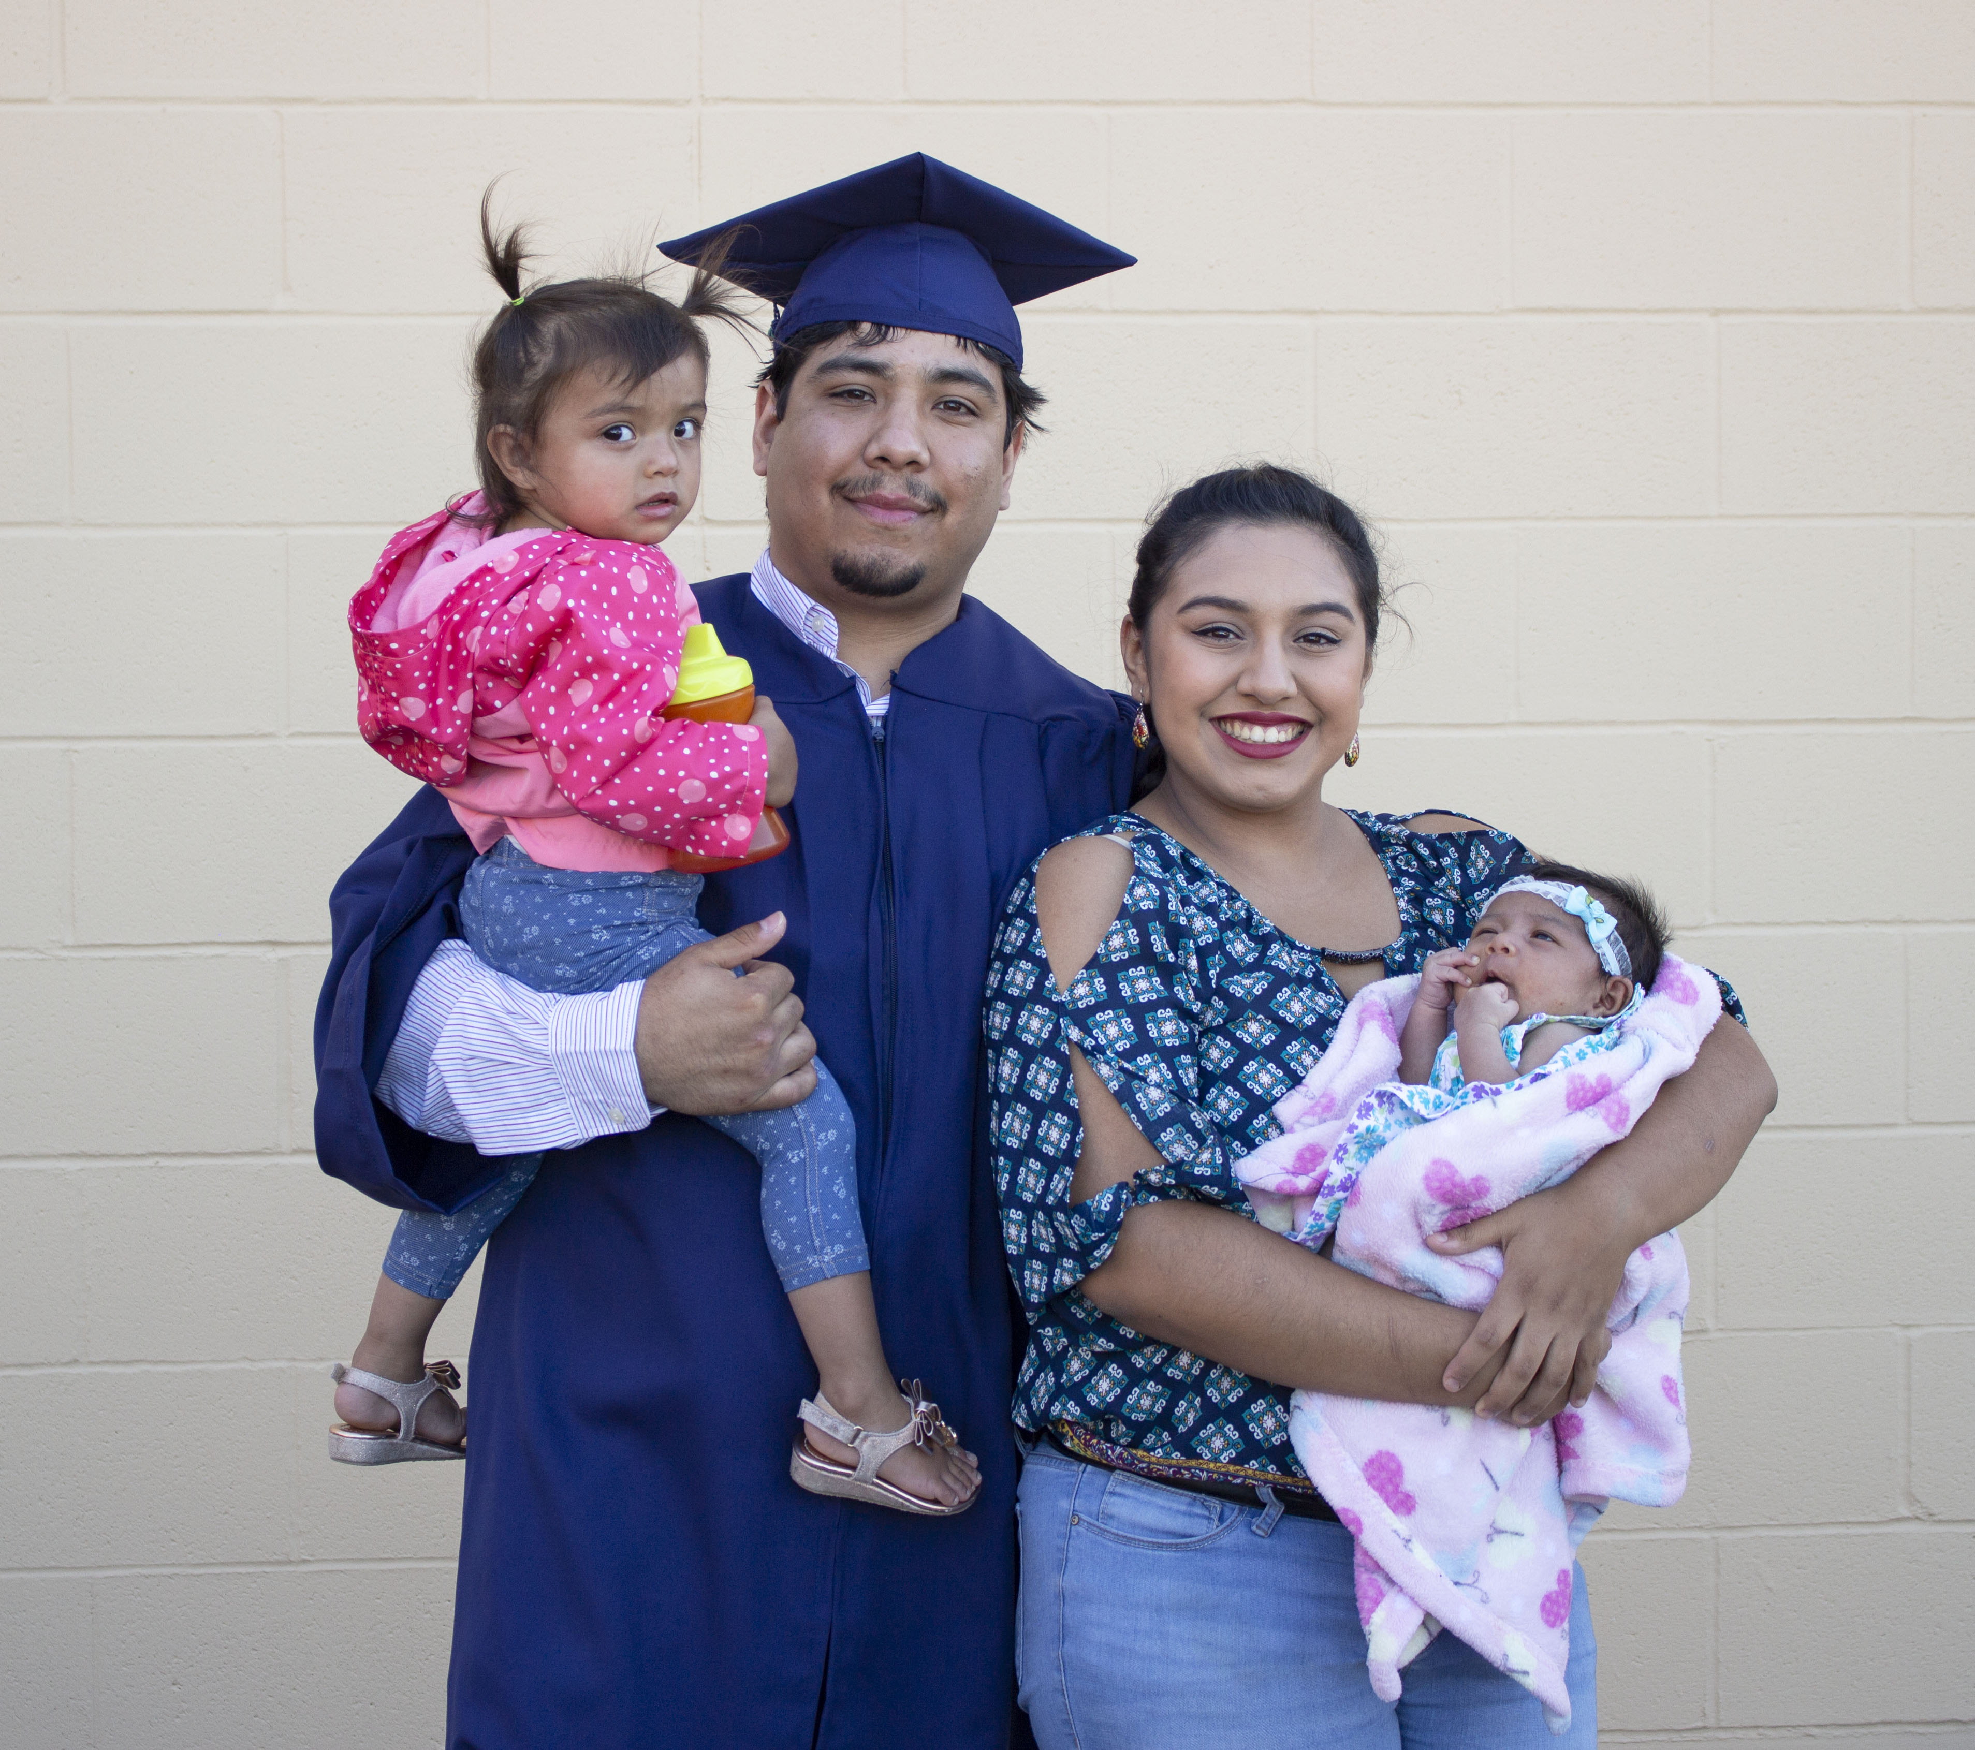
Pathway Design
Pathway Development
Program Maps
Pathway Entry
Intake
Entry Advising
Pathway Navigation
Progress Monitoring
Teaching & Learning
Engagement
Scheduling
Completion Support
Degree Math and English in One Year
Effectiveness
Improvement
Inclusion
Alignment
Educational Planning
Financial Planning
Math Pathways
Guided pathways framework
Equity Minded Leadership
and Management

Slide 8
Workforce Education Investment Act
At a minimum, Guided Pathways Implementation mut include:
Comprehensive mapping of student educational pathways with student end goals in mind
Dedicated advising and career counseling that helps students make informed program choices and develop completion plans
Data analysis of student learning as well as program and service outcomes.
A student success support infrastructure effective in closing equity gaps among historically underserved student populations and improve completion rates:
  Equity competent academic advising services;
  Equity competent career development programming;
  Clear information regarding financial aid and financial literacy; and
  Inclusive curriculum and teaching practices.

Slide 9
Pair and share
Where has your college focused most intensely in your Guided Pathways work?
What are your biggest wins?
What are your biggest struggles?
What are your greatest opportunities?

Slide 10
Adoption of Guided Pathways Practices at Scale for Washington Colleges

Slide 11
Work plan Overview
Large Scale Change
Pathway Entry
& Navigation
Data Analytics
Pathway and Program Design
Equity informed project and change management infrastructure
Comprehensive mapping of student educational pathways with student end goals in mind
Students make informed program choices and develop completion plans
Data analysis of student learning as well as program and service outcomes
Success Support
Infrastructure
High impact practices in teaching and learning
Auto populated with data
Aligned with legislative requirements from the Workforce Education and Investment Act
Redesign cohorts
Inform statewide PD, coaching, and technical assistance.
Released March 4, 2024
Due June 28, 2024

Slide 12

Feedback, comments, questions

Slide 13

Scaling Guided Pathways in Washington

Slide 14
Pathway design and mapping
Accomplishments
Growth Areas
90% of WA CTCs have scaled meta-majors wherein programs of study are organized by interest area, but only half track information for individual students by meta-major
Just over half CTCs have scaled program maps for CTE and/or transfer, with CTE more common than transfer.
Almost 75% of CTCs report scaling math pathways on some level
Limited evidence that student-level data on program and meta-major is collected or systematically leveraged by institutions to support broader reform goals

Slide 15
Pathway entry
Accomplishments
Growth Areas
Over 60% of WA CTCs have scaled the practice of advising students to take at least one program-specific course in their first term
The majority of colleges have scaled entry advisement with exposure to program-specific courses
Scaling Career Assessments with entry advisement
Educational plans and online plans for student progress monitoring
Onboarding activities contextualized with meta-major-related content

Slide 16
Pathway Navigation
Accomplishments
Growth Areas
About 75% of WA CTCs have scaled case load advising, which assigns an advisor to each student based on interest area or meta-major.
Less than 30% of colleges have scaled mandatory ongoing advising
Less than 10% of colleges have scaled data utilization about students’ meta-majors and program plans to develop course schedules aligned with completion goals

Slide 17
Teaching and learning
Accomplishments
Growth Areas
65% of colleges offer at least one corequisite math course.
75% of those offering corequisite courses also provide a prerequisite alternative for students.
Widespread Developmental Education reform
Multiple Measures and Directed Self-Placement
Equity Focus
Strengthening transfer pathways
Experiential and career connected learning

Slide 18
SBCTC & SSC Action and support
Peer and Professional
Development
Resource Development and Dissemination
Many Modalities
Pillar and Practice Focused
Technology Integration
Updated Work Plan
Transparent priorities
Strategic Alignment
Updated Cohorts
Common Student Success Software
Contextualized ctcLink training
Quick Reference Guide Development
Notes:
Student Success and Pathway Navigation
Faculty development and ensured learning
Math pathways and placement
Coaching

Slide 19

Questions? Comments? Collaborations?
Reach out anytime!
Monica Wilson
Student Success Center & Strategic Initiatives
Director
mwilson@sbctc.edu
503-307-1555

