Slide 1
Fall cbs laces update
Scott Toscano, Relationship & Compliance Analyst
October 2024

Slide 2
Laces implementation summary
Initial LACES implementation period
  January 5 – September 30, 2024
65 state deployment work orders
233 user support requests from 30 providers
3 pending customizations

Slide 3
Laces implementation survey
LACES implementation survey
  September 25 – October 4, 2024
55 responses
  44 local organization staff
  8 SBCTC staff
  3 LiteracyPro staff

Slide 4
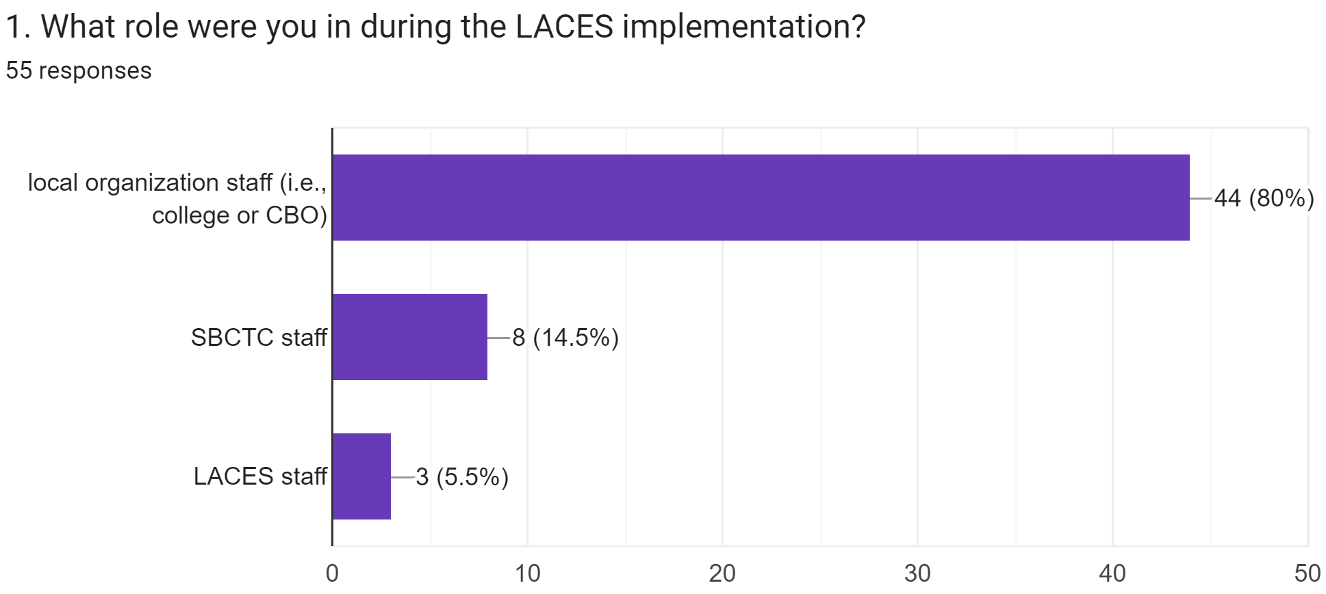
Q1

Slide 5
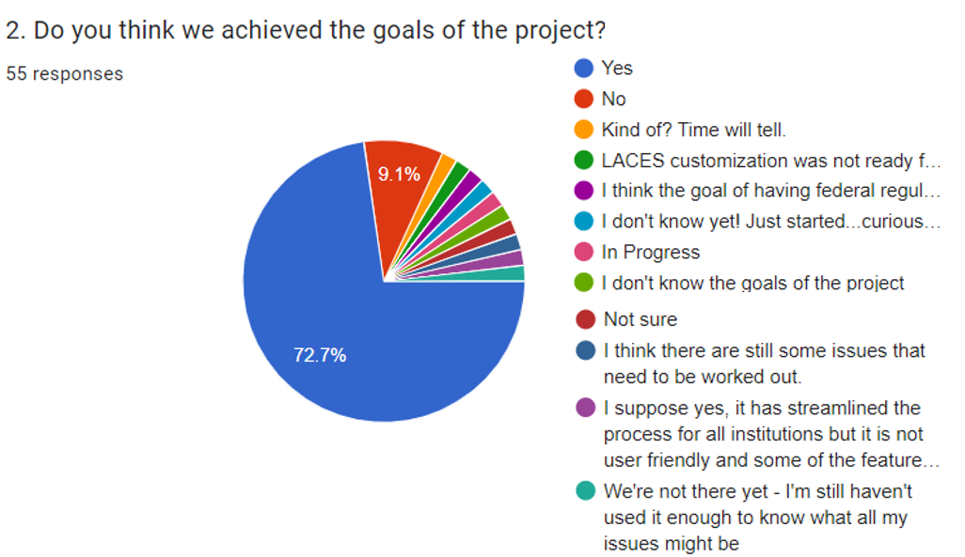
q2

Slide 6
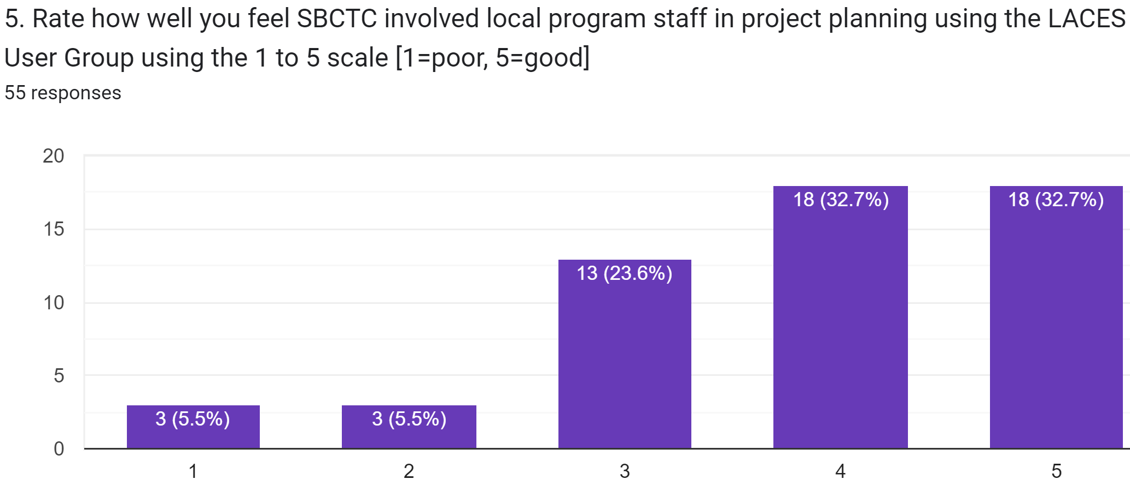
q5

Slide 7
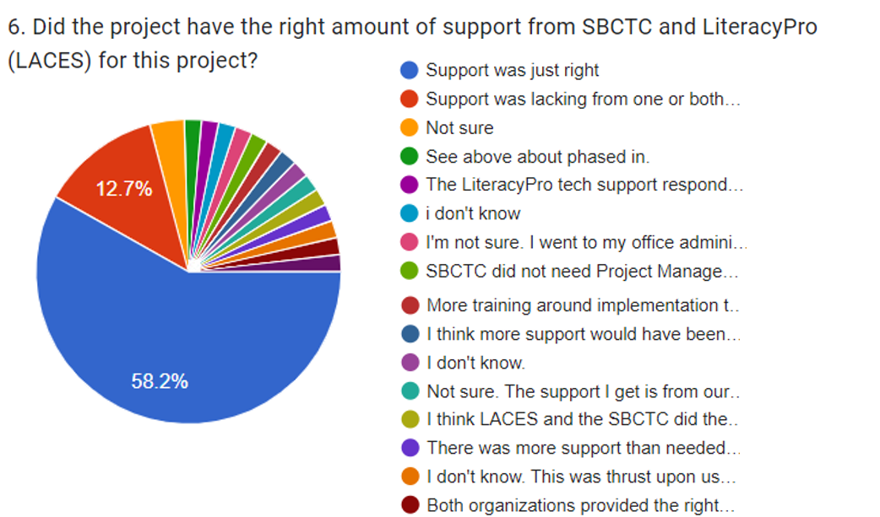
q6

Slide 8
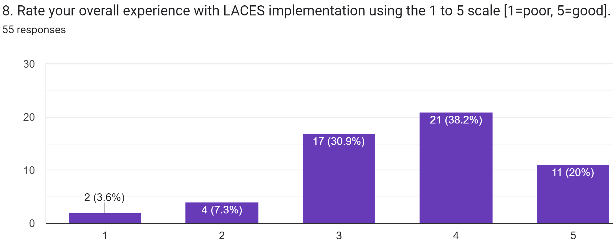
q8

Slide 9
Outstanding work orders & ongoing issues
Pending Work :
  New User Roles - 10/25
  GED subject test results minus scores – 11/22 or earlier
Ongoing Issues:
  Statewide CASAS test sync
  Performance Summary Report

Slide 10
Future plans for laces
Auto move forward CASAS tests
Data Quality Checklist – reviewing draft
Performance dashboard & target alignment
  Example: performance and enrollment
Update dashboards to factor in credits
  Example: post-test eligibility
Post-exit outcomes survey

Slide 11
Topics for nov. 13 Laces refresher
Under 19 checkbox
Career & Training Services data entry
Student Intake
Staff Intake
Drops & swaps

Slide 12
Wrap up
Any final questions for me or your peers?

Slide 13

We’re Here to Help
LACES Helpdesk: helpdesk@literacypro.com
LACES Listserv: laces_wa@lists.ctc.edu
SBCTC Helpdesk: bedareporting@sbctc.edu
CASAS Tech Support: techsupport@casas.org, or call 1-800-255-1036 option 2, 6 a.m. to 5 p.m. Mon to Fri.
Note: All material licensed under Creative Commons Attribution 4.0 International License.

