Slide 1

WASHINGTON STATE BOARD
FOR COMMUNITY AND TECHNICAL COLLEGES
The SBCTC Allocation Model
Allocation Model Policy Approved August 2025 | Resolution 25-08-36 Implementation Approved October 2025 | Resolution 25-10-49

Slide 2
WHY AN ALLOCATION MODEL AND WHAT IS IT?
RCW 28B.50.090 COLLEGE BOARD – POWERS AND DUTIES
General supervision and control over the state system
Preparation of a single budget for the support of the system
Establish guidelines for the disbursement of funds; and receive and disburse such funds for operations and capital support of college districts
ALLOCATION MODEL - GUIDELINES FOR THE DISTRIBUTION OF FUNDS
Funding formula and metrics used to calculate how much legislatively provided state funding goes to each college district.
Key components of the allocation model:
Minimum Operating Allocation (MOA)
District Enrollment Allocation Base (DEAB)
Performance Funding – Student Achievement Initiative (SAI)
Priority Enrollments
Funding held outside of the allocation model calculations:
Legislative Provisos
State Board Earmarks
Four-Year Safe Harbor for Compensation Adjustment Funding, M&O, and Leases

Slide 3
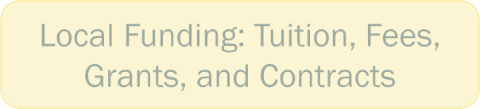
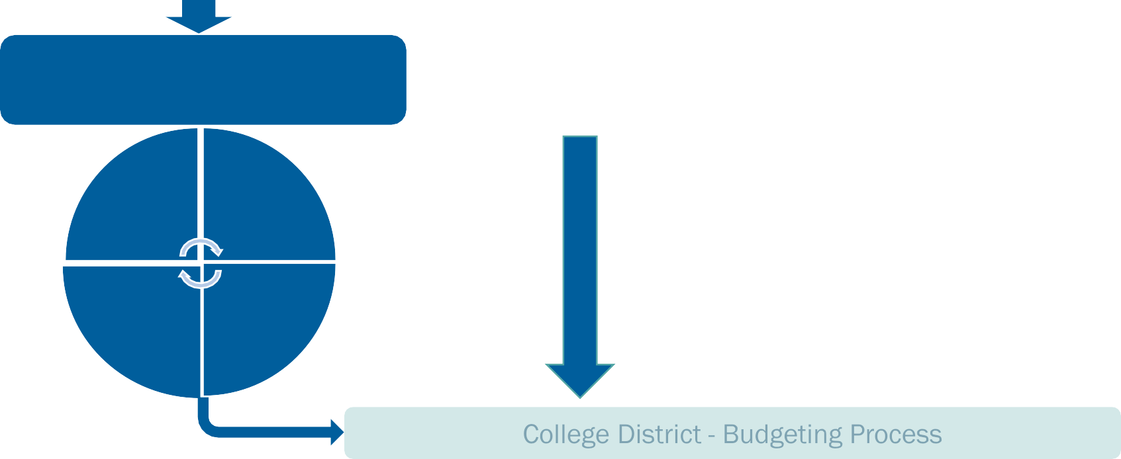
COLLEGE FUNDING: HOW THE DOLLARS FLOW
Legislatively Provided State Funding: Appropriations Act
Allocation Model Key Components
Provisos, Earmarks, and 4-year Safe Harbor
MOA
DEAB
Priority Enrollment
SAI

Slide 4
STATE BOARD APPROVED
Allocation Model Changes and Implementation
Allocation Model Approved August 2025 | Resolution 25-08-36 Implementation Approved October 2025 | Resolution 25-10-49

Slide 5
OBJECTIVE AND GUIDING PRINCIPLES
The Allocation Model Review Committee was charged with investigating, analyzing, and making recommendations on proposed changes to the current allocation model. Recommendations should align with the overall charge of the committee and in alignment with established guiding principles.
Prioritize State Board vision of leading with racial equity.
Be stable and predictable, minimize harm to students whose colleges may be disproportionately impacted.
Be understandable; use “plain talk” so that all constituencies can access the model.
Treat all colleges consistently and equitably, to minimize harm to students.
Recognize the interdependence of the colleges while allowing for individual college needs, so that students who attend any specific college or type of college are not disproportionately impacted.
Allow for flexibility in the use of designated funds, so that colleges can adapt to best serve their students and communities.
Achieve an appropriate balance between access/enrollment and performance/student outcomes, so that students are not disadvantaged by a cost model that only addresses access, retention, or completion.
Continue to right-size enrollment averages, so that funding more closely meets the current-day needs of communities.

Slide 6
CONTEXT SETTING
The new model will redistribute existing funds rather than introduce new funding.
While evaluating the model, it is essential to view it through a system-wide lens, considering the collective impact across all colleges, not just individual institutions.
Outside the committee’s scope were State Board budget/staffing, centralized IT services, system reserves, and Legislative provisos.
Final recommendations remain principle-driven.
Final recommendations approved by WACTC were presented to the State Board.
  Voting was conducted at the July WACTC retreat and was open to all 34 college presidents and three chancellors. Two colleges did not have representation in the vote. 35 of the 37 participated.
The State Board (the nine members) holds statutory authority, as provided in RCW 28B.50.090, to establish guidelines for the disbursement of state appropriations to the college districts.

Slide 7
STATE BOARD APPROVED
Allocation Model Core Components
94% APPROVAL
33 out of 35 voted YES
1 NO, 1 ABSTAIN

Slide 8
MINIMUM OPERATING ALLOCATION (MOA)
Current Model
$2.85M annually per college
34 total colleges
System total of $96.9M
  $85.5M from operating funds
  $11.4M from capital funds
New Model
$3.7M annually per college
34 total colleges
System total of $125.8M
  $114.4M from operating funds
  $11.4M from capital funds

Slide 9
DISTRICT ENROLLMENT ALLOCATION BASE (DEAB)
Current Model
Uses outdated enrollment targets
District targets are a share of the system’s base target (130,981) originally established by legislature
Includes limited number of international enrollments
New Model
Eliminate targets
Use a 4-year rolling average
Allocate based on 50% FTE and 50% headcount
Do not include international, corporate, or continuing education enrollments

Slide 10
PERFORMANCE FUNDING
STUDENT ACHIEVEMENT INITIATIVE (SAI)
Current Model
Fixed 5% of total state operating appropriations
Achievement measures include:
  Building toward college-level skills
  Retention
  Completing college-level math and English/writing
  Completions (degrees, high-value certificates, apprenticeship training)
New Model
Preserve the fixed 5% of total state operating appropriations
Maintain current academic momentum point metrics

Slide 11
PRIORITY ENROLLMENTS
Current Model
Four enrollment categories earn additional weight of 0.3/FTE:
  Basic Education for Adults (BEdA)
  STEM
  Upper-level BAS
  Skills Gap
Funding fluctuates based on the number of weighted enrollments
New Model
Fixed 5% of total state operating appropriations for two enrollment categories:
  Basic Education for Adults (BEdA)
  Skills Gap
Allocate 50% to BEdA and 50% to Skills Gap
Update Skills Gap list

Slide 12

SKILLS GAP LIST
Current Model
Uses CIP (Classification of Instructional Programs) code list based on a 2013 Skilled and Educated Workforce report–last updated in 2017
Focuses on two-year degree graduates
New Model
Update the Skills Gap list to combine local with current and future demands using:
  supply/demand data to identify current high-need occupations
  long-term projection data to capture forecasted growth in job openings
Local component separated by Workforce Development Area

Slide 13
STATE BOARD APPROVED
Earmarks and 4-year Safe Harbor

Slide 14
STATE BOARD EARMARKS - MAINTAIN
Maintain specific-purpose funding for high-priority programs that support students throughout the system, including:
Aerospace Enrollments
Centers of Excellence
Disability Accommodations
Goldstar Family Book Stipends
Labor Education Resource Center
Opportunity Grant
Outreach Specialists
Student Emergency Assistance Grants
Students of Color
Worker Retraining
Workforce Development Grants
94% APPROVAL
33 out of 35 voted YES
1 NO, 1 ABSTAIN

Slide 15
STATE BOARD EARMARKS – ELIMINATE
Integrate earmarked funds that are underutilized or for institution-specific programs into the allocation model, including:
Aerospace Apprenticeship
  (phased in to address current contractual obligations)
Employment Resources
Hospital Employee Education and Training
Maritime Industries
University Contracts
89% APPROVAL
31 out of 35 voted YES
3 NO, 1 ABSTAIN

Slide 16
STATE BOARD EARMARKS - ELIMINATE
Move King County Regional Pay from earmarks into 4-year safe harbor.
Consistent with current practices for compensation adjustment funding that is not appropriated through proviso
Aligns with recommendation to continue 4-year safe harbor processes
83% APPROVAL
29 out of 35 voted YES
4 NO, 2 ABSTAIN
Reclassify ABE Enrollments, Federal Basic Education State Match, and DOC Compensation Correction as State Board allocation but maintain the
specific purpose designation.
100% APPROVAL
35 out of 35 voted YES

Slide 17
4-YEAR SAFE HARBOR
Current Model
Includes new appropriations for
  compensation increases, benefit changes
  maintenance and operation funding for new buildings that will be occupied within the fiscal year
  costs associated with new leases
Amounts are held in safe harbor for 4 years before rolling into the allocation model
New Model Recommendation
Maintain current 4-year safe harbor processes
100% APPROVAL
35 out of 35 voted YES

Slide 18
EXPLORATORY REVIEW
Demographics and Institutional Equity

Slide 19
EXPLORATORY REVIEW OF RECOMMENDED MODEL
A select group of community and technical college research experts were invited to evaluate the recommended model focused on demographic and institutional equity:
Race/Ethnicity: No statistical evidence of disproportionate funding by race/ethnicity.
Small Colleges: Receive more per FTE, reflecting economies of scale and intentional support for rural institutions.
Technical Colleges: Funding distribution is relatively balanced.
Geographic Distribution: No systemic bias detected. However, the Skills Gap list currently favors King County due to higher CIP eligibility—future adjustments may rebalance this.

Slide 20
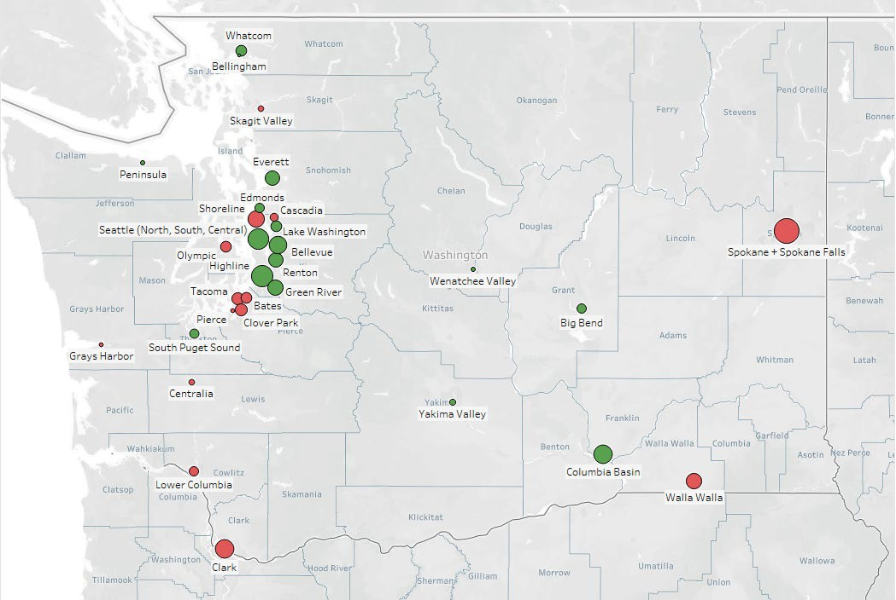
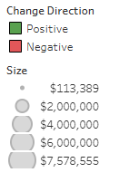
GEOGRAPHICAL CONSIDERATIONS
Estimated total allocation change. Does NOT represent actual implementation impacts.

Slide 21
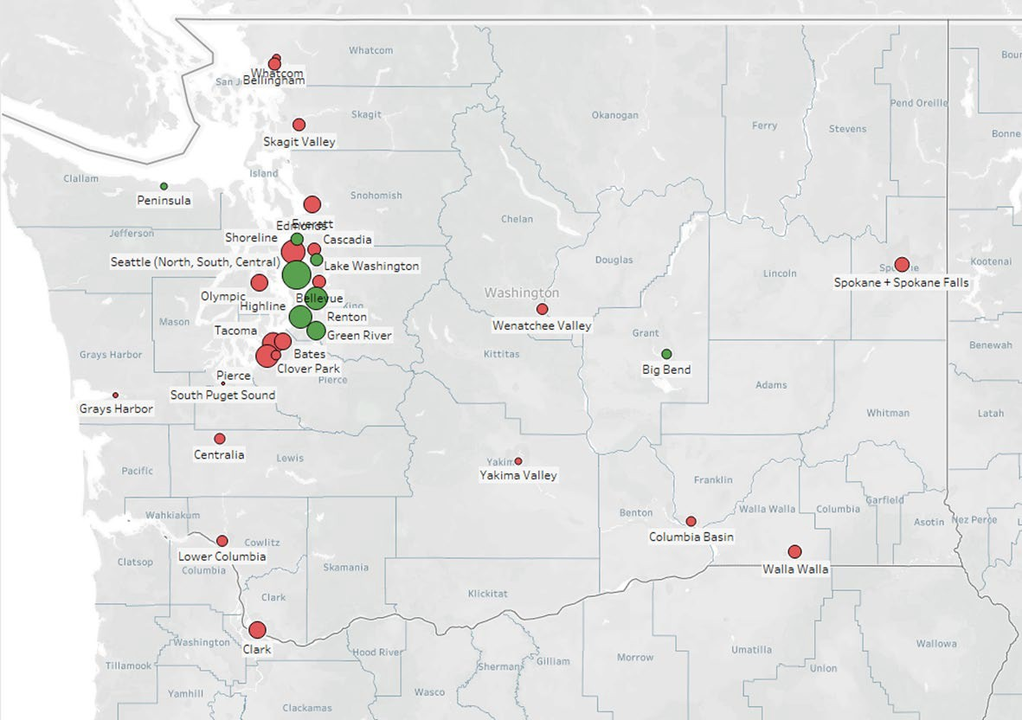
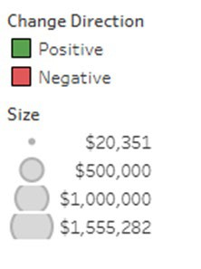
GEOGRAPHICAL CONSIDERATIONS
Estimated priority enrollment change. Does NOT represent actual implementation impacts.

Slide 22
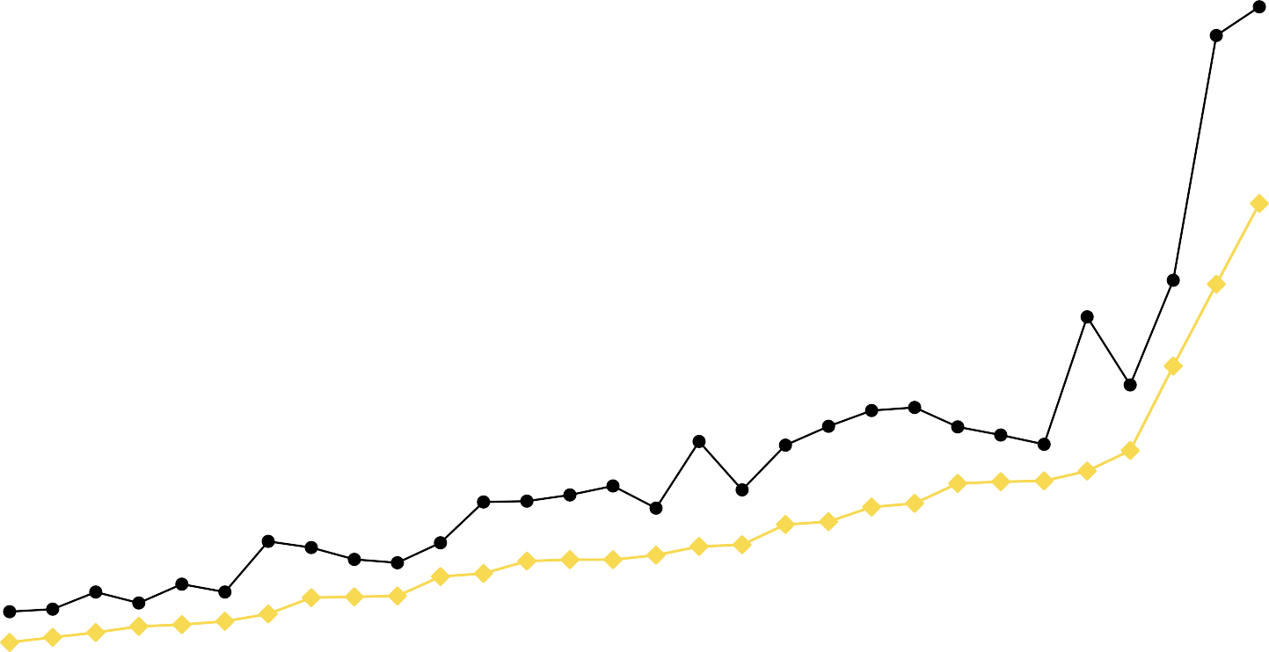
Compare Current Allocation Model To Proposed Allocation Model Distributions
(Estimate purposes only - does not represent actual implementation impacts)
80,000,000
14000
70,000,000
12000
60,000,000
10000
50,000,000
Allocation
8000
40,000,000
FTES
6000
30,000,000
4000
20,000,000
10,000,000
2000
-
0
Current Model FY26
AMRC final recommendations FY26
DEAB Target
Actual FTE 4-yr Avg

Slide 23
STATE BOARD APPROVED
Implementation and Smooth- In Timeline

Slide 24



IMPLEMENTATION AND SMOOTH-IN PERIOD
Implement the new model July 1, 2026 (FY27), with a six-year smooth-in period.
Realize 16.67% of each institution’s initial gain/loss each year.
FY27 16.67%
gain/loss
FY29 50.0%
gain/loss
FY31 83.33%
gain/loss
FY28 33.33%
gain/loss
FY30 66.67%
gain/loss
FY32 100%
gain/loss
Predictable, phased-in adjustments of gains and losses
Reduces financial disruption; protects programs and people
Provides time for colleges to adapt budgets and implement change
Ensures the enrollment declines resulting from the COVID-19 pandemic are outside of the 4-year rolling average
Extends beyond near-term state revenue deficit and federal uncertainty

Slide 25
APPROVED NEW MODEL
State Board Strategic Goals Alignment

Slide 26
ALIGNMENT WITH STATE BOARD STRATEGIC GOALS
Increase Access and Retention Among Marginalized Populations
Equity-Driven Design Grounded in racial equity; guided by WACTC Equity Committee principles.
MOA Increase $3.7M minimum allocation to stabilize smaller/rural colleges.
SAI Performance Funding Rewards momentum for historically marginalized student groups.
Priority Enrollment Investment More funds for Basic Education for Adults (BEdA).
Improve Completion and Transfer Rates for All Students
Performance-Based Funding Incentivizes completion across degrees, certificates, apprenticeships, and bachelor’s programs.
Equity in Outcomes Rewards progress for underrepresented student populations.
Enrollment Base Reform 4-year rolling average reflects part-time and non-traditional attendance patterns.

Slide 27
ALIGNMENT WITH STATE BOARD STRATEGIC GOALS
Provide Flexible Career-Training Aligned with Workforce Needs
Skills Gap Funding Targets programs matching workforce demand.
Updated CIP Methodology Regular updates using labor market data for high-demand fields.
Support Financial Sustainability and Resiliency of Colleges
Base Funding Stabilization Predictable baseline funding for all colleges.
Smooth Implementation Phase-in to reduce disruption.
4-Year Safe Harbor Continuation Maintains buffer for fiscal changes.
Reallocation of Earmarks Maximizes flexibility in use of funds.
Built-in Review Cycles Ensures adaptability to changing needs.

Slide 28



QUESTIONS?
Stephanie Winner
Operating Budget Director 360-704-1023
swinner@sbctc.edu
Note: All material licensed under Creative Commons Attribution 4.0 International License.

Slide 29
Student Achievement Initiative Review Process
Work Started in 2025
Scheduled to continue through summer, with final recommendation moving forward in the fall
Focuses on Guided Pathways metrics of retention & completion

