Slide 1

Creating a common course system for ELL
system enhancement for English Language Learner programs, and
potential alternative to CASAS testing
MSG - Measurable Skill Gains for English Language Learners

Slide 2

Background
We have alternative ways to document MSG for HS
Completion, IBEST, and GED. We do not
have an alternative to
CASAS testing for English Language Learners.
The Innovations
Committee has been looking for an
additional assessment method.

Slide 3
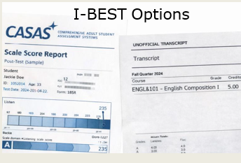
Assessments
Background 2
Last year, the
committee worked with SBCTC staff to
see if we could f ind a correlation between CASAS post- test
scores and ESL levels.
 | Federally approved assessment methods
BEdA Program | CASAS | College course completion | High school credits | GED subject test | Common Course Completion
IBEST | yes | yes
HS+ | yes |  | yes
GED Prep | yes |  |  | Yes
ELL | yes |  |  |  | proposal
The initial sample
analysis was not
promising. Not worth continuing with a
larger data set.

Slide 4

Background 3
ELL students must pre and post test to
demonstrate a level increase.
Challenges:
ELL students work on skills across
multiple areas not
just reading or
listening.
CASAS is not a
reliable indicator of student learning.

Slide 5

New Idea
Use course completion to determine MSG by
creating a Common
Course system to track level gains.
Similar to the common course system used for college level
classes. Examples:
EDUC&115, ENGL&101

Slide 6

Process
Create a faculty workgroup to
determine the common course outcomes that align with completion of each ELL level, 1 - 6
Colleges /providers
then determine which of their courses align with those ELL
common outcomes.

Slide 7
Process cont.
Faculty work together to create a list of 4-6 course outcomes for each ELL level.
These courses become a second option for demonstrating measurable skill gains (MSG) for ELL students.
Individual colleges/providers have the option of converting one or more of their leveled ELL courses to align with the identified common courses.
SBCTC submits the proposed new assessment method for approval to Department of Education.
The data collection could be accomplished in a few different ways:
Create a new name and number for these common courses to be used across the system.
Use a specific course code for each common
course.
Overview of process to
implement
this new assessment option
CASAS testing remains an option

Slide 8
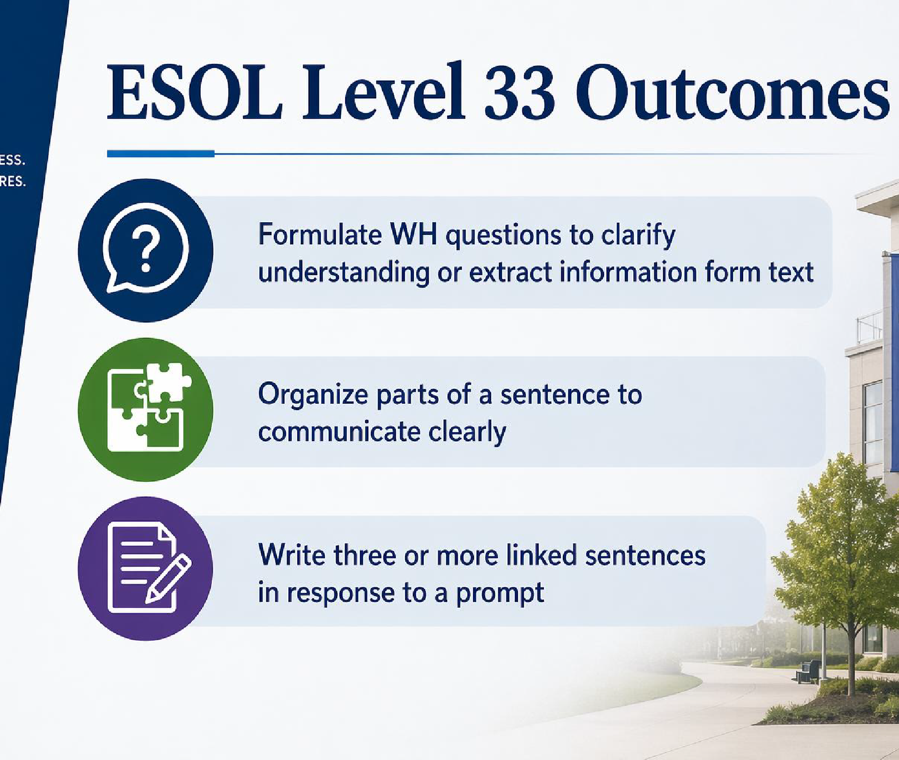
Example
Quick example using Skagit course
outcomes

Slide 9
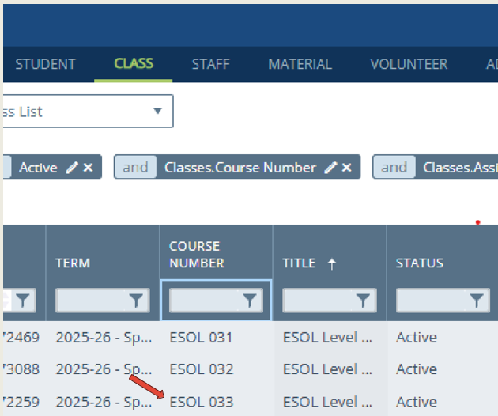
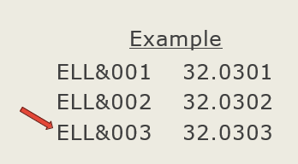
Tracking details
Once the courses were determined, we could either rename those
courses using a
common name or use
a different identifier
such as the CIP code.
If the student passes a designated course they receive an MSG.

Slide 10

Discussion
Quick 5 minutes to
discuss at your table.
What are the
benefits of adding a
common course
system for ELL
beyond having an alternative to
CASAS.
What are the concerns?
Other ideas?

Slide 11

Poll
Are you interested in having the Innovations Committee move forward with this project?

