Slide 1
LACES Post-exit survey Examples
Kelli Graham, Hopelink
Cat Howell, Literacy Source
Scott Toscano, SBCTC

Slide 2
Presentation Overview
Based on work being done by the Innovations Committee
Purpose is to share survey examples and ideas on implementation
LACES technical aspects will be covered in the upcoming LACES Refresher

Slide 3
Post Exit Employment Survey
Post Exit Employment Survey (Word doc)
On the State-Provided Documents page. Make sure to bookmark the page!
Two quarters (6 months) after exit – Ask:
if employed during 2nd quarter after exit, and
how much they made
Four quarters (one year) after exit – Ask if employed during 4th quarter after exit.
Add your own questions if desired.
These procedures are not required; however, SBCTC strongly encourages programs with a high number of missing SSNs on Performance Summary report to survey students without SSNs.

Slide 4
Why do we need to survey students after exit?
All Participants are data matched for employment outcomes using SSNs in a national database once a year.
Students without SSNs cannot be data matched for employment outcomes and count against program performance.
Reporting post exit employment outcomes will increase your program’s employment results on NRS Table 5 and support the state in meeting AEFLA-Title II its federal targets.

Slide 5
Who do we survey?
LACES will generate a list of eligible students to survey. See SBCTC Documentation.
Learn more in the LACES Refresher on June 3!

Slide 6
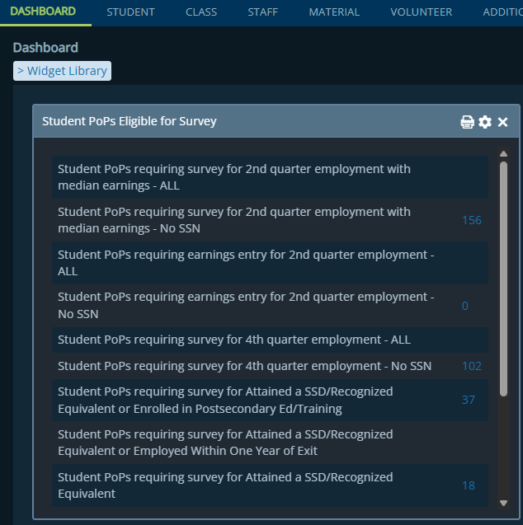

Who do we survey?
Use the Dashboard Student PoPs Eligible for Survey to find:
Student PoPs requiring survey for 2nd quarter employment with median earnings – No SSN, and
Student PoPs requiring survey for 4th quarter employment – No SSN.
DO NOT use the survey to follow up about GEDs/diplomas or college credentials. Those are data match only!

Slide 7
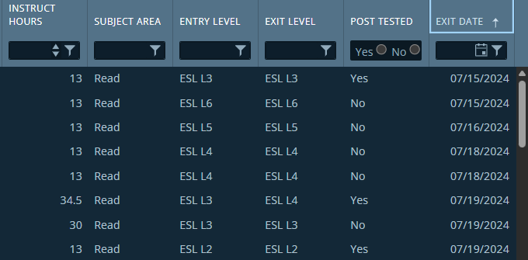
Working with the survey list
Sort
Want to include
Contact Info?
Create a copy of the view and add Email if not already done.
Sort the list of students to survey by the Exit Date.
Export the list and save file as Excel workbook.

Slide 8
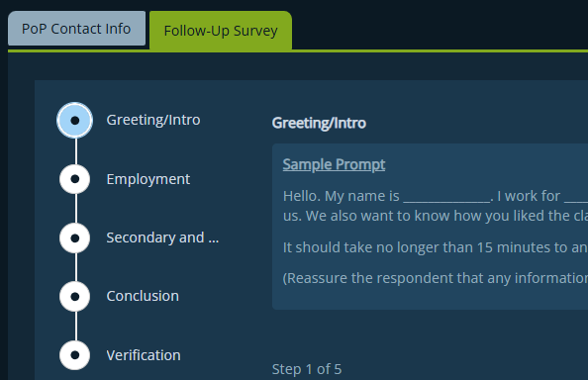
Reporting survey results
Click
Only report employment results.
Skip other follow up questions.
Enter your name under Verification.
Skip
Enter Results
Skip
Skip
Enter Name

Slide 9
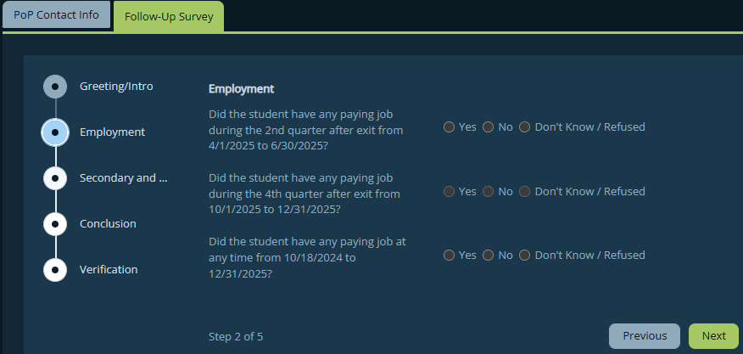
How to enter data
Select if Yes
Select if Yes
This will autofill
*If response was No, not employed, leave blank. No need to report anything.

Slide 10
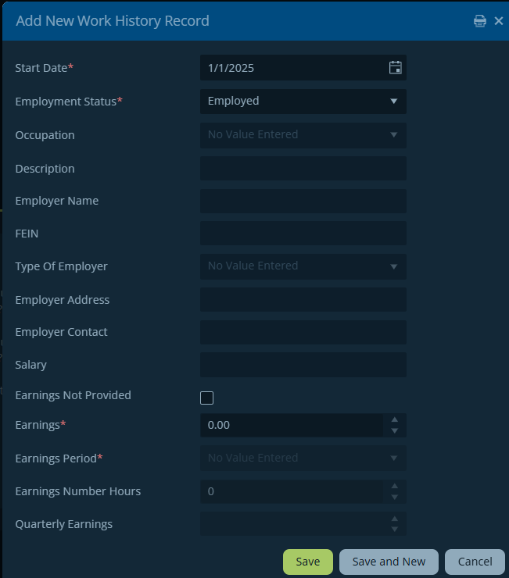
How to enter earnings data
If employed = Yes, a pop-up window will open.
Do not change default data fields.
Only enter earnings information.
2 default responses

Slide 11
Entering earnings data
Report 2nd quarter after exit earnings the way that best matches the information collected by the survey.
4th quarter earnings NOT required.
$ info required

Slide 12

Employed but no earnings provided
An earnings amount is required to count the Employed outcome.
Enter $1 for the Earnings and select “Quarterly” for the Earnings Period.

Slide 13
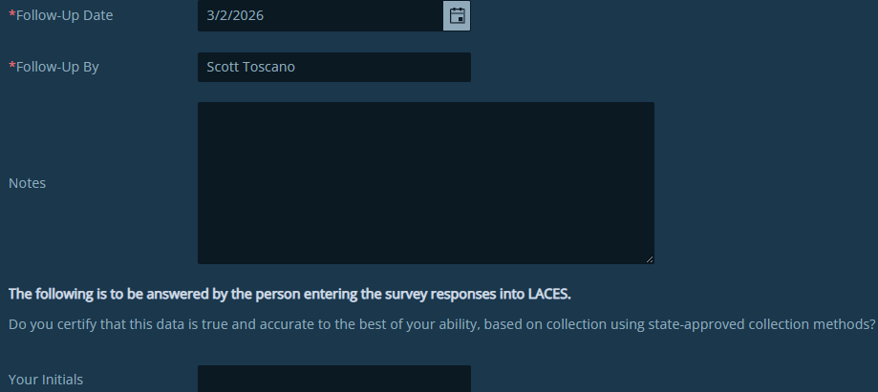

Verify the data
Do not change default data fields.
Enter any notes you want.
Type your initials to e-sign the form.
Click Done when complete.
2 default responses
E-sign

Slide 14
Hopelink
by Kelli Graham

Slide 15
Hopelink English for Work Post-Exit Survey
Goals
Content
Implementation
Results
5E Experience Model
Notes:
We have been surveying students for several years, so the challenge for me was to look at our existing process and figure out how to make it work for the post exit survey in LACES as well.
We currently only survey a subset of our students—our intermediate and advanced level English for Work students who take and successfully complete our one-quarter long job prep-focused class. This is about 150 students/year.

Slide 16

English for Work Survey: Goals
Track program effectiveness
Outcomes reporting for Hopelink and funders
"Working in aviation has always been my dream, and I feel truly fortunate to have finally stepped into this field...Your guidance made a significant difference and helped me to achieve my goals…”
Photo shared with permission

Slide 17
English for Work Survey: Content
Did the class help you prepare for employment? (star rating)
Did you get a job after you completed the class? (Y/N)
Job title, start date, company name, hours/week, hourly wage, are you still working at this job—yes/no → end date
Did you get another job after you completed the class? (Y/N)
Did you take classes to earn a certificate or degree or enroll in a job training/apprenticeship program? (Y/N)
Start date, school/organization name, goal, did you complete—yes/no → completion date
Notes:
SurveyMonkey Powered Online Survey

Slide 18

English for Work Survey: Implementation
Teachers send email telling students they will receive a survey (admin staff do the legwork)
Survey Monkey – automated emails and reminders & response rate monitoring
Teachers send text or WhatsApp message to boost response rate
Survey closes—export data from Survey Monkey and check against LACES survey list
Enter job outcomes data in LACES for students who appear in the LACES survey list

Slide 19

English for Work Survey: Implementation
Click the email icon to see the email template teachers send to graduates!
Notes:
Mutuality

Slide 20
English for Work Survey: Results
50% response rate
FY2025– 72% of survey respondents got a job or enrolled in an education program to work toward their employment goals
Notes:
50% target is set by Hopelink to ensure that we have enough data to effectively monitor the program and report on outcomes

Slide 21
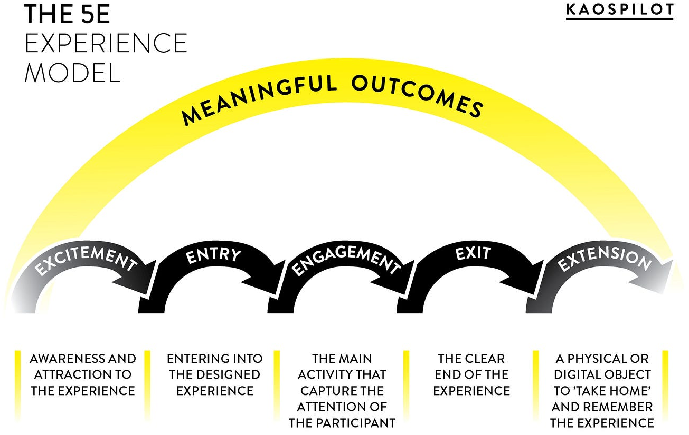
5E Experience Model

Slide 22
English for Work 5E Experience Model
5E’s | What we do
Excitement | Work emphasis: Improve your English. Prepare for Work”; “Reach your career goals.”
Entry | Orientation and student-friendly syllabus: we communicate about the post-exit survey – “Your success is our success.”
Engagement | Classes and 1-on-1 advising with job search focus (goal setting, resume development, networking, mock interviews)
Exit | End of class celebration: reminder about post-exit survey, encouragement to stay connected and contact us with questions about education/employment, invitation to join alumni network
Extension | Alumni network

Slide 23
Literacy source
By Cat Howell

Slide 24
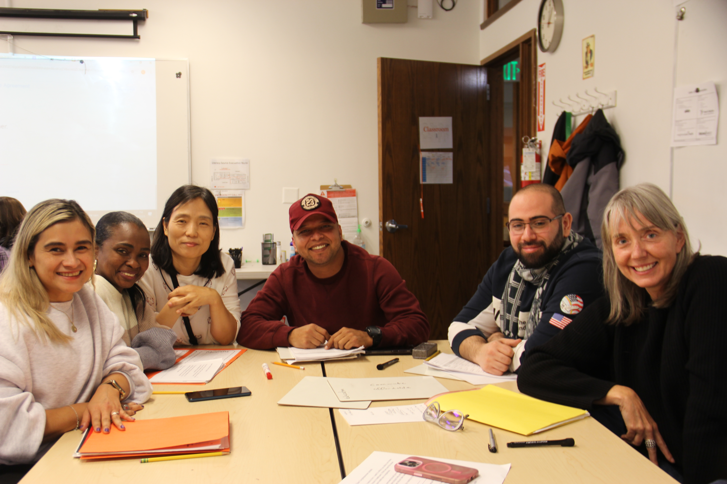

Literacy Source Post-Exit Survey
Goals
Content
Implementation
Results

Slide 25
Literacy Source Survey: Goals
Employment data for Federal Reporting
Student reengagement with organization
Reenrollment
Communications and outreach to other students
Volunteering
Notes:
Also how we came up with these – team meeting with Data Manager, Volunteer Manager, Fundraiser/Communications staff. Assigned responsibilities – Data Mgr managing the process/including next quarter registration info but if volunteers or communications – other staff took up responsibility for following up with former students

Slide 26
Literacy Source Survey: Content
Organizational decision to start with cohorts in 2nd & 4th quarter exits that matched up with when we first administered survey- not backtracking through all eligible students in LACES.
Received input from Communications, Fundraising, Volunteer and Instructional staff about desired reengagement questions and included those after asking about employment outcomes.
Literacy Source Survey
Notes:
Weekly hours worked, hourly pay rate
Interest in receiving monthly newsletter
Interest in volunteering at events and parties
Interest in sharing their story in communications
Sharing how Literacy Source has helped them reach their learning goals
Sharing upcoming New Student Registration information so they can come back to classes or share with their community
Also how we came up with these – team meeting with Data Manager, Volunteer Manager, Fundraiser/Communications staff. Assigned responsibilities – Data Mgr managing the process/including next quarter registration info but if volunteers or communications – other staff took up responsibility for following up with former students'
We decided to only ask about a single employment outcome. While some students may have more than one job, our current survey method does not account for that. Survey responders could combine their weekly hours and hourly pay into one line, but we have not had feedback asking for more employment reporting options.

Slide 27
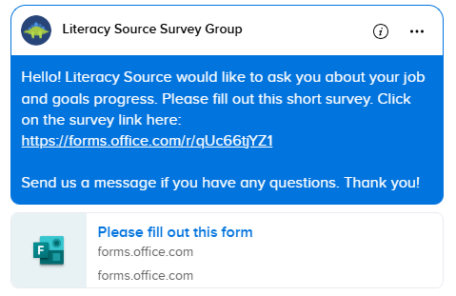
Literacy Source Survey: Implementation
Survey creation in Microsoft Forms
Survey link texted to cohorts in Remind
Responses collected in linked Excel sheet
Employment responses reported in LACES
All responses added to student records in Literacy Source's internal database
Literacy Source Process
Notes:
Survey is updated each quarter with the new date range that matches up for 2nd & 4th qtr after exit groups. LS uses SBCTC's documentation for finding those date ranges based on exit dates in LACES. Each cohort is about 65 students
Once a former student responds to the survey, they are removed from the group, so they don't receive more texts.
A reminder text is sent out halfway through the quarter and again during the last week of the quarter.
The list of students eligible for the survey is updated in Remind before the next reporting date period.
Only students with phone numbers in Remind are added to the survey group. We do not add former students into/back into the system if they have removed themselves.
The same response sheet is used each quarter, with responses tabbed out by quarter at the end of a reporting period, but the main tab keeps all responses
Only students who report employment and earnings have their information updated in LACES. You can enter No if they do not have a job, but it's not necessary. If you do enter No, LACES prompts you if you want to add an updated employment status for that date range.
We built a report for other staff to use so they can pull data during any time period they want for communications & fundraising purposes. For example, student information for newsletters gets updated monthly.

Slide 28
Literacy Source Survey: Results
1.5 quarters of implementation, just over 10% response rate.
2 students with reportable employment data.
Most students interested in reengaging by volunteering or receiving our newsletter.
Most students want to share their story- 1 former student spoke at our annual fundraiser!
1 student reenrolled in classes.
Notes:
Each cohort is about 65 students

Slide 29
Recommendations
Build a process in partnership with others within your organization → connect to mission.
Mutuality vs. transactional
Figure out the right tool based on what you’re already using (MS forms, Survey Monkey, etc.)
Determine how to make it feasible – you can make choices!

Slide 30
Discussion / Questions?

Slide 31

We’re Here to Help
Kelli Graham, Hopelink, kgraham@hopelink.org
Cat Howell, Literacy Source, cath@literacysource.org
Scott Toscano, SBCTC: stoscano@sbctc.edu
LACES Helpdesk: helpdesk@literacypro.com
LACES Listserv: laces_wa@lists.ctc.edu
Note: All material licensed under Creative Commons Attribution 4.0 International License.

