Slide 1
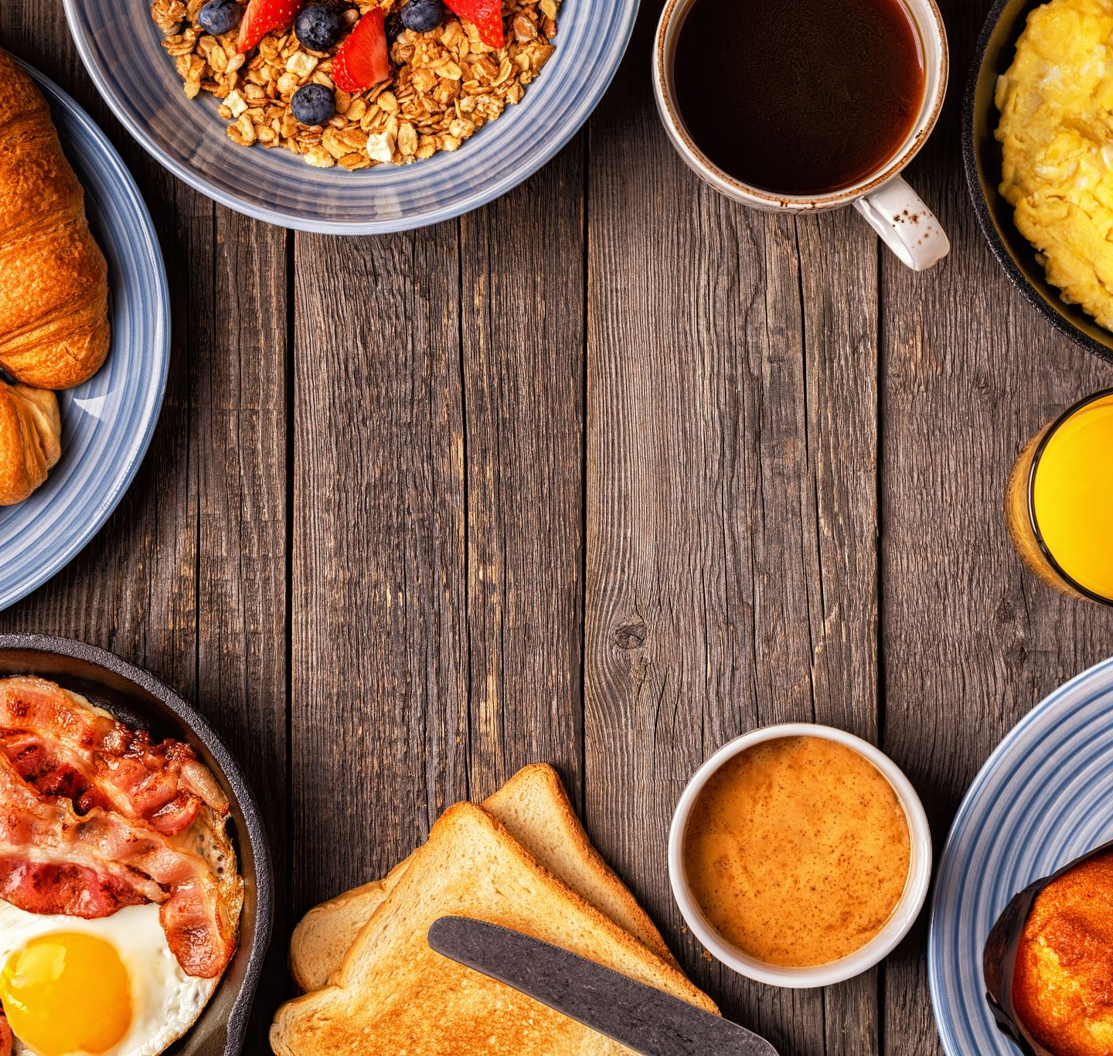
Working Breakfast
Question:
What are the things you want to talk about during collaboration time?
Please take a Post-it note from your table, write down your response, and add it to the sheet on the wall.
Wifi information:
Network: CCOpen
Password: Littel1925!

Slide 2
Welcome to CBS-Fall
Centralia College
Centralia, WA
October 29 & 30, 2026
Wifi information:
Network: CCOpen
Password: Littel1925!

Slide 3
Welcome
CBS Welcome- Amie Batton
Land Acknowledgement- Lindsey Gracia
Corrections/Reentry Student Panel-Moderated by Lindsey Garcia
Centrella College Welcome with VPI- Connie Smejkel
Wifi information
Network: CCOpen
Password: Littel1925!

Slide 4
Council Discussion Items
Documents that need reviewed are on CBS Teams under General>1. Fall Meeting 2026 Documents
Review By-laws
Key things updated
  2026 wording and format update
  More inclusive for all members
  Clarification on roles and duties
  Added information about Committees, council representative
  Added clarification on SBCTC’s role and how we support them
  Dues and professional development
Wifi information
Network: CCOpen
Password: Littel1925!

Slide 5

Treasury Report
Dues and Process
Please update slide with whatever
Wifi information
Network: CCOpen
Password: Littel1925!
This Photo by Unknown Author is licensed under CC BY-NC

Slide 6

New working lunch
This is all Amy 1’s fault
The idea: Building more time for colleges, CBOs, and Corrections to have time to discuss their unique challenges (That isn’t at 8AM on Friday morning during Breakfast.)

Slide 7
New working lunch Plan
Take a break and move to the new room and get stationed.
Take time to connect, pull up the resources, and review the questions
At noon get lunch and return to the assigned room
If you need guiding question, you may use the prompts, but if you know what you want to work on. Dive in.

Slide 8
New working lunch locations
TAC 105B & TAC 105C – Colleges
TAC 122 – CBOs
TAC 129 – Corrections

