Slide 1
Energy Program
Kirsten G. Wilson, PE
October 9, 2023

Slide 2
Topics being covered
Overview of ESPC Energy Program PM role ESCO role Types of projects Process overview | Summary of EaaS | Decarbonization Plans (HB 1390) | CBA Compliance Assistance | RCM Pilot Project

Slide 3
What is ESPC
Energy Savings Performance Contracting (ESPC)
Fully collaborative process
Fully negotiable process
Provides guarantees
Emphasizes achievement of energy savings

Slide 4





WHAT IS THE ROLE OF DES?
1986 RCW
39.35 A and C:
Legislative
Authority to
DES
Prequalified Providers
Project Oversight
Contractual Framework & Coordination
Financial Transparency
Notes:
RCW 39.35 gives municipalities and agencies legislative authority to use of performance-based contracting to do energy and water conservation. DES is to assist in developing and implementing conservation projects. The ESPC process satisfies all other procurement requirements; therefore, the city does not have to go to bid.
Every biennium DES prequalifies ESCOs. This provides a list of qualified professional energy service companies for city to select from.
DES provides project oversight. We have main energy service agreements and general conditions that outlines complete contractual requirements. A DES project manager assists with project development and implementation. This includes attending design and construction meetings, reviewing and approving energy service proposal, invoices, change orders, and handling of administrative paperwork.
DES developed all contracts that have been reviewed by Attorney General and ESCO’s have already agreed to abide by.
ESCO’s are required to substantiate all construction costs; materials, labor, site supervision, subcontractors, commissioning. Agency have price transparency where dollars are being spent in project. DES PM reviews and approves all substation and accounting.

Slide 5

ENERGY SERVICE COMPANY ROLE
Energy Services Company (ESCO)
Some similarities to a Design/Build firm
Turnkey service for energy efficiency projects
Expertise in energy engineering
Commissions project work
Measures and verifies energy savings

Slide 6
QUALIFYING PROJECTS
Conservation projects resulting in cost savings or benefits:
Energy efficient lighting retrofits
High efficiency HVAC systems
Boiler and chiller systems
Motor and pumping systems
Solar, wind and co-generation
Water and Wastewater Treatment Plants
Water efficiency projects
EV charging
Demand response & grid resiliency
Submetering

Slide 7
SEQUENCE OF AN ESCO PROJECT
Initiate Interagency Agreement
Preliminary Audit
Design & Construction
ESCO Selection
Investment Grade Audit
Measurement & Verification

Slide 8



1: INTERAGENCY AGREEMENT
DES initiates an Interagency Agreement (IAA) between the State and the client agency
DES management fee schedule is included in the IAA
The Client signs and DES executes the IAA

Slide 9



2: ESCO SELECTION
DES pre-qualifies Energy Service Companies (ESCOs) every biennium and creates a registry through an RFQ
The client reviews qualifications and chooses the ESCO that is right for them
ESCO Interviews are optional

Slide 10
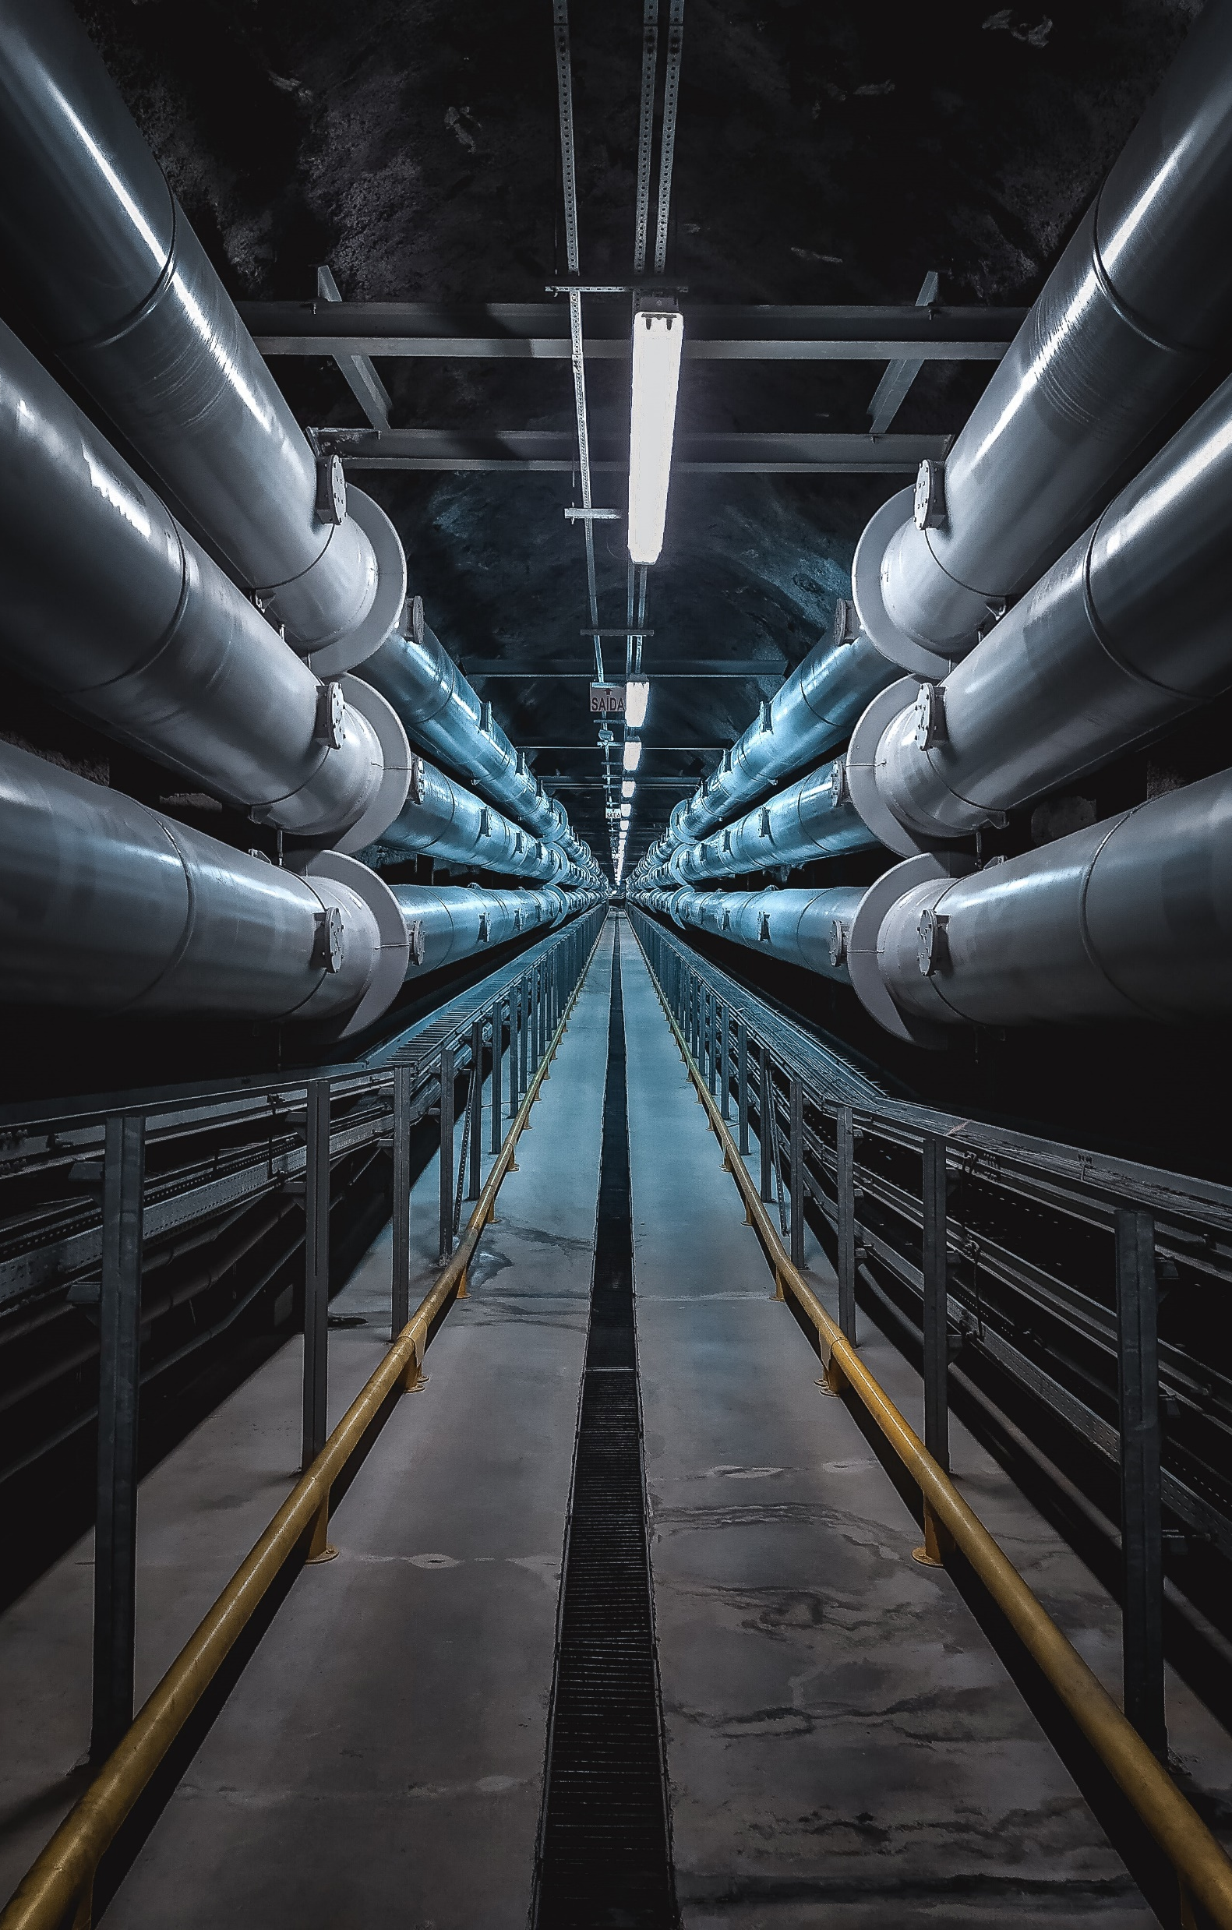
3: PRELIMINARY AUDIT
Walkthrough to identify facilities and systems to study
Project team determines desired project outcomes
Client establishes cost-effectiveness criteria
ESCO provides preliminary audit results
Project team review list of energy efficiency measures proposed

Slide 11
4: INVESTMENT GRADE AUDIT & ESP
ESCO and DES sign investment grade audit agreement, Client signs funding authorization.
ESCO conducts detailed site investigation, energy analysis, and cost estimation of proposed scope.
Client may identify preferred subs and equipment.
IGA report delivered identifying energy savings and costing for each measure investigated.
Energy Services Proposal (ESP) outlines scope, guaranteed savings, detailed budget, guaranteed costs, schedule etc. for measures agreed to.
Client and DES review energy services proposal. ESP is basis for construction contract set.

Slide 12

5: DESIGN AND CONSTRUCTION
ESCO and DES sign construction contract set
  Client signs funding authorization and IAA amendment
  DES issues notice to proceed to ESCO
Client and DES review design documents
Project documents prepared by ESCO
Sub-contractors and equipment selected
DES PMs provide management and review of construction meetings, invoicing, change orders, substantial completion/commencement of energy savings, closeout, NOC, intents, affidavits, apprenticeship, etc.

Slide 13



6: MEASUREMENT AND VERIFICATION
First year measurement and verification (M&V) is part of every project. ESCO to provide report.
Longer term of M&V is recommended for systems which require frequent adjustments, such as controls systems.

Slide 14
Energy as a Service
Project funding is through a special purpose entity (SPE)
Requires an agreement signed by Client and the SPE
Follows same pathway of ESPC currently used through construction
Ownership and maintenance of equipment is by the SPE after construction

Slide 15

Decarbonization Plans
Only applies to campus with a district energy system(s) serving 5 or more buildings and at least 100k sf
Allows for 15-year time horizon to implement energy efficiency and decarbonize campus facilities
Must be approved by Commerce
Updated every 5 years
Provides compliance pathway for CBA

Slide 16
CBA Compliance Assistance
ESCO staff meet qualification requirements for auditing
ESCOs are required to validate ESPM data and determine EUIt
ESCO assists in developing energy management and O&M plans
DES Energy requires Level 2 audits

Slide 17

RCM Pilot
Pilot participant: Renton Technical College
Number of target buildings: 2
RCM site visits
RCM staff interviews
Opportunities Identified

Slide 18
Thank you
kirsten.Wilson@des.wa.gov
509.370.0216
des.wa.gov/energy-program

